Slide 1
UNIVERSITY Success analysis
-Jaiveer Singh Rathore

Slide 2
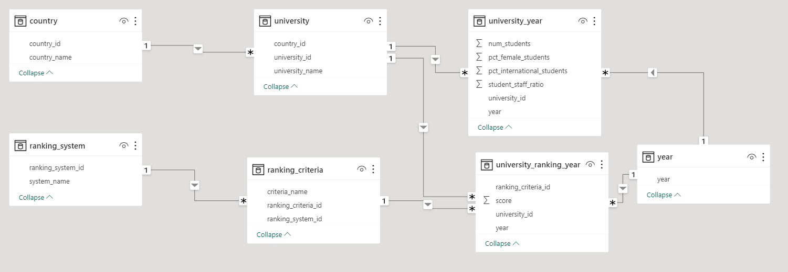
ER DIAGRAM

Slide 3
DASHBOARDS

Slide 4
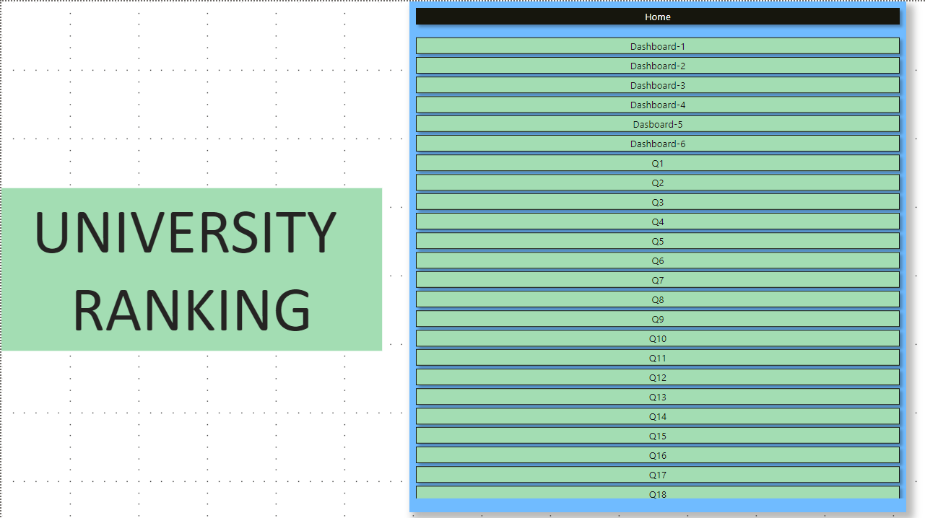

Slide 5
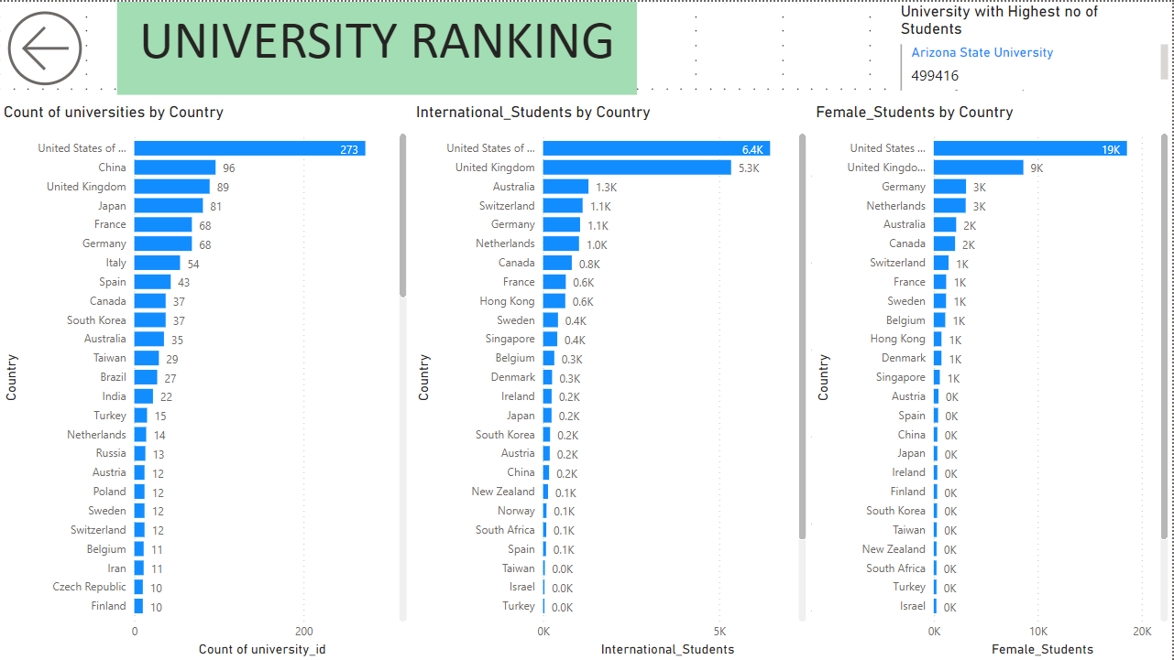

Slide 6
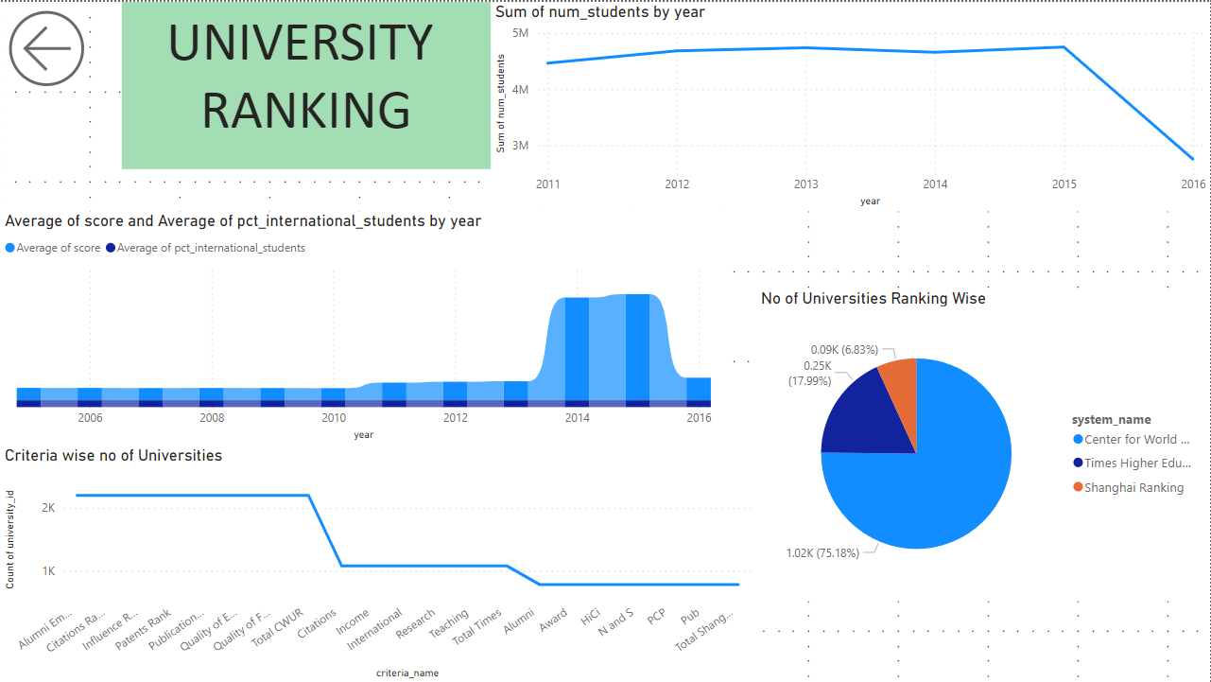

Slide 7
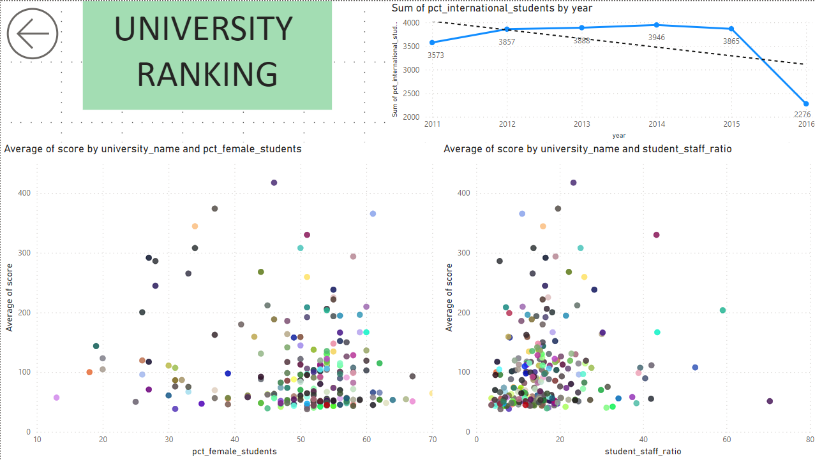

Slide 8
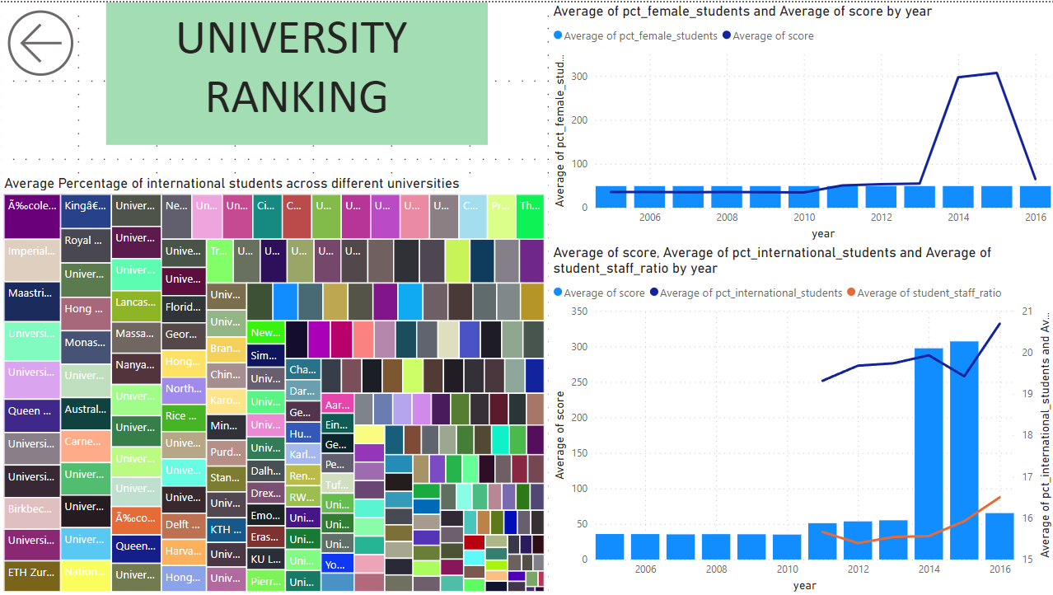

Slide 9
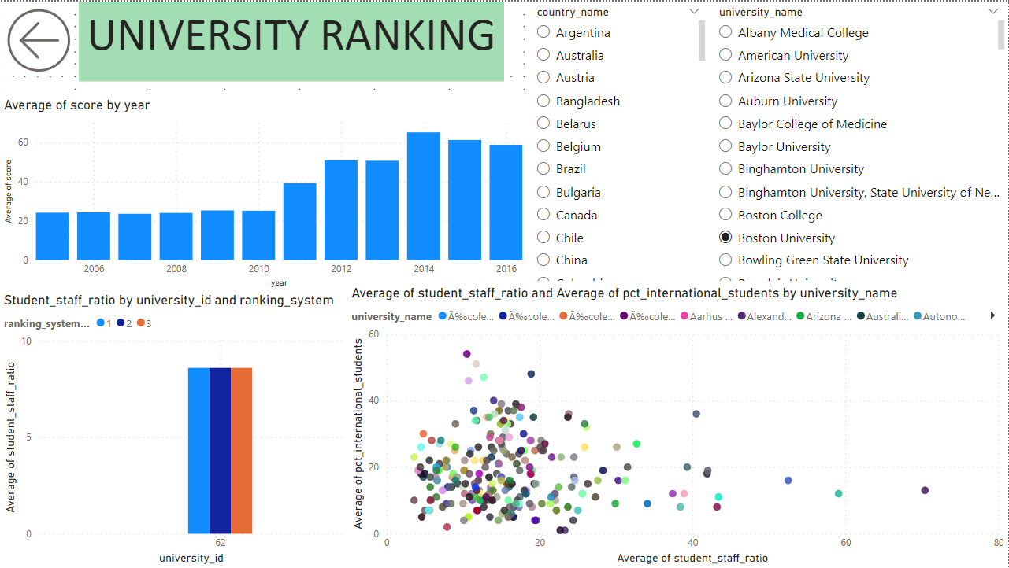

Slide 10
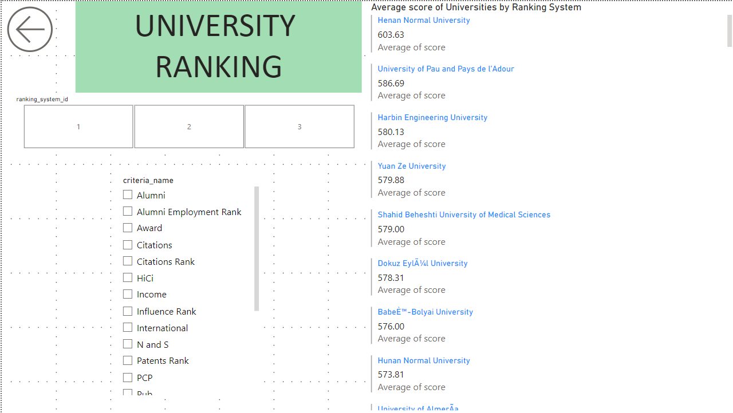

Slide 11
Powerbi questions

Slide 12
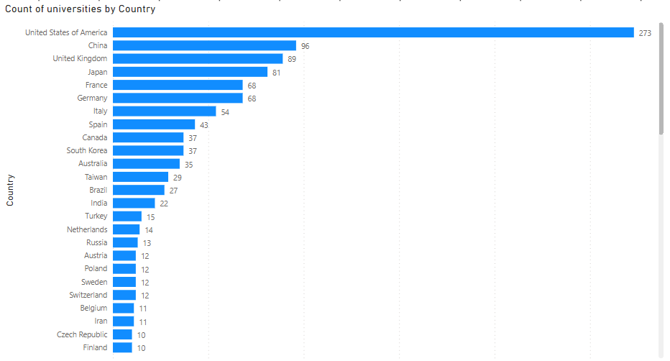
Q1 How many universities are there in each country?
According to the distribution USA is at the top with 273 universities.

Slide 13
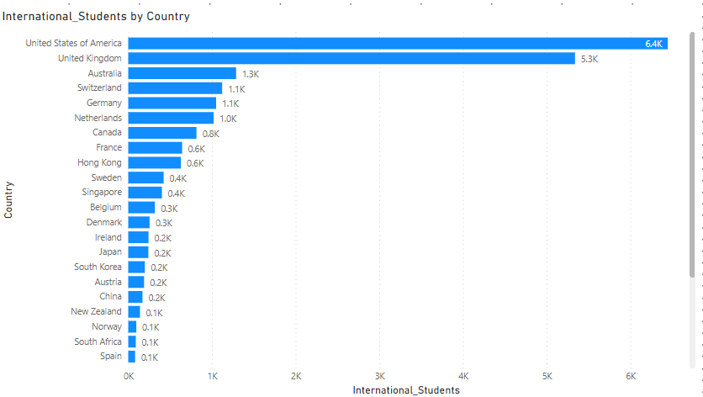
Q2 What is the distribution of international students across different countries?
As per the distribution most number of international students are in USA and then comes UK and so on.

Slide 14
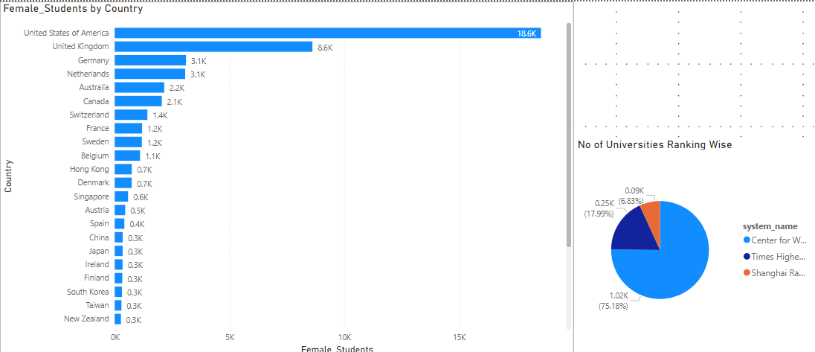
Q3 Which country has the highest number of female students enrolled in universities? How many universities are ranked by each ranking system?
The country with highest number of female students is USA with 18.6k female students.
Universities by each ranking system are 1024 universities by Center for World University Rankings, 93 by Shanghai Ranking and 245 by Times Higher Education World University Ranking

Slide 15
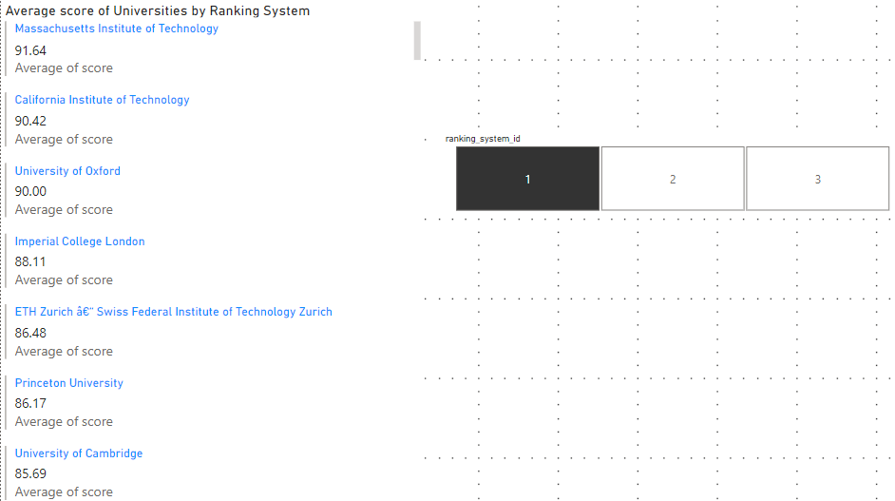
Q4 What is the average score for universities according to each ranking system?
A multi-row card and slicer displaying the average scores for universities according to each ranking system.

Slide 16
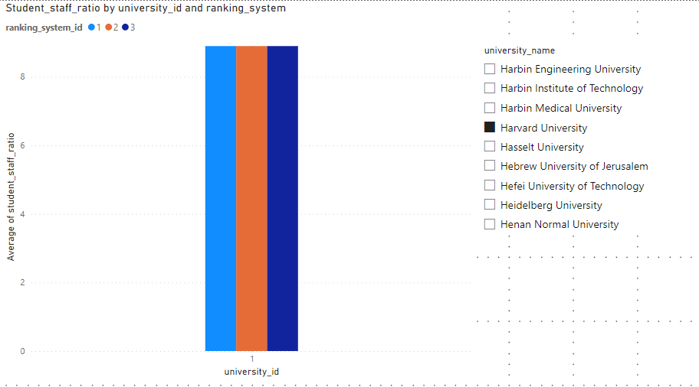
Q5 How does the ranking system affect a university's student-staff ratio?
Analyzing the relationship between ranking system and student-staff ratios, the higher-ranked universities tend to have higher ratios.

Slide 17
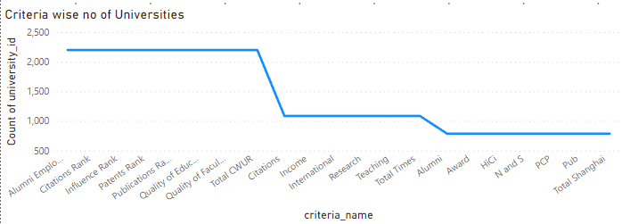
Q6 What are the most important criteria considered by ranking systems?
Criteria’s such as Alumni Employment, Citations Rank, and Influence Rank are top 3.

Slide 18
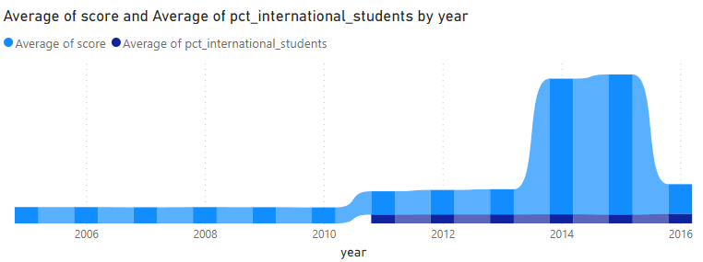
Q7 Is there a correlation between a university's score and the number of international students?
The two variables have a 0.63 correlation coefficient, which is regarded as a strong correlation. The amount of international students and a university's score have a significant positive correlation, according to this.

Slide 19
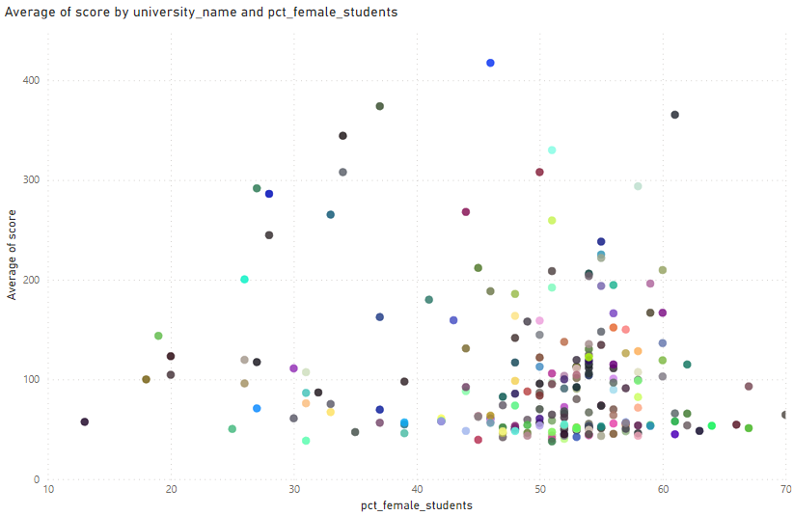
Q8 How does the percentage of female students impact a university's ranking?
Scatter plots illustrating how the proportion of female students affects university rankings. This supports the planning and policies for gender inclusive education.

Slide 20

Q9 Which university has the highest number of students?
Using multi row card we can find the answer just like in the image

Slide 21
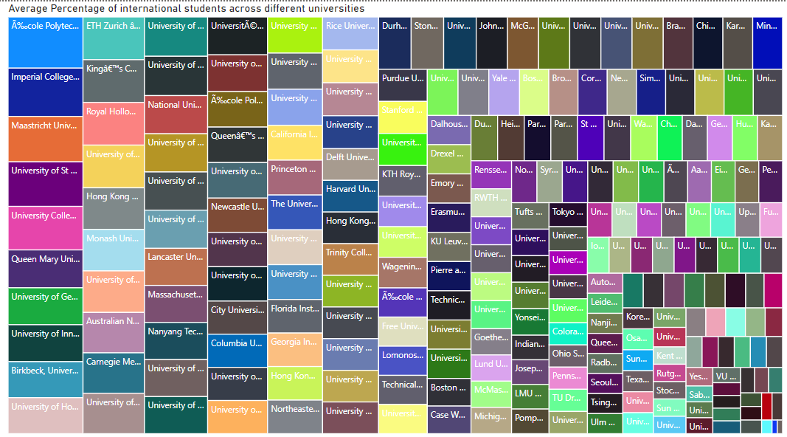
Q10 How does the percentage of international students vary across different universities?
A Waterfall chart displaying the variation in the percentage of international students across universities.

Slide 22
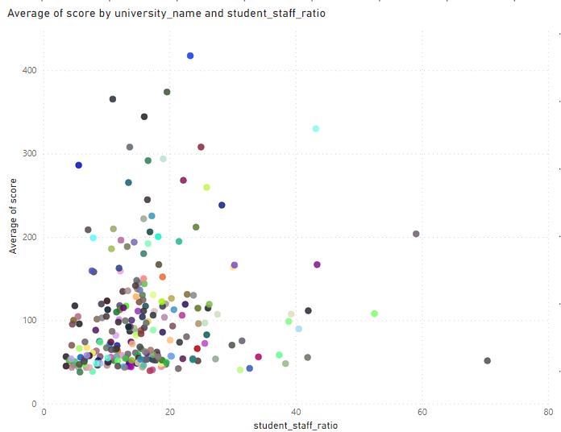
Q11 Is there a correlation between a university's ranking and its student-staff ratio?
The relationship between student-staff ratios and university rankings using Scatter plot. It optimizes resources.

Slide 23
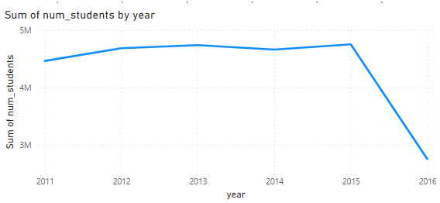
Q12 How does the number of students in universities change over time?
There is not so much of a change till 2015 but after the year there is a huge drop in the total number of students.

Slide 24
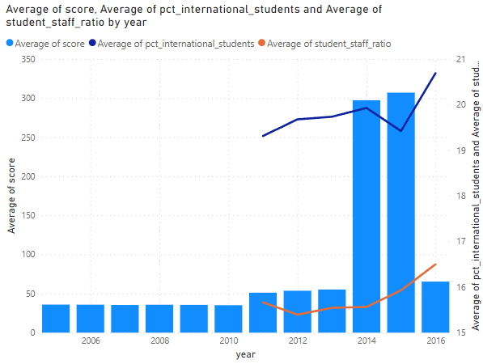
Q13 Is there a correlation between a university's ranking score and the student-staff ratio over the years?
Column chart with line graph showing the correlation between university ranking scores and student-staff ratios over the years.

Slide 25
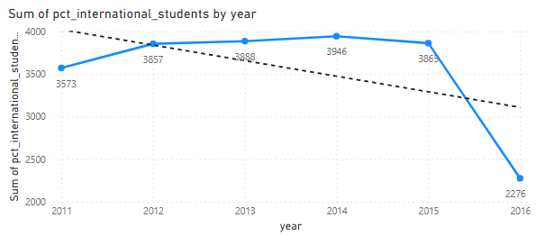
Q14 How does the percentage of international students vary across different years?
Line graph displaying the proportion of international students by year.This demonstrates shifting patterns in the recruiting of international students.

Slide 26
Q15 What is the impact of a university's ranking on the number of international students it attracts?
Column chart with line graph showing the correlation between university ranking scores and number of international students over the years.

Slide 27
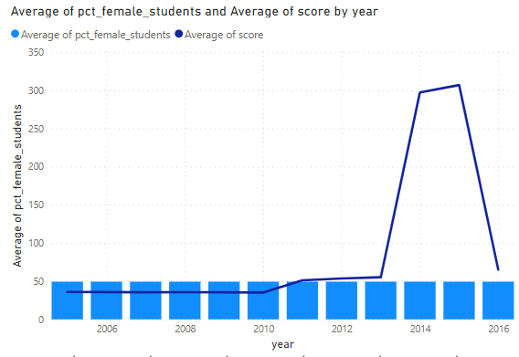
Q16 Is there a relationship between a university's ranking score and the percentage of female students enrolled?
The relationship between ranking scores and student-staff ratios has not changed over time, according to the analysis.

Slide 28
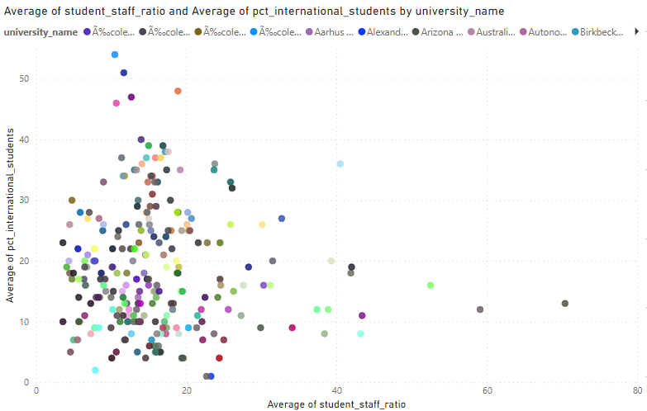
Q17 How does the percentage of international students affect a university's student-staff ratio?
There is a weak negative correlation between the percentage of international students and the student-staff ratio. As a result, colleges with a larger proportion of international students tend to have lower student-to-staff ratios.

Slide 29
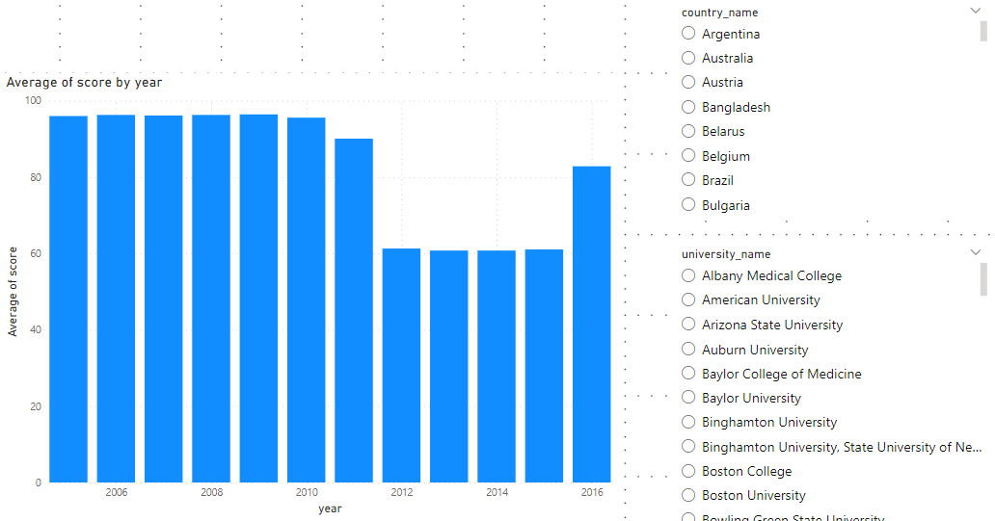
Q18 Are there any significant trends or patterns in the rankings of universities from different countries?
Visualizations highlighting trends or patterns in university rankings. There have been a few significant patterns over time. The countries with the highest average scores are Sweden, Switzerland, the United States, and the United Kingdom.

Slide 30
EDA questions

Slide 31
Q1 Is there a correlation between a country's GDP and the number of universities?
This question cannot be answered because the dataset does not contain a distinct column for GDP and there is insufficient information to answer it.

Slide 32
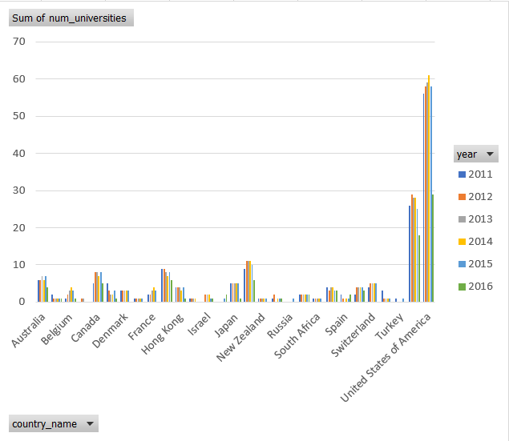
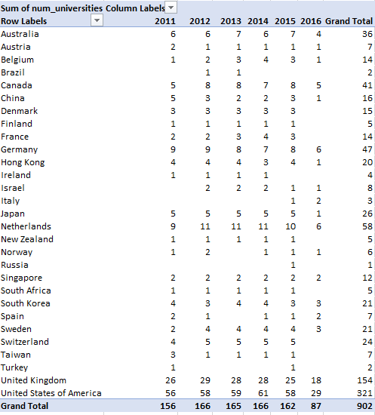
Q2 How has the number of universities changed over the years in each country?
A table showing the change in the number of universities over the years for each country. In this we apply filter for country name.

Slide 33
Q3 Is there a relationship between a country's population and the number of universities?
This question cannot be answered because the dataset does not contain a distinct column for population and there is insufficient information to answer it.

Slide 34
Q4 Are there any common criteria used by different ranking systems?
As can be seen in the table, there is no common criteria used by different ranking system.

Slide 35
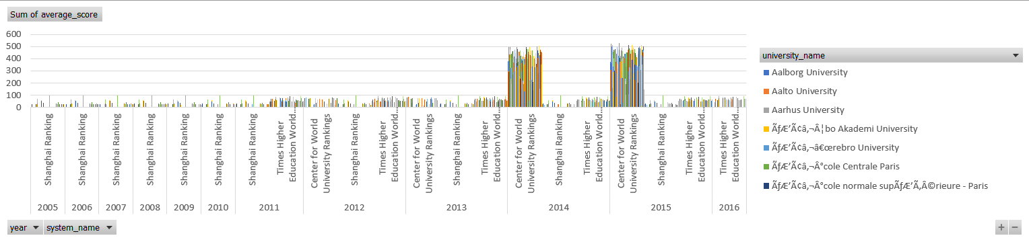
Q5 What is the trend in university rankings over the years according to each system?
The three rankings' combined average ranking score has increased since 2010. This is most likely due to a variety of factors, including the rising demand for higher education, the expanding internationalization of higher education, and the rising rivalry between universities.

Slide 36
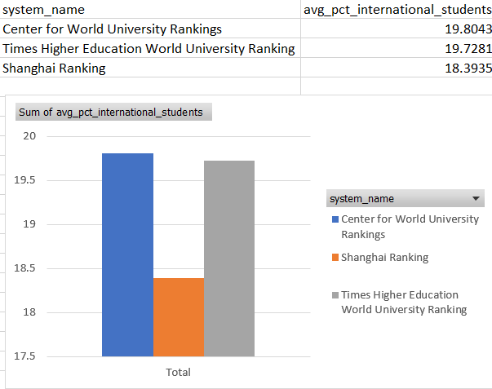
Q6 How does the choice of ranking system affect a university's international student enrollment?
University rankings have an impact on the recruitment of international students at universities. The ranking method chosen by a university may have a number of impacts on the enrollment of international students. Higher rankings in a ranking system are preferred by students, and this adds to the marketing of the university.

Slide 37
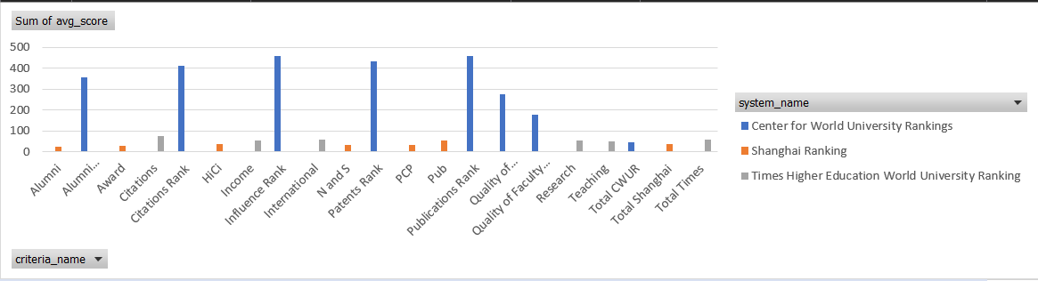
Q7 Are there any criteria that have different weights in different ranking systems?
As we can see, all three ranking systems use some of the same factors, such as reputation among academics, research production, and instruction quality. However, they assign different weights to these criteria. For instance, the CWUR prioritizes research and instruction equally between the THE and the Shanghai Ranking.

Slide 38
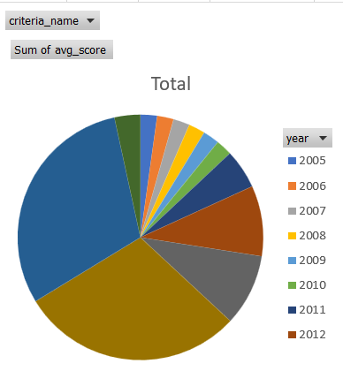
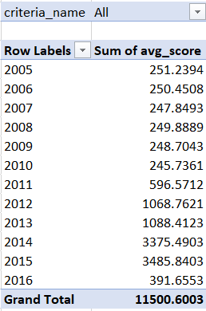
Q8 How have the weights of ranking criteria changed over time?
The Shanghai Ranking has traditionally placed a high priority on research output, but over time it has begun to concentrate more weight on influence rather than citations. The Center for World University Rankings claims that the relative importance of influence and citations has evolved throughout time. The Times Higher Education World University Ranking has changed over time to place more focus on teaching excellence and less weight on research output. These changes demonstrate how important research impact and teaching effectiveness are becoming in higher education. Universities are being judged more and more on their ability to perform excellent research with immediate applications and to provide their students with excellent instruction.

Slide 39
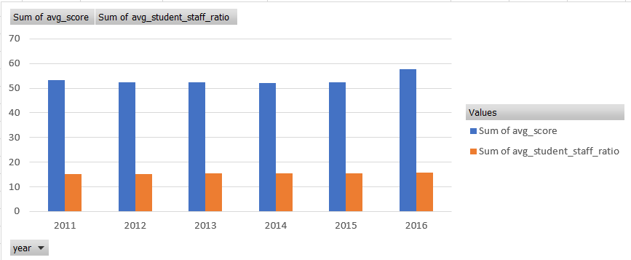
Q9 Is there a relationship between a university's score and the student-staff ratio?
There isn't an obvious correlation between a university's ranking and its student-staff ratio in the chart. The correlation between the two variables is extremely low, at only 0.03. The student-staff ratio does not accurately predict a university's ranking because there is minimal correlation between the two factors.

Slide 40
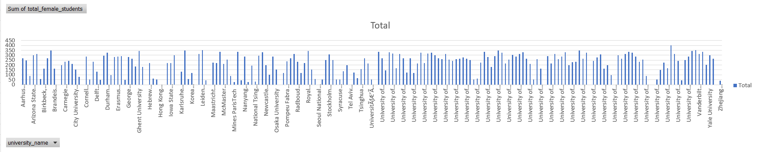
Q10 How does the number of female students differ among universities?
The number of female students differs among universities due to the fact that some are located in countries with a smaller gender gap in education.

Slide 41
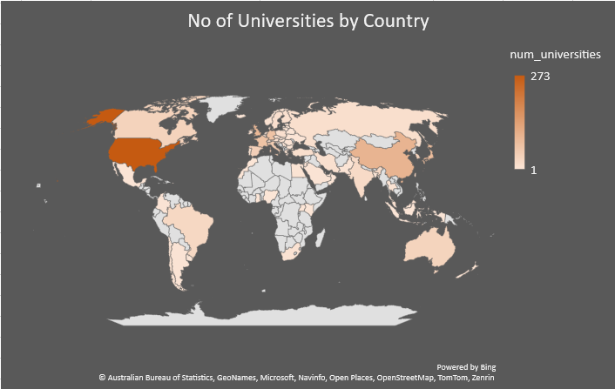
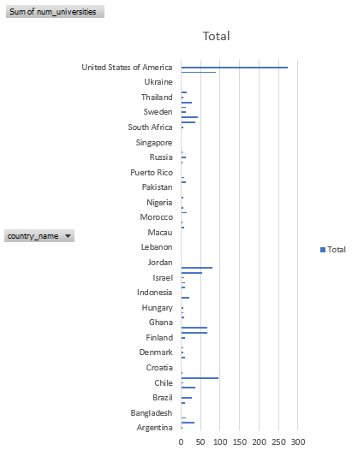
Q11 What is the distribution of universities across different countries?

Slide 42
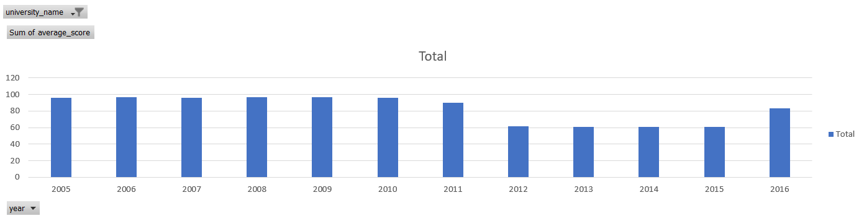
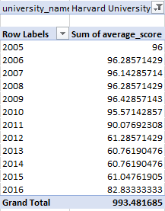
Q12 How has the ranking of universities changed over the years?
Here in this chart and table, for instance, take Harvard University, which performed extremely well until 2011 but then experienced a decline in its ranking. However, starting in 2016, it has begun to perform better once more.

Slide 43
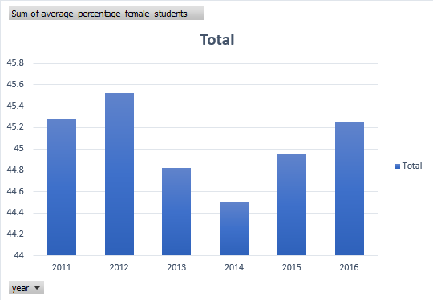
Q13 What is the trend in the percentage of female students over time?
The proportion of female students has been increasing over time; it momentarily decreased before starting to increase again. The graph demonstrates the increase in female enrollment in universities all throughout the world.

Slide 44
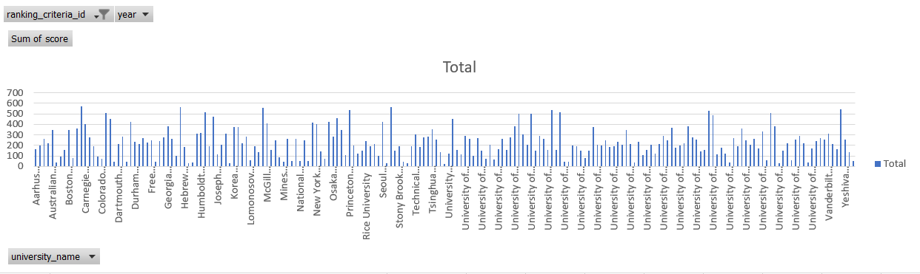
Q14 How has the ranking score of universities evolved over the years?
Rating scores for universities have improved throughout time. The average ranking scores for the Center for World University Rankings, Shanghai Ranking, and Times Higher Education World University Ranking have all significantly increased since 2010.

Slide 45
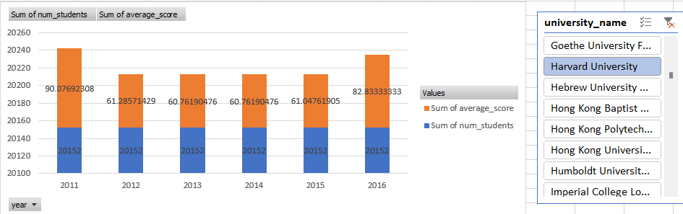
Q15 Is there a relationship between a university's ranking score and the number of students over time?
Every year, fewer people enroll in a college, but the average score fluctuates. Take Harvard University as an example, and we can observe that the number of students did not vary while the average score changed.

