Slide 1
Missed-Lead Detector
Machine Learning-Based Missed-Lead Detection and Automated Follow-Up System for Customer Retention in Sales Pipelines
AD4V71 — Machine Learning Operations (MLOps)
Presented By
Team Member 1 Name • Regd No. • Section Team Member 2 Name • Regd No. • Section
CIT Chennai — Batch 2025-27

Slide 2
Problem Identification & Title Justification
🔍 Relevance of the Problem
🎯 Scope of the Project
▸ Customers message businesses daily about price, demo, or availability — these are 'leads'
▸ Busy staff sometimes miss replying; after ~24 hours, unanswered customers move to competitors
▸ This 'missed lead' problem is common for SMBs with limited staff
▸ No real-time way to know which messages were not replied to timely
▸ A missed lead is rarely noticed until the sale is already lost
▸ Title: ML-Based Missed-Lead Detection & Automated Follow-Up System
▸ ML identifies leads missed by staff, then auto-sends follow-up or alerts staff
▸ Built and tested on self-created sample + Kaggle real-world data
▸ Real business data integration planned for next phase
▸ 8 classification models tested including Deep Learning & Ensembles
📋 Project Title Justification
▸ Machine Learning identifies which customer messages did not receive a timely reply
▸ Automated Follow-Up Engine sends human-like replies (clients cannot detect automation)
▸ Sales Pipeline Retention — ensures no business opportunity is lost due to missed messages
▸ System includes: Gmail monitoring → ML scoring → Auto-reply → Dashboard → Notifications
▸ GitHub Actions schedules automatic scans every 10 minutes

Slide 3
Objectives of the Project
🎯 Primary Objectives
📊 Technical Objectives
▸ Build a system that analyzes customer messages and identifies untimely replies
▸ Automatically send follow-up emails to missed leads
▸ Alert staff members with reminders until they respond
▸ Ensure no business opportunity is lost due to missed messages
▸ Goal: 100% lead coverage with automated detection
▸ Train 8 ML models and compare performance (AUC, F1, CV scores)
▸ Implement Optuna hyperparameter tuning for XGBoost
▸ Build PyTorch deep learning model with residual connections
▸ Create intent-aware smart reply engine (8 intent categories)
▸ Deploy Streamlit dashboard for real-time monitoring
🚀 Current Scope & Next Phase
▸ Currently: Self-created synthetic data (500 leads) + Kaggle datasets (9,240 + 4,000 leads = 13,740 total)
▸ Currently: Text-based messages — email, chat, WhatsApp, phone inquiry channels
▸ Currently: Gmail IMAP integration for real inbox monitoring
▸ Next Phase: Connect with real business CRM data sources
▸ Next Phase: Multi-platform integration (WhatsApp Business API, website chat widgets)
▸ Next Phase: Real-time WebSocket dashboard updates

Slide 4
Basic Concepts & Machine Learning Models
🔧 Key Features
🤖 Traditional ML Models
🧠 Advanced Models
▸ Response Gap: time between message and reply
▸ Intent Score: customer interest level from words
▸ Channel Encoding: email, chat, WhatsApp, phone
▸ Business Hours Flag: 9AM–6PM detection
▸ Gap Bucket: 0-6h, 6-12h, 12-24h, 24h+
▸ Message Length: text complexity proxy
▸ Logistic Regression (Baseline)
▸ Naive Bayes (Probabilistic)
▸ Decision Tree (Rule-based)
▸ Random Forest (Bagging Ensemble)
▸ XGBoost (Gradient Boosting)
▸ Optuna-tuned XGBoost (Best: AUC 0.9794)
▸ Voting Ensemble (RF+XGB+LR)
▸ Grand Ensemble (ML+DL soft-voting)
▸ Deep Learning: PyTorch Neural Network
▸ - Residual blocks + BatchNorm
▸ - He init + GELU activation
▸ - Class-weighted BCE loss
📊 Unsupervised Learning
⚙️ Optuna Tuning
🏆 Model Performance
▸ KMeans Clustering (3 segments)
▸ - High-Intent-Missed
▸ - Low-Intent
▸ - Already-Converted
▸ 100 trials with TPE sampler
▸ 5-fold stratified cross-validation
▸ Optimized: n_estimators, max_depth,
▸ learning_rate, subsample, gamma
▸ XGBoost Tuned: AUC 0.9794
▸ Random Forest: AUC 0.9725
▸ Grand Ensemble: AUC 0.9709
▸ Deep Learning: AUC 0.9613
🎯 Smart Reply Engine — 8 Intent Categories
▸ Pricing | Demo | Course | Placement | Complaint | Interest | Availability | Urgent
▸ Each intent has multiple template variations for natural variety — clients cannot tell replies are automated
▸ Intent detection uses keyword scoring with normalized confidence scores across all 8 categories

Slide 5
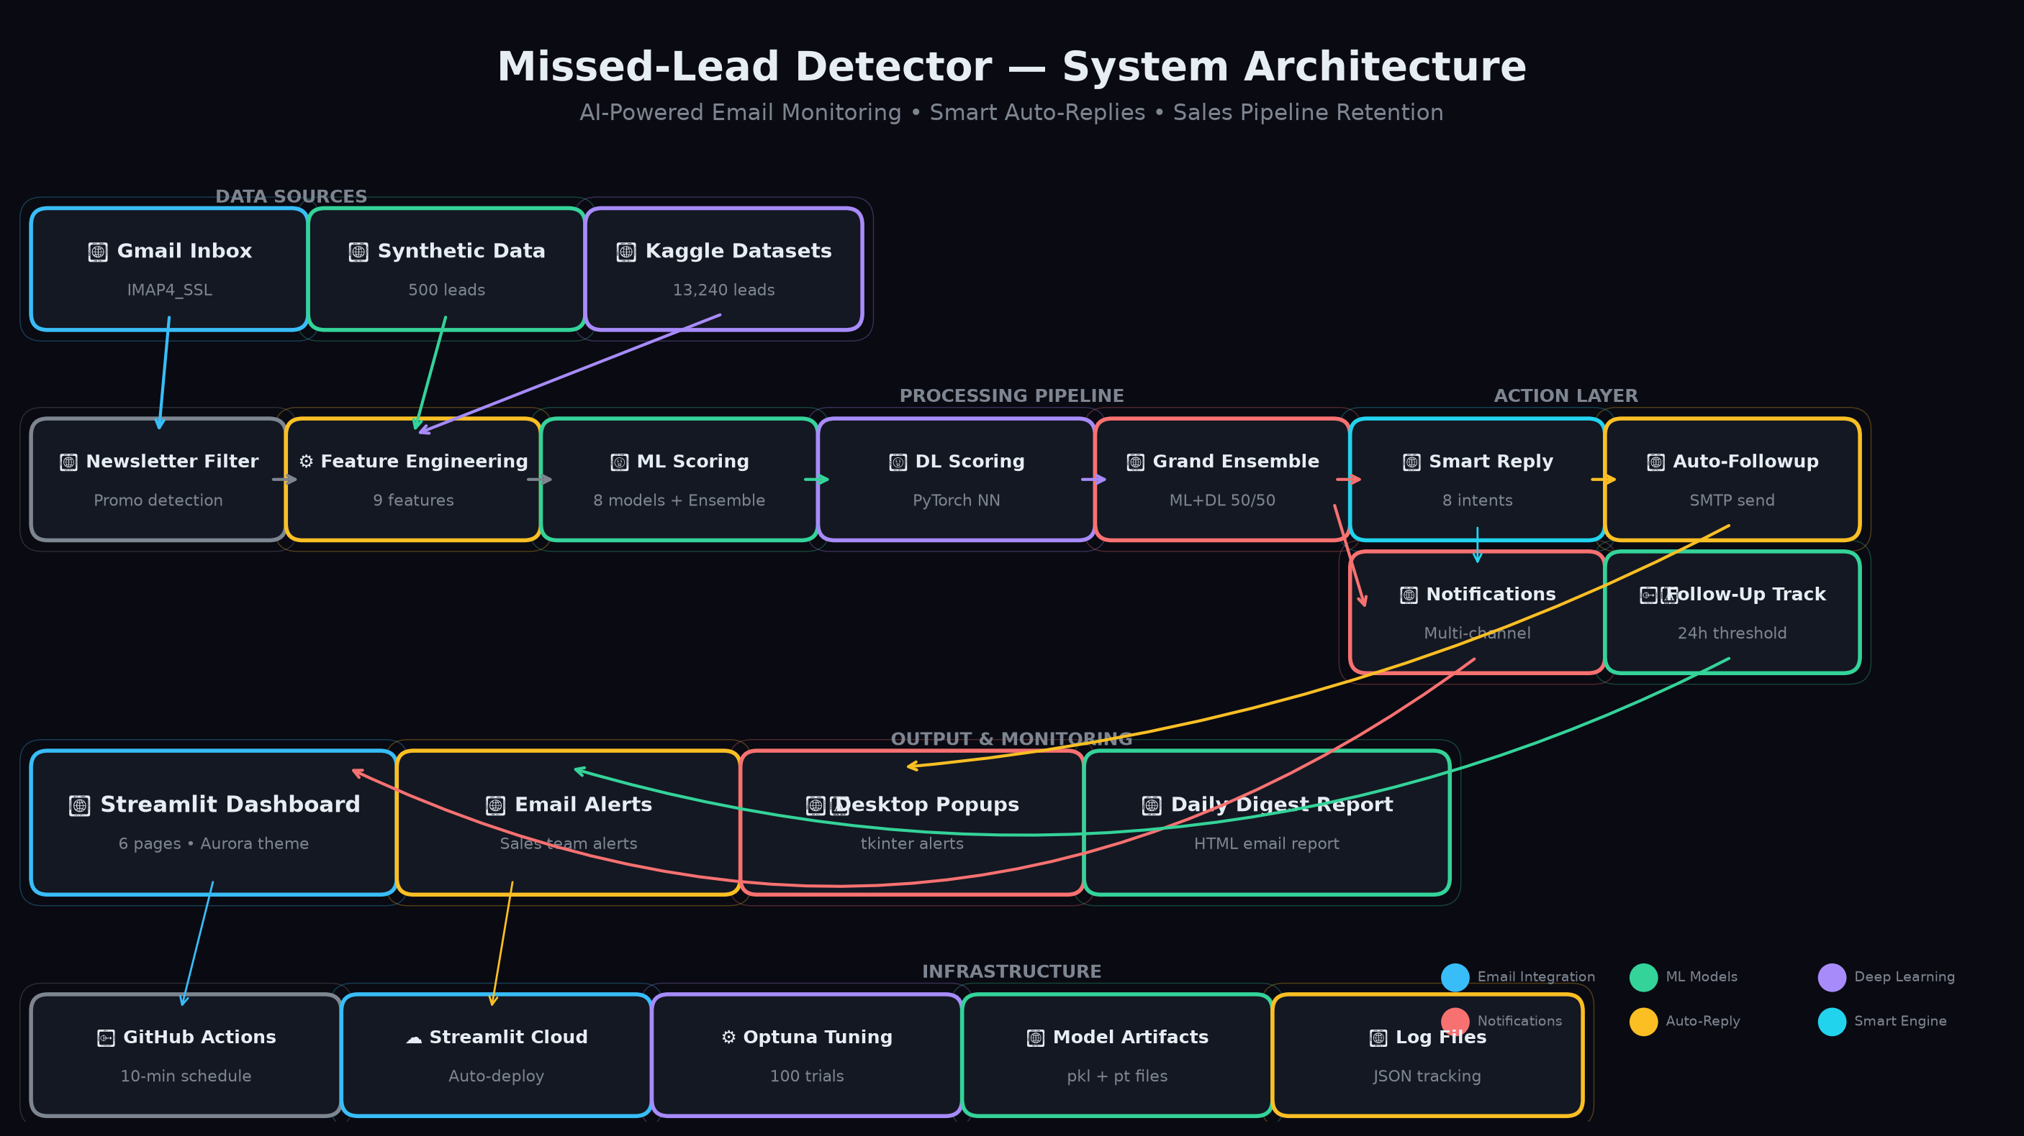
System Architecture & Pipeline
📧 Gmail Inbox (IMAP Fetch)
🔍 Newsletter Filter
🤖 ML Scoring (8 Models)
💬 Smart Reply Engine
📤 Auto-Reply (SMTP)
🔔 Notifications (Email+Dashboard)
📧 Email Integration (IMAP/SMTP)
🤖 ML Scoring Pipeline
▸ IMAP4_SSL fetches Gmail inbox with promotional filter
▸ Deduplicates via Message-ID tracking
▸ SMTP threaded replies with In-Reply-To headers
▸ Grand Ensemble: 50% ML + 50% DL (soft-voting)
▸ XGBoost tuned with Optuna (100 trials, TPE sampler)
▸ Feature engineering: 9 features per lead

Slide 6
Results & Model Performance
📊 Dataset
▸ Model AUC Score Note
▸ Total: 13,740 samples
▸ Synthetic: 500 leads
▸ Kaggle Lead Scoring: 9,240
▸ Kaggle Support Tickets: 4,000
▸ XGBoost (Optuna-tuned) 0.9794 🏆 Best ML
▸ RandomForest 0.9725
⚙️ Training Config
▸ Ensemble (RF+XGB+LR) 0.9720
▸ 5-fold Stratified CV
▸ 80/20 Train-Test Split
▸ StandardScaler normalization
▸ Early stopping (patience=20)
▸ Grand Ensemble (ML+DL) 0.9709 🎯 Overall Best
▸ Deep Learning (PyTorch) 0.9613
🔧 Hyperparameters
▸ Decision Tree 0.9627
▸ XGBoost: 100 trials (Optuna)
▸ DL: 200 epochs max, batch=64
▸ Dropout: 0.3, LR: 1e-3
▸ Weight decay: 1e-4
▸ Logistic Regression 0.9132 Baseline
▸ Naive Bayes 0.8604
💡 Key Insight
▸ Grand Ensemble (ML+DL) achieves
▸ best overall performance by combining
▸ strengths of both paradigms

Slide 7
Thank You!
Missed-Lead Detector — AI-Powered Sales Command Center
CIT Chennai • Batch 2025-27 AD4V71 — Machine Learning Operations (MLOps)

