Slide 1
HACKNOVATE’26
Problem Statement Title :Cancer Prediction And Stock Prediction
Problem Statement ID :HCK008
Team Name : MS BOYS
Team Leader Name : Vishal S K(23CDR185)
Team Members Name :
1).Karthikeyan S(23CDR068)
2).Jaiyandh A S(23CDR060)

Slide 2
SOLUTION
PROBLEM STATEMENT
Lung cancer is one of the leading causes of cancer-related deaths worldwide
Early-stage lung cancer is hard to detect due to subtle visual cues in CT scans
Manual diagnosis:
  Time-consuming
  Prone to human error
  Requires expert radiologists
Lack of systems that are both accurate and explainable
We propose an Lung Cancer Detection System that:
  Analyzes CT scan images
  Classifies scans as Malignant/Benign/Normal
  Uses Deep Learning (CNNs) for high accuracy
  Applies Grad-CAM to visually explain predictions

Slide 3
TECHNICAL STACK/DEPENDENCIES
Dataset:
Publicly available lung CT scan dataset
Labeled as cancerous / non-cancerous
Preprocessing Steps:
Image resizing
Normalization
Noise reduction
Data augmentation for better generalization
We experimented with state of the art CNN architectures:
ResNet18
  Lightweight
  Faster training
  Good baseline performance
DenseNet121
  Strong feature reuse
  Higher accuracy
  Better medical image understanding
Models were trained, evaluated, and compared

Slide 4
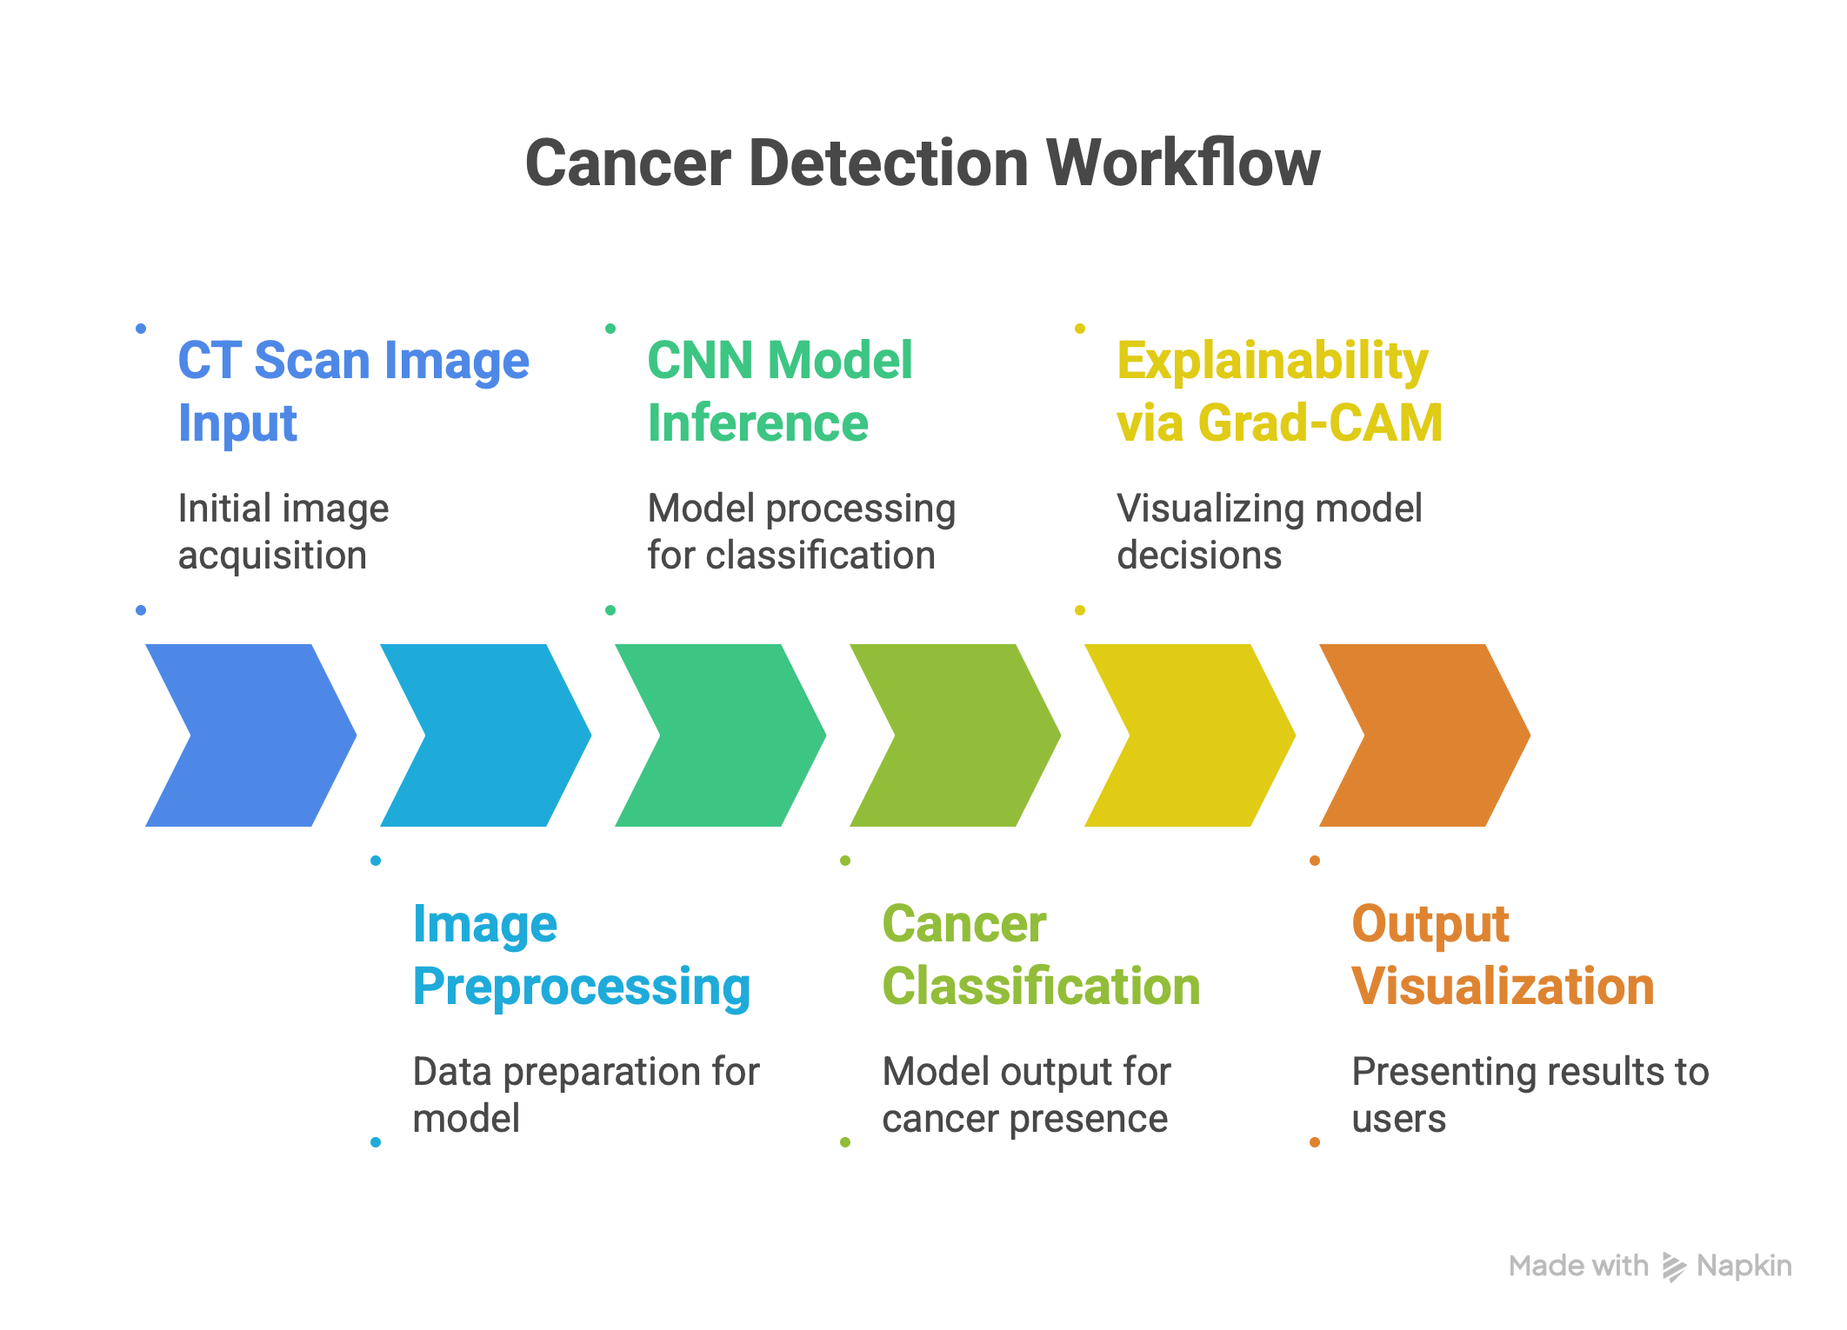

Slide 5
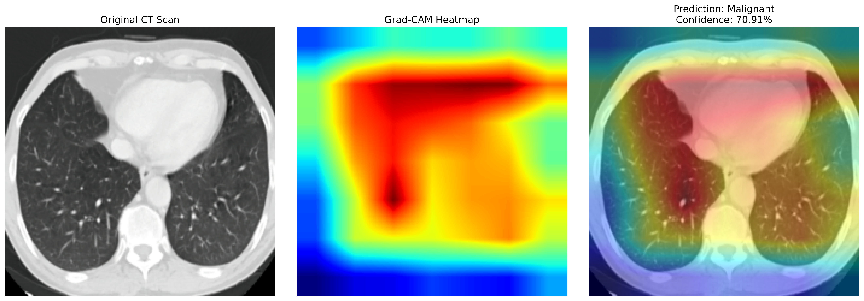
ADDITIONAL DETAILS

Slide 6
THANK YOU

