Slide 1
Attention and Transformer

Slide 2
1. Challenges with RNNs and how Transformer models can help overcome those challenges
1.1 RNN problem 1 — Suffers issues with long-range dependencies. RNNs do not work well with long text documents.
Transformer Solution —Transformer networks almost exclusively use attention blocks. Attention helps to draw connections between any parts of the sequence, so long-range dependencies are not a problem anymore. With transformers, long-range dependencies have the same likelihood of being taken into account as any other short-range dependencies.
1.2. RNN problem 2 — Suffers from gradient vanishing and gradient explosion.
Transformer Solution — There is little to no gradient vanishing or explosion problem. In Transformer networks, the entire sequence is trained simultaneously, and to build on that only a few more layers are added. So gradient vanishing or explosion is rarely an issue.
1.3. RNN problem 3 — RNNs do not allow parallel computation. GPUs help to achieve parallel computation. But RNNs work as sequence models, that is, all the computation in the network occurs sequentially and can not be parallelized.
Transformer Solution — No recurrence in the transformer networks allows parallel computation. So computation can be done in parallel for every step.

Slide 3
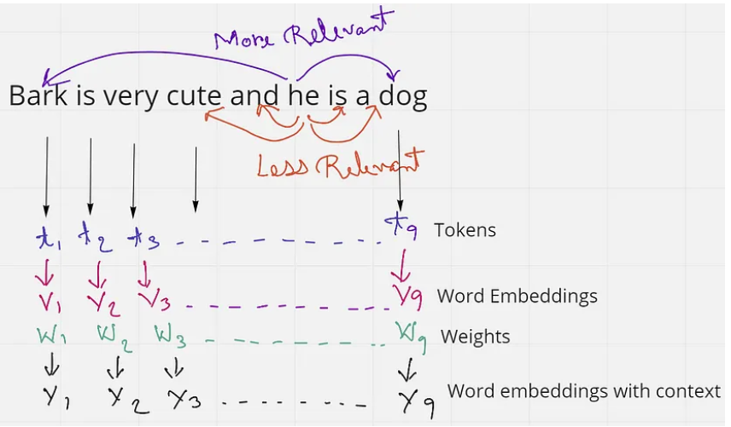
Self Attention

Slide 4
Self Attention
In an embedding space, similar words appear closer together or have similar embeddings. Such as the word ‘king’ will be more related to the word ‘queen’ and ‘royalty’, than with the word ‘zebra’. Similarly, ‘zebra’ will be more related to ‘horse’ and ‘stripes’, than with the word ‘emotion’.
We use this idea to find the weight vectors W, by multiplying (dot product) the word embeddings together to gain more context. So, in the sentence Bark is very cute and he is a dog, instead of using the word embeddings as it is, we multiply the embedding of each word with one another.

Slide 5
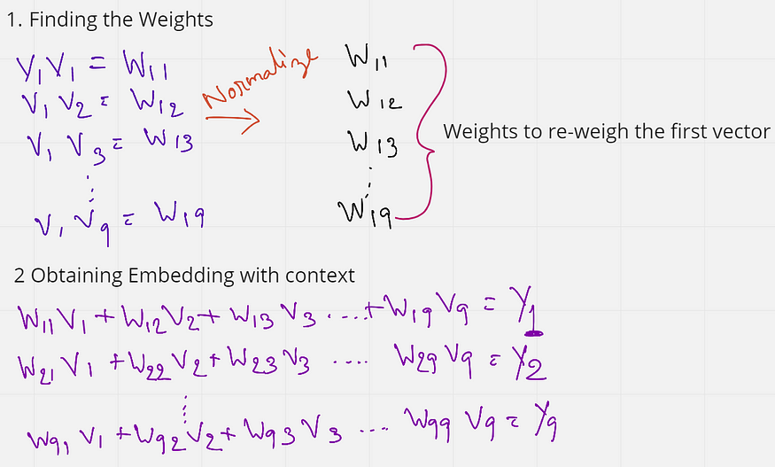
Self Attention
These weights (W11 to W19) are also normalized to have a sum of 1. Next, these weights are multiplied with the initial embeddings of all the words in the sentence.
W11 V1 + W12 V2 + …. W19 V9 = Y1
W11 to W19 are all weights that have the context of the first word V1. So when we are multiplying these weights to each word, we are essentially reweighing all the other words towards the first word. So in a sense, the word ‘Bark’ is now tending more towards the words ‘dog’ and ‘cute’, rather than the word that comes right after it. And this, in a way gives some context.

Slide 6
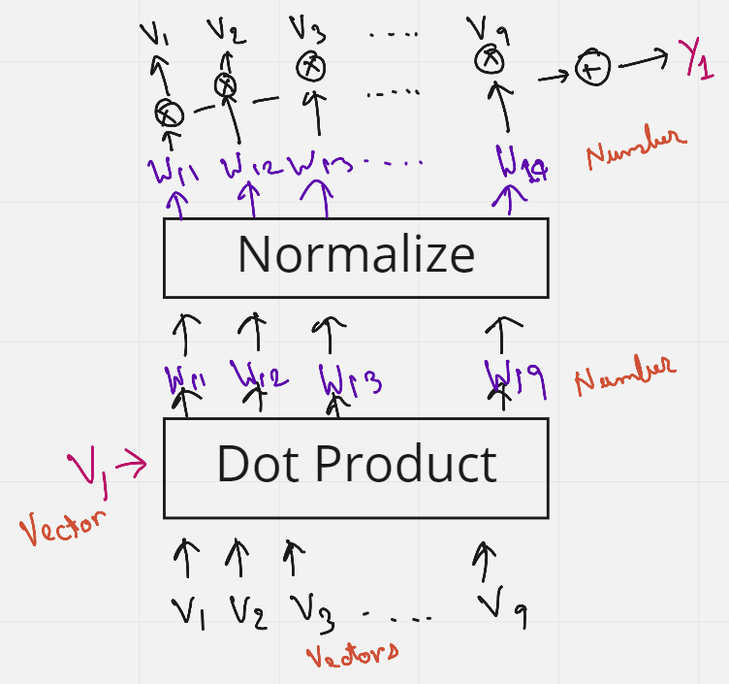
Self Attention
What is interesting here is that no weights are trained, the order or proximity of the words have no influence on each other. Also, the process has no dependency on the length of the sentence, that is, more or fewer words in a sentence do not matter. This approach of adding some context to the words in a sentence is known as Self-Attention.

Slide 7
Query, Key, and Values
The issue with Self-Attention is that nothing is being trained. But maybe if we add some trainable parameters:
Query, Key and Value
initial word embeddings (V) are used 3 times. 1st as a dot product between the first word embedding and all other words (including itself, 2nd) in the sentence to obtain the weights, and then multiplying them again (3rd time) to the weights, to obtain the final embedding with context.
These 3 occurrences of the V’s can be replaced by the three terms Query, Keys, and Values.

Slide 8
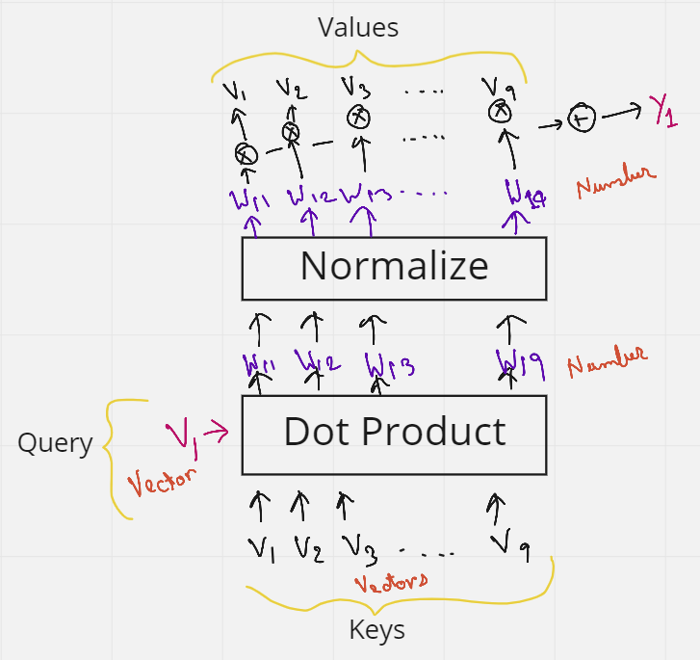
Query, Key, and Values
But wait, we have not added any matrix that can be trained yet.
Multiply each key from V1 to V10 (each of shape 1 x k), with a matrix Mk (Key matrix) of shape k x k. Similarly, the query vector is multiplied with a matrix Mq (Query matrix)., and the Values vectors are multiplied with Values matrix Mv.
All the values in these matrices Mk, Mq, and Mv can now be trained by the neural network, and give much better context than just using self-attention.

Slide 9
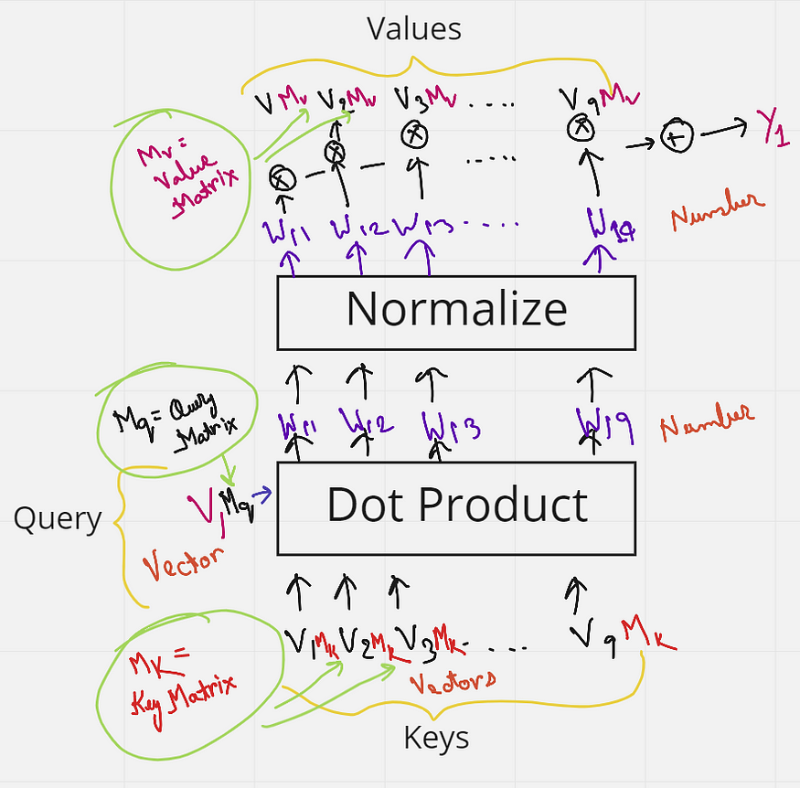
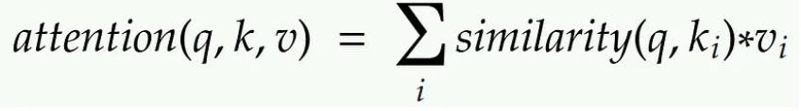


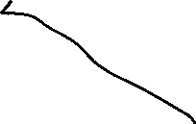


Query, Key, and Values

Slide 10
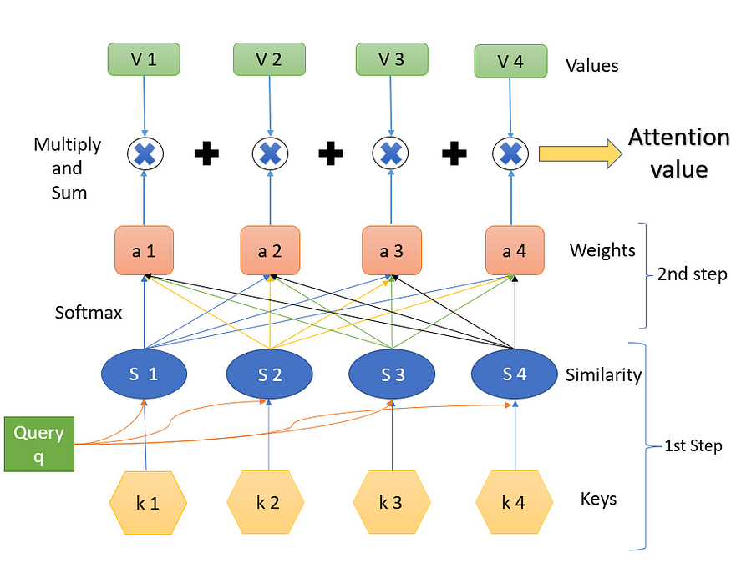
Final attention value from the query, keys, and values
Keys and the query and the respective similarity measures
Step 2 is finding the weights a. This is done using ‘SoftMax’.
Step 3 is a weighted combination of the results of the softmax (a) with the corresponding values (V). The final output that we obtain is the resulting attention value that is desired.

Slide 11
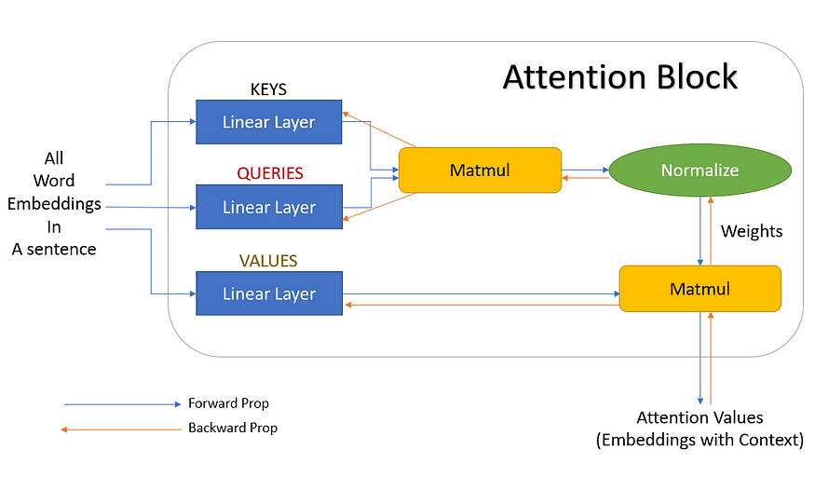






Neural network representation of Attention

Slide 12
Multi-Head Attention
To overcome some of the pitfalls of using single attention, multi-head attention is used.
Eg: Bark is very cute and he is a dog”. Here, if we take the word ‘dog’, grammatically we understand that the words ‘Bark’, ‘cute’, and ‘he’ should have some significance or relevance with the word ‘dog’. These words say that the dog’s name is Bark, it is a male dog, and that he is a cute dog. Just one attention mechanism may not be able to correctly identify these three words as relevant to ‘dog’, and we can say that three attentions are better here to signify the three words with the word ‘dog’. This reduces the load on one attention to find all significant words and also increases the chances of finding more relevant words easily.

Slide 13
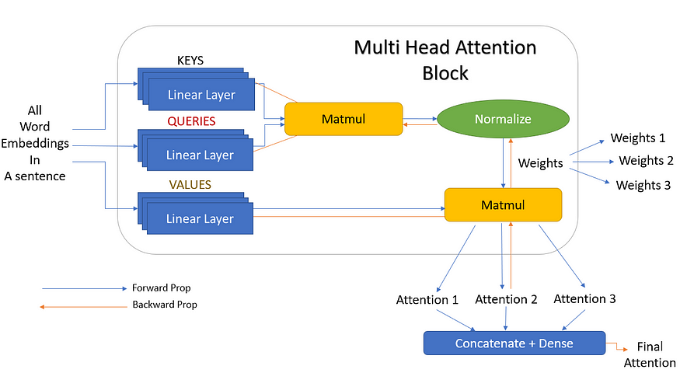
Multi-Head Attention
But 3 is just a random number we chose. In the actual scenario, these can be any number of linear layers, and these are called heads (h). That is there can be h number of linear layers giving h attention outputs which are then concatenated together. And this is exactly why it is called multi-head attention (multiple heads).

Slide 14
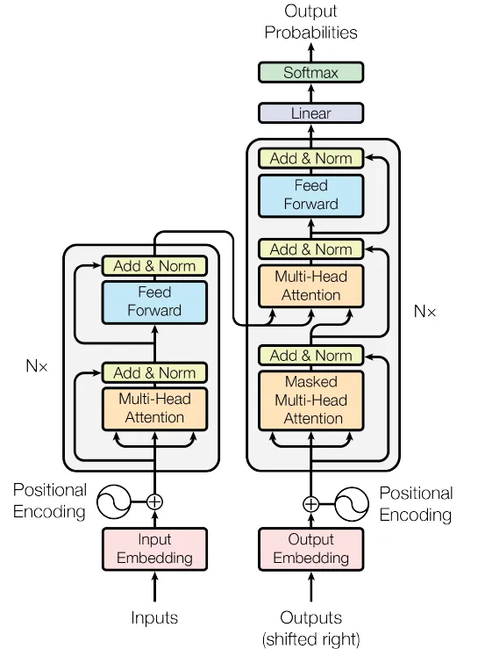
Transformer
The network contains two parts — The encoder and the decoder.
In machine translation, the encoder is used to encode the initial sentence and the decoder is used to produce a translated sentence. The encoder of the transformer can process the whole sentence in parallel, making it much faster and better than RNNs — which process one word of the sentence at a time.

Slide 15
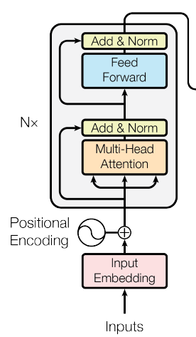
The Encoder Blocks
The encoder network begins with the inputs. Here the entire sentence is fed at once.
They are then embedded at the ‘input embedding’ block.
Then a ‘positional encoding’ is added to each word in a sentence.
This encoding is essential in understanding the position of each word in a sentence.
Without positional embedding, the model will treat the entire sentence as just a bag full of words without having any sequence or meaning.

Slide 16
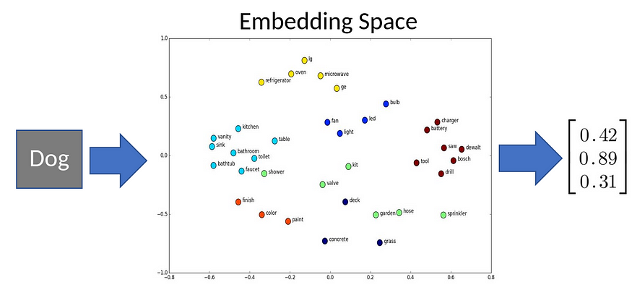
The Encoder Blocks
Input embedding:
The word ‘dog’ in a sentence can use the embedding space to obtain a vector embedding.
Embedding is just converting a word in any language to its vector representation.
In the embedding space, similar words have similar embeddings, for example, the word ‘cat’ and the word ‘kitty’ will fall very close in the embedding space, and the word ‘cat’ and ‘emotion’ will fall further away in the space.

Slide 17
Positional encoding
In any sentence, the words come one after the other to have a significant meaning.
If the words in the sentence are jumbled, then the sentence will have no meaning.
But when a transformer loads the sentences, it does not do so in sequential order but loads them in parallel.
Since the transformer architecture does not include the order of the words while loading in parallel, we must explicitly define the position of the words in a sentence.
This helps the transformer to understand that one word comes after the other in a sentence.
This is where positional embeddings come in handy. This is sort of a vector encoding defining the position of a word.
This positional embedding is added to the input embedding before going into the attention network.

Slide 18
Multi-Head Attention
After the word/input embedding and positional embedding is complete, the embeddings then flow into the most important part of the encoder which contains the two important blocks — a ‘multi-head attention’ block and a ‘feed-forward’ network.

Slide 19
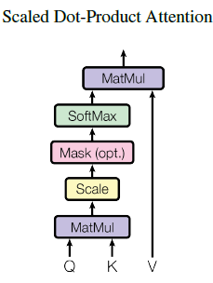
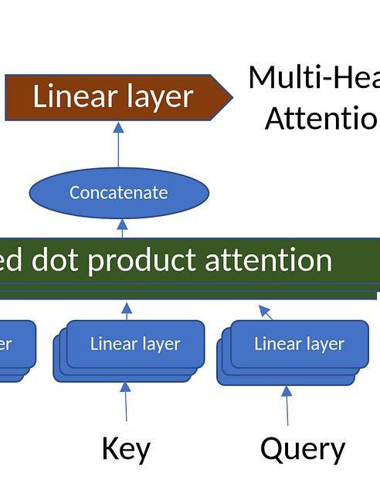
Multi-Head Attention
As input, this block receives a vector (the sentence) that contains a sub-vector (words in a sentence). The multi-head attention then computes the attention between every position with every other position of the vector.
Multi-head attention takes in multiple keys, queries, and values, feeds it through multiple scaled dot-product attention blocks, and finally concatenates the attention to give us a final output.

Slide 20
A simpler explanation
The main vector (sentence) contains sub-vectors (words) — with each word having a positional embedding.
The attention computation treats each word as a ‘query’ and finds some ‘keys’ that correspond to some other words in the sentence, and then take a convex combination of the corresponding ‘values’.
In multi-head attention, multiple values, queries, and keys are chosen which provides multiple attention (better word embedding with context).
These multiple attentions are concatenated to give a final attention value (combination of context for all the words from all the multiple attentions), which works much better than using a single attention block.
In simple words, the idea of multi-head attention is to take a word embedding, combine it with some other word embedding (or multiple words) using attention (or multiple attentions) to produce a better embedding for that word (embedding with a lot more context of the surrounding words).

Slide 21
Add & Norm and Feed-Forward
The next block is the ‘Add & Norm’ which takes in a residual connection of the original word embedding, adds it to the embedding from the multi-head attention, and then normalizes it to have zero mean and variance 1.
This is fed to a ‘feed forward’ block which also has an ‘add & norm’ block at its output.
The whole multi-head attention and feed-forward blocks are repeated n times (hyperparameters), in the encoder block.

Slide 22

Output of Encoder
The output of the encoder is again a sequence of embeddings, one embedding per position, where each position embedding contains not only the embedding of the original word at the position but also information about other words, that it learned using attention.

Slide 23
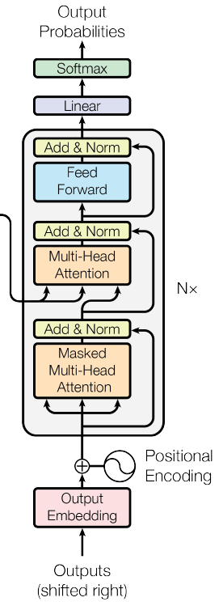
Decoder Block
The purpose of the decoder is to produce some output.
In the paper, Attention is All You Need, this decoder was used for sentence translation (say from English to French).
So the encoder will take in the English sentence, and the decoder will translate it to French.

Slide 24
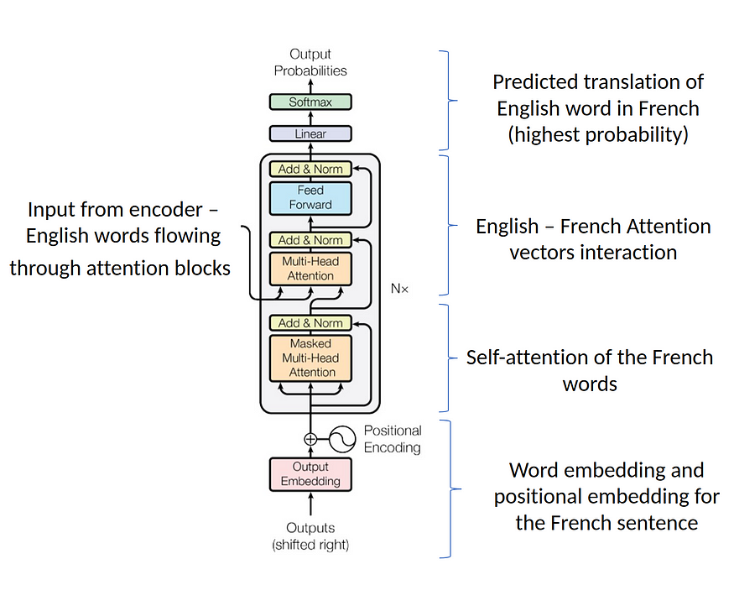
Decoder Block
In sentence translation, the decoder block takes in the French sentence (for English to French translation). Like the encoder, here we add a word embedding and a positional embedding and feed it to the multi-head attention block.
2. The self-attention block will generate an attention vector for each word in the French sentence, to show how much one word is related to the other in the sentence.
3. This attention vector from the French sentence is then compared with the attention vectors from the English sentence. This is the part where the English to French word mappings happen.
4. In the final layers, the decoder predicts the translation of the English word to the best probable French word.
5. The whole process is repeated multiple times to get a translation of the entire text data.

Slide 25
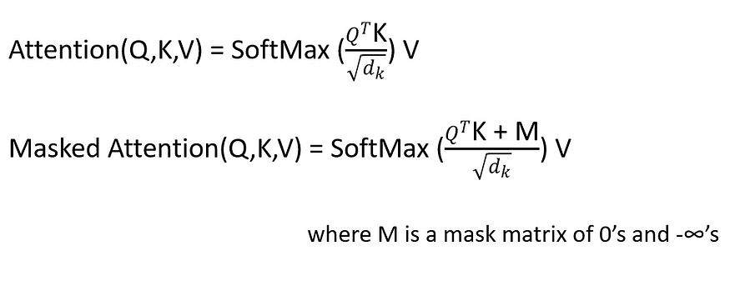
Masked Multi-head Attention
This is a multi-head attention block where some values are masked. The probabilities of the masked values are nullified or not selected.
For example, while decoding, the output value should only depend on previous outputs and not future outputs. Then we mask the future outputs.

