Slide 1
ARIMA Models
- Jaiyesh Chahar

Slide 2
Stationarity and differencing
A stationary time series is one whose statistical properties do not depend on the time at which the series is observed.
Thus, time series with trends, or with seasonality, are not stationary — the trend and seasonality will affect the value of the time series at different times
A white noise series is stationary
Some cases can be confusing — a time series with cyclic behaviour (but with no trend or seasonality) is stationary. This is because the cycles are not of a fixed length, so before we observe the series we cannot be sure where the peaks and troughs of the cycles will be.

Slide 3
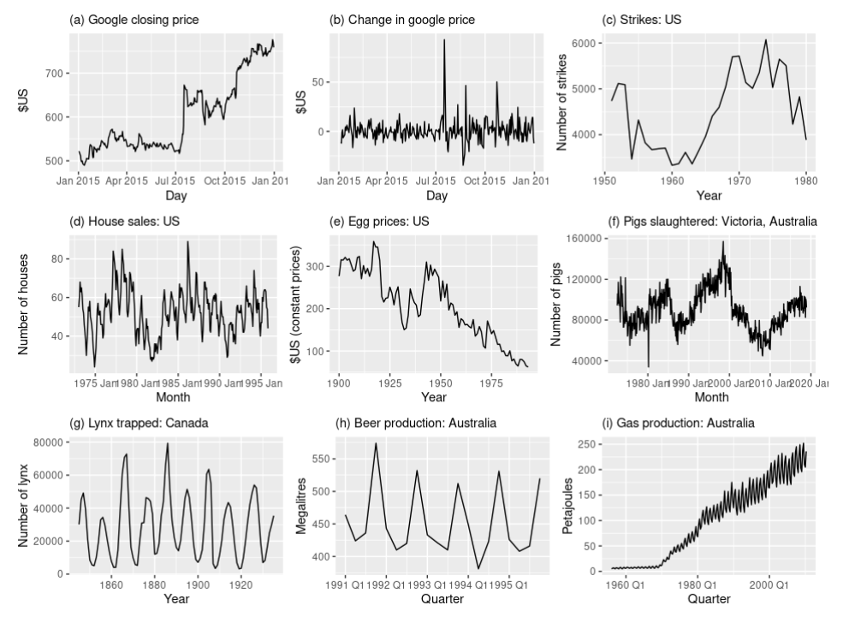
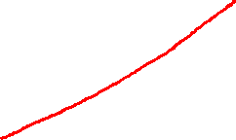
Seasonality rules out series (d), (h) and (i).
Trends and changing levels rules out series (a), (c), (e), (f) and (i).
Increasing variance also rules out (i). That leaves only (b) and (g) as stationary series.

Slide 4
Differencing
Google stock price was non-stationary in panel (a), but the daily changes were stationary in panel (b).
This shows one way to make a non-stationary time series stationary — compute the differences between consecutive observations. This is known as differencing.
Differencing can help stabilise the mean of a time series by removing changes in the level of a time series, and therefore eliminating (or reducing) trend and seasonality.

Slide 5
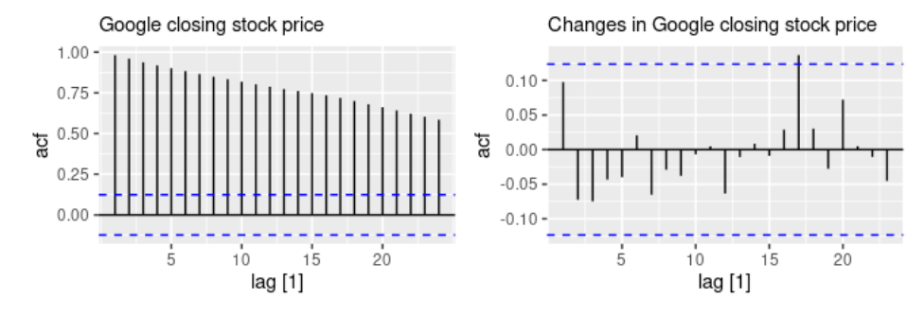
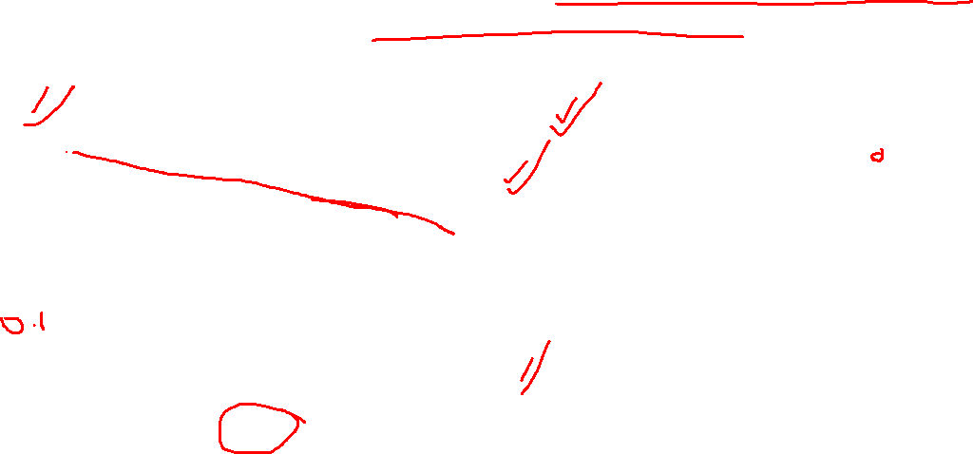
ACF Plot and Stationarity
ACF plot is also useful for identifying non-stationary time series. For a stationary time series, the ACF will drop to zero relatively quickly, while the ACF of non-stationary data decreases slowly. Also, for non-stationary data, the value of r1�1 is often large and positive.

Slide 6
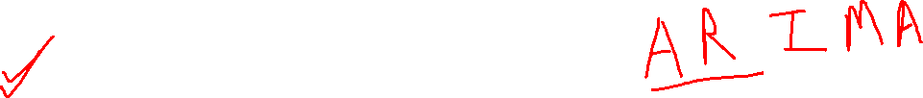
Autoregressive Models
In an autoregression model, we forecast the variable of interest using a linear combination of past values of the variable.
The term autoregression indicates that it is a regression of the variable against itself.
Thus, an autoregressive model of order p can be written as:
We refer to this as an AR(p) model, an autoregressive model of order p.

Slide 7

Moving Average Models
Rather than using past values of the forecast variable in a regression, a moving average model uses past forecast errors in a regression-like model.
Where εt is white noise. We refer to this as an MA(q) model, a moving average model of order q. Of course, we do not observe the values of εt, so it is not really a regression in the usual sense.
Notice that each value of yt can be thought of as a weighted moving average of the past few forecast errors.

Slide 8
Non-seasonal ARIMA models
If we combine differencing with autoregression and a moving average model, we obtain a non-seasonal ARIMA model. ARIMA is an acronym for AutoRegressive Integrated Moving Average (in this context, “integration” is the reverse of differencing).
The full model can be written as:
Where yt′ is the differenced series (it may have been differenced more than once)

Slide 9
ARIMA
The “predictors” on the right hand side include both lagged values of yt and lagged errors. We call this an ARIMA(p,d,q) model, where:
p= | order of the autoregressive part;
d= | degree of first differencing involved;
q= | order of the moving average part.

Slide 10
ACF and PACF plots
It is usually not possible to tell, simply from a time plot, what values of p� and q� are appropriate for the data.
However, it is sometimes possible to use the ACF plot, and the closely related PACF plot, to determine appropriate values for p� and q�.

Slide 11
ACF and PACF plots
Recall that an ACF plot shows the autocorrelations which measure the relationship between yt and yt−k for different values of k�. Now if yt and yt−1 are correlated, then yt−1and yt−2must also be correlated. However, then yt and yt−2might be correlated, simply because they are both connected to yt−1, rather than because of any new information contained in yt−2that could be used in forecasting yt.
To overcome this problem, we can use partial autocorrelations

Slide 12
ACF and PACF plots
Partial autocorrelations
These measure the relationship between ytand yt−k after removing the effects of lags 1,2,3,…,k−1.
So the first partial autocorrelation is identical to the first autocorrelation, because there is nothing between them to remove.

Slide 13
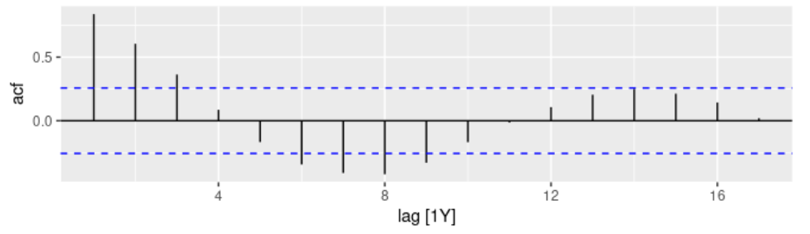
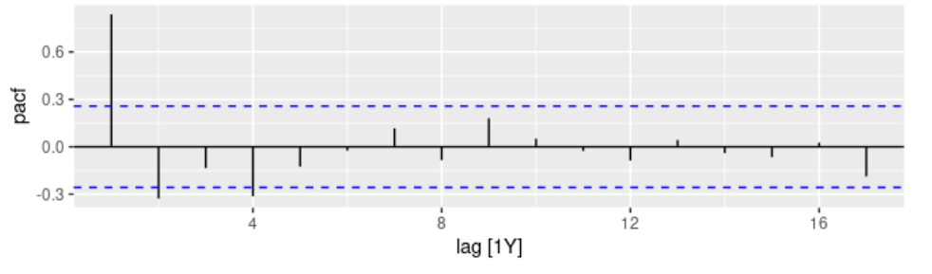

Slide 14
ACF and PACF
If the data are from an ARIMA(p�,d�,0) or ARIMA(0,d�,q�) model, then the ACF and PACF plots can be helpful in determining the value of p� or q�. If p� and q� are both positive, then the plots do not help in finding suitable values of p� and q�.

Slide 15
ACF and PACF Plots
The data may follow an ARIMA(p�,d�,0) model if the ACF and PACF plots of the differenced data show the following patterns:
the ACF is exponentially decaying or sinusoidal;
there is a significant spike at lag p� in the PACF, but none beyond lag p�.
The data may follow an ARIMA(0,d�,q�) model if the ACF and PACF plots of the differenced data show the following patterns:
the PACF is exponentially decaying or sinusoidal;
there is a significant spike at lag q� in the ACF, but none beyond lag q�.

