Slide 1
IS 362 Final Project
Correlation between income and birth rates in new York state

Slide 2
Project goal
To find out if people have more kids the higher their income is and vice-versa
Which New York county has the highest birth rate?
Which New York county has the lowest birth rate?
Compare the results according to their income level

Slide 3
Data used
Natality data was retrieved from Centers for Disease Control and Prevention’s website.
Household income data was retrieved from The United States Census Bureau’s website

Slide 4
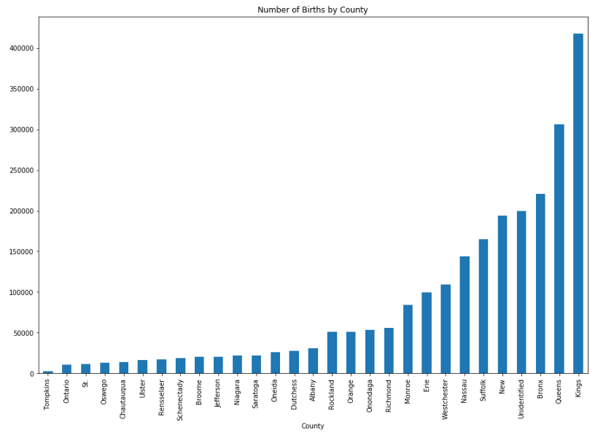
Number of births by new york county

Slide 5
Explanation:
The number of births by NY county graph shows that Kings County has the highest birth rate with 417,865.
Tompkins County has the lowest number of births with 2,463.

Slide 6
Household type
The U.S. Census classified the households by type: households, families, married-couple families, and non-family households.
The “households” has the highest number of people, followed by “families” household.

Slide 7
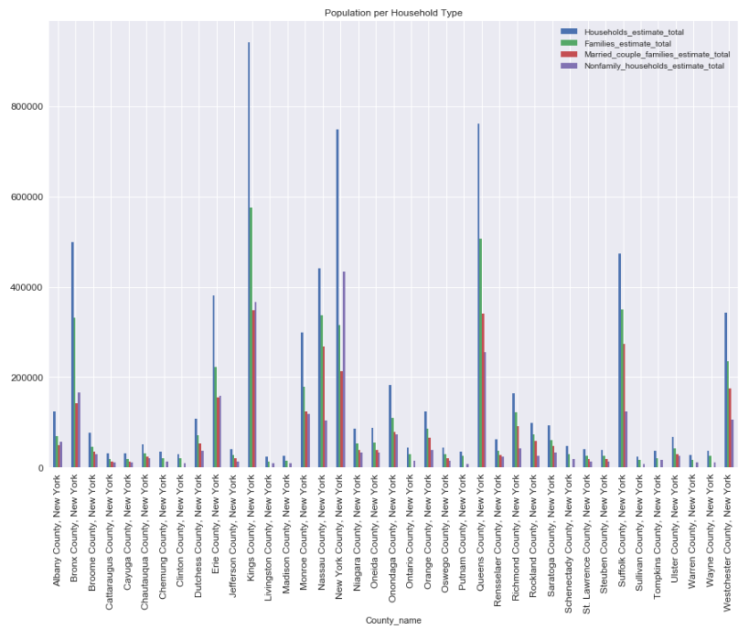
Population per household type

Slide 8
Given the different household types, I’ve decided to look closer into the “families” data.
First, I summed up the income brackets by income class:
Low Income Class: Below 10,000 to 24,000
Lower Middle Class: 25,000 - 49,000
Middle Middle Class: 50,000 - 99,999
Upper Middle Class: 100,000 or more

Slide 9
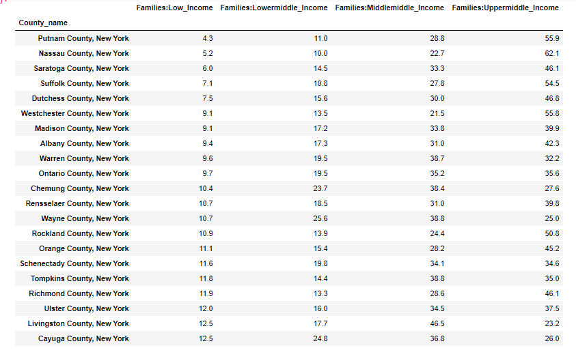
Snapshot of the percentages

Slide 10
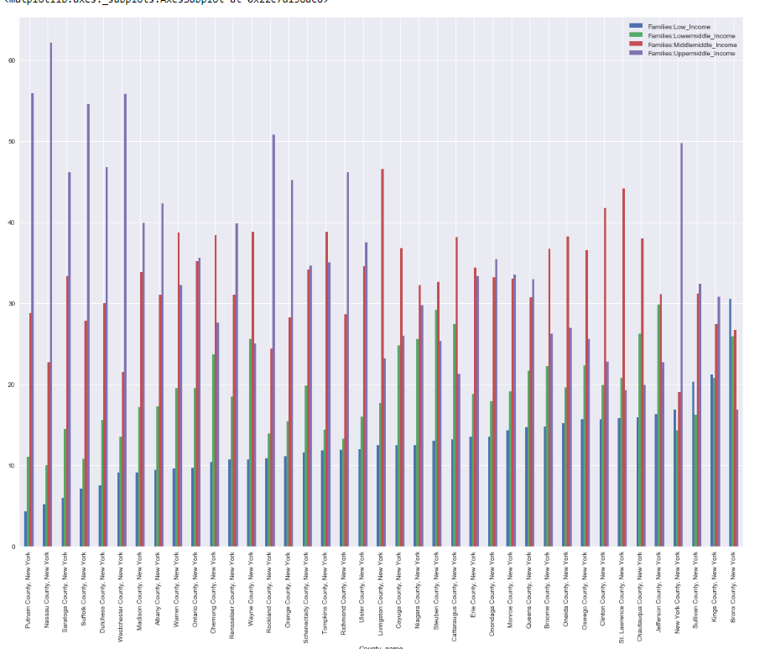
Data plot
Families population percentage based on income class

Slide 11
DATA EXPLAINED
Looking at the income data, King's County's income seems to be almost distributed evenly between low income (21.2 percent), low middle class income (20.8 percent), middle middle income (27.4 percent), and upper middle class income (30.8 percent). Tompkins County, in the other hand, has more middle middle income (38.8 percent) and upper middle class income population (35.8 percent. The population with low income is only 11.8 percent and the low middle class is 14.4.

Slide 12
Comparing the two counties
Kings County number of births = 417,865
Kings County “families” population = 575,987
low income (21.2 percent), low middle class income (20.8 percent), middle middle income (27.4 percent), and upper middle class income (30.8 percent)
Tompkins County number of births = 2,463
Tompkins County “families” population = 20,315
low income is only 11.8 percent and the low middle class is 14.4
middle middle income (38.8 percent) and upper middle class income population (35.8 percent)

Slide 13
CONCLUSION
Looking at the comparison between these two counties, it seems that the difference in the number of births has something to do with the population's income. The higher the income, the lower the birth rate.
According to a study, across countries, there is a strong negative correlation between GDP and fertility, and within countries there is a strong negative correlation between household income and fertility. Richer countries have lower fertility rates than poor ones, and high-income families in a given country have fewer kids than low-income families do. The data I've analyzed did confirm that this also true in New York counties; evidence that income causes fertility to drop.

