Slide 1
Photolithography
Advanced experimental techniques in quantum materials spring semester 2026
By
Jajapuram Shiva Sai
Krish Garg

Slide 2
Table of content
1. Fundamental Physics
2. Photochemistry
3. Fabrication Pipeline
4. Lab scale photolithography
5. References

Slide 3
Section 01: Fundamental Physics

Slide 4
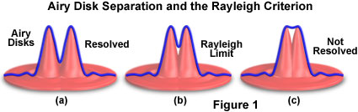
Diffraction & The Rayleigh Criterion
The Concept: Light passing through a mask slit diffracts, creating a blurry "Airy disk" on the wafer. If features are too close, these disks overlap, preventing resolution.
The Resolution Limit (CD): The minimum feature size (Critical Dimension) is governed by the Rayleigh Criterion:
CD = k₁ * (λ / NA)
CD: Smallest printable feature size (nm).
λ (Wavelength): Shorter is better (e.g., 193nm DUV to 13.5nm EUV).
NA (Numerical Aperture): Light-gathering ability of the lens.
k₁: Process factor (physical limit = 0.25).

Slide 5
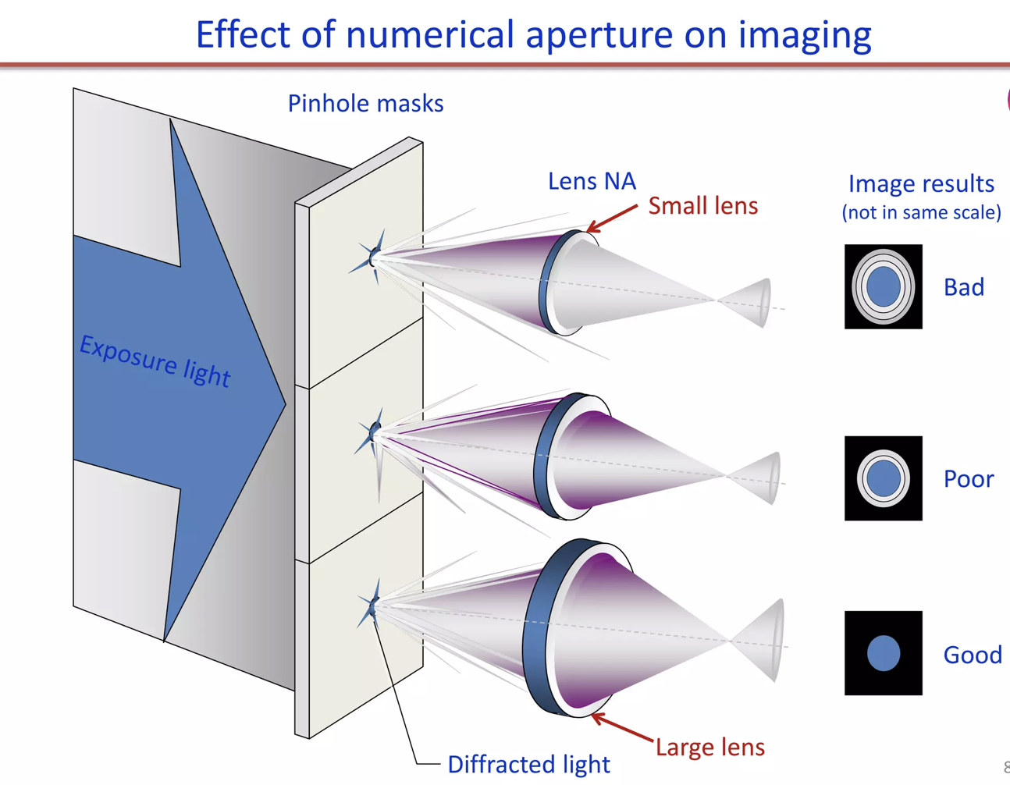
Numerical Aperture (NA) & Immersion
The Concept: NA characterizes the range of angles over which the optical system can accept light. Higher NA captures higher-order diffracted light, yielding finer details.
NA = n * sin(θ)
n: Refractive index of the medium.
θ: Acceptance half-angle.
Immersion Lithography: By injecting ultra-pure water (n = 1.44) between the lens and the wafer, engineers pushed NA past the theoretical air limit of 1.0, reaching up to 1.35.

Slide 6
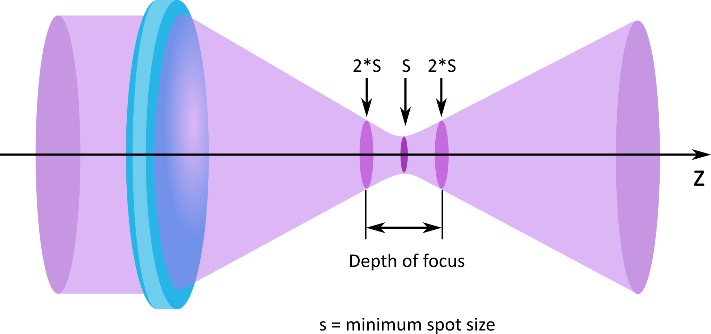
The Depth of Focus (DOF) Dilemma
The Concept: DOF is the vertical distance over which the projected image remains sharp enough to properly expose the photoresist.
DOF = k₂ * (λ / NA²)
The Trade-off: Because NA is squared in the denominator, increasing NA to improve resolution drastically shrinks the Depth of Focus. Modern High-NA systems have a DOF of just a few dozen nanometers, requiring near-atomic substrate flatness.

Slide 7
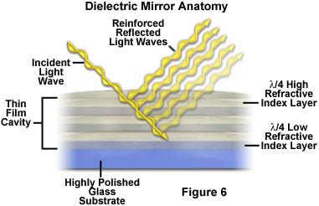
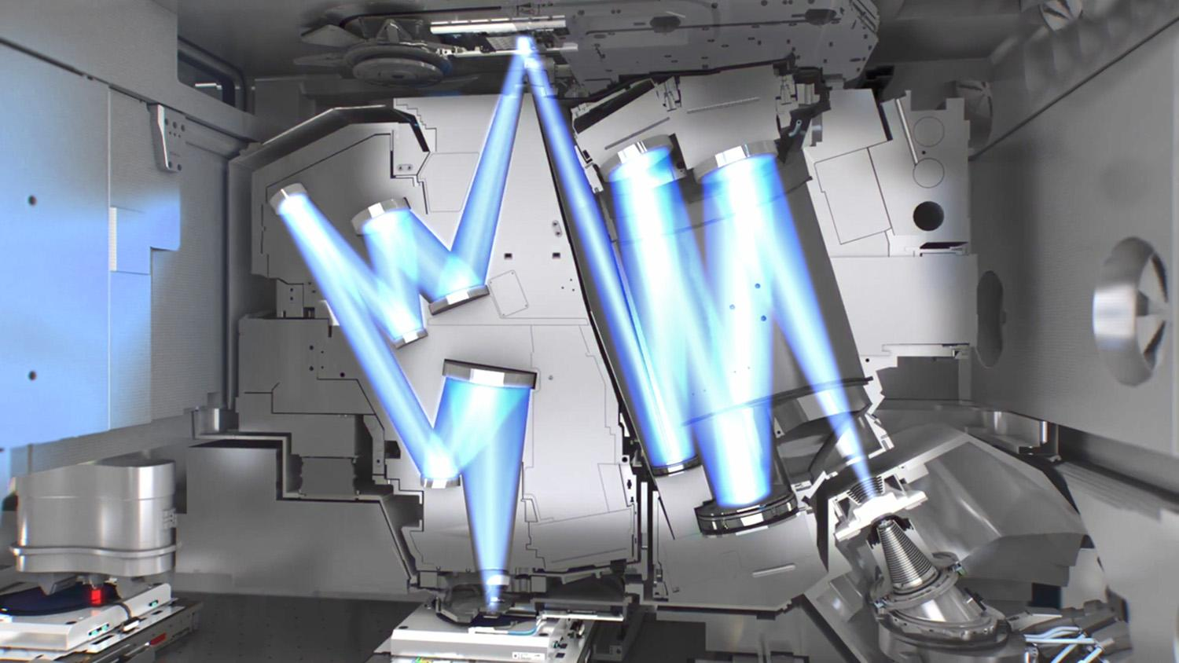
EUV Optics & Bragg Reflectors
The Concept: At 13.5nm (Extreme Ultraviolet), light is absorbed by literally all matter, including standard quartz lenses.
Catoptric Optics: EUV requires mirror-based optics using Bragg Reflectors—alternating atomic layers of Molybdenum and Silicon.
Bragg's Law: nλ = 2d * sin(θ)
Reflections from each layer must perfectly, constructively interfere for the mirror to function

Slide 8
Section 02: Photo Chemistry & Deposition

Slide 9
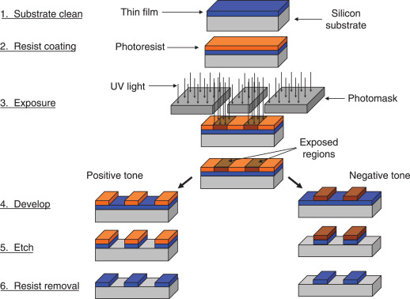
Photoresist Types: Positive vs. Negative

Slide 10
Photoresist Types: Positive vs. Negative
The Concept: Photoresists are light-sensitive polymeric liquids. Depending on their chemical makeup, they react to UV/EUV light in entirely opposite ways, dictating how the mask pattern transfers to the wafer.
Positive Photoresist (+ve): * Mechanism: Exposure to light weakens the polymer by breaking its chemical bonds (chain scission) or triggering an acid-catalyzed deprotection reaction.
Result: The areas exposed to light become highly soluble in the chemical developer.
Outcome: The resist exactly matches the mask. Where the mask was transparent, the resist is washed away, leaving a hole. This is the industry standard for high-resolution logic fabrication.
Negative Photoresist (-ve):
Mechanism: Exposure to light strengthens the polymer by causing the molecules to bond together into a rigid 3D network (cross-linking).
Result: The areas exposed to light become insoluble in the developer, while the unexposed areas are washed away.
Outcome: The resist forms a photographic negative of the mask. Where the mask was transparent, the resist remains as a solid structure. Often used for packaging, MEMS, or specific lift-off processes.

Slide 11
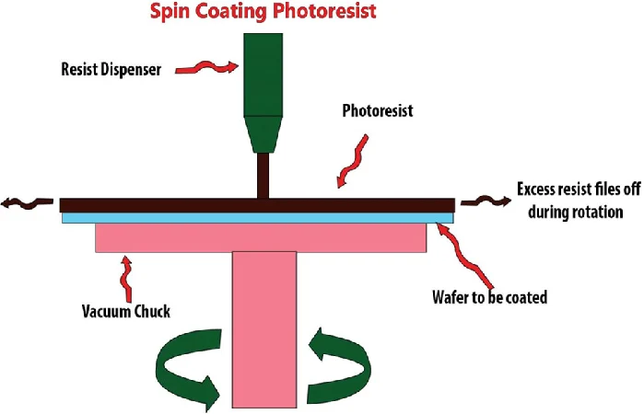
Spin Coating & The Physics of Deposition
The Concept: Traditionally, photoresist is applied as a liquid. The wafer is rotated at high speeds (1,000–5,000 RPM) to spread the fluid into a uniform, nanometer-thick layer via centrifugal force.
Thickness Control: h = k * (P² / √ω)
The final thickness (h) is inversely proportional to the square root of the angular velocity (ω), balanced by the percentage of solids (P) and solvent evaporation rates.

Slide 12
Chemical Kinetics: The Dill A-B-C Model
The Limits of Liquid Resists at the Nanoscale
The Concept: The exposure process models the destruction of the Photoactive Compound (PAC).
∂M/∂t = -C * M * I
A/B: Bleachable and non-bleachable absorption coefficients.
C: Exposure rate constant.
M: PAC concentration. Chemical Amplification: Modern resists use Photoacid Generators (PAGs). During a Post-Exposure Bake (PEB), a single acid molecule acts as a catalyst to dissolve thousands of polymer bonds, drastically increasing light sensitivity.
Capillary Collapse: As we scale past the 3nm node, the aspect ratios of printed lines become extreme. Liquid developers exert capillary forces that can physically pull adjacent nanostructures together, causing pattern collapse.
EUV Transparency: Traditional organic polymers (Carbon/Hydrogen/Oxygen) absorb very little EUV light, meaning most expensive 13.5nm photons pass through without triggering a reaction.

Slide 13
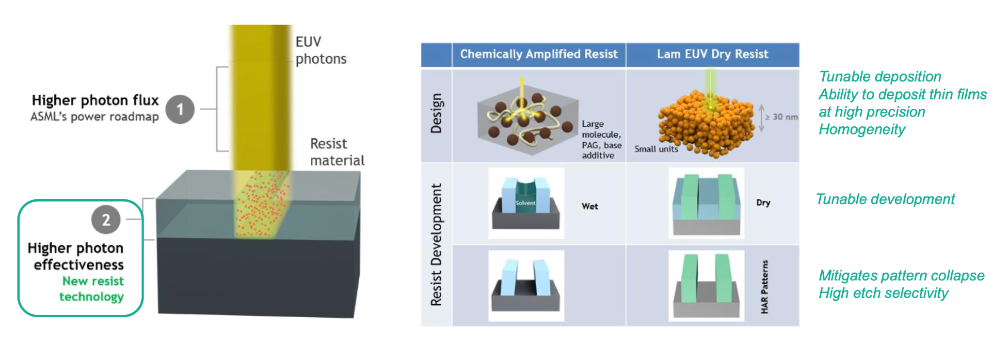
The Future: Chemical Vapor Deposition (CVD) Dry Resists
The Concept: "Dry Resist" is deposited in a vacuum chamber as a gas, growing a perfectly conformal film atom by atom.
Metal-Oxide (MOx) Resists: CVD utilizes inorganic compounds (like Tin or Zirconium). Metals have a vastly higher EUV absorption cross-section, requiring lower light doses.
Dry Development: They are developed using plasma etching, completely eliminating liquid capillary forces and pattern collapse.

Slide 14
Section 03: The VLSI Fabrication Pipeline

Slide 15
The VLSI Design Flow
Building the Chip Hierarchy
The Concept: Modern chips (billions of transistors) require highly automated Electronic Design Automation (EDA) pipelines.
RTL & Synthesis: Coding hardware behavior (Verilog) and mapping it to standard logic gates.
Place & Route: Positioning standard cells and wiring them together to minimize delay.
Tape-Out: Exporting the layout as a GDSII file, containing the geometric polygons used to manufacture the physical masks.
Front-End-of-Line (FEOL): The extreme-precision bottom layers where active devices (silicon fins, high-k gates) are patterned into the substrate.
Middle-End-of-Line (MEOL): The intermediate contacts (tungsten/cobalt) connecting transistor terminals to the wiring grid.
Back-End-of-Line (BEOL): The upper wiring layers; complex 3D networks of copper/ruthenium wires and vertical vias separated by low-k dielectrics.

Slide 16
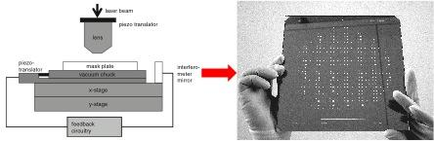
Photomask Fabrication: Building the Master Template
The Concept: Before a chip can be printed, its digital layout must be translated into a physical master template called a photomask (or reticle).
Materials: * Deep UV (DUV): Made of ultra-pure fused silica (quartz) glass, which is transparent to 193nm light, coated with an opaque patterned layer of Chromium.
Extreme UV (EUV): Because EUV is absorbed by glass, EUV masks are reflective. They use the same Mo/Si Bragg reflector layers as the scanner mirrors, topped with a patterned Tantalum-based absorber.
Electron Beam Lithography (EBL): Because the mask must be physically perfect, it cannot be written with light. It is written using an electron beam in a high-vacuum chamber. This process is incredibly slow and expensive, sometimes taking days to write a single complex mask.

Slide 17
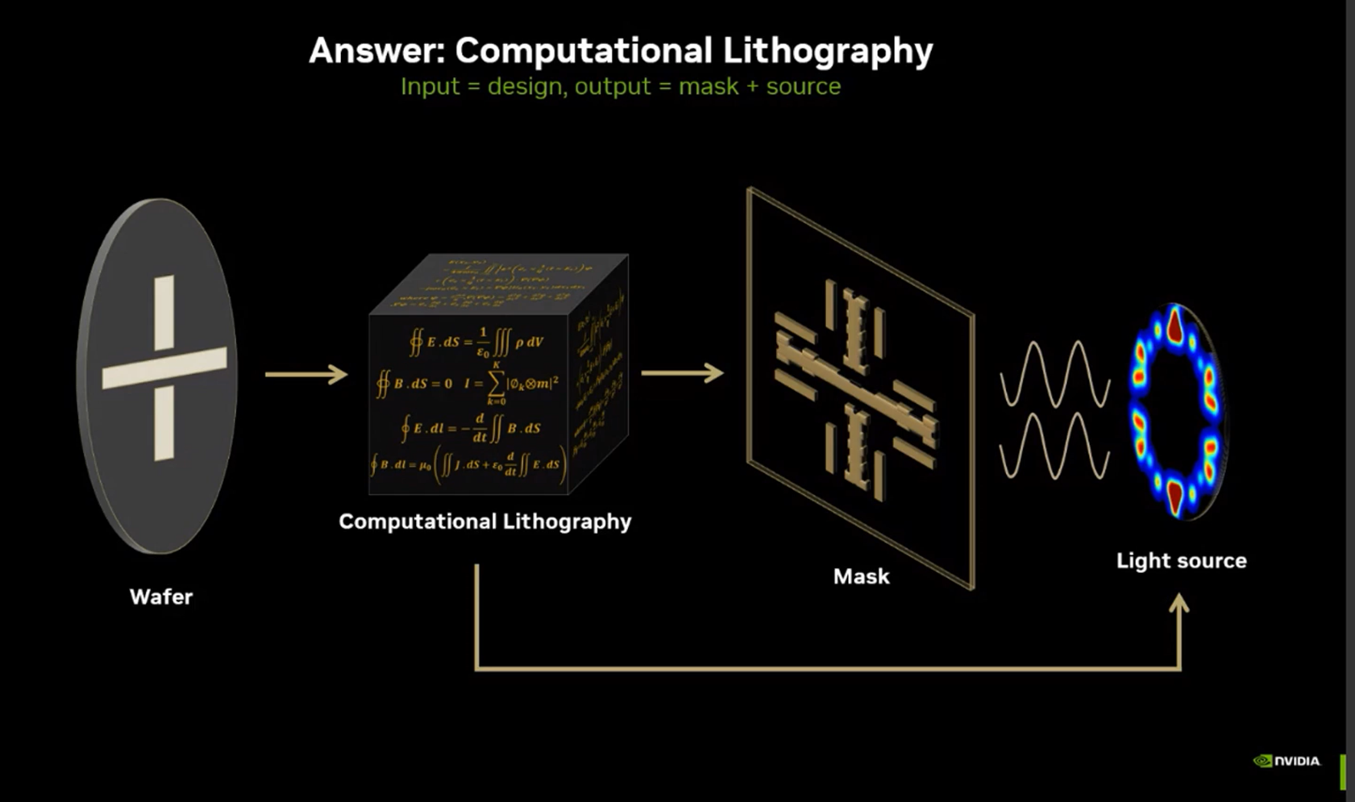
Computational Lithography: Defeating Diffraction
The Concept: Because the features on the mask are smaller
than the wavelength of light, severe diffraction occurs.
A perfectly square corner on the mask will print
as a blurry circle on the wafer.
Lines will suffer from "line-end shortening."
Optical Proximity Correction (OPC): Engineers intentionally distort
the mask shapes to pre-compensate for optical blurring.
This involves adding geometric adjustments like
"hammerheads" to line ends and "mouse bites"
to inner corners so that they print correctly on the silicon.
Sub-Resolution Assist Features (SRAF): Placing tiny,
non-printing shapes (scatter bars) next to the main features.
They are too small to resolve on the wafer, but they
manipulate the light via constructive interference to sharpen the main feature's aerial image.

Slide 18
The Multi-Layer Fabrication Loop
Stacking & Planarization
The Concept: A modern microprocessor requires 50 to 100+ separate stacked lithography layers.
The Loop:
Deposition: Grow a blanket layer of material (oxide, metal).
Lithography: Coat resist, expose, and develop the stencil.
Pattern Transfer: Reactive Ion Etching (RIE) through the stencil.
Strip: Remove the leftover resist via plasma ashing.
Edge Placement Error (EPE): Layer N must perfectly align with Layer N-1. A 2nm misalignment can ruin the chip.
Chemical Mechanical Planarization (CMP): Because high-NA scanners have such a shallow Depth of Focus, the wafer cannot be bumpy. CMP uses chemical slurries and rotating pads to grind the surface perfectly flat between every single layer.

Slide 19
Advanced Mask Physics: PSM and ILT
Scaling Challenges & Alternatives
Phase-Shift Masks (PSM): A technique that exploits the wave nature of light. By selectively etching trenches into the quartz glass, the phase of the light passing through is shifted by 180 degrees. When the shifted light and unshifted light meet at the edge of a feature on the wafer, complete destructive interference occurs, creating a perfectly dark, razor-sharp edge.
Inverse Lithography Technology (ILT): Instead of starting with the desired shape and adding OPC tweaks, ILT treats the process as an inverse mathematical problem. Using massive compute clusters (and increasingly, Machine Learning), ILT calculates the absolutely optimal mask shape required to produce the desired wafer target.
The Result: ILT generates highly complex, amoeba-like, curvilinear mask patterns that look completely alien, but they perfectly counter the physics of diffraction to yield pristine square grids on the chip.
Stochastic Shot Noise: At EUV wavelengths, the random arrival times of individual high-energy photons cause unpredictable flaws and Line Edge Roughness (LER).
Alternatives to Optical Lithography:
Electron Beam Lithography (EBL): Incredible atomic resolution, but unviably slow for mass production.
Directed Self-Assembly (DSA): Utilizing block copolymers that naturally self-organize into highly ordered nanoscale cylinders or lines.

Slide 20
Section 05: Lab Photolithography

Slide 21
Lab-Scale Photolithography: The Aluminum Hall Bar
The Concept: Bridging theoretical optics with tangible device fabrication by creating high-precision aluminum (Al) thin-film Hall bar contacts on a Si/SiO2 substrate.
The Photoresist: The process utilizes PMMA (typically 950k or 495k molecular weight).
The Masking Approach: Rather than using highly complex EUV reticles, practical lab-scale patterning can be achieved using a DIY chart photomask mounted directly on a standard UV mask aligner.
Spin Coating & Baking: After a rigorous ultrasonic cleaning and dehydration bake, PMMA is spin-coated at 3000–5000 RPM for 60 seconds. A critical hard bake is then performed on a hot plate at exactly 180°C for 90 seconds to solidify the film and ensure proper lift-off profiles.ß
Exposure & Development: The UV radiation breaks the PMMA polymer chains (chain scission) in the specific shape of the Hall bar and contact pads. The substrate is developed in a MIBK:IPA (1:3) solution , then immediately rinsed in an IPA stop bath.
Thermal Evaporation: A thin layer of Aluminum (350nm) is deposited over the entire substrate under high vacuum (≈10⁻⁶ Torr). The deposition rate must be kept very slow to prevent radiant heat from melting the underlying PMMA layer.

Slide 22
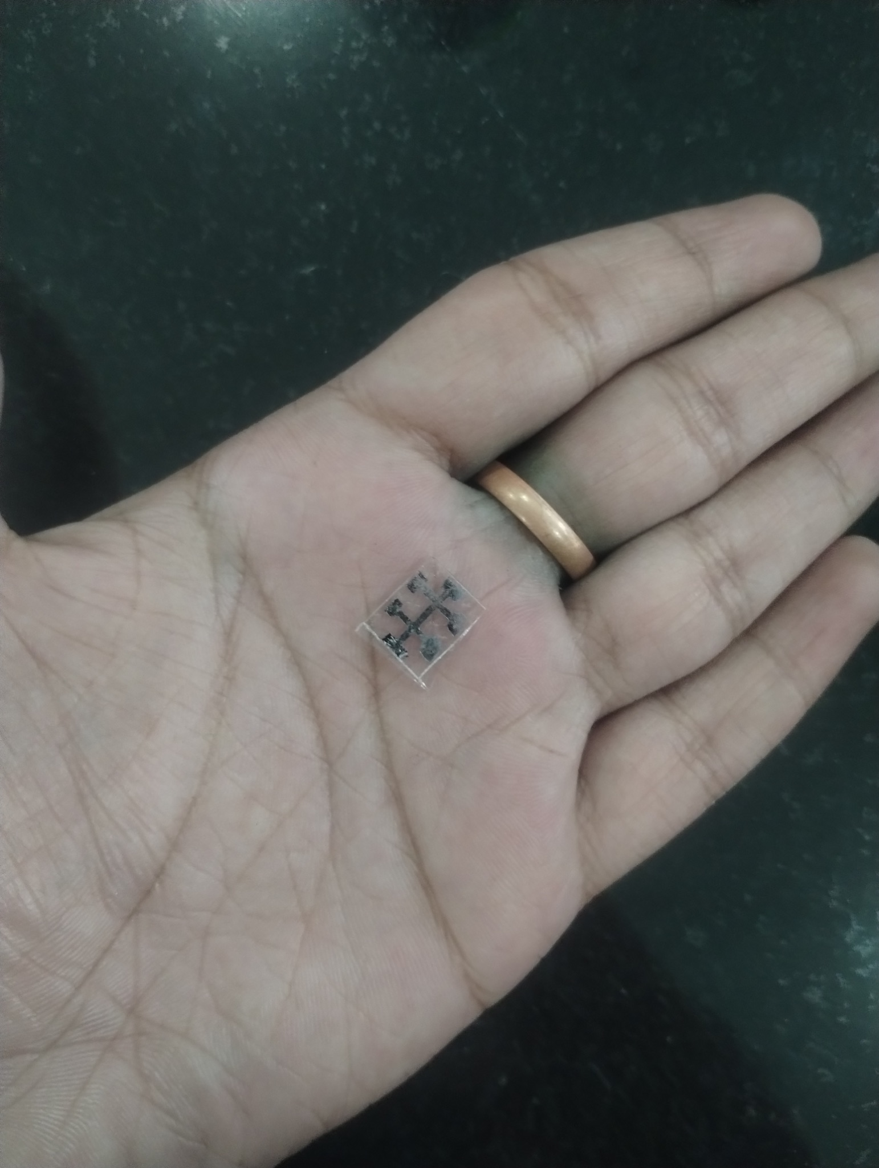
Device Finalization and Characterization
Executing the Lift-Off: The sample is submerged in an Acetone bath. As the solvent dissolves the unexposed PMMA, the excess aluminum sitting on top of it simply flakes off, leaving only the desired Hall bar geometry.
Optical Inspection: Using an optical microscope, the device is inspected to ensure the edges are razor-sharp and that no residual aluminum "flags" remain. The final resulting device is a clean, thin-film Al pattern on a roughly 6mm x 6mm substrate. * Electrical Verification: A probe station or multimeter is used to verify electrical continuity between the pads before attempting rigorous magnetotransport analysis. When performing the subsequent Van der Pauw measurements on these completed structures, it is a standard practice to record and process the transverse Hall voltages strictly in true volts, rather than millivolts, to avoid calculation errors when extracting sheet resistance and carrier mobility limits.

Slide 23
Key References and Further Reading
Fundamental Lithography & Optics:
Levinson, H. J. (2019). Principles of Lithography (4th ed.). SPIE Press. (The definitive text on the physics, diffraction limits, and chemistry of the lithographic process).
Smith, B. W., & Suzuki, K. (2020). Microlithography: Science and Technology (3rd ed.). CRC Press.
Photoresist Chemistry & Kinetics:
Dill, F. H., et al. (1975). "Characterization of positive photoresist." IEEE Transactions on Electron Devices, 22(7), 445-452. (The foundational paper establishing the Dill A, B, C parameters).
High-NA EUV & Advanced Fabrication (2026 State-of-the-Art):
Proceedings of the SPIE Advanced Lithography + Patterning Conference. (Current year publications on High-NA scanner performance, MOx dry resists, and defectivity limits).
International Roadmap for Devices and Systems (IRDS). (Latest edition for sub-2nm node scaling, EPE budgets, and interconnect materials).
Computational Lithography (OPC/ILT):
Wong, A. K.-K. (2001). Resolution Enhancement Techniques in Optical Lithography. SPIE Press.
Poonawala, A., & Milanfar, P. (2007). "Mask design for optical microlithography—An inverse imaging problem." IEEE Transactions on Image Processing.

