Slide 1
Out-of-Time-Order Correlators based Spectroscopy for Nuclear Spin Geometries
A Quantum Simulation Approach to Hamiltonian Learning via Many-Body Echo Spectroscopy
jajapuram shiva sai
4th November 2025

Slide 2
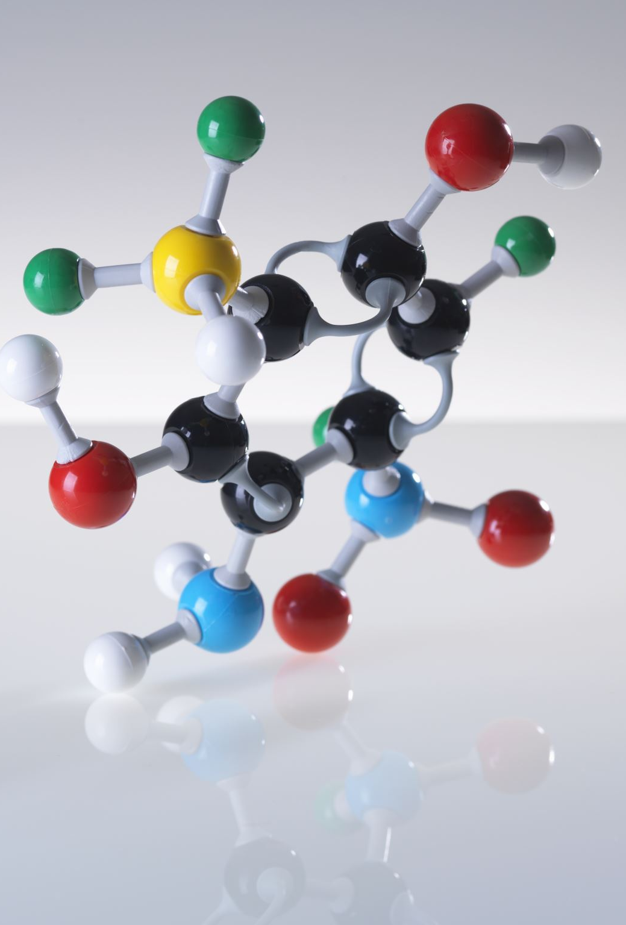
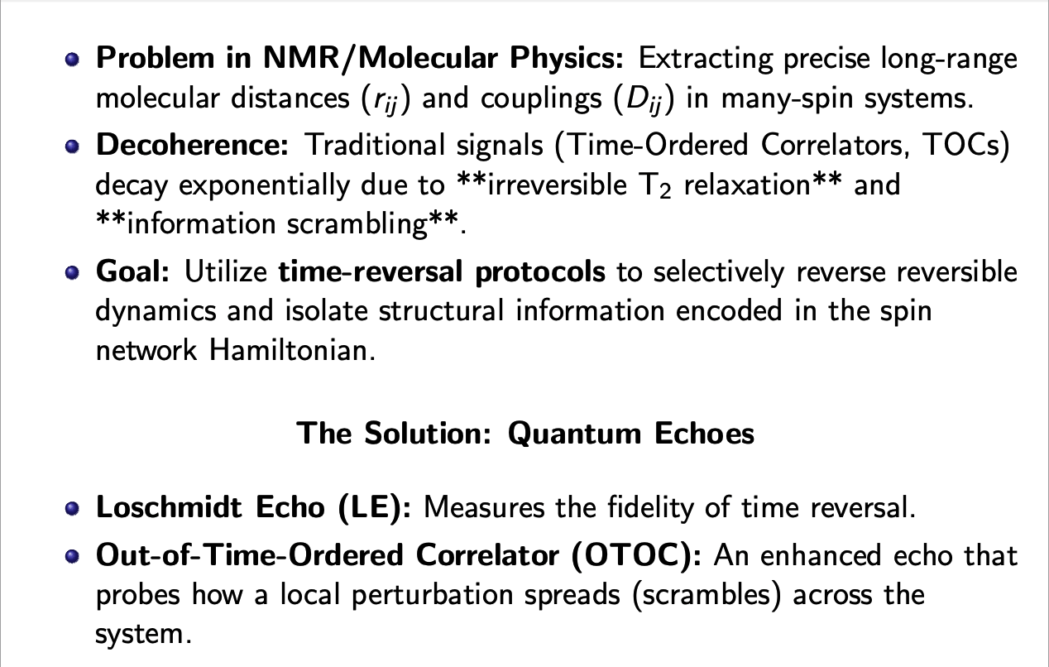
Motivation: The Challenge of Spin Networks in NMR

Slide 3
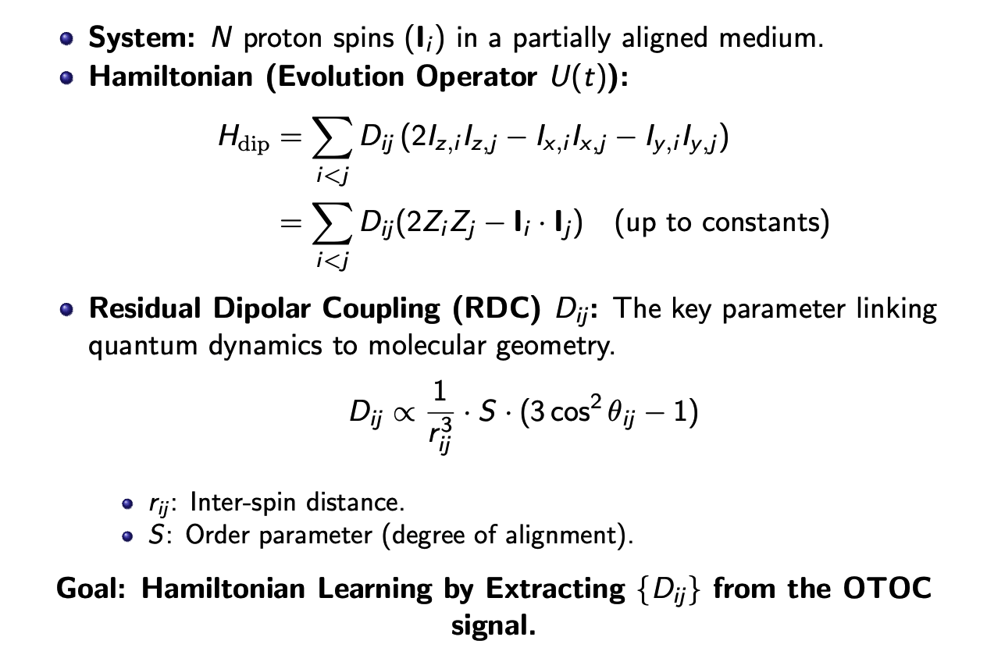
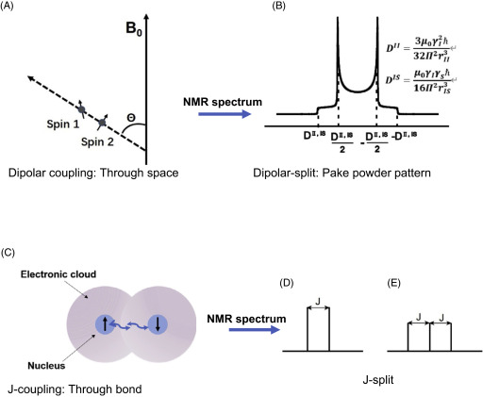
Physical Model: The Secular Dipolar Hamiltonian

Slide 4
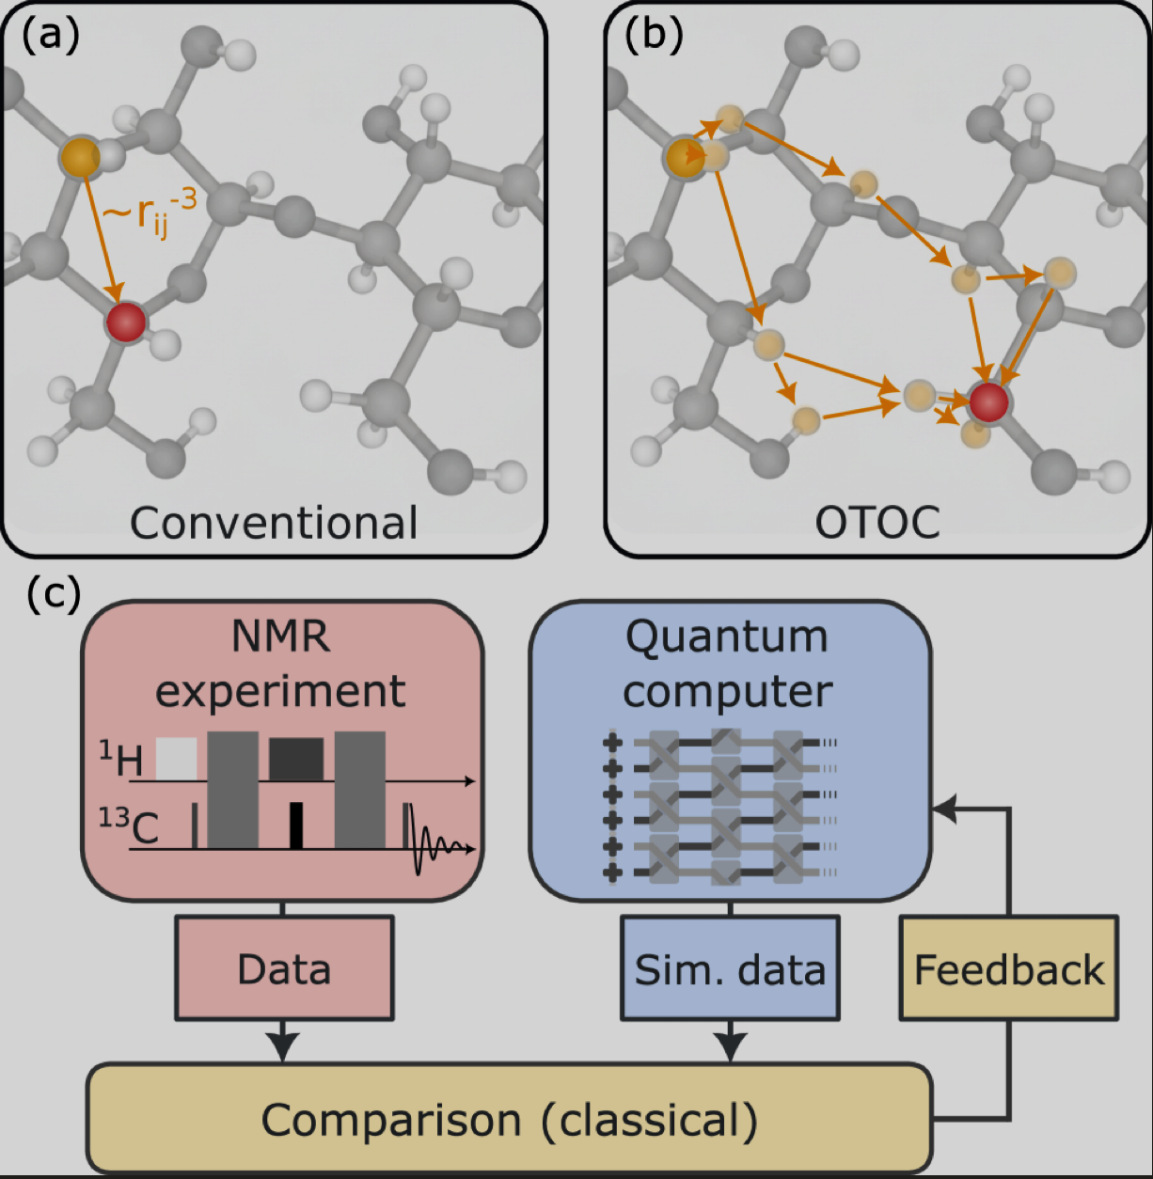
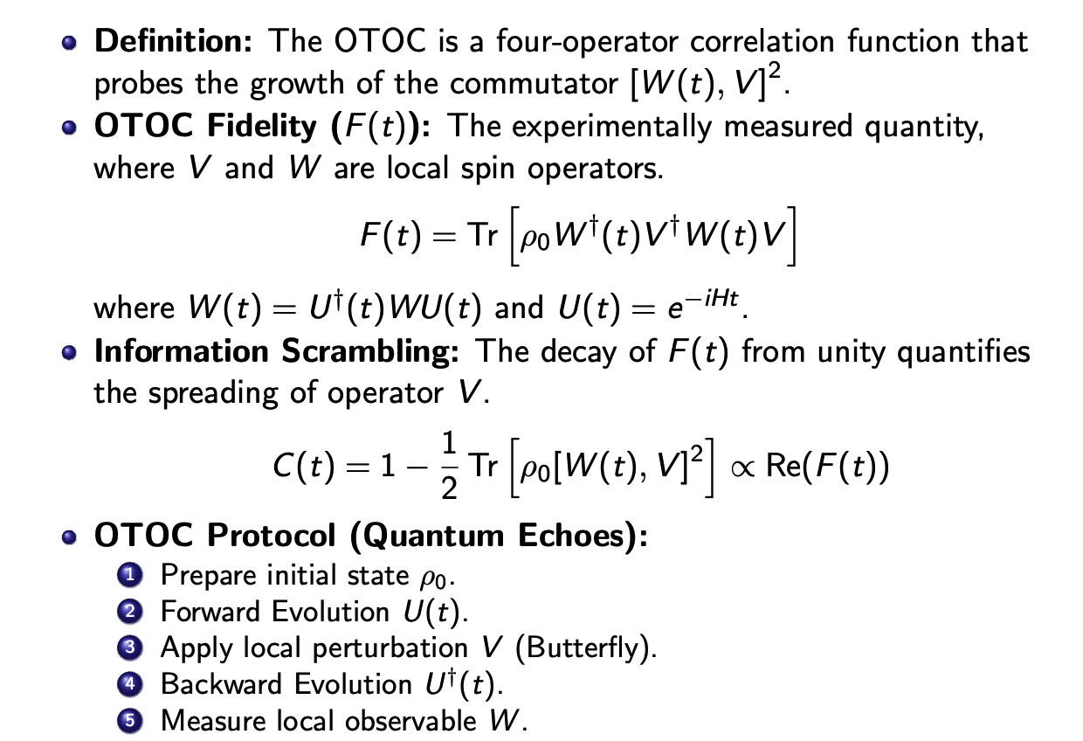
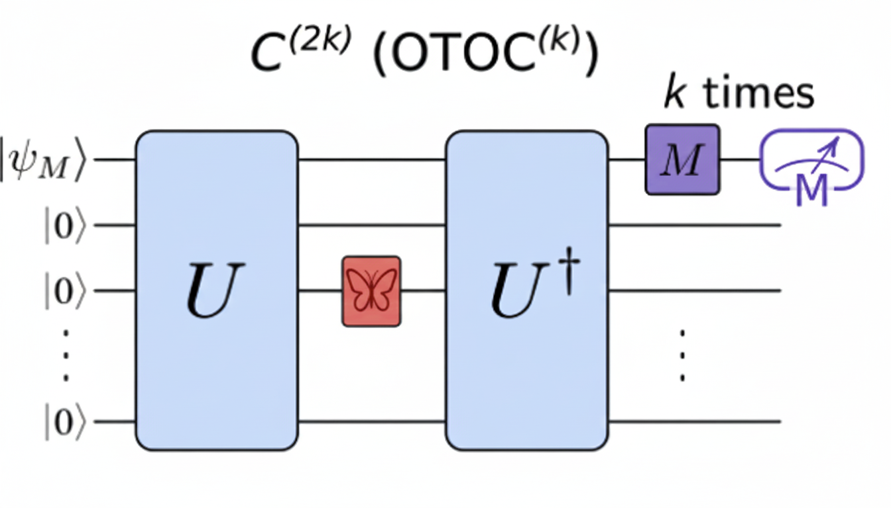
The Quantum Probe: Out of Time
Ordered Correlator (OTOC)

Slide 5
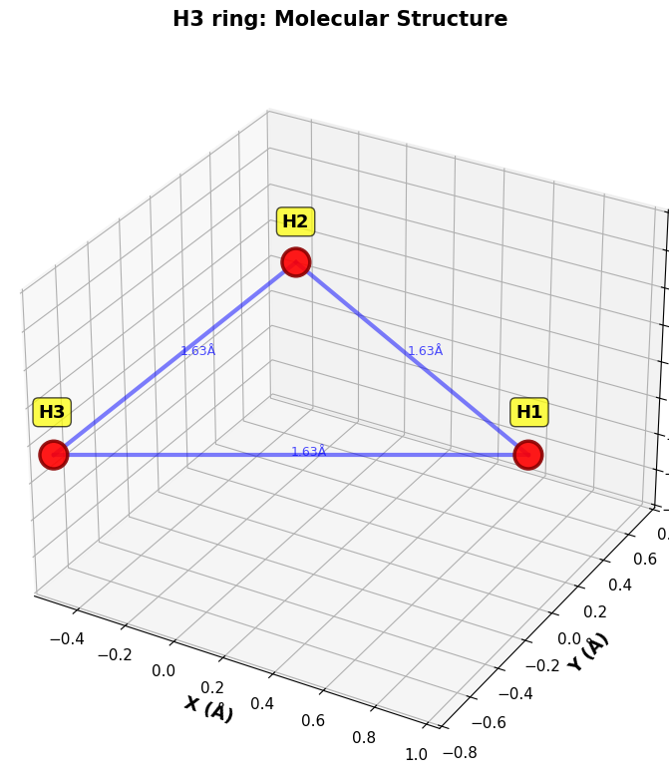
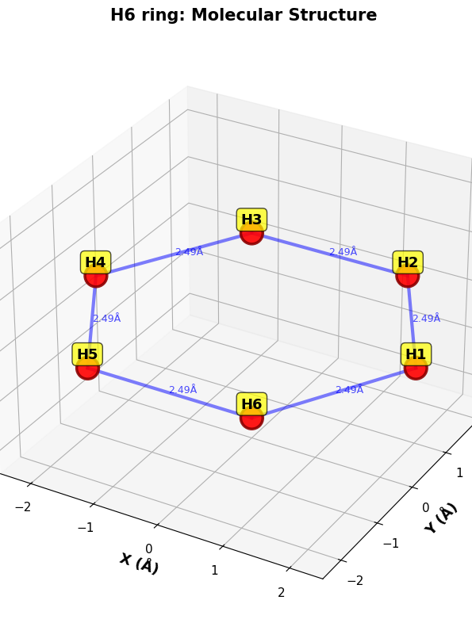
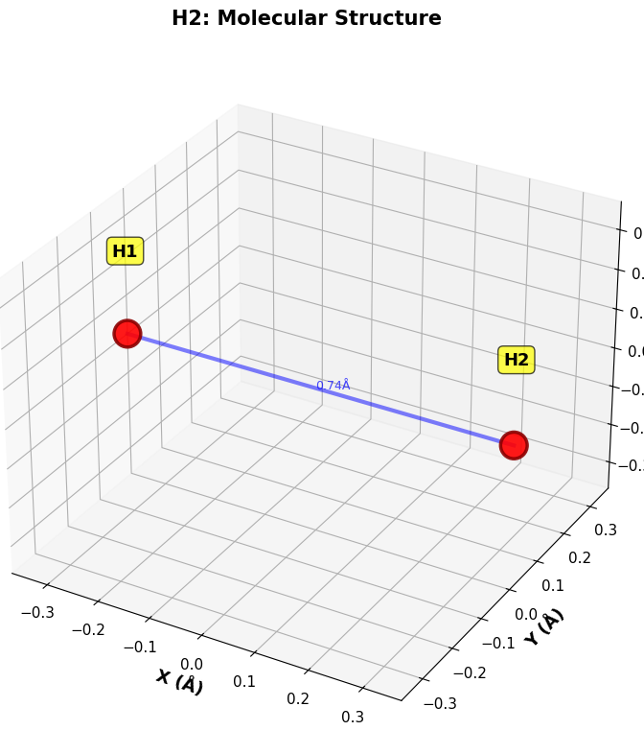
Simulation Samples (H2, H3, H6)
Systems Simulated
H2 Dimer (2 Qubits): Single coupling D01.
H3 Ring (3 Qubits): Equilateral triangle topology.
H6 Ring (6 Qubits): Benzene-like topology with complex, multiple
Simulation Parameters
H2 {n_qubits: 2, delta_nu: [0, 4000] Hz, J₁₂: 144 Hz, T₂: 0.50 s, dt: 20 µs, total_time: 0.50 s}
H3 {n_qubits: 3,delta_nu: [0, 3000, 6000] Hz,J₁₂=144 Hz, J₂₃=7 Hz, J₁₃=0 Hz, T₂: 0.35 s, dt: 20 µs, total_time: 0.60 s}
H6 {n_qubits: 6, delta_nu: [0,200,400,600,800,1000] Hz, J_ortho = 7.5 Hz, J_meta = 1.4 Hz, J_para = 0.6 Hz, T₂: 0.25 s, dt: 10 µs, total_time: 0.80 s}
Result
The OTOC signal exhibits a rapid, non-monotonic decay
whose features are directly determined by the inter-spin couplings,
confirming structural sensitivity

Slide 6
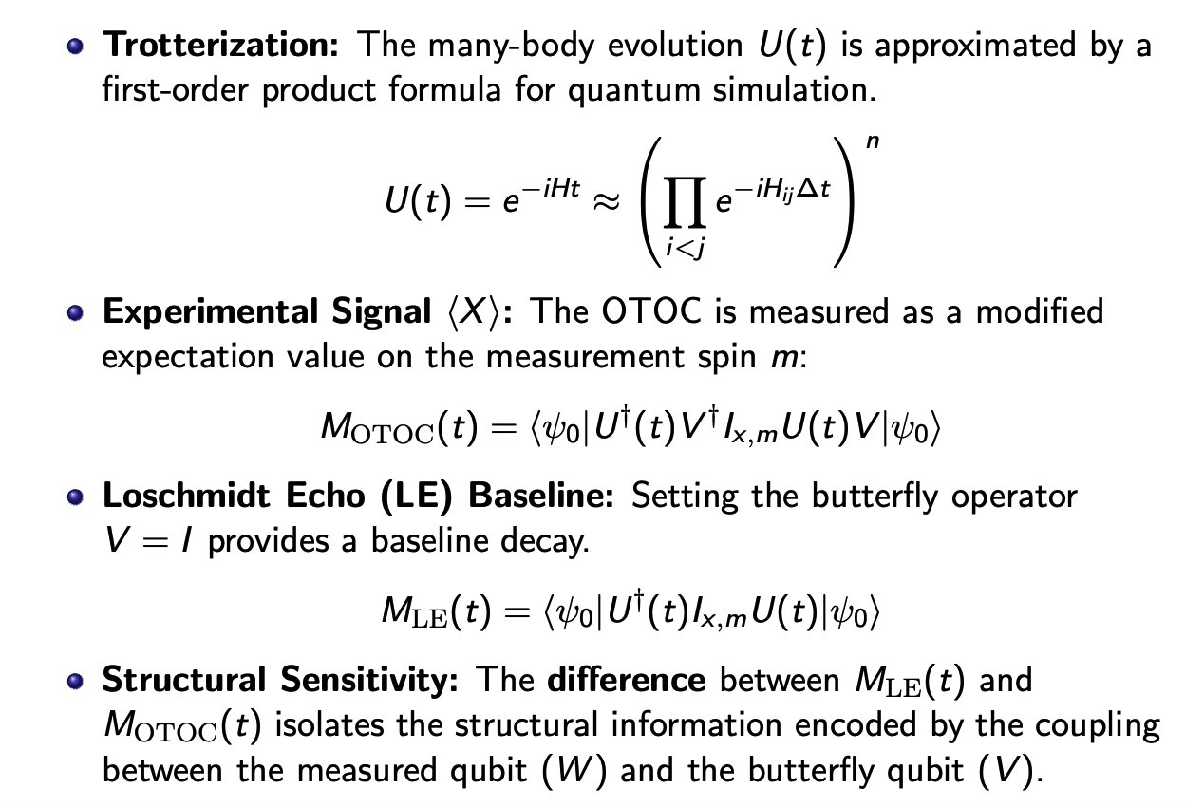
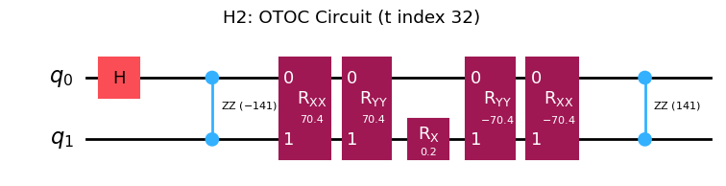
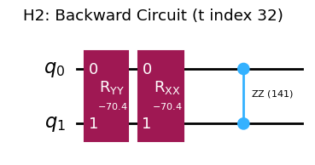
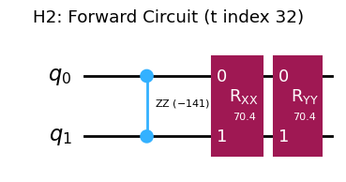
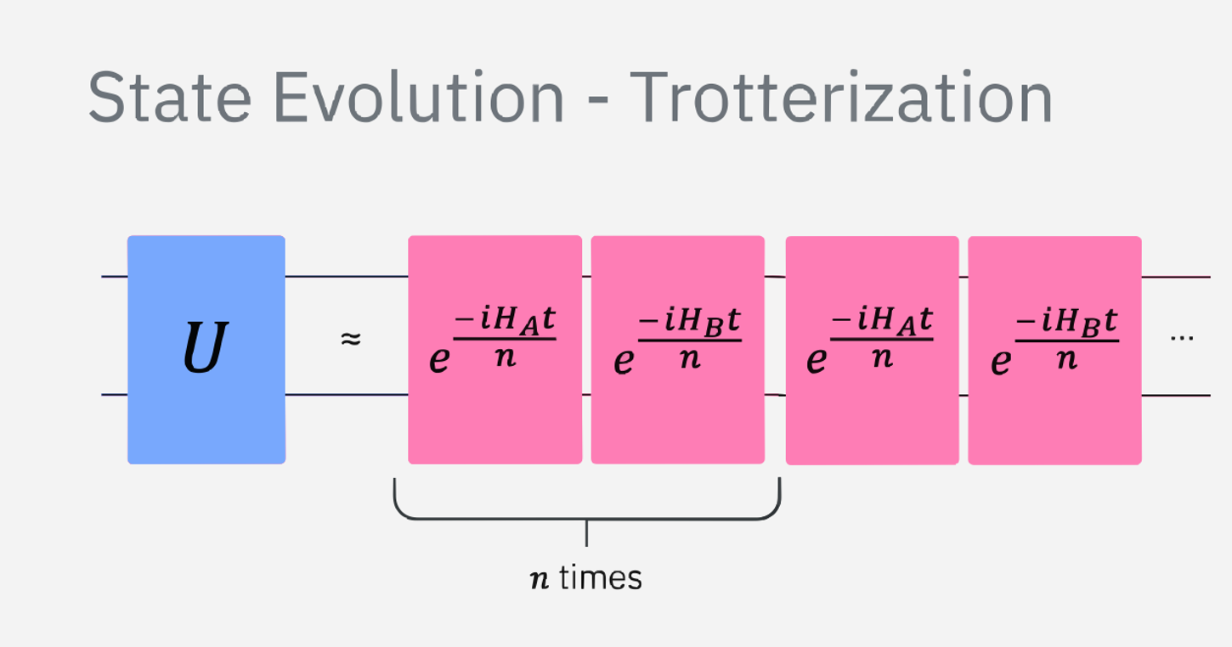
Quantum Implementation and Observable

Slide 7
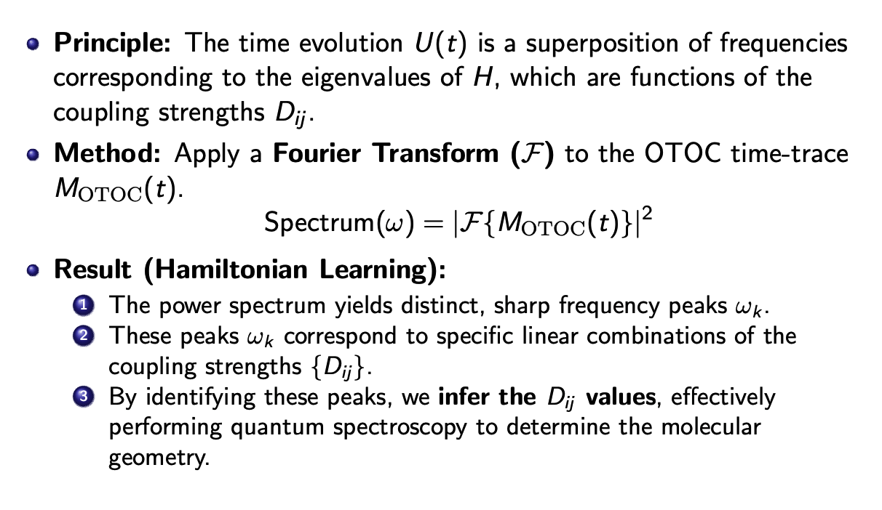
Data Analysis: Spectral Extraction of Couplings

Slide 8
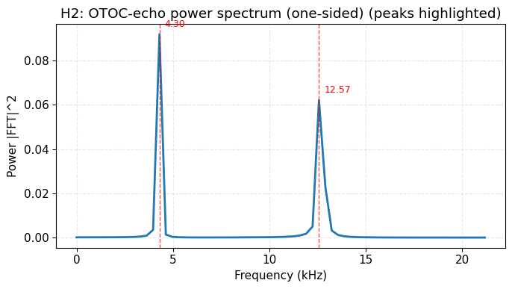
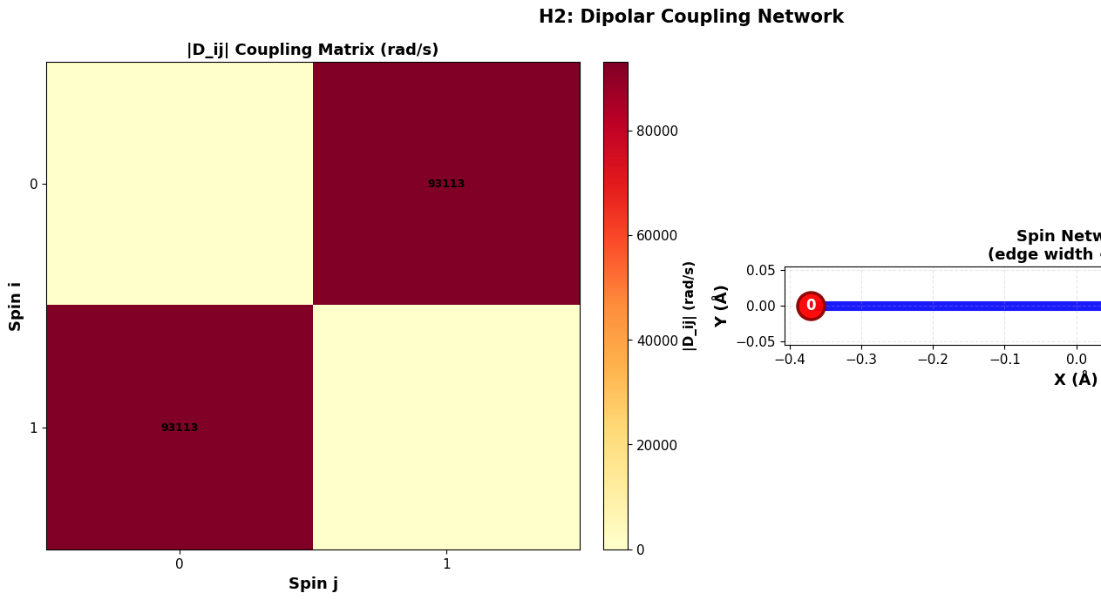
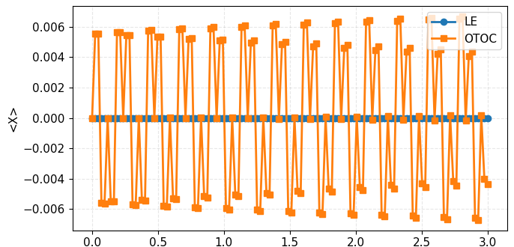
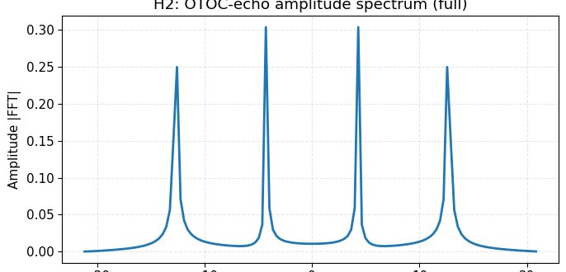

Slide 9
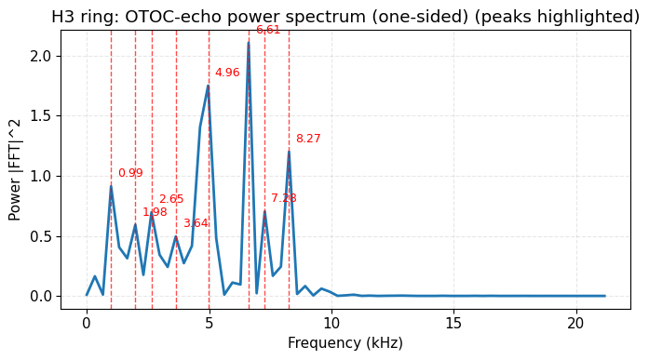
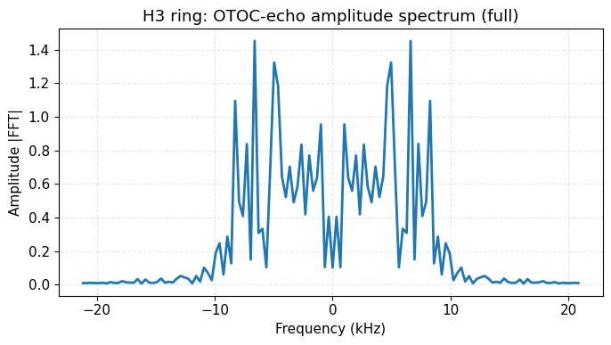
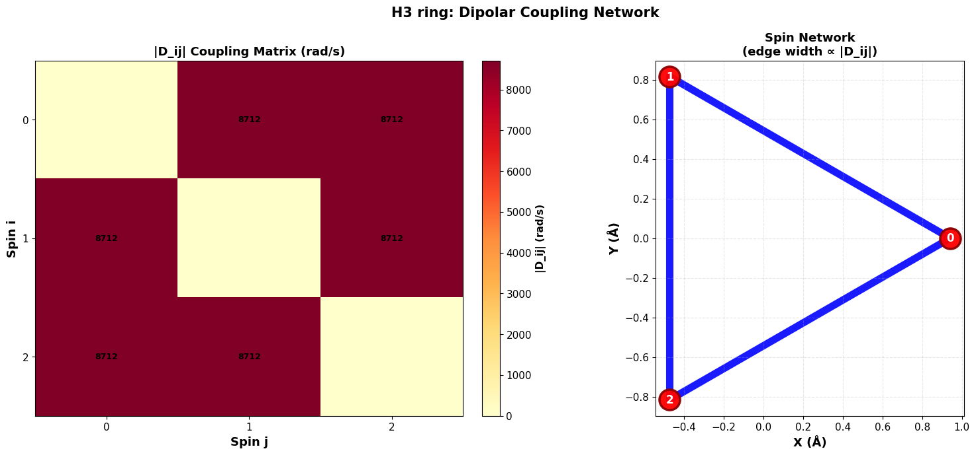
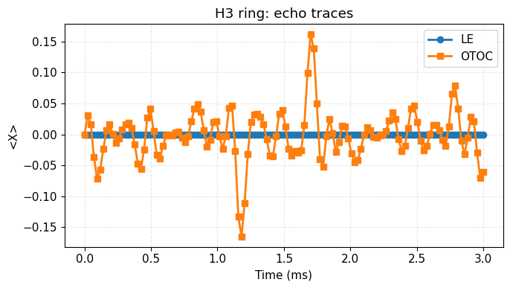

Slide 10
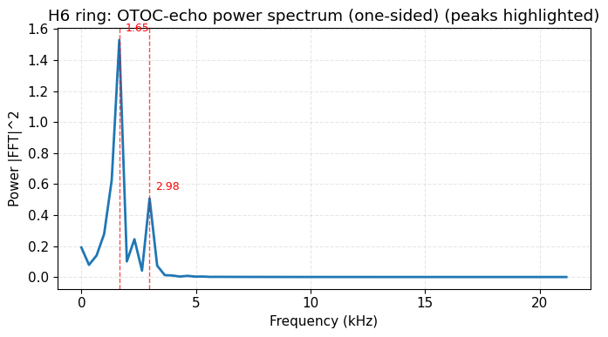
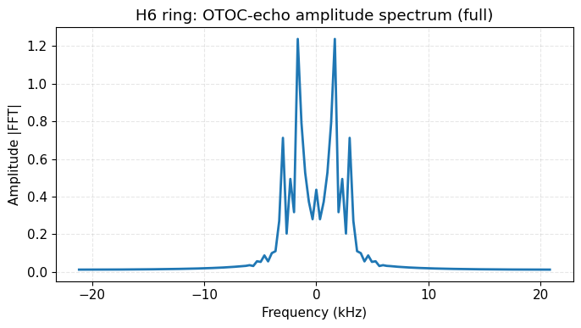
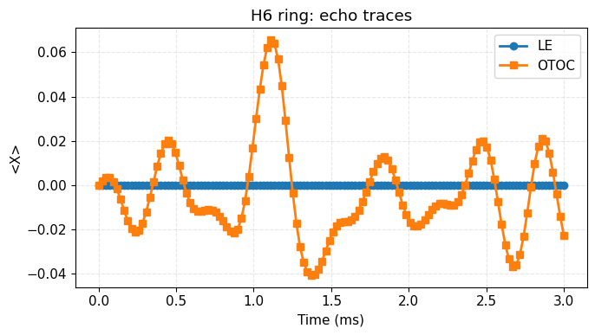
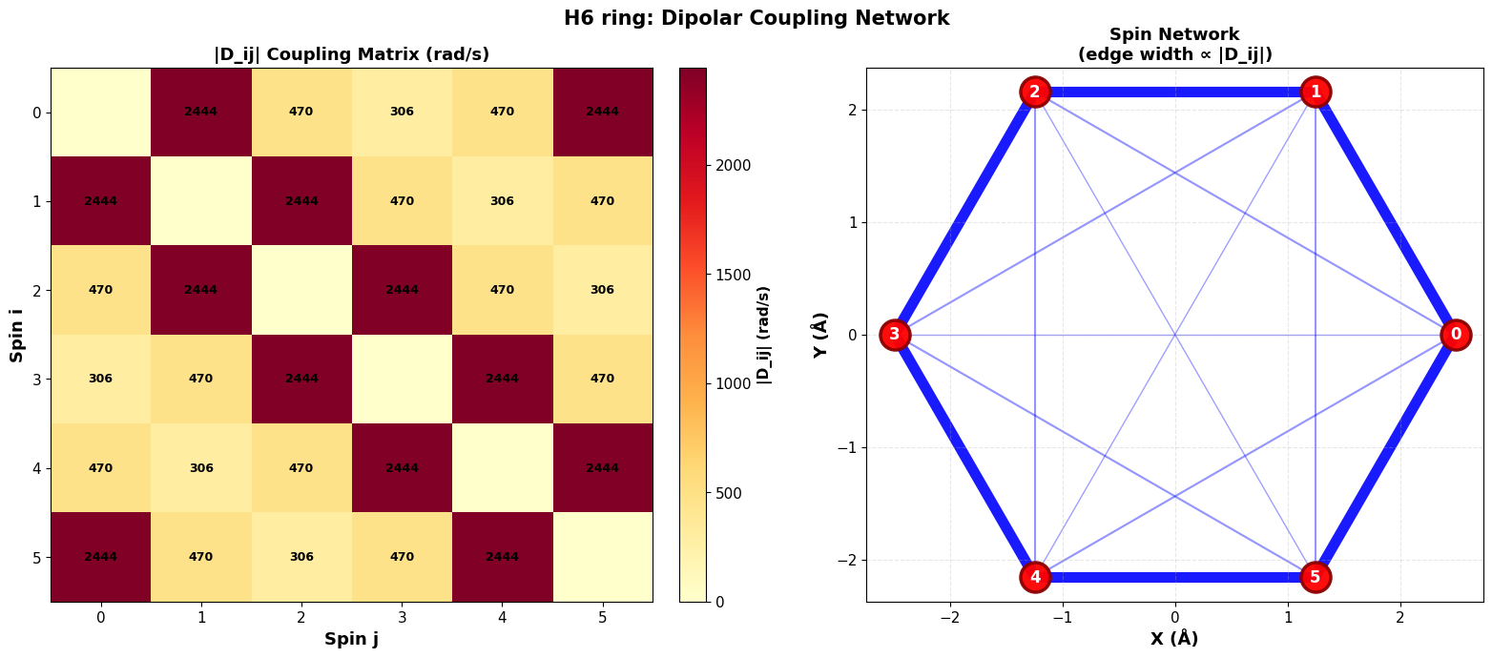

Slide 11
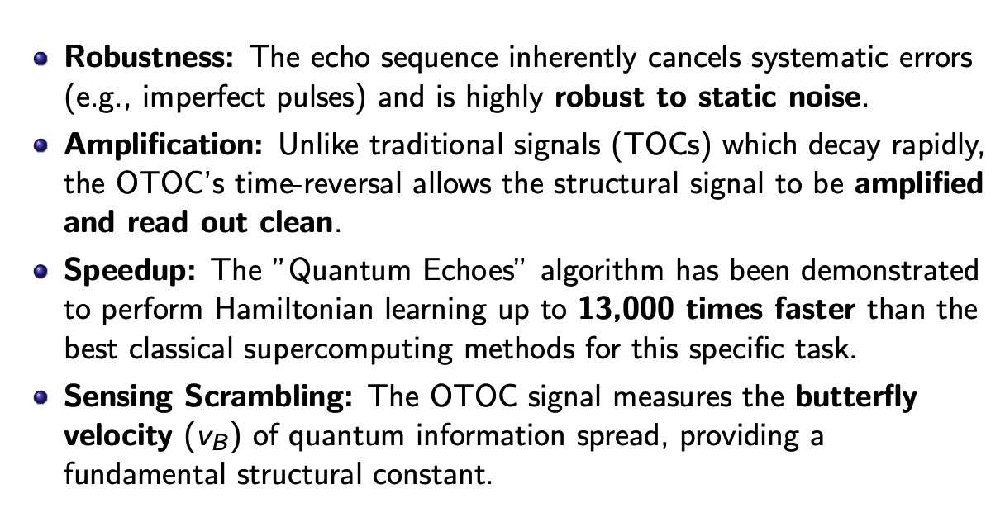
The Quantum Advantage, A Molecular Ruler

Slide 12
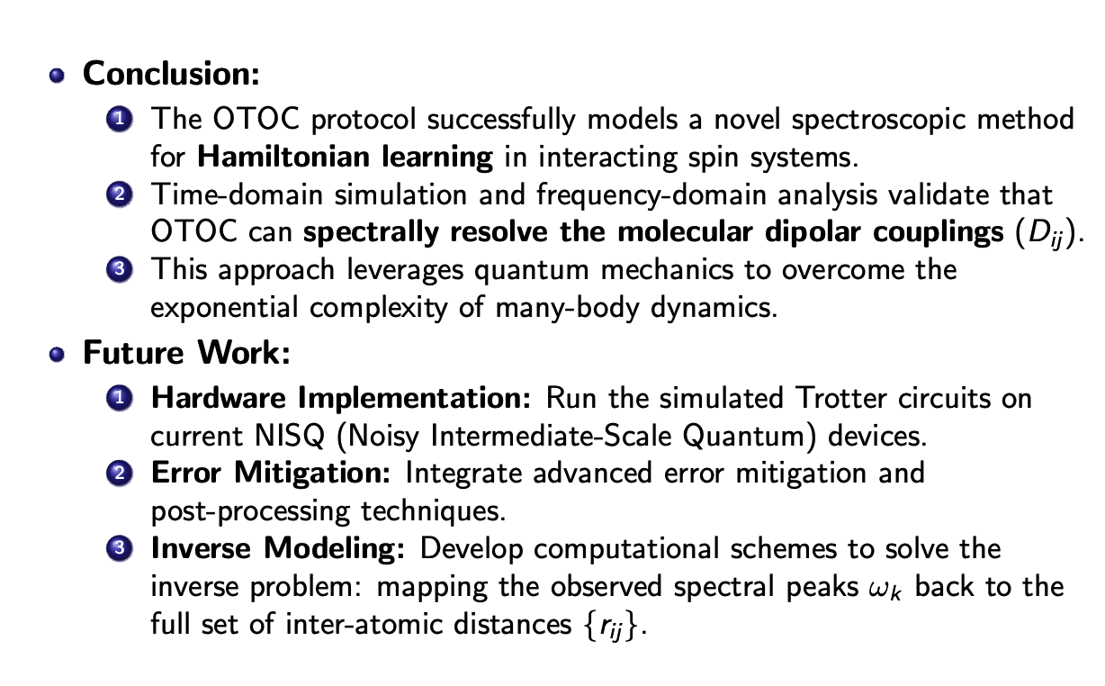
Conclusion and Future Direction

Slide 13
References
GitHub Repository
Observation of constructive interference at the edge of quantum ergodicity
Quantum computation of molecular geometry via many-body nuclear spin echoes

