Slide 1

JbTree
Tree principles
Algorithm
Implementation verification
Notes:
Vzdycky me zajimaly stromove struktury, v poslednim roce jsem mel prilezitost si imlementovat, povazuju to za zajimave, chtel bych se s tim podelit

Slide 2
Index
Tree B^{link} tree algorithm
Development
Microbenchmarks
Java Path Finder
Profiling

Slide 3
Why tree?
Trees are everywhere
  Indexes
  ...
High complexity
  Concurrency
  Transaction
  Locking
  …
  (ARIES/KVL and ARIES/IM:)
Interesting
Notes:
Databaze, cache, NonSQL uloziste …, Priklad, http sessions do db. Try google it. Jak rostli moznosti technicke, vice dat, vice souvislostii, (hierarchicke db systemy) Udajne dily na letadla,

Slide 4
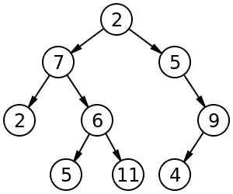
Tree taxonomy
Binary tree
B-tree
  Every node has at most m children.
  Every non-leaf node (except root) has at least ⌈m⁄2⌉ children.
  The root has at least two children if it is not a leaf node.
  A non-leaf node with k children contains k−1 keys.
  All leaves appear in the same level
B+ tree
  Nodes contains only keys
B*-tree same as B-tree
Notes:
Why tree? Fast inserts, fast search, relatively easy to implement structure, lot of enhancements

Slide 5
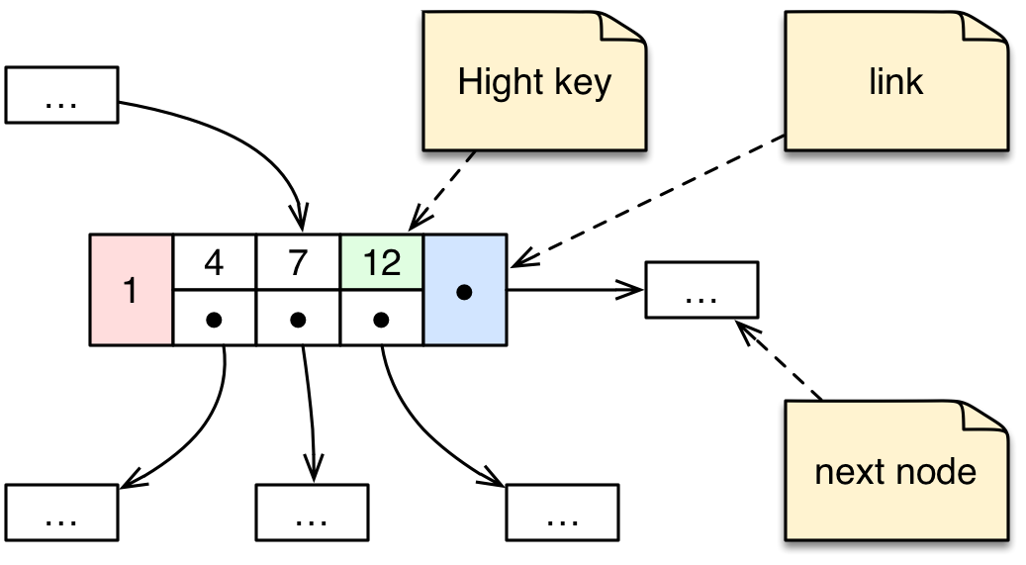
B^{link} tree - definition
Keys are in ascending order
K_{i-1} < v_{i} <= K_{i}
Node have link value
“Efficient Locking for Concurrent Operations on B-Trees”
Philip L. Lehman
S. Bing Yao
Nodes in store, copies in memory
Notes:
MySQL, PostgreSQL
Neni tam zminka o poctu klicu v nodu ;-)

Slide 6
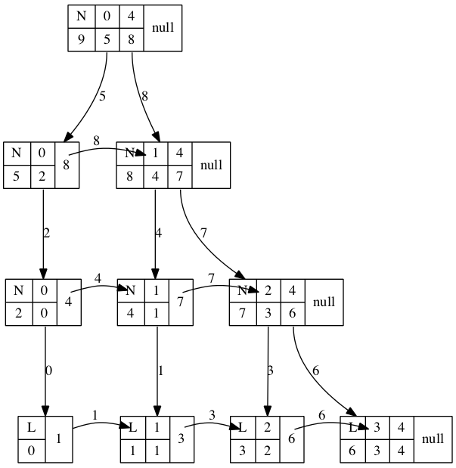
B^{link} tree – example tree snapshot
Graph viz

Slide 7
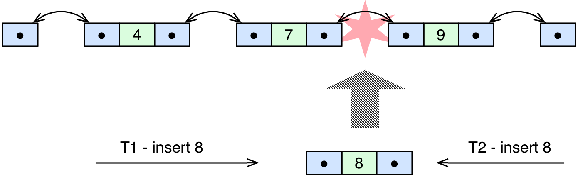
Thead safe locking - example
Locking order – consistent

Slide 8
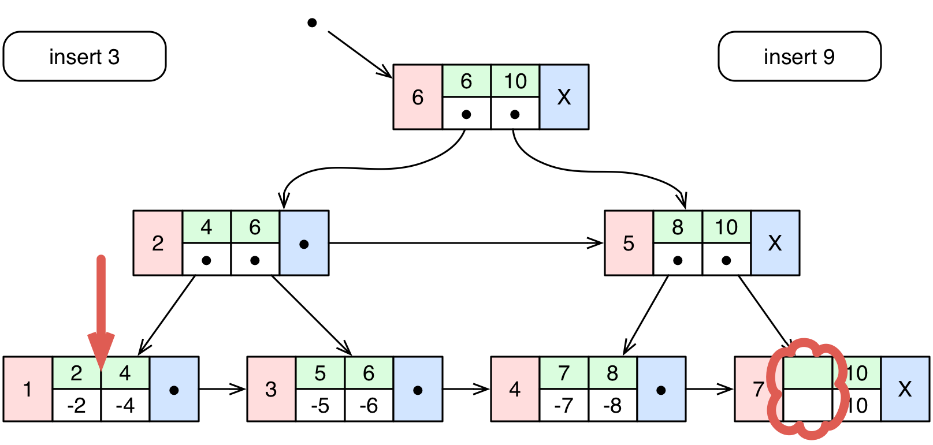
B^{link} tree – search & insert 1
Search, inserts (stack)

Slide 9
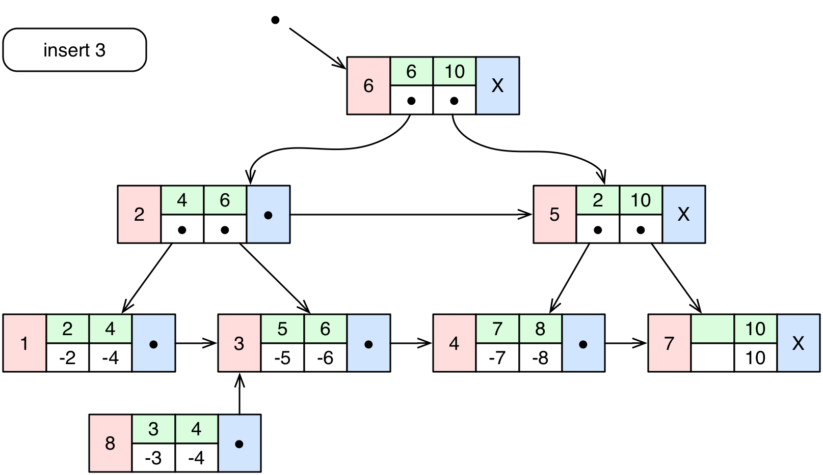
B^{link} tree – insert 2

Slide 10
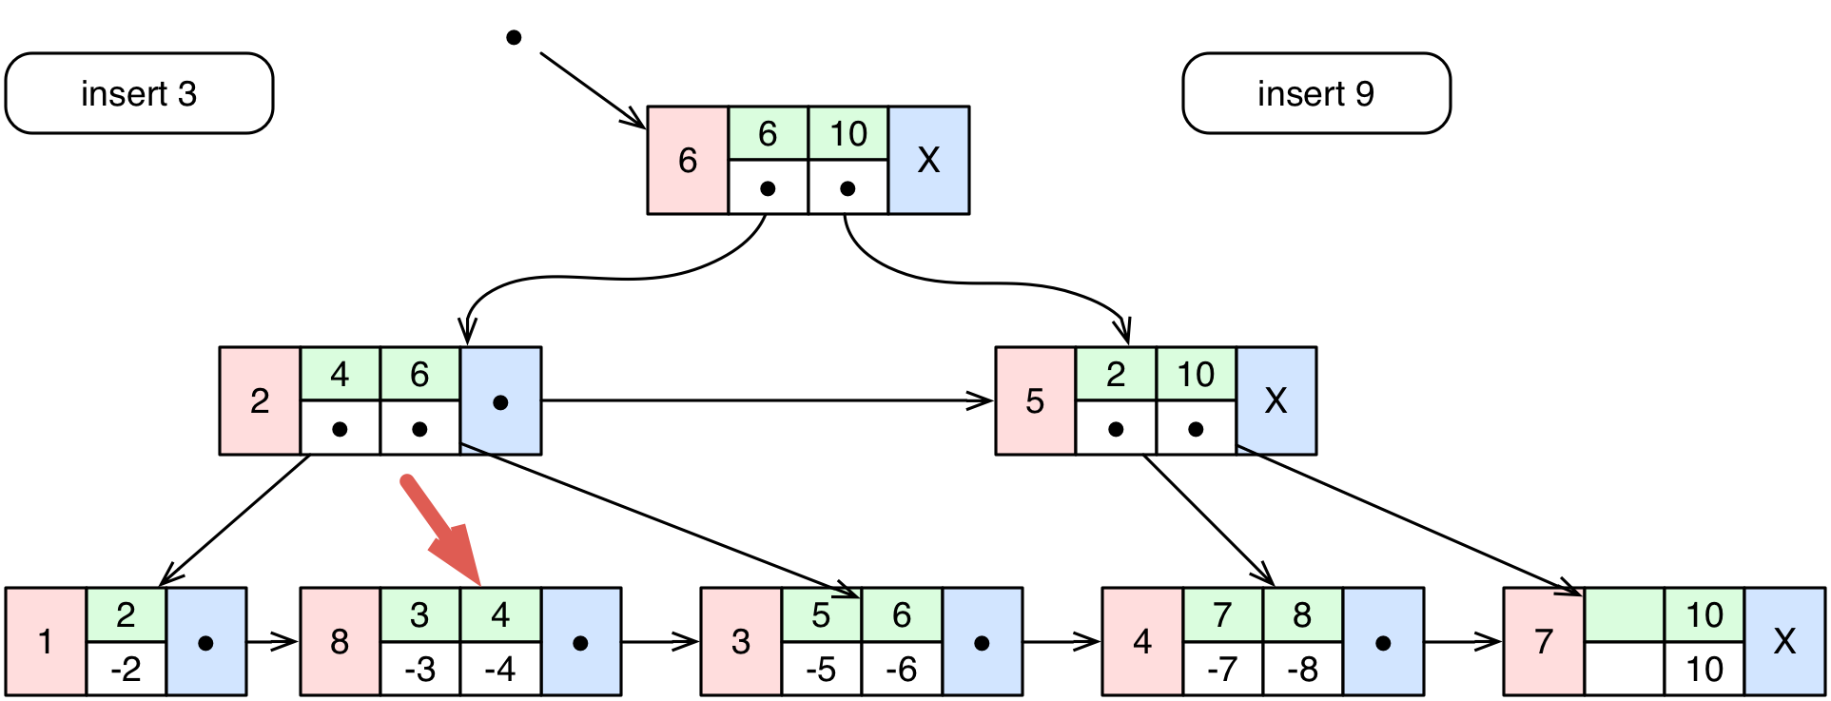
B^{link} tree – insert 3

Slide 11
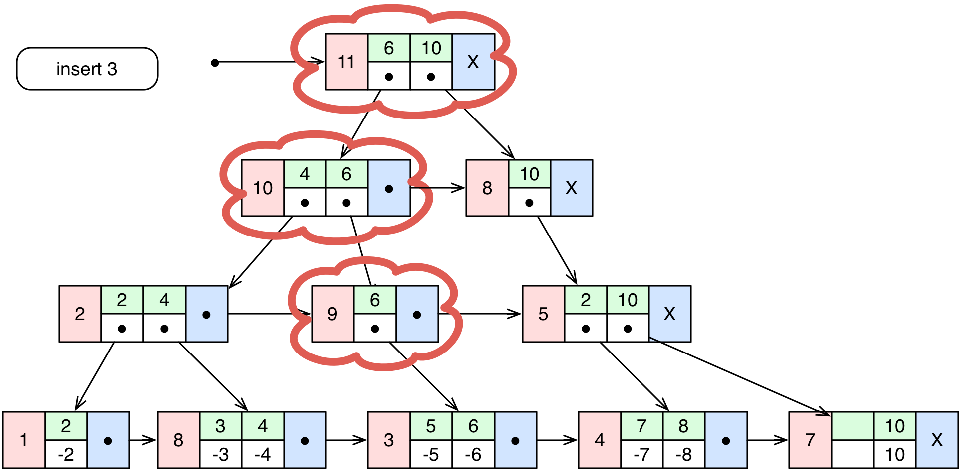
B^{link} tree – insert 4

Slide 12
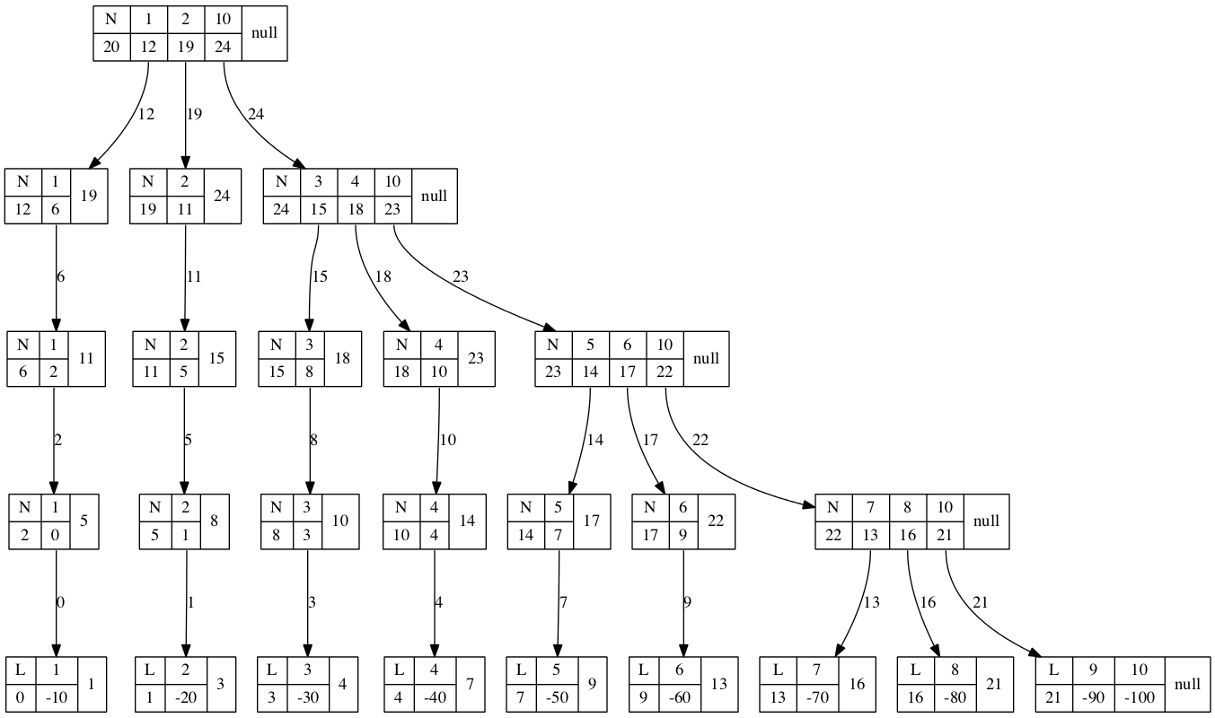
Algorithm limits
Incorrect data strcture
Notes:
Incorrect number max items in node, inserting ascending number sequence

Slide 13
B^{link} tree insert - conclusion
Formal algorithm proof
Not covered race conditions
  Root node splitting & locking
  Right nodes splitting
  Higher node id number propagating
  Deleting
Algorithm effectiveness
  Low numbers of key
  Inserting number sequence
  Max 3 locked nodes per thread
Notes:
Reseni lze dohledat v zdrojacich existujiich implementaci

Slide 14
Resources
https://en.wikipedia.org/wiki/B-tree

Slide 15
Development
Junit
Notes:
Je to o developmentu, ale nic vam o tom nereknu.

Slide 16
Development
It was fun!
Long term > 50h
Maven project
Old school JUnit tests
  80
  Extremely useful
  Preconditions
    Isolated problem
    No integration

Slide 17
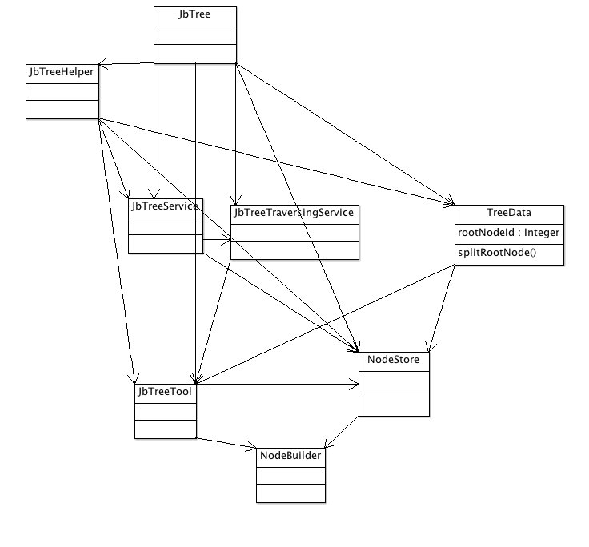
Java.util.Map implementation
Fluent API constructor
No 3rd party dependencies
ReentrantLock x synchronized
tree = TreeBuilder.builder().setL(2).setKeyType(Types.integer())
.setValueType(Types.integer()).build();
Notes:
Proc ne synchronized? Java 1.5 Rozdeleni lock, unlock, tryLock(Timeout) lock poling, fairness policy, better performance,
Kluci – jestli neco mate, dejte mi vedet pripravim si to

Slide 18
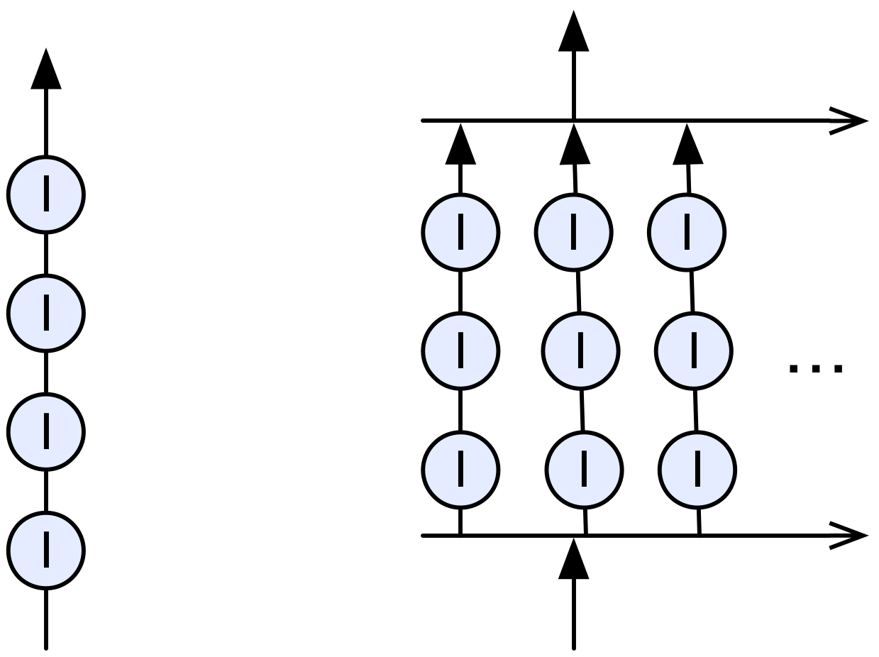
Testing
Easy to write
Easy to run
Basic verification
java.util.concurrent
  CountDownLatch
Performance
Memory consumption
  Depends on time, HW, …

Slide 19
JBLink project
Easy to use java.util.Map implementation
https://github.com/jajir/jblinktree
next steps
Notes:
Duration, Zaklad pro db indexy, ukazu pozdeji, db naivne zajimalal,
Rekl jsem si udelam si strom, proc?
Maven site ukazat + project na git hubu

Slide 20
Microbenchmarks
Verify code speed
http://openjdk.java.net/projects/code-tools/jmh/
Notes:
Souhrn

Slide 21
Microbenchmarks
Measure JVM
  Speed
    System.currentTimeMillis()
    System.nanoTime()
  Memory
    Runtime instance = Runtime.getRuntime();
    instance.freeMemory()
Microbenchmarks - JMH
  History (???)
  Usage
    Fluent API
    Annotation based
Notes:
NanoTime – CPU clocks cycles based
CurrentTimeMillis – related to date, not CPU
JMH
- eclipse plugin, pouze maven
- mereni v jave je nekolikata virtualizace, JVM, OS

Slide 22
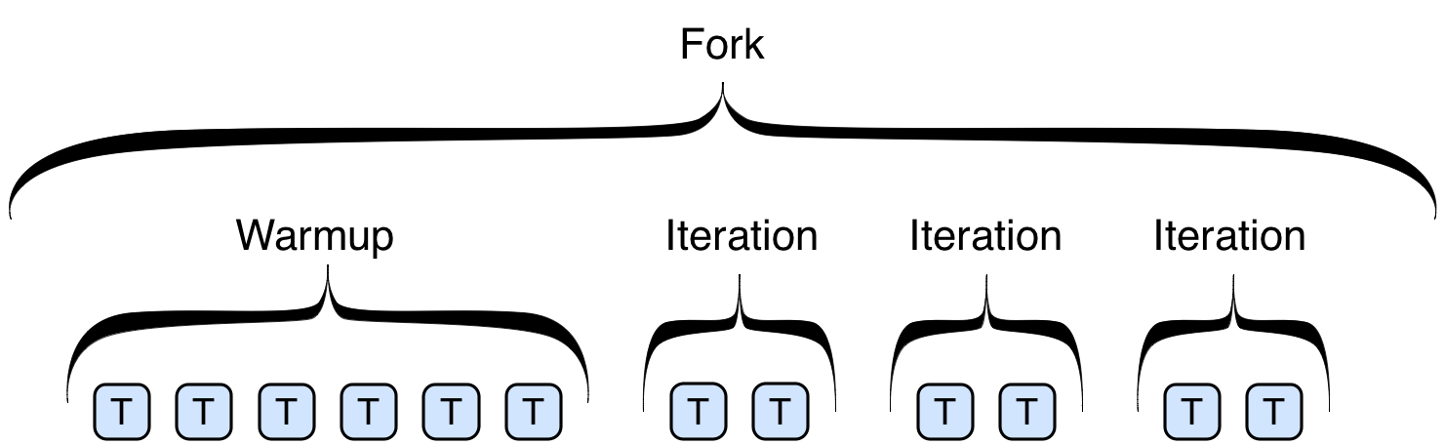
Benchmark – test structure
Why micro?
JVM
Notes:
Super priklady, chovani urcuje kombinace n annotaci a run time prepinacu, nekdy neni jasne, co bude test delat.

Slide 23
JMH - Configuration
Framework annotations
  Class
    @State(Scope.Benchmark, Group, Thread)
    @BenchmarkMode(Mode.AverageTime, Throughput)
    @OutputTimeUnit(TimeUnit.MILLISECONDS)
  Test method
    @Benchmark
    @Warmup(iterations = 1, batchSize = 1, time = 1)
    @TearDown
Fluent API
Options options = new OptionsBuilder()
.include(ExampleBenchmark.class.getSimpleName())
.mode(Mode.SingleShotTime)
.warmupMode(WarmupMode.INDI)
.warmupBatchSize(7)
.warmupIterations(1)
.warmupTime(TimeValue.NONE)
.threads(1)
.verbosity(VerboseMode.NORMAL)
.forks(1)
.measurementIterations(10)
.measurementBatchSize(100)
.measurementTime(TimeValue.NONE)
.jvmArgsAppend("-server", "-XX:+AggressiveOpts", "-dsa", "-Xbatch", "-Xmx1024m")
.build();
new Runner(options).run();
Notes:
Anotace, lze kombinovat libovolne, nekdy je to moc,

Slide 24
B^{link} tree benchmark – test conditons
Conditions
  Threads
    100
  Data
    File with random unique numbers
  Warmup
    100 000 or 1 000 000
  Measurement iterations
    1 sec of inserting
    10 times
  Forks
    5
Tested cases
Concurrent hash map
new ConcurrentHashMap<Integer, Integer>();
JbTree
TreeBuilder.builder().setL(10).setKeyType(Types.integer()).setValueType(Types.integer()).build();
Synchronized HashMap
Collections.synchronizedMap(new HashMap<Integer, Integer>());
Synchronized TreeMap
Collections.synchronizedMap(new TreeMap<Integer, Integer>());
Notes:
Anotace, lze kombinovat libovolne, nekdy je to moc,

Slide 25
B^{link} tree benchmark results 1/3
Tree params
  N 2
  Numbers 100 000
Collections.synchronizedMap(

Slide 26
B^{link} tree benchmark results 2/3
Tree params
  N 10
  Numbers 100 000

Slide 27
B^{link} tree benchmark results 3/3
Tree params
  N 10
  Numbers 1 000 000

Slide 28
Microbenchmarks - my opinion
premature optimization is the root of all evil
    Donald Knuth – 1974
Answer is:
  Understand performance model
  It's a micro benchmark
  Loot at technical recommendations
Notes:
"The First Rule of Program Optimization: Don't do it. The Second Rule of Program Optimization (for experts only!): Don't do it yet." — Michael A. Jackson
Jeste potrebuju upravit ???, aby to bylo rychlejsi.

Slide 29
Microbenchmarks - conclusion
Cons
  Not easy to setup test environment
  I wasn't able to measure memory consumption
  Results interpretation – don't trust numbers
Pros
  Nice results
    Repeatable
    Consistent (partially)
  Maven support
  Great java doc
Notes:
It's not easy to setup JMH.

Slide 30
Resources
https://github.com/google/caliper
http://www.clarkware.com/software/JUnitPerf.html
  Probably dead project
http://hg.openjdk.java.net/code-tools/jmh/file/bcec9a03787f/jmh-samples/src/main/java/org/openjdk/jmh/samples
  Examples
http://openjdk.java.net/projects/code-tools/jmh/
  Home

Slide 31
Java Path Finder
Static code analysis
Notes:
Dotknu se vice oblasti, ale ne vzdy popisu do detailu

Slide 32
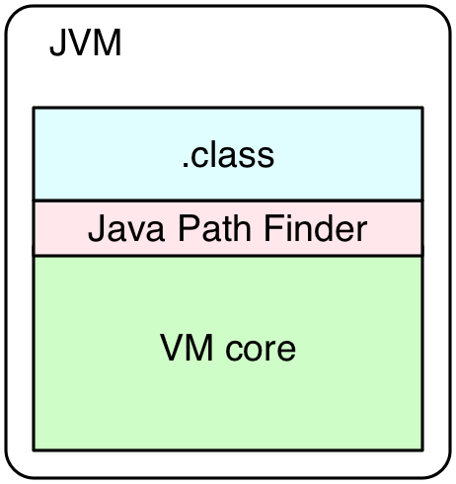
Java™ Pathfinder - JPF
History
  NASA, open sourced in 2005
Present
  Probably dead (2013)
Principle
  modular
Usage
  Depends on target
Notes:
Suverene nejslozitejsi nastroj, proto reknu nejmene

Slide 33
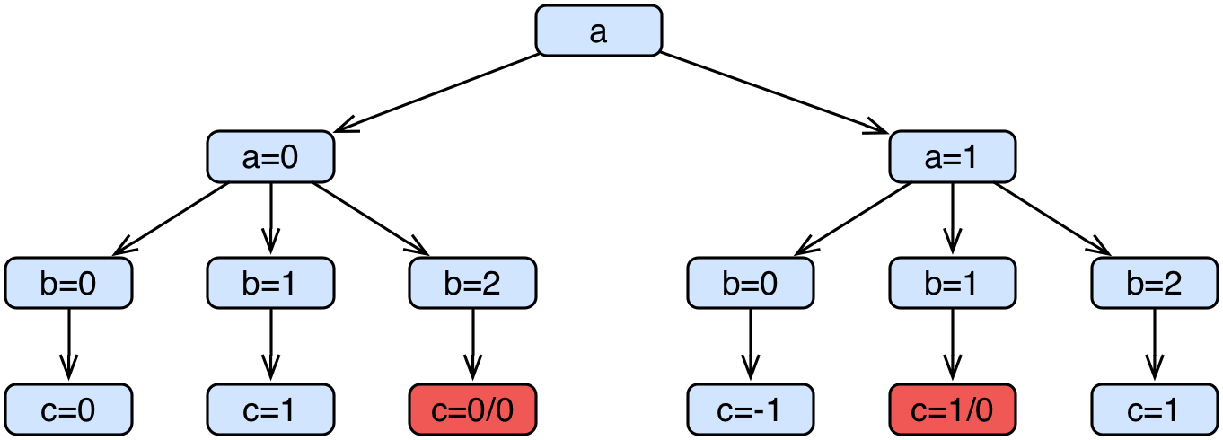
Simple example
public static void main(String[] args) {
Random random = new Random(42);
int a = random.nextInt(2);
int b = random.nextInt(3);
int c = a / (b + a - 2);
}

Slide 34
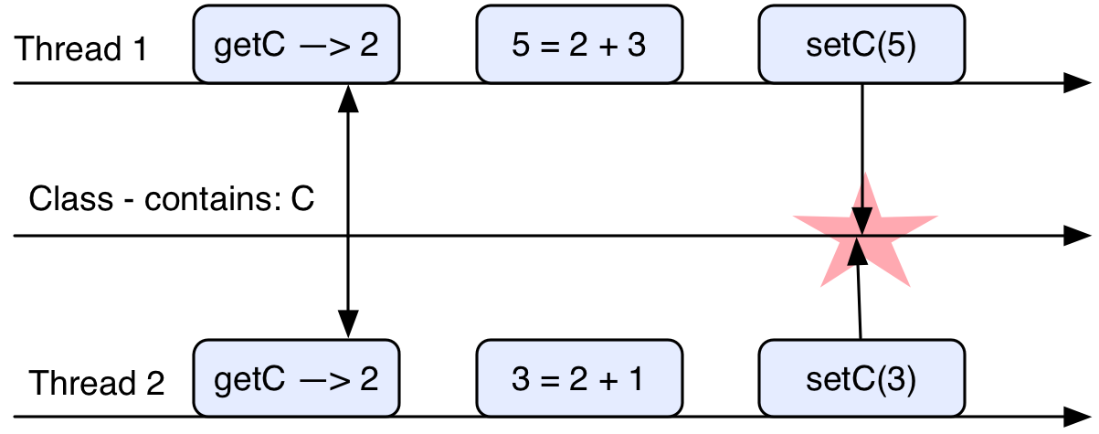
Thread safe
A piece of code is thread-safe if it only manipulates shared data structures in a manner that guarantees safe execution by multiple threads at the same time. (Wikipedia)
Notes:
Odmitnuti, nullPointer … porad to muze byt thread safe

Slide 35
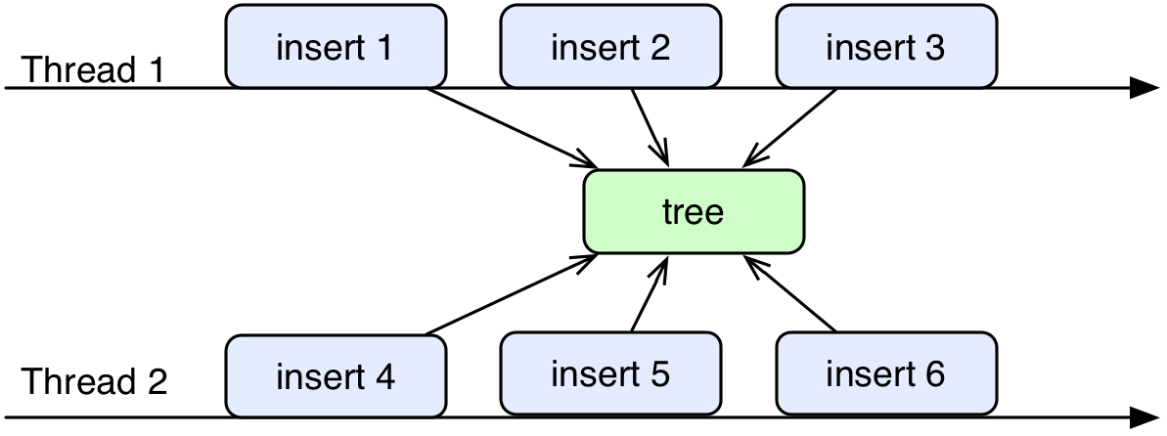
B^{link} tree - example
All permutations
  1,2,3,4,5,6
  1,2,3,4,6,5
  …
  6! - 720
JVM instructions
  All permutations, state explosion

Slide 36
Singleton - find the bug
public class ClassicSingleton {
private static ClassicSingleton instance = null;
public static ClassicSingleton getInstance() {
if(instance == null) {
instance = new ClassicSingleton();
}
return instance;
}
}

Slide 37
Conclusion
Pros
  Only way to prove thread-safe
Cons
  Complex
  State explosion
  Possibly dead project
Notes:
No binary distribution, install from sources

Slide 38
Resources
http://babelfish.arc.nasa.gov/trac/jpf/
https://groups.google.com/forum/#!forum/java-pathfinder

Slide 39
Profiling
Memory leaks detection
Speed bottle necks detection
Notes:
Dotknu se vice oblasti, ale ne vzdy popisu do detailu

Slide 40
JProfiler
Older than 2003
Allow o watch running JVM
Really useful

Slide 41
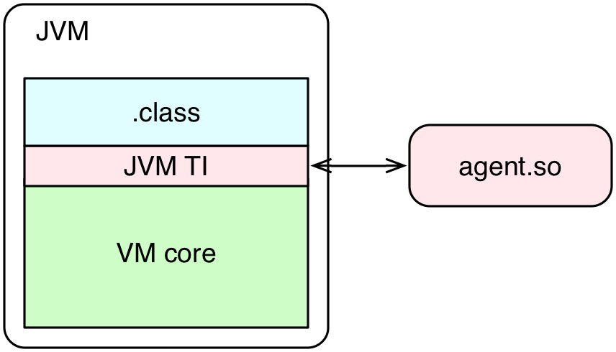
How it works
Java Virtual Machine Tools Interface - JVM TI
-agentpath:
From Java 5.0
Allows to control gc
Notes:
Based on registraton → events
Capabilities:
- replace class code
- JVM TI agents start before VM initialized
-JVM TI events can be sent before main()
-Allows VM configuration

Slide 42
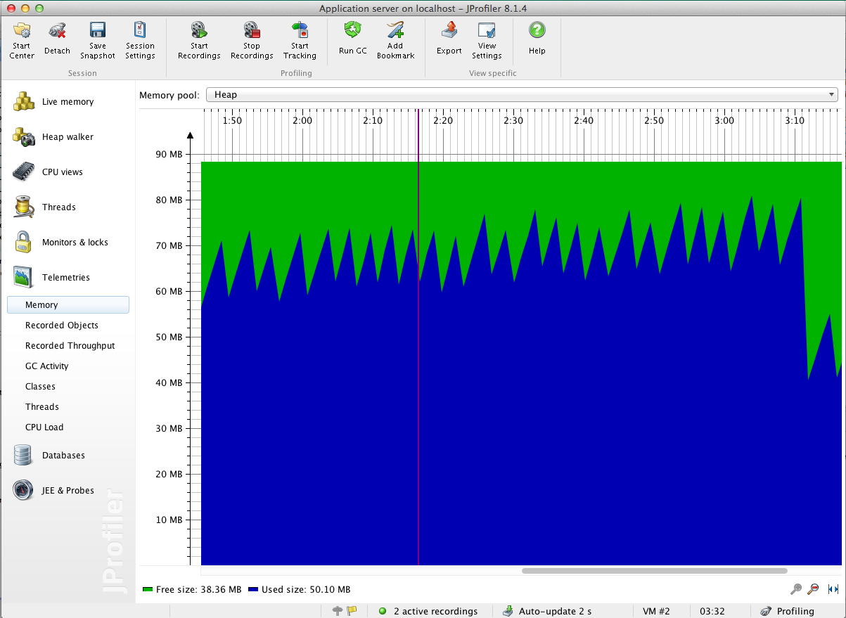
JVM - memory
Notes:
GC

Slide 43
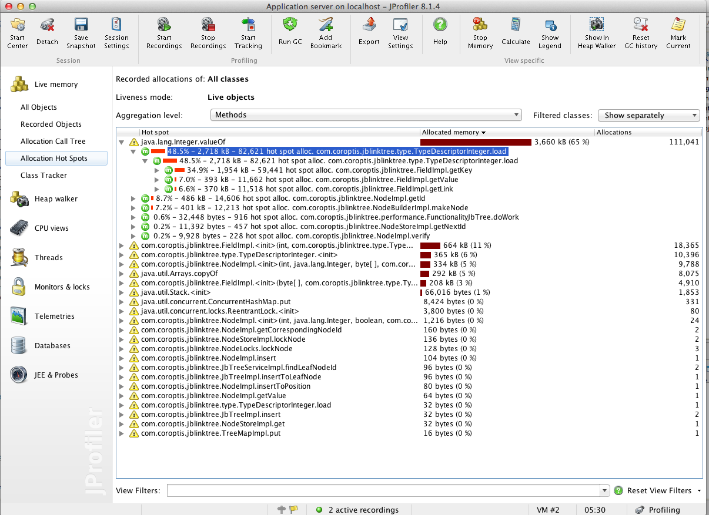
Method – total consumed time
Notes:
Extremely hungry

Slide 44
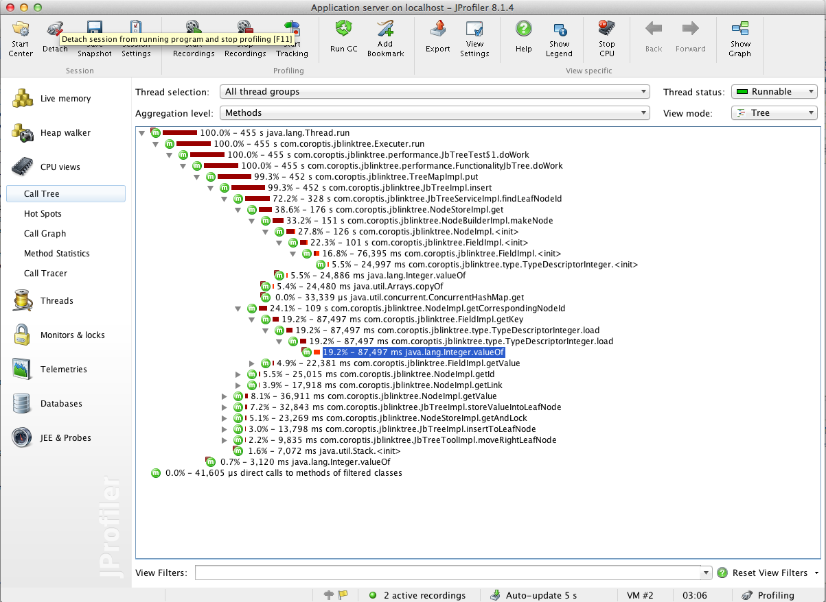
Call stack – time and number of calls

Slide 45
Conclusion
Pros
  Easy to use
  Easy to understand
  Really useful
  Live JVM access
Cons
  Extra load to measured JVM
  Expensive
  Agent installation for remote access
  Difficult to use in cluster

Slide 46
Resources
https://www.ej-technologies.com/products/jprofiler/overview.html
http://www.root.cz/clanky/pohled-pod-kapotu-jvm-sledovani-cinnosti-virtualniho-stroje-javy-pres-rozhrani-jvm-ti/
https://docs.oracle.com/javase/8/docs/technotes/guides/jvmti/
http://www.ibm.com/developerworks/java/library/j-jtp10264/

Slide 47
Last few words
...

Slide 48
State of development
Still not done
Lot of possible improvements
  Reduce boxing/unboxing (fields manipulations)
  Store nodes in better data structure
  Improve algorithm structure
  Reduce object creating
Make release
Documentation
Similar projects
  http://www.mapdb.org/
  https://github.com/OpenHFT/Koloboke

Slide 49
Conclusion
Time is worth less
It's pleasure
No one helps
Don't do it
Notes:
Proc jsem to delal? Je to jasn: je to zajimave

Slide 50
Q & A
...

