Slide 1

JbTree
Tree principles
Algorithm
Implementation verification
Notes:
Vzdycky me zajimaly stromove struktury, v poslednim roce jsem mel prilezitost si imlementovat, povazuju to za zajimave, chtel bych se s tim podelit

Slide 2
Index
Tree B^{link} tree algorithm
Development
Microbenchmarks
Java Path Finder
Profiling

Slide 3
Why tree?
Trees are everywhere
  Indexes
  ...
High complexity
  Concurrency
  Transaction
  Locking
  …
  (ARIES/KVL and ARIES/IM:)
Interesting
Notes:
Databaze, cache, NonSQL uloziste …, Priklad, http sessions do db. Try google it. Jak rostli moznosti technicke, vice dat, vice souvislostii, (hierarchicke db systemy) Udajne dily na letadla,

Slide 4
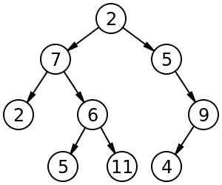
Tree taxonomy
Binary tree
B-tree
  Every node has at most m children.
  Every non-leaf node (except root) has at least ⌈m⁄2⌉ children.
  The root has at least two children if it is not a leaf node.
  A non-leaf node with k children contains k−1 keys.
  All leaves appear in the same level
B+ tree
  Nodes contains only keys
B*-tree same as B-tree
Notes:
Why tree? Fast inserts, fast search, relatively easy to implement structure, lot of enhancements

Slide 5
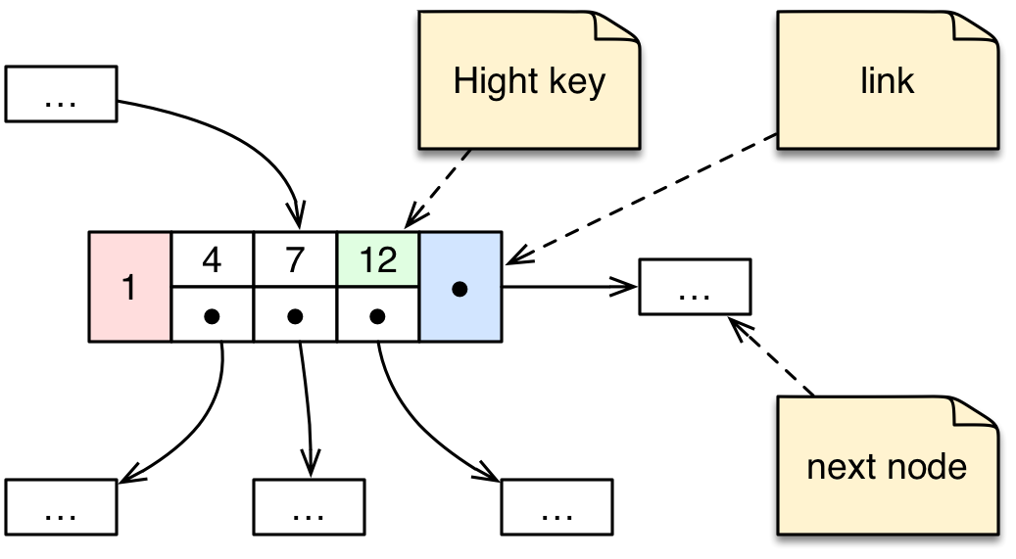
B^{link} tree - definition
Keys are in ascending order
K_{i-1} < v_{i} <= K_{i}
Node have link value
“Efficient Locking for Concurrent Operations on B-Trees”
Philip L. Lehman
S. Bing Yao
Nodes in store, copies in memory
Notes:
MySQL, PostgreSQL
Neni tam zminka o poctu klicu v nodu ;-)

Slide 6
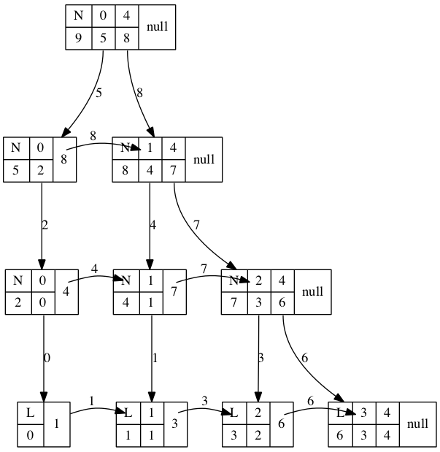
B^{link} tree – example tree snapshot
Graph viz

Slide 7
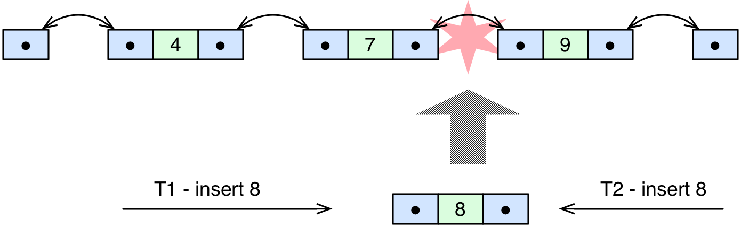
Thead safe locking - example
Locking order – consistent

Slide 8
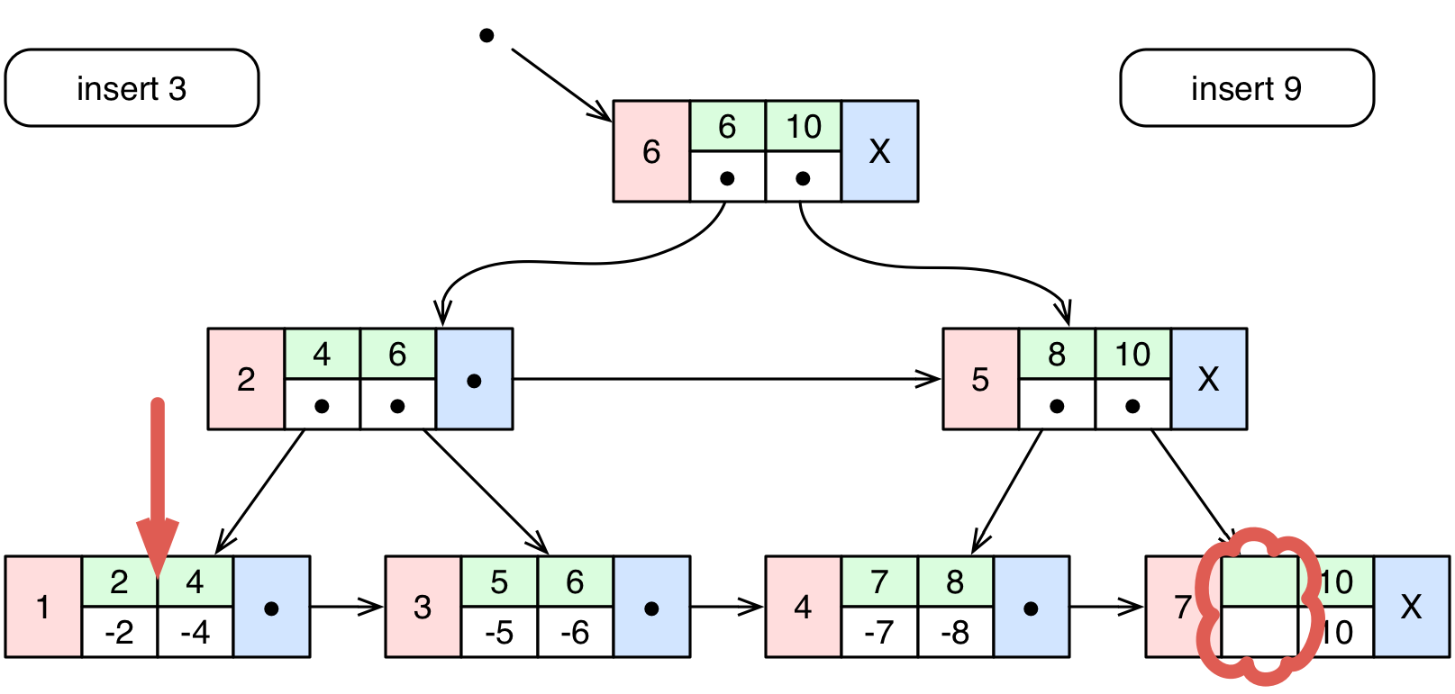
B^{link} tree – search & insert 1
Search, inserts (stack)

Slide 9
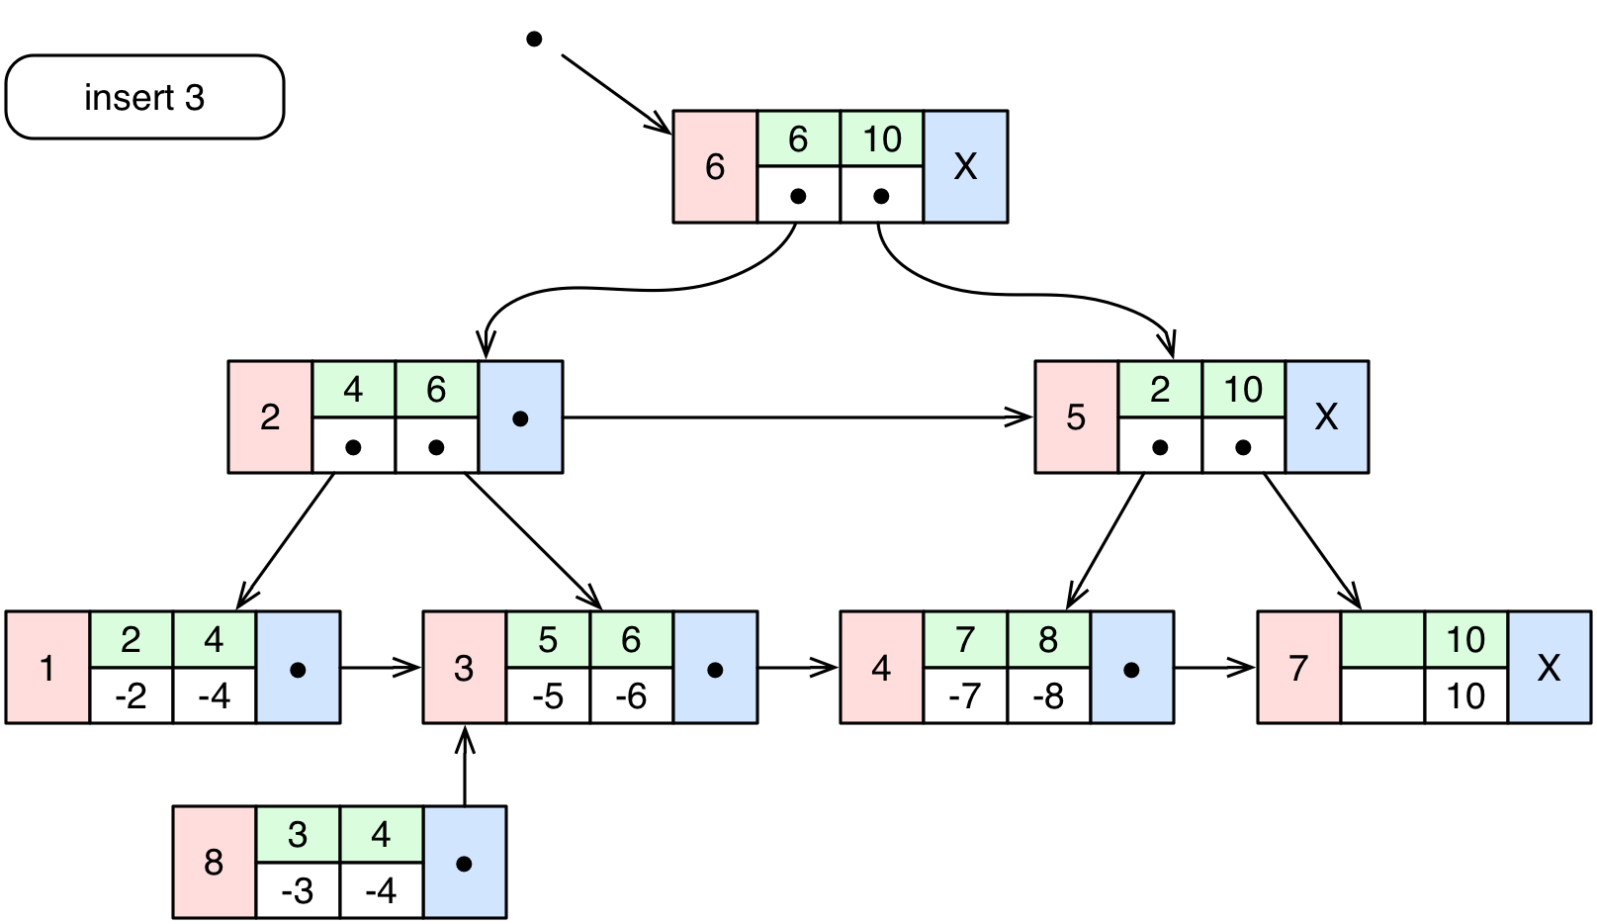
B^{link} tree – insert 2

Slide 10
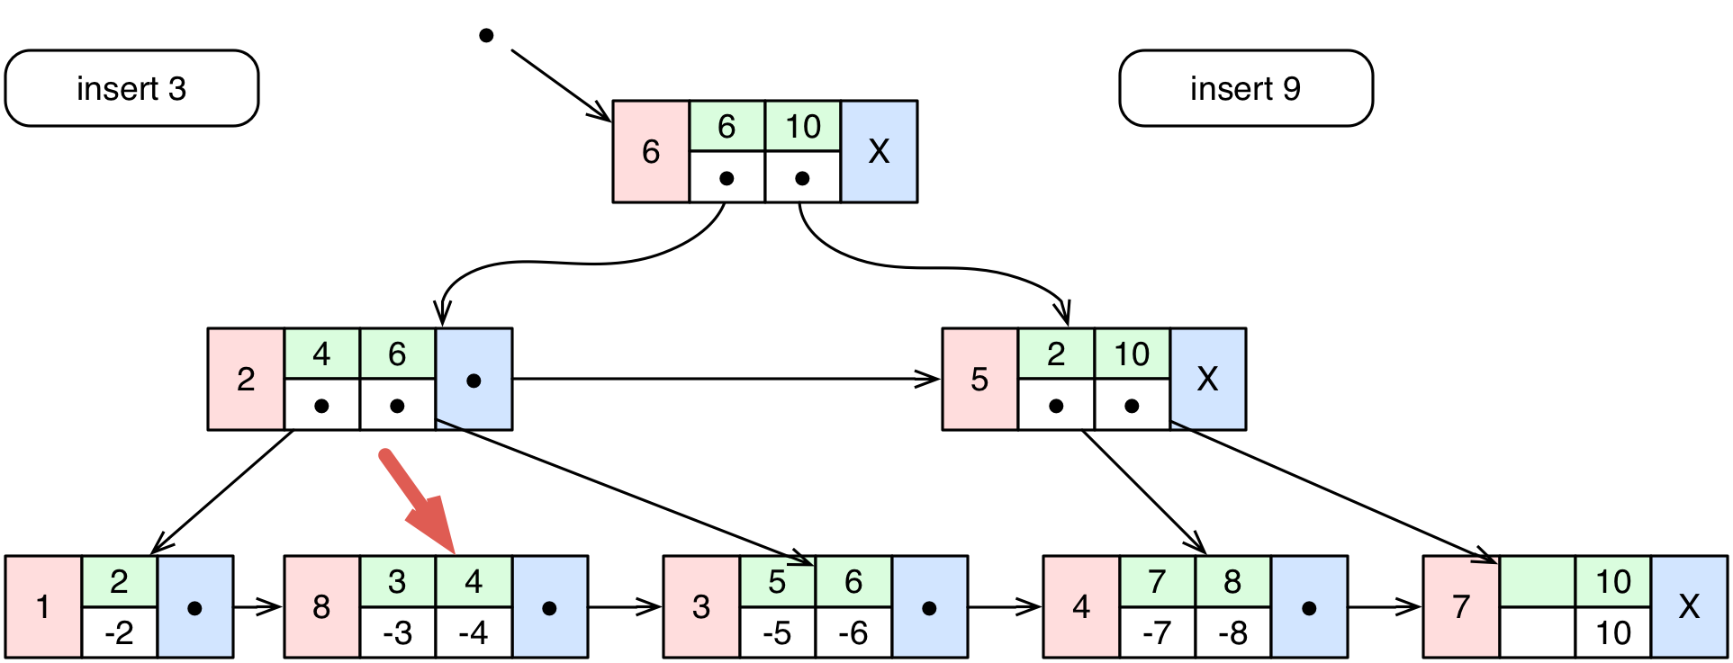
B^{link} tree – insert 3

Slide 11
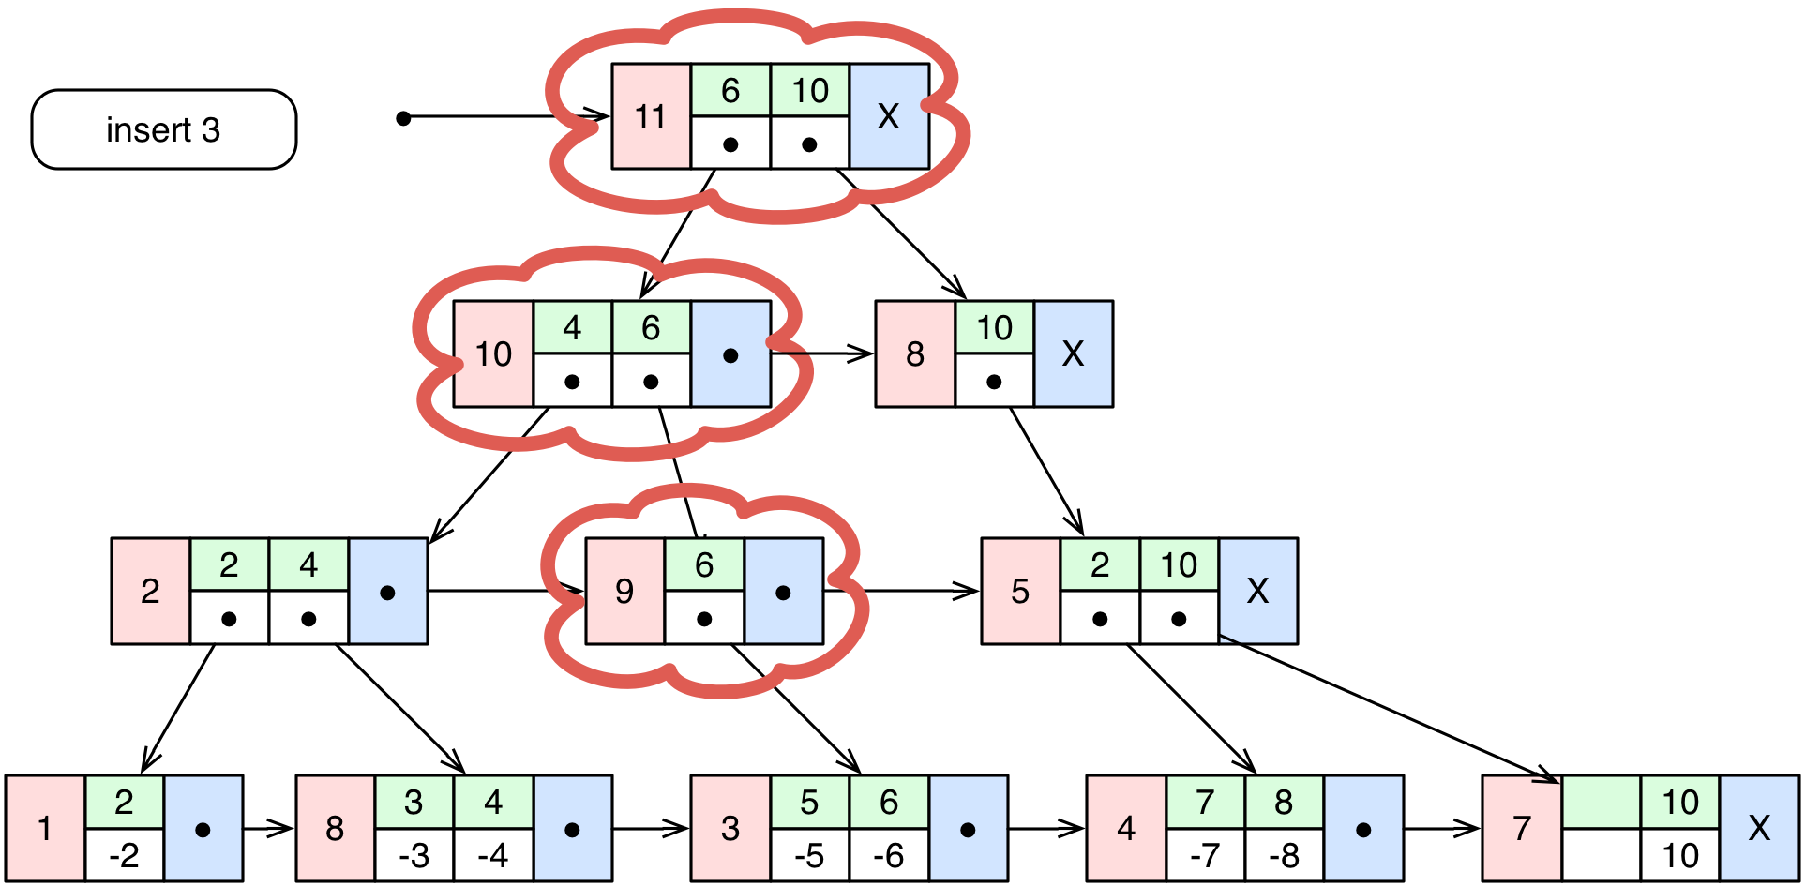
B^{link} tree – insert 4

Slide 12
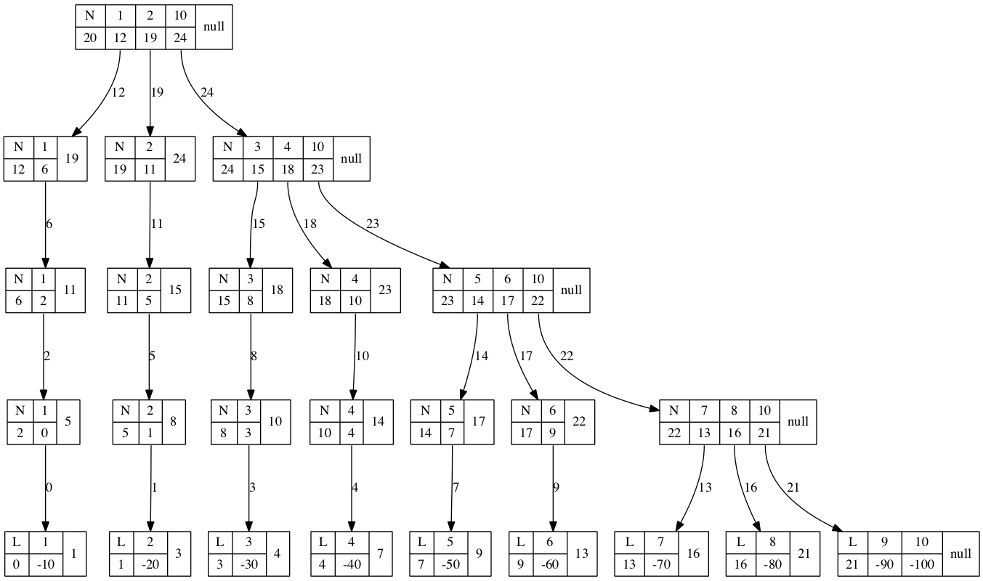
Algorithm limits
Incorrect data strcture
Notes:
Incorrect number max items in node, inserting ascending number sequence

Slide 13
B^{link} tree insert - conclusion
Formal algorithm proof
Not covered race conditions
  Root node splitting & locking
  Right nodes splitting
  Higher node id number propagating
  Deleting
Algorithm effectiveness
  Low numbers of key
  Inserting number sequence
  Max 3 locked nodes per thread
Notes:
Reseni lze dohledat v zdrojacich existujiich implementaci

Slide 14
Development
Junit
Notes:
Je to o developmentu, ale nic vam o tom nereknu.

Slide 15
Development
It was fun!
Long term > 50h
Maven project
Old school JUnit tests
  80
  Extremely useful
  Preconditions
    Isolated problem
    No integration

Slide 16
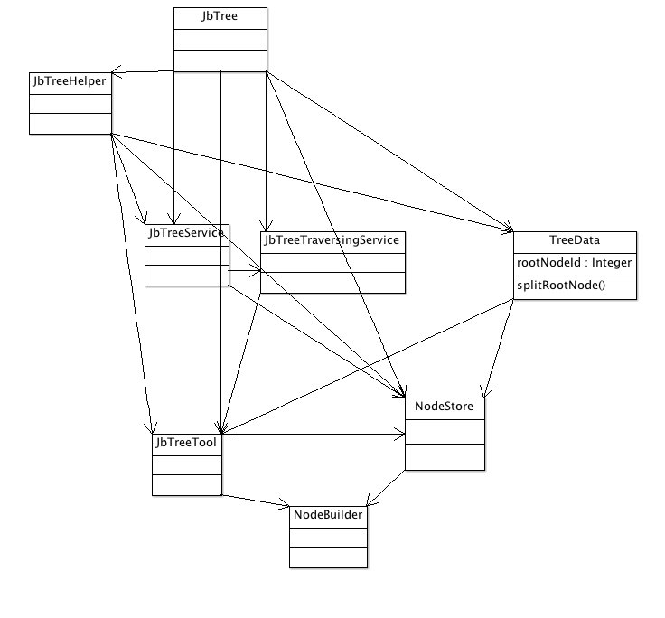
Java.util.Map implementation
Fluent API constructor
No 3rd party dependencies
ReentrantLock x synchronized
tree = TreeBuilder.builder().setL(2).setKeyType(Types.integer())
.setValueType(Types.integer()).build();
Notes:
Proc ne synchronized? Java 1.5 Rozdeleni lock, unlock, tryLock(Timeout) lock poling, fairness policy, better performance,
Kluci – jestli neco mate, dejte mi vedet pripravim si to

Slide 17
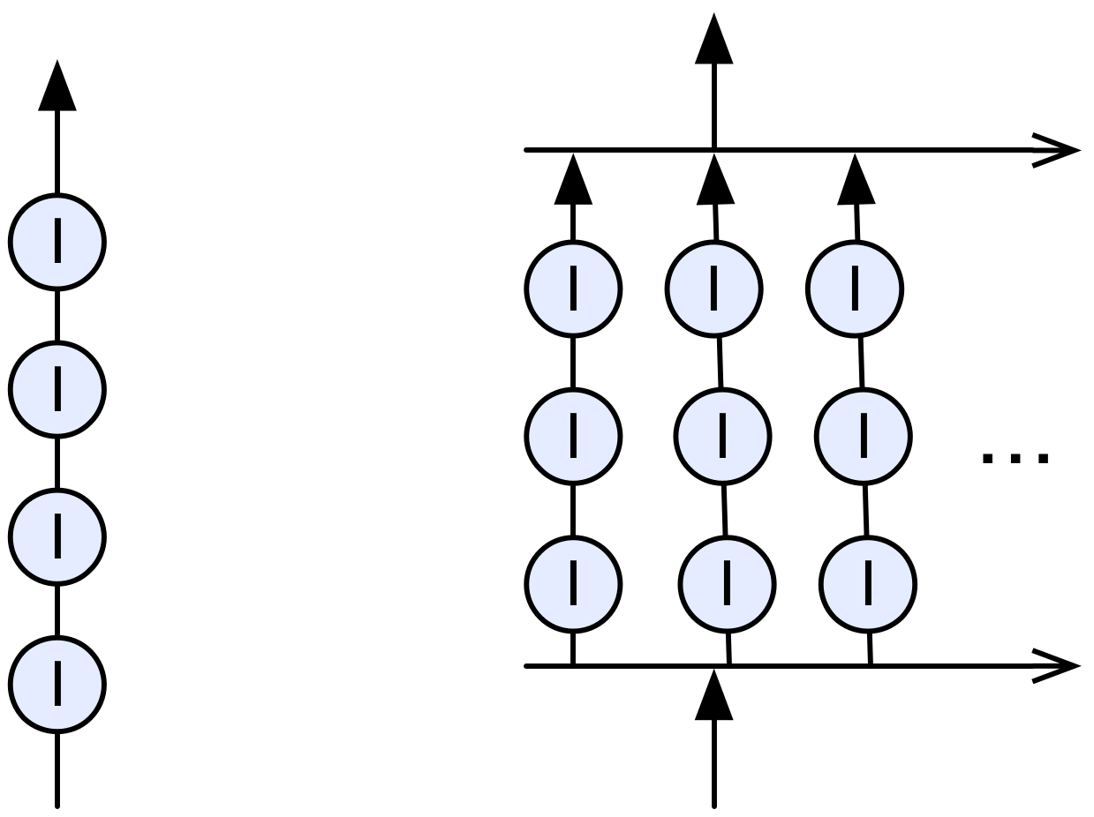
Testing
Easy to write
Easy to run
Basic verification
java.util.concurrent
  CountDownLatch
Performance
Memory consumption
  Depends on time, HW, …

Slide 18
JBLink project
Easy to use java.util.Map implementation
https://github.com/jajir/jblinktree
next steps
Notes:
Duration, Zaklad pro db indexy, ukazu pozdeji, db naivne zajimalal,
Rekl jsem si udelam si strom, proc?
Maven site ukazat + project na git hubu

Slide 19
Microbenchmarks
Verify code speed
http://openjdk.java.net/projects/code-tools/jmh/

Slide 20
Microbenchmarks
Measure JVM
  Speed
    System.currentTimeMillis()
    System.nanoTime()
  Memory
    Runtime instance = Runtime.getRuntime();
    instance.freeMemory()
Microbenchmarks
  History
  How it works
  Usage
    Fluent API
    Annotation based
Notes:
NanoTime – CPU clocks cycles based
CurrentTimeMillis – related to date, not CPU

Slide 21
My opinion
premature optimization is the root of all evil
    Donald Knuth – 1974
Jeste potrebuju upravit ???, aby to bylo rychlejsi – WTF?
Notes:
"The First Rule of Program Optimization: Don't do it. The Second Rule of Program Optimization (for experts only!): Don't do it yet." — Michael A. Jackson

Slide 22
JMH
Warmup
  Time
  Iterations
  Batch

Slide 23
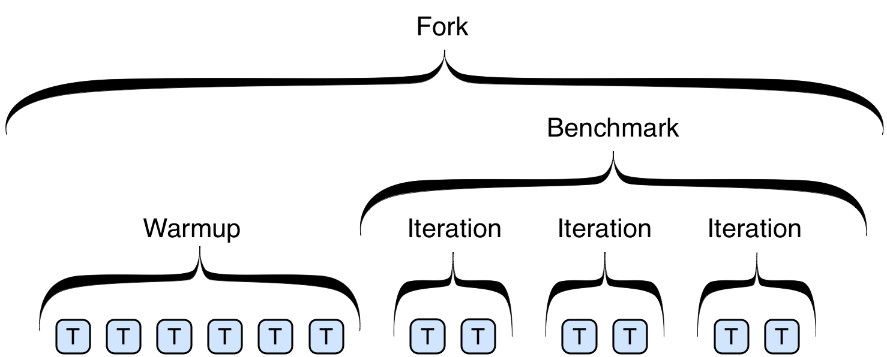
Benchmark - structure
coja
Notes:
Super priklady, chovani urcuje kombinace n annotaci a run time prepinacu, nekdy neni jasne, co bude test delat.

Slide 24
B^{link} tree benchmark – test conditons
Framework annotations
  Class
    @State(Scope.Benchmark, Group, Thread)
    @BenchmarkMode(Mode.AverageTime, Throughput)
    @OutputTimeUnit(TimeUnit.MILLISECONDS)
  Test method
    @Benchmark
    @Warmup(iterations = 1, batchSize = 1, time = 1)
    @TearDown
Conditions
  Threads
    100
  Data
    File with random unique numbers
  Test insert
    10 000
  Measurement iterations
    10
  Test warm up
    Random unique numbers
Notes:
Anotace, lze kombinovat libovolne, nekdy je to moc,

Slide 25
B^{link} tree benchmark results 1/3
Tree params
  N 2
  Numbers 100 000
Collections.synchronizedMap(

Slide 26
B^{link} tree benchmark results 2/3
Tree params
  N 10
  Numbers 100 000

Slide 27
B^{link} tree benchmark results 3/3
Tree params
  N 10
  Numbers 1 000 000

Slide 28
Microbenchmarks - conclusion
Cons
  Not easy to setup test environment
  I wasn't able to measure memory consumption
  Results interpretation – don't trust numbers
Pro
  Nice results
    Repeatable
    Consistent (partially)
  Maven support
  Great java doc
Notes:
It's not easy to setup JMH.

Slide 29
Sources
https://github.com/google/caliper
http://www.clarkware.com/software/JUnitPerf.html
  Probably dead project
http://hg.openjdk.java.net/code-tools/jmh/file/bcec9a03787f/jmh-samples/src/main/java/org/openjdk/jmh/samples
  Examples
http://openjdk.java.net/projects/code-tools/jmh/
  Home

Slide 30
Java Path Finder
Static code analysis
Notes:
Dotknu se vice oblasti, ale ne vzdy popisu do detailu

Slide 31
Java™ Pathfinder
History
Present
Principle
Usage

Slide 32
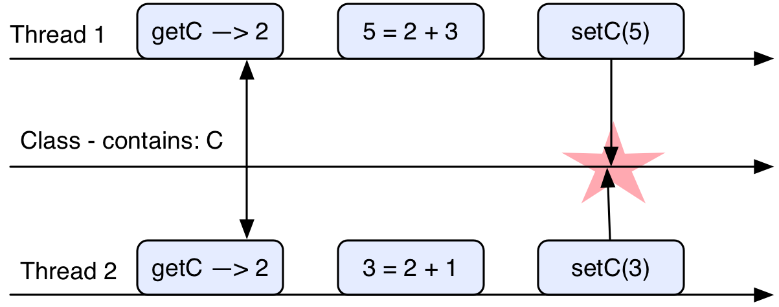
Thread safe
A piece of code is thread-safe if it only manipulates shared data structures in a manner that guarantees safe execution by multiple threads at the same time. (Wikipedia)
Notes:
Odmitnuti, nullPointer … porad to muze byt thread safe

Slide 34
Singleton - find the bug
public class ClassicSingleton {
private static ClassicSingleton instance = null;
public static ClassicSingleton getInstance() {
if(instance == null) {
instance = new ClassicSingleton();
}
return instance;
}
}

Slide 35
Profiling
Memory leaks detection
Speed bottle necks detection
Notes:
Dotknu se vice oblasti, ale ne vzdy popisu do detailu

Slide 36
JProfiler

Slide 37
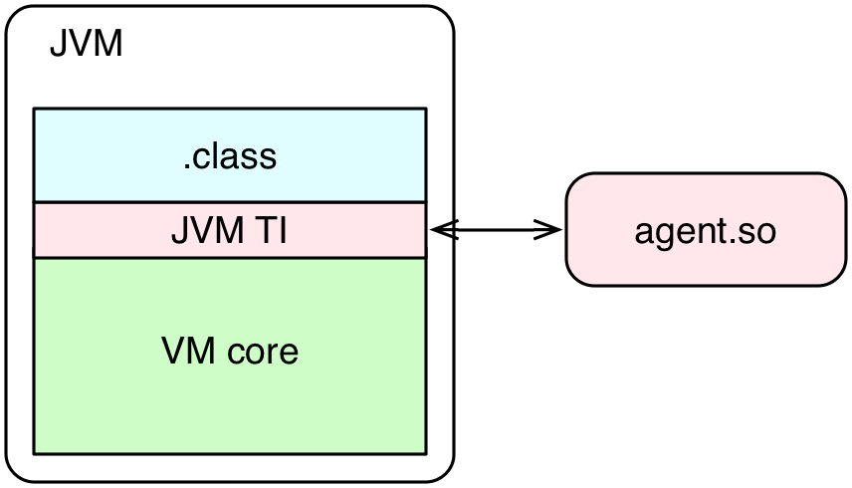
How it works
Java Virtual Machine Tools Interface - JVM TI
-agentpath:
From Java 5.0
Allows to control gc
Notes:
Based on registraton → events
Capabilities:
- replace class code
- JVM TI agents start before VM initialized
-JVM TI events can be sent before main()
-Allows VM configuration

Slide 38
Conclusion
Time is worth less
It's pleasure
No one wants help
Don't do it
Notes:
Proc jsem to delal? Je to jasn: je to zajimave

Slide 39
Q & A
Tree principles
Algorithm
Implementation verification

Slide 40
Resources
https://en.wikipedia.org/wiki/B-tree
http://babelfish.arc.nasa.gov/trac/jpf/wiki
http://www.root.cz/clanky/pohled-pod-kapotu-jvm-sledovani-cinnosti-virtualniho-stroje-javy-pres-rozhrani-jvm-ti/
https://docs.oracle.com/javase/8/docs/technotes/guides/jvmti/
http://www.ibm.com/developerworks/java/library/j-jtp10264/

