Slide 1
Search
Lucene
Solr
Notes:
Chcete v jave hledat? Vemte si k ruce lucene. Moznost obaleni.

Slide 2
over 150GB/hour on modern hardware
small RAM requirements -- only 1MB heap
incremental indexing as fast as batch indexing
index size roughly 20-30% the size of text indexed

Slide 3
Questions

Slide 4
O cem
Index – architektura
Tica
Scoring
UIMA
Auto-complete
Geospatial search
Druhy searche – facet search ...
Druhy parseru dismax, edismax

Slide 5
Pouze plain text

Slide 6
Powered by Lucene
Pouze plain text

Slide 7
Jak funguje seach
Parsing
Tokenization
  Stemming (lemmatization)
  Stop word
  Synonym expansion
Core analysis
Result retrieving

Slide 8
Invertovaný slovník
term-based search

Slide 9
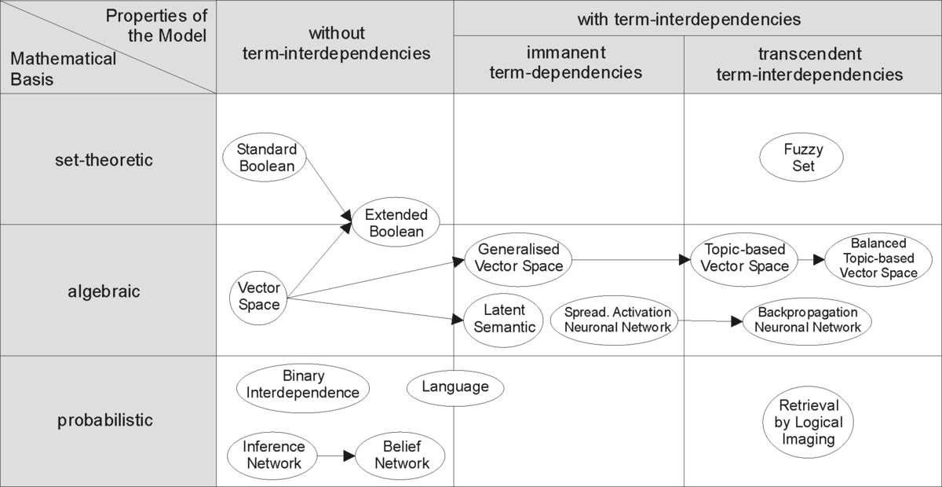
Information retrieval models
https://en.wikipedia.org/wiki/Information_retrieval

Slide 10
Boolean model
  AND OR na slova z dotazu
Vektorový model

Slide 11

Luke
Live show
https://github.com/DmitryKey/luke

Slide 12
Stematizace != lemmatizace

