Slide 1

Fusing Climate Data Products using a Spatially Varying
Autoencoder
Jacob Johnson¹, Matthew Heaton¹, William Christensen¹, Lynsie Warr², Summer Rupper³
¹Brigham Young University; ²University of California – Irvine; ³University of Utah
This material is based upon work supported by the National Aeronautics and Space Administration.

Slide 2
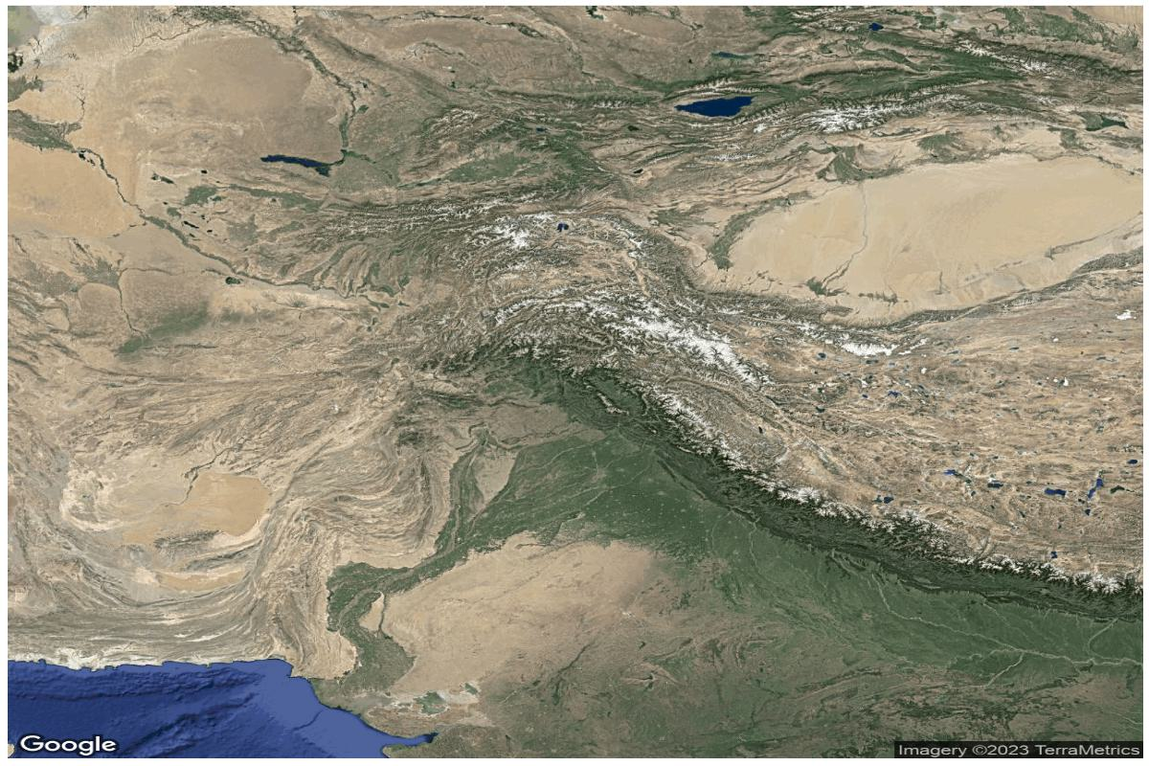
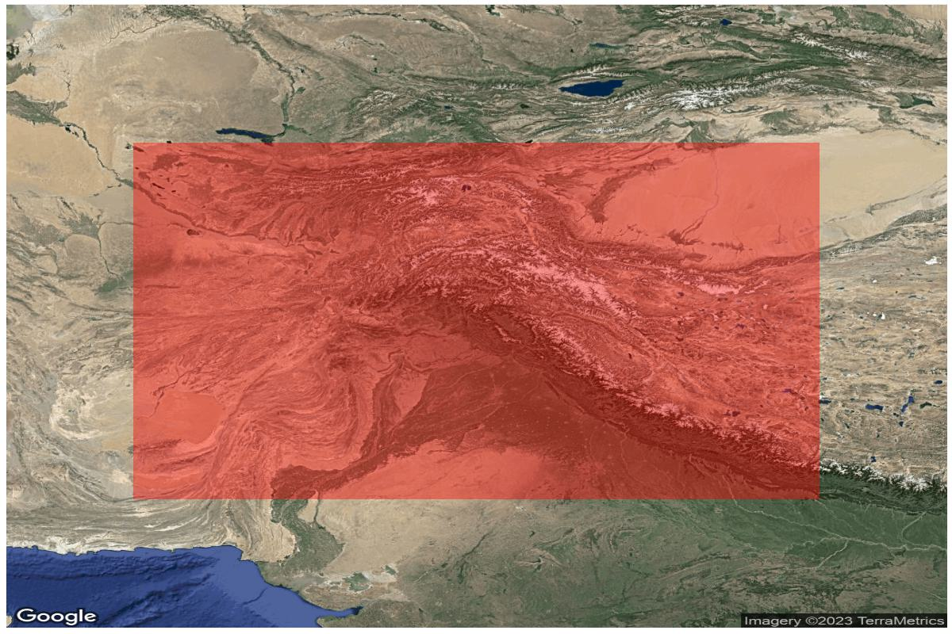
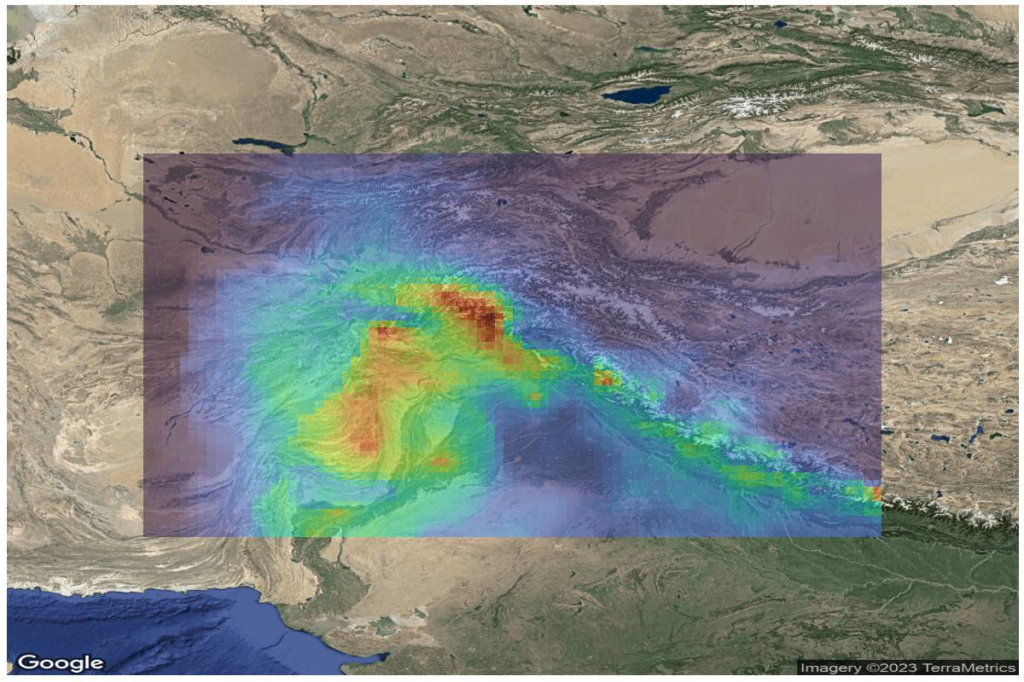
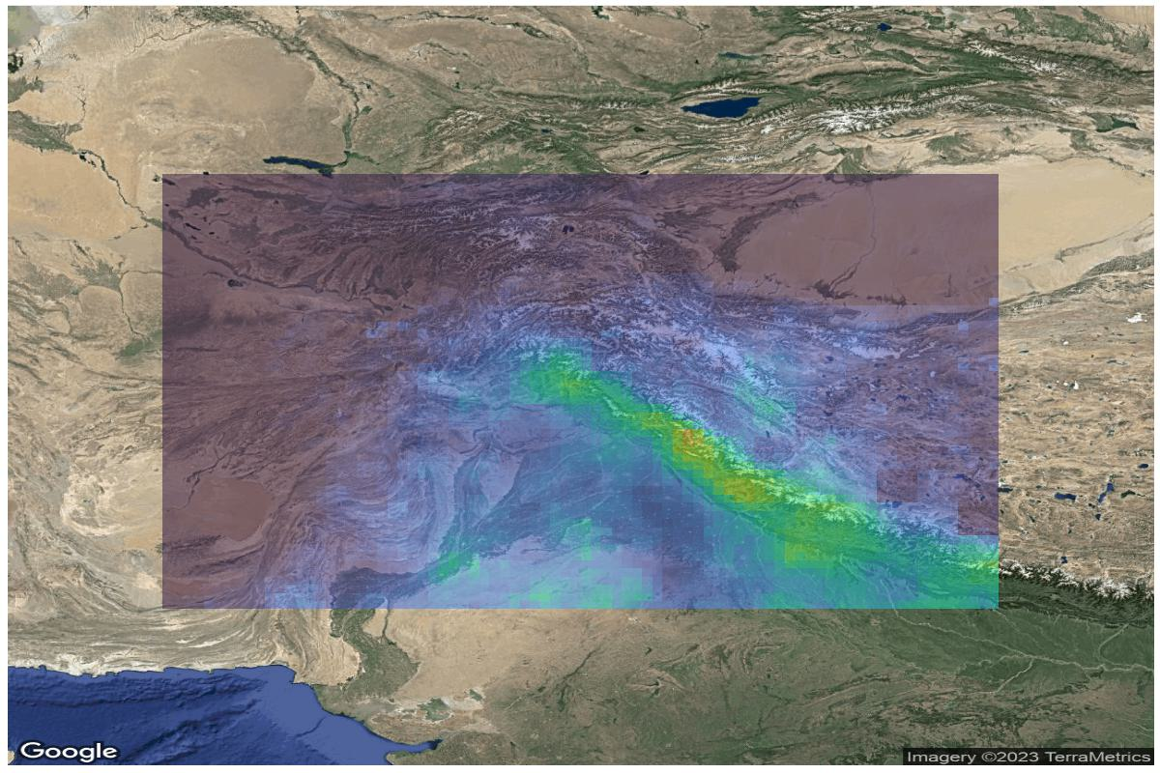
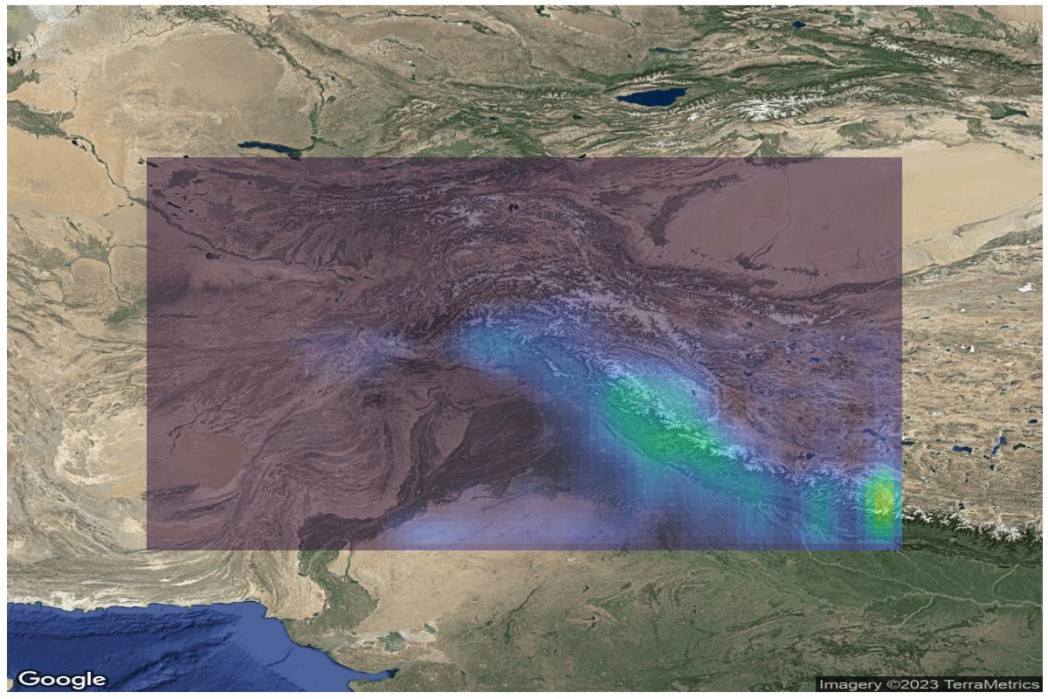
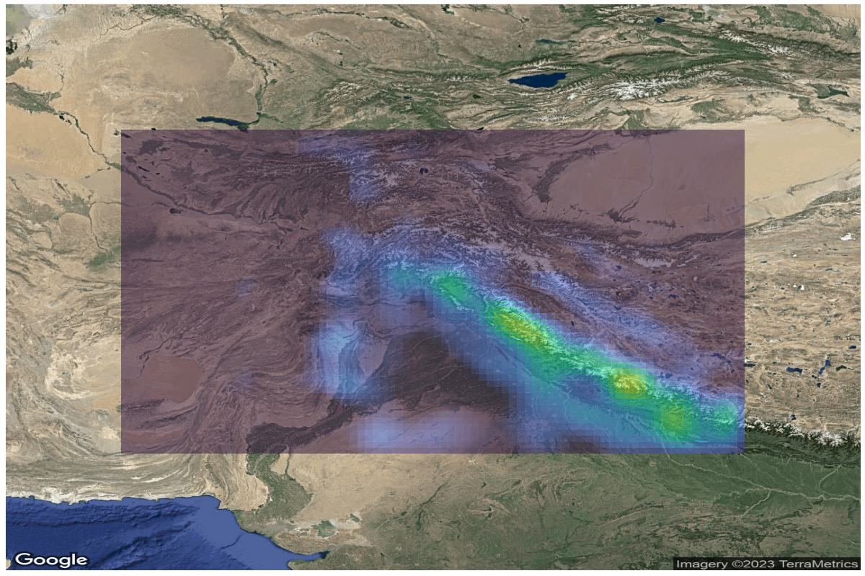
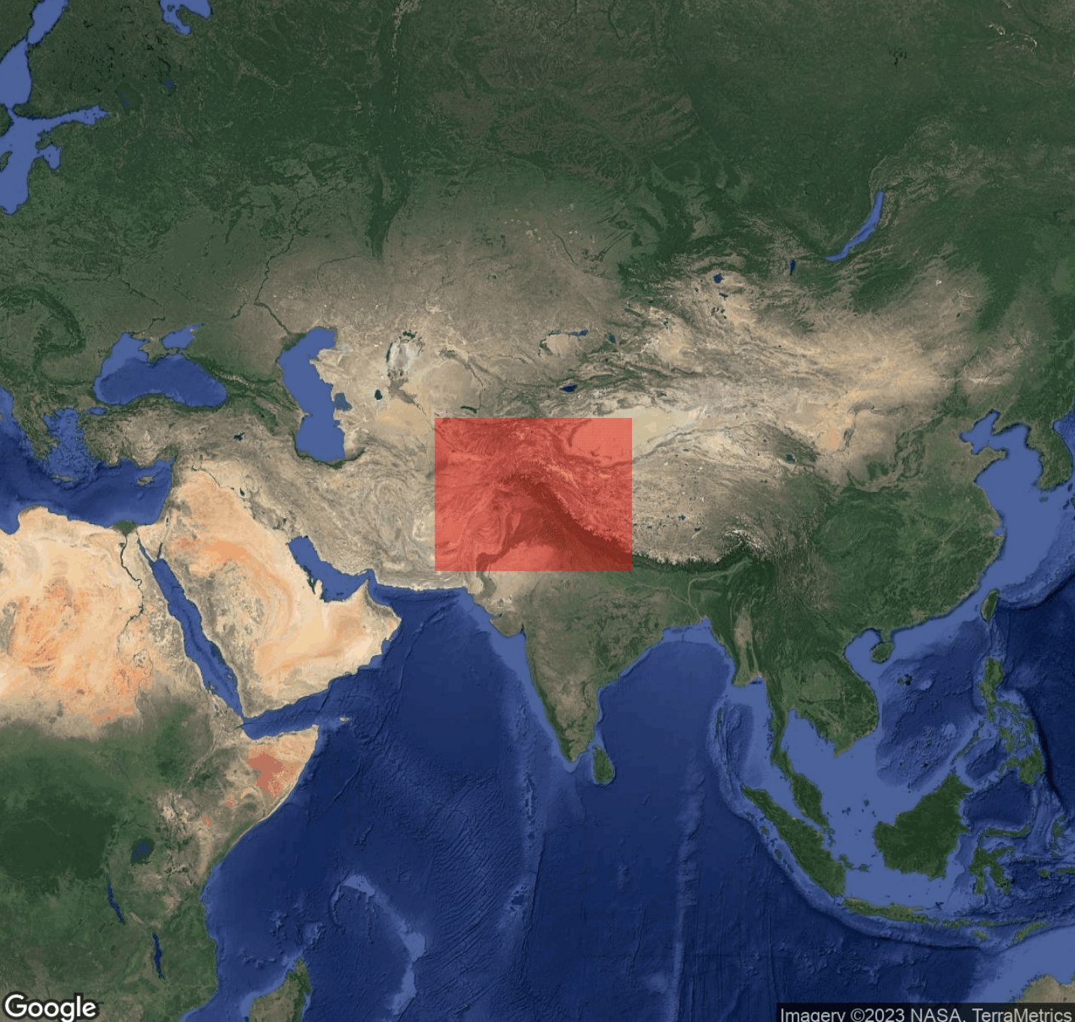
Data Description
Data Description – ERA5
Data Description – MERRA-2
Data Description – TRMM
Data Description – APHRODITE
Notes:
Roughly 64 to 84 Longitude (63.625 to 8.875) East
Roughly 27 to 40 Latitude (26.875, 39.875) North

Slide 3
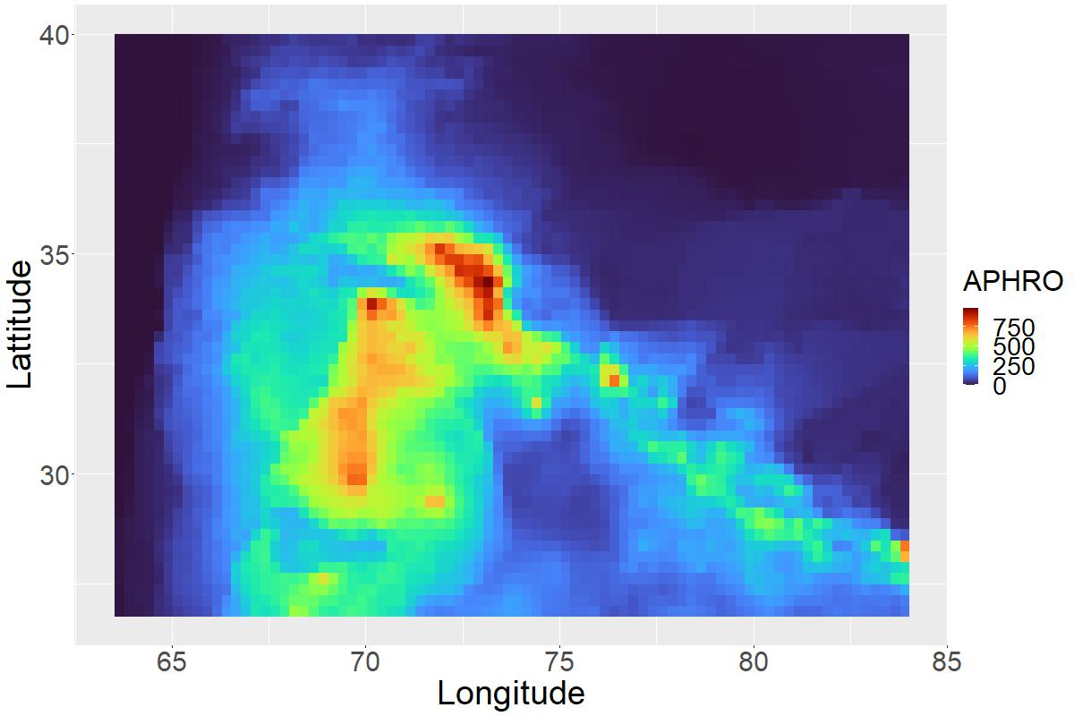
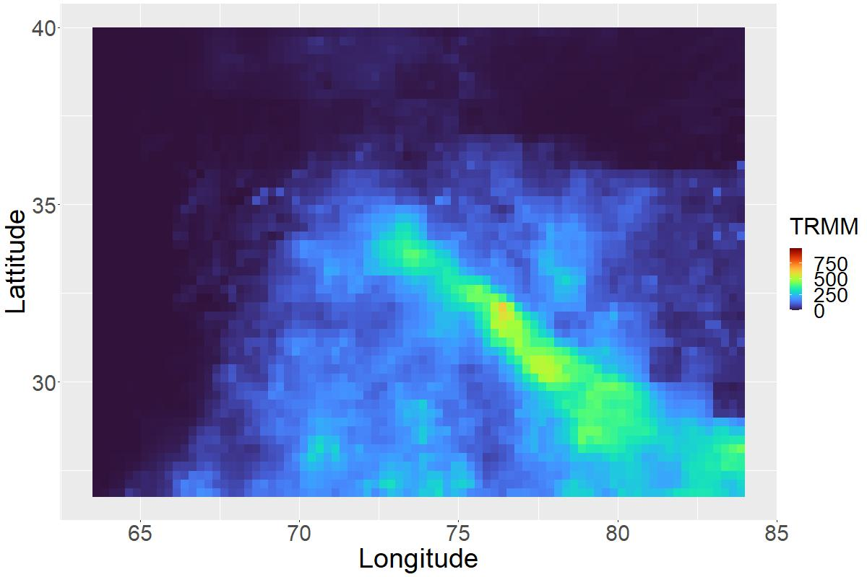
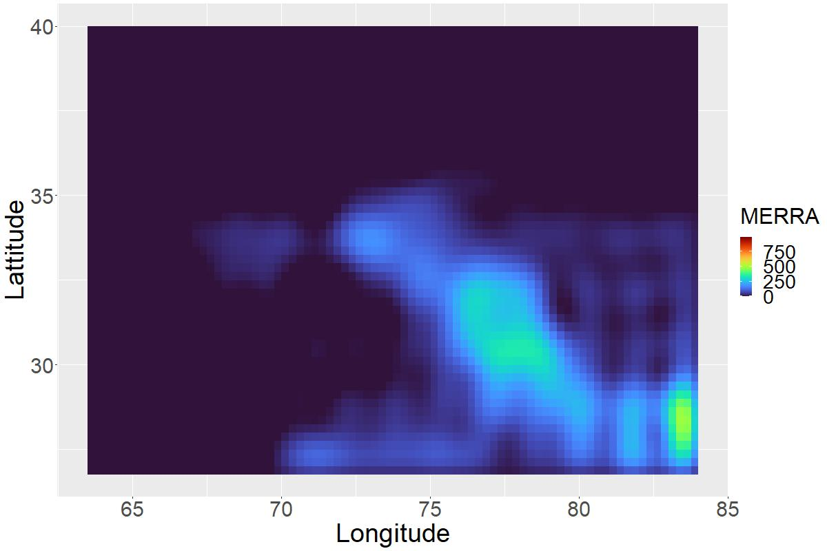
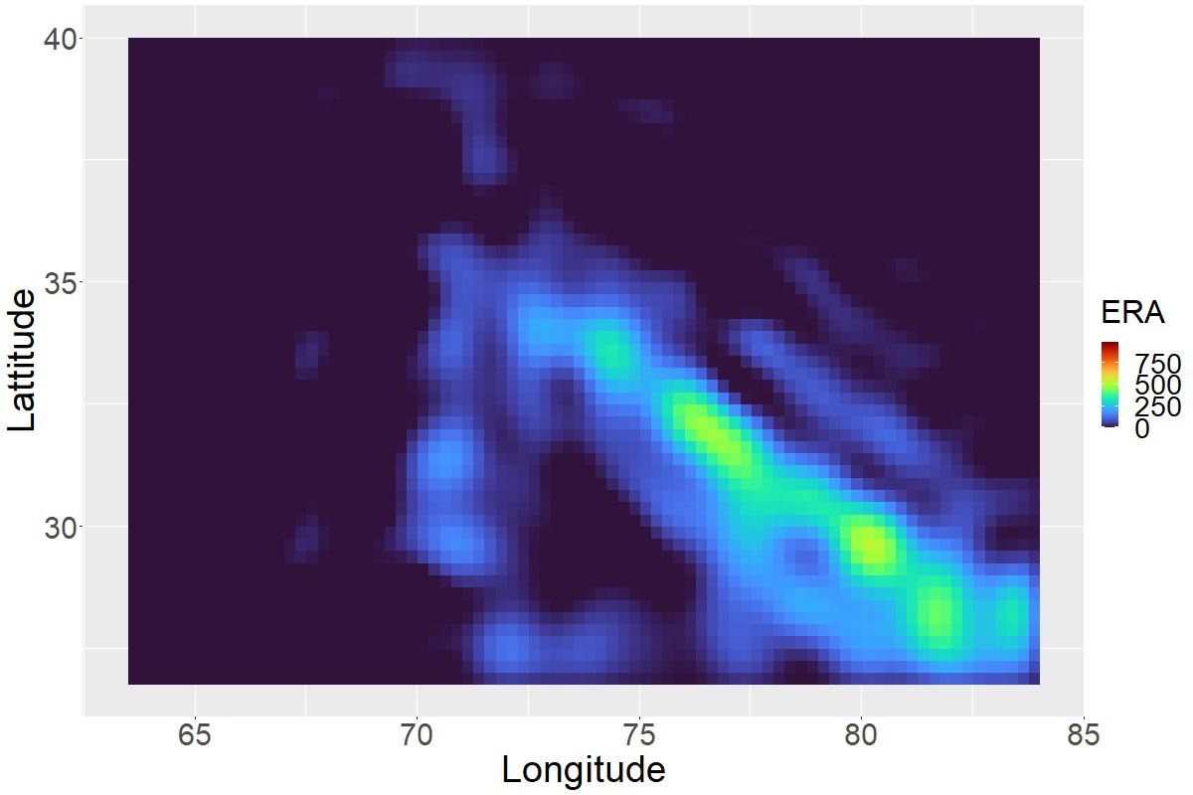
Data Description – July 2015
APHRODITE
Asian Precipitation – Highly-Resolved Observational Data Integration Toward Evaluation
TRMM
Tropical Rainfall Measuring Mission
MERRA-2
Modern-Era Retrospective analysis for Research and Applications, Version 2
ERA5
5th Generation ECMWF atmospheric reanalysis

Slide 4
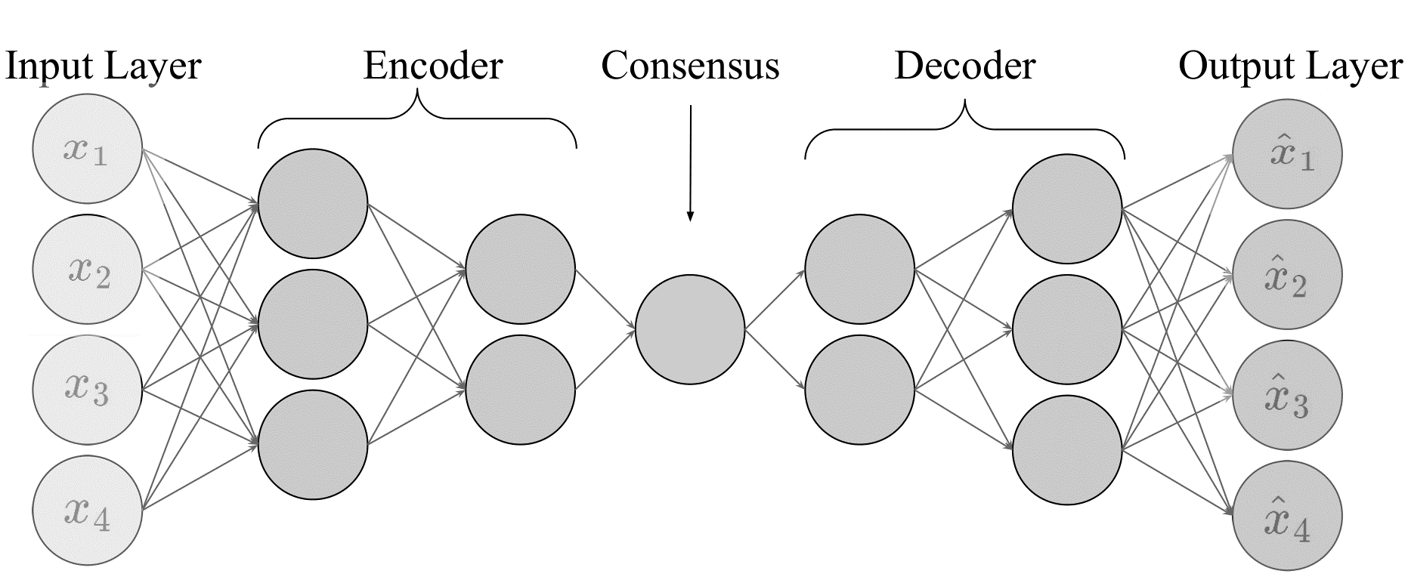
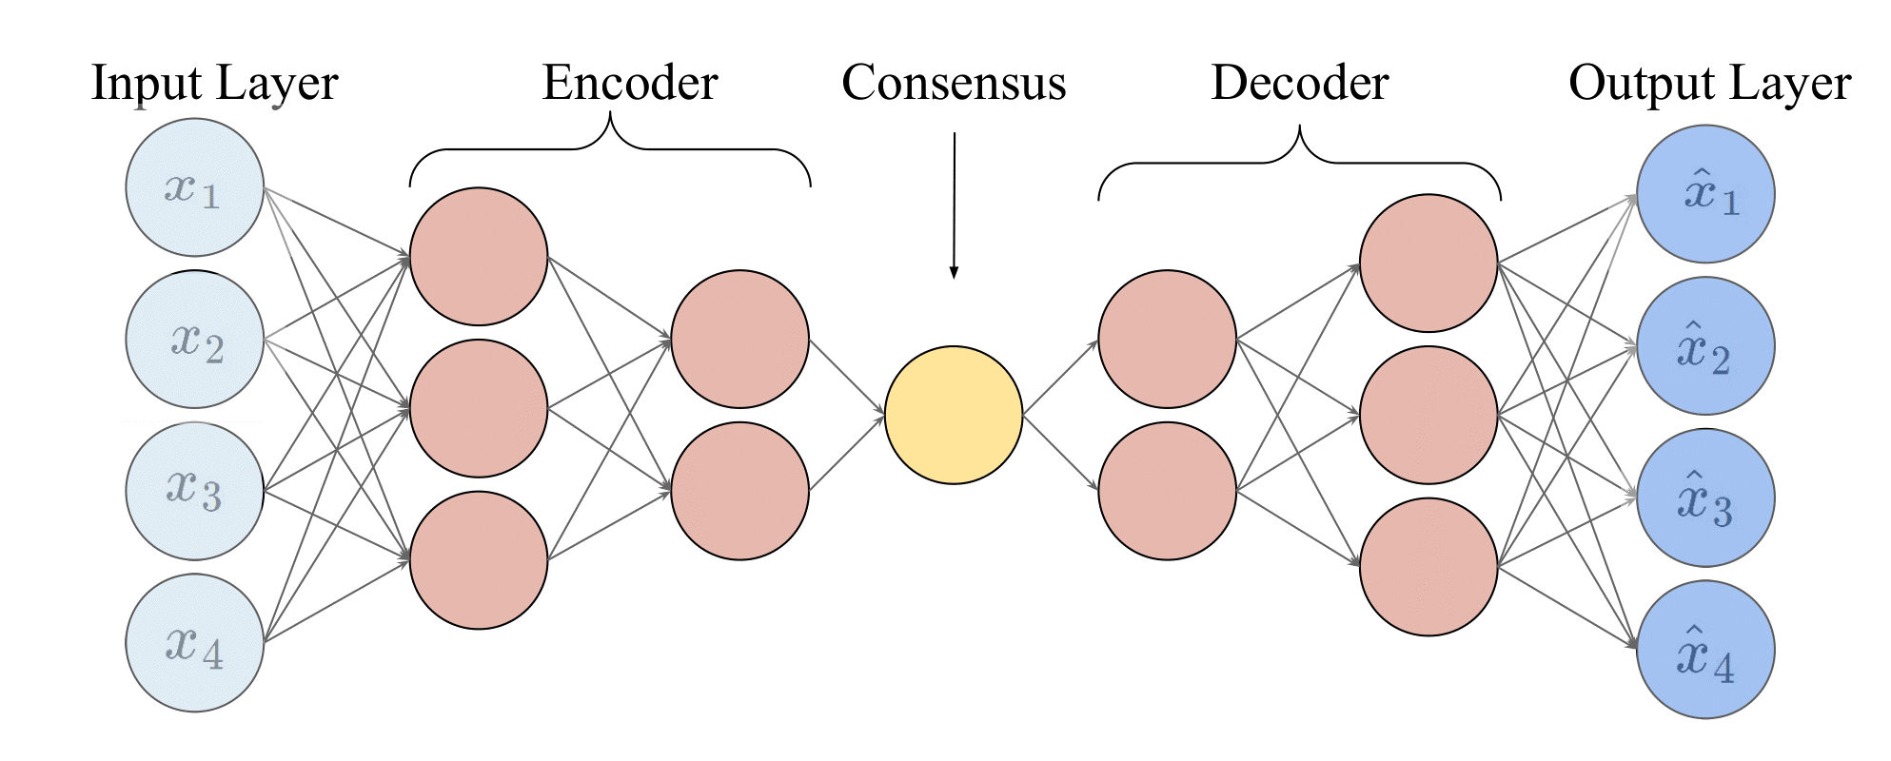
Autoencoder Basics

Slide 5

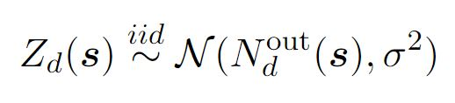
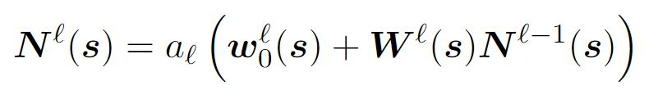
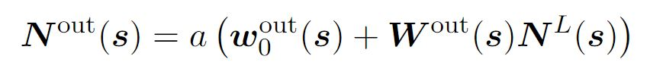
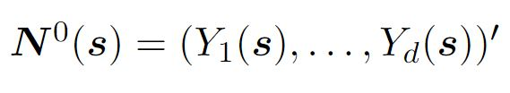

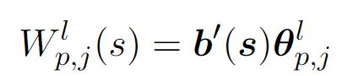
Full autoencoder model

Slide 6

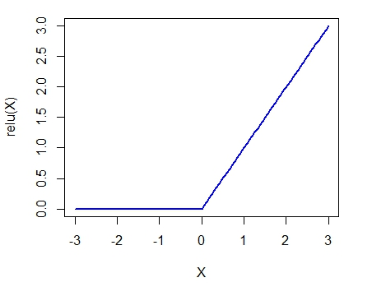
Preserving Support

Slide 7
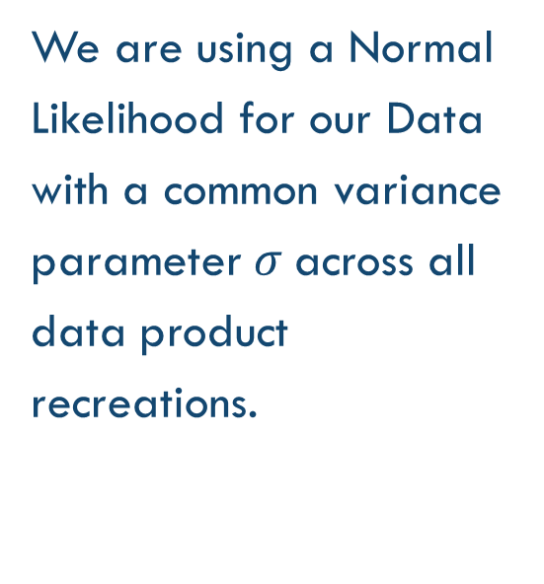
Likelihood
We are using a Normal Likelihood for our Data with a common variance parameter$σ$ across all data product recreations.

Slide 8
Network Connections

Slide 9
Network Connections

Slide 10

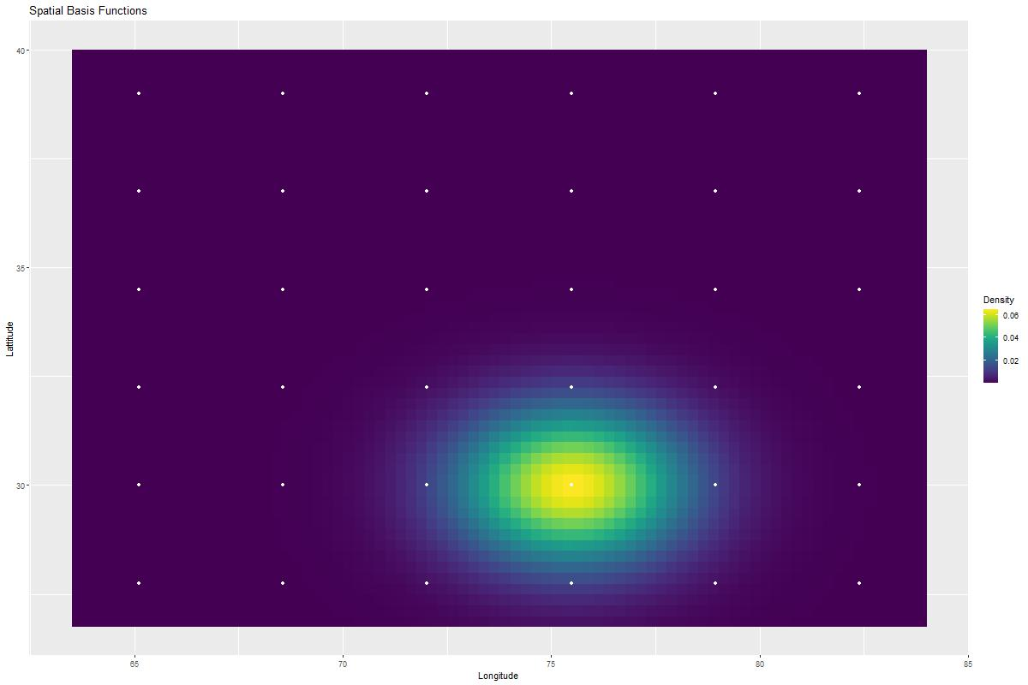
Spatial Basis Functions

Slide 11
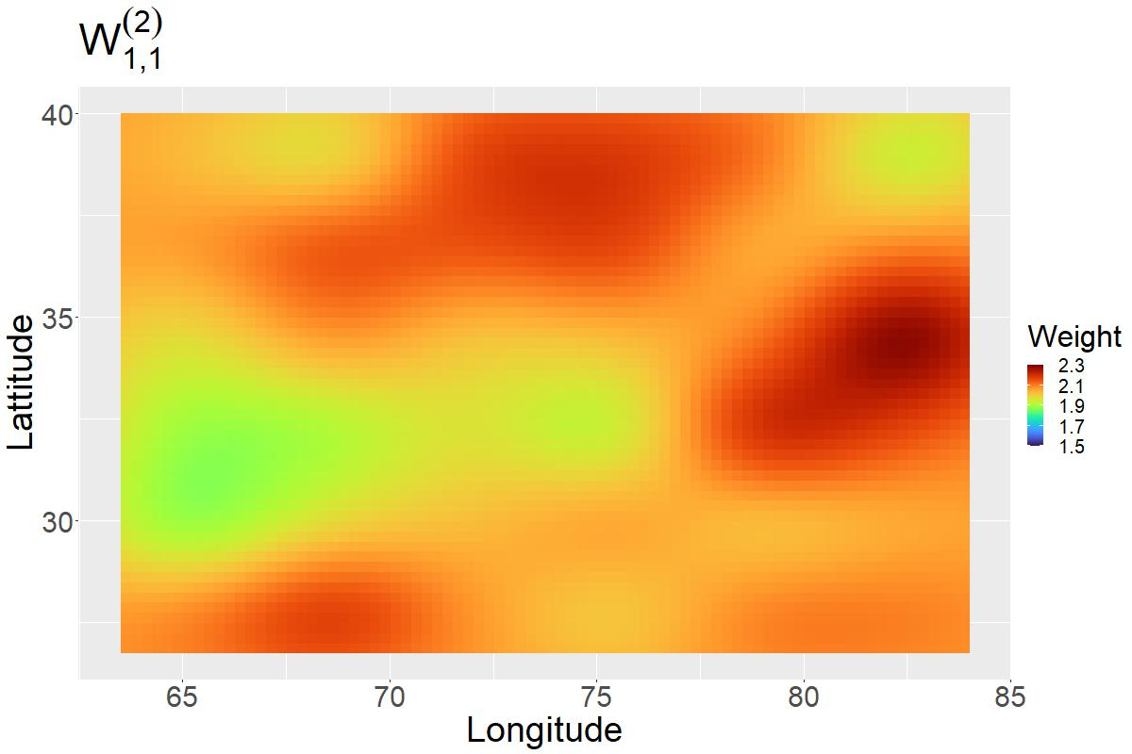
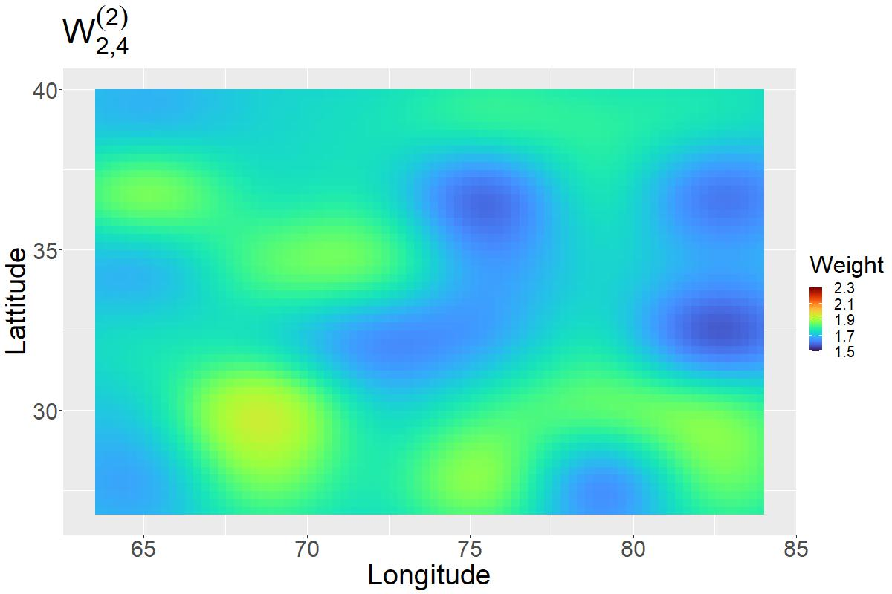
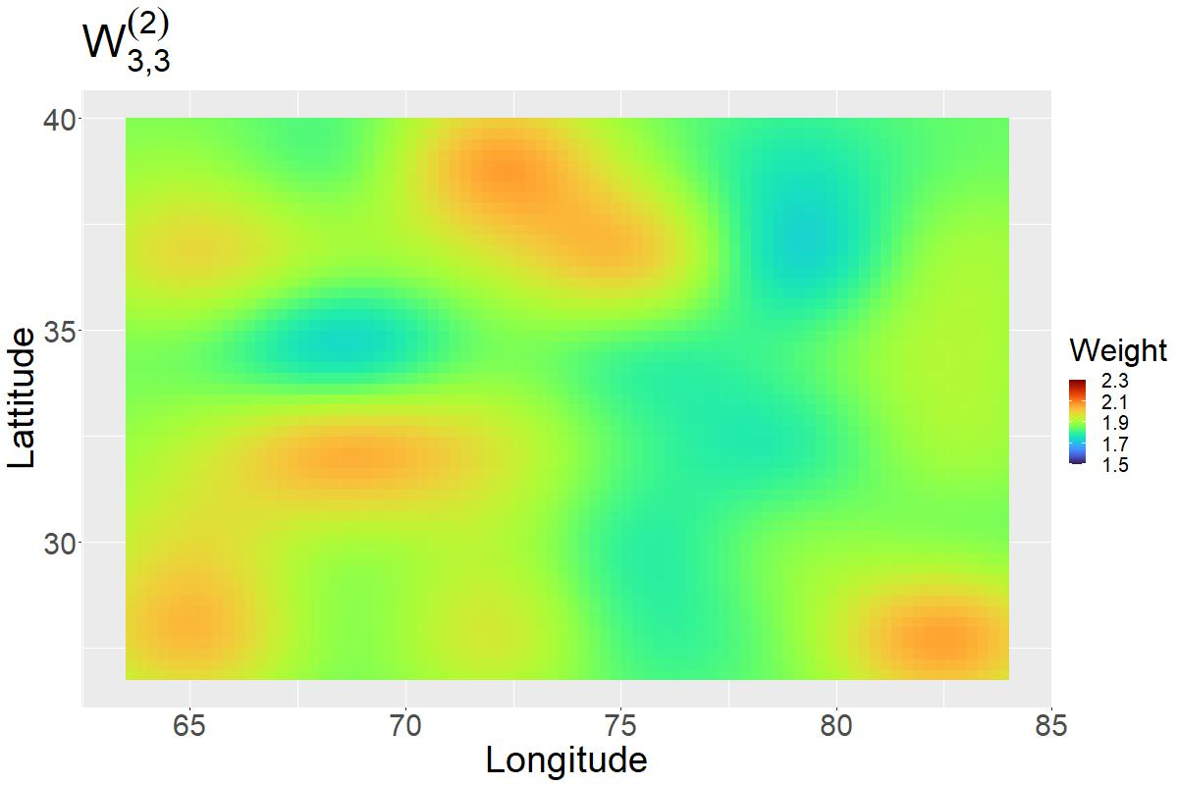
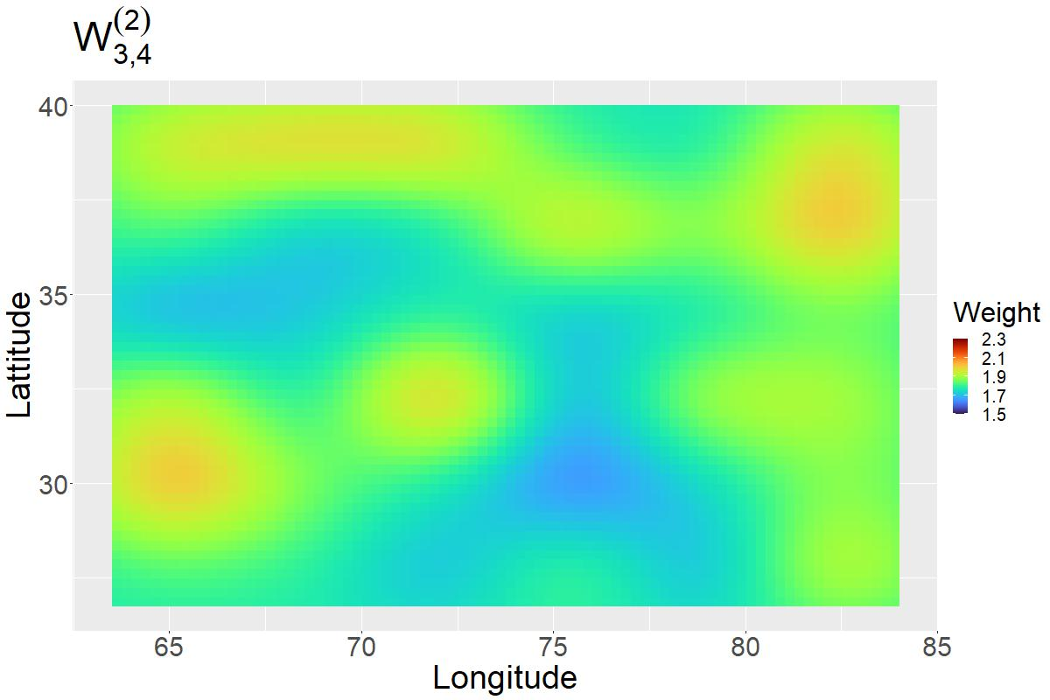
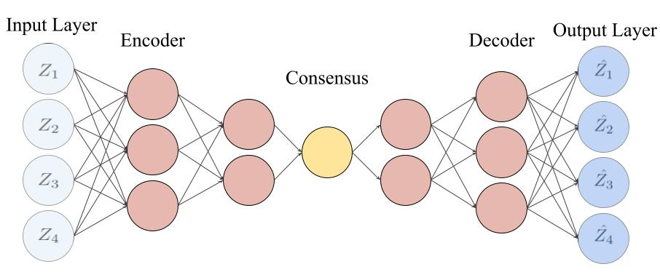
Spatially Smoothed Weights

Slide 12
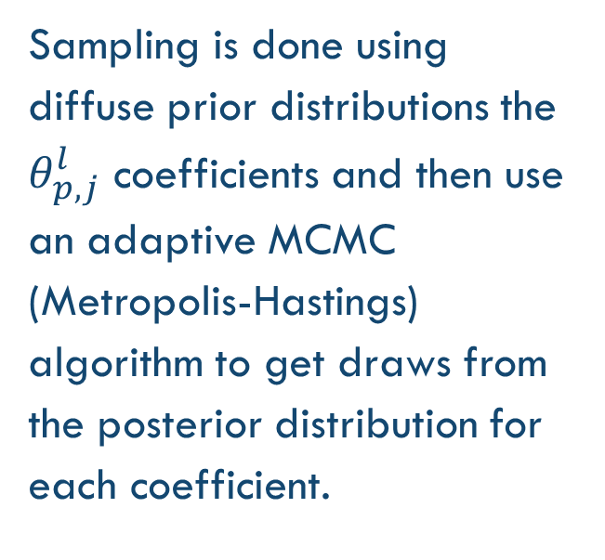
MCMC Sampling
Sampling is done using diffuse prior distributions the $θ_{p,j}^{l}$ coefficients and then use an adaptive MCMC (Metropolis-Hastings) algorithm to get draws from the posterior distribution for each coefficient.

Slide 13
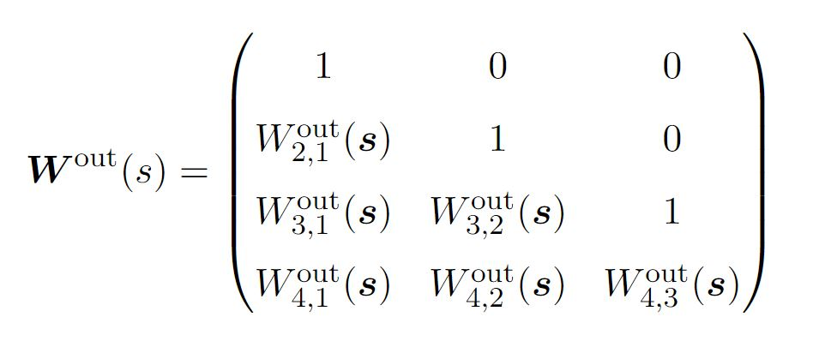
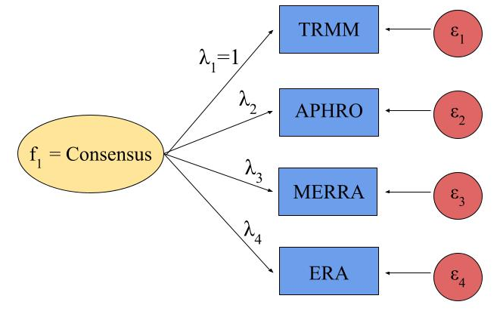
Constraints for Identifiability and interpretability
Because autoencoders are often not interpretable nor identifiable, we borrowed a constraining technique from Confirmatory Factor Analysis (CFA).

Slide 14
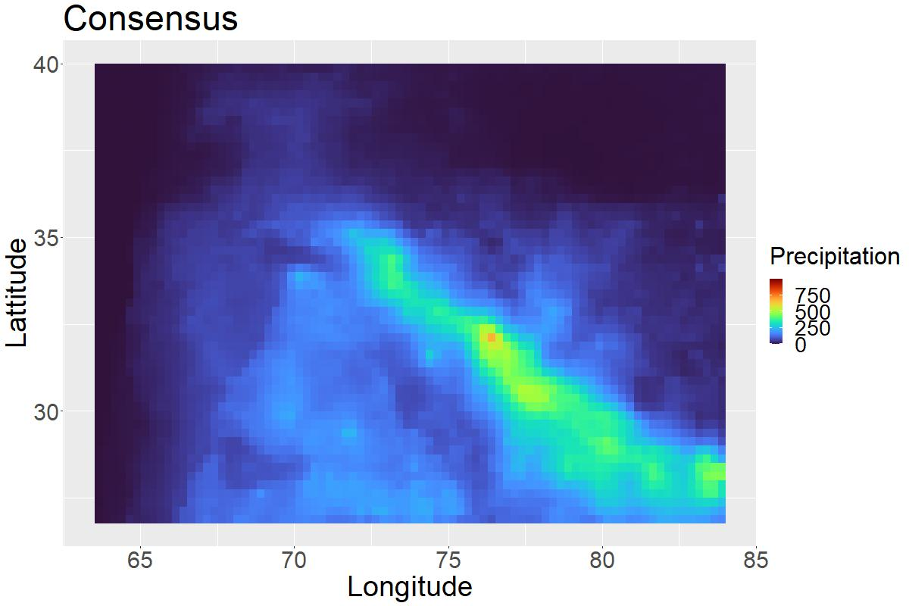
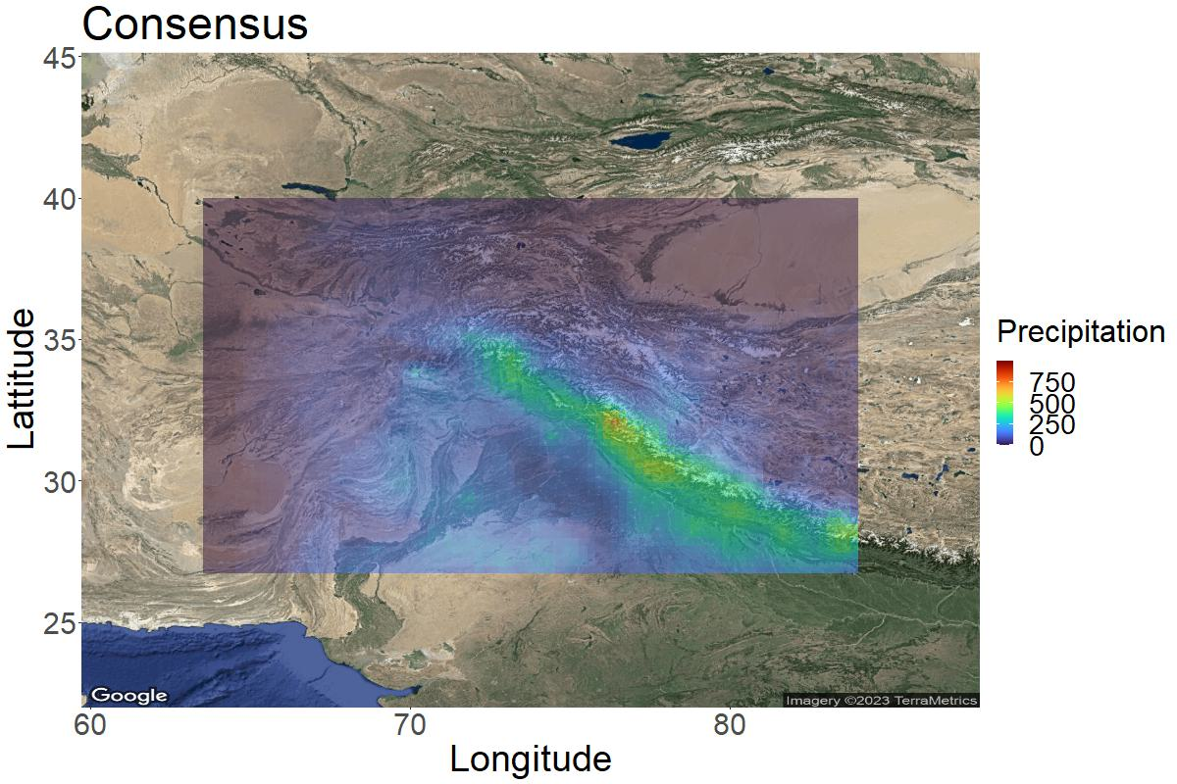

Slide 15
Consensus Features
APHRODITE
TRMM
MERRA-2
ERA5

Slide 16
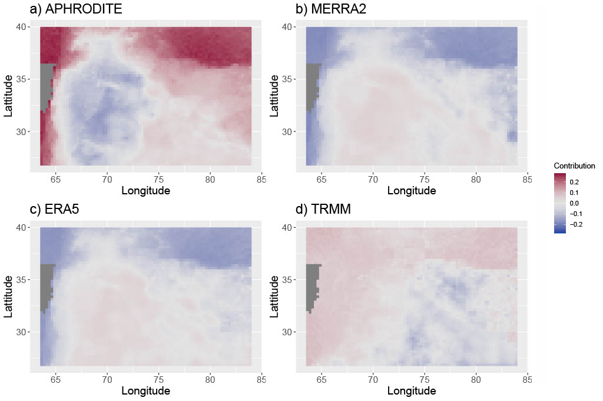
Measuring Contribution
APHRODITE
TRMM
MERRA-2
ERA5

Slide 17
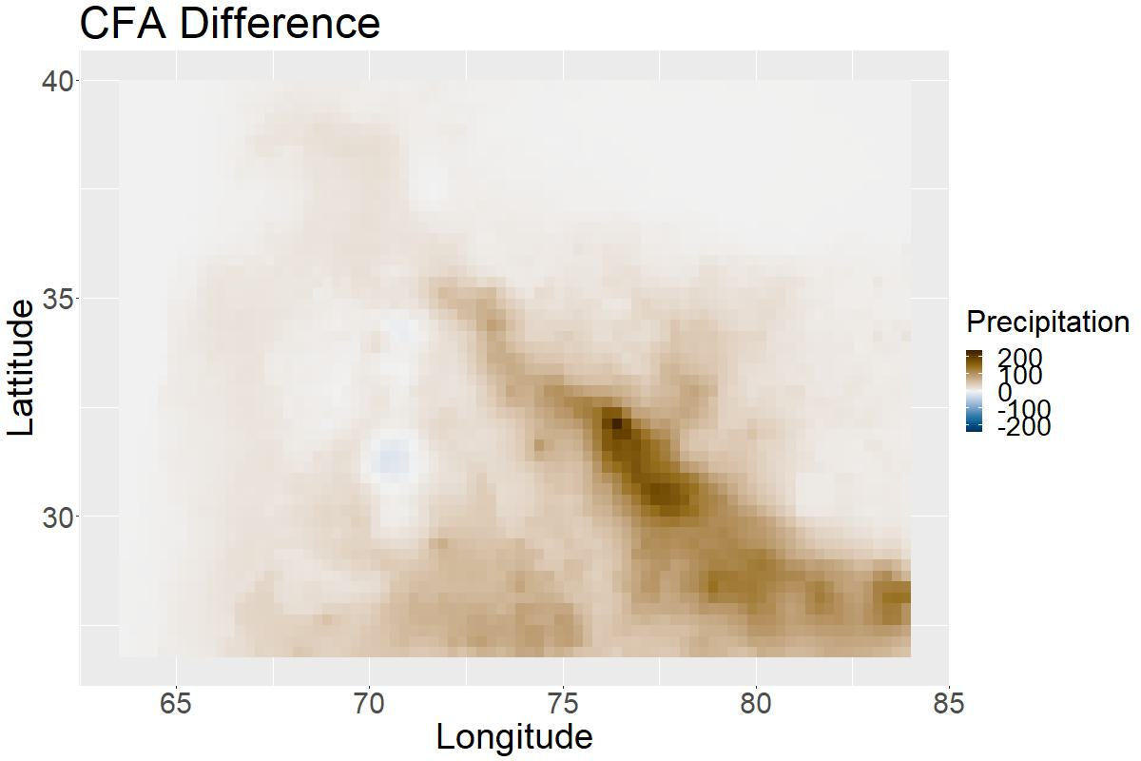
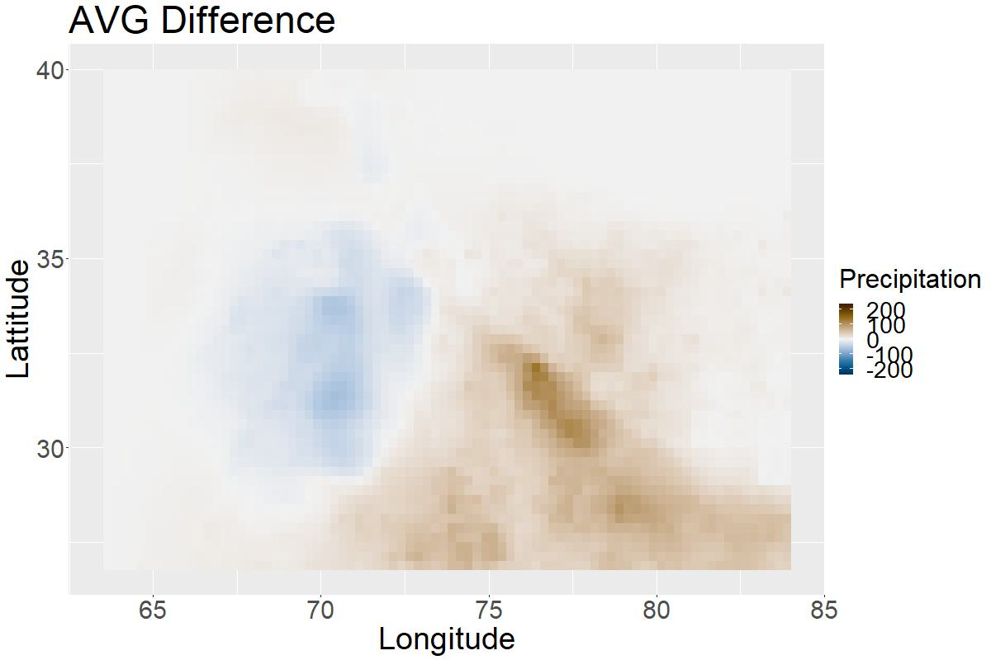
difference between techniques
Notes:
Our Consensus – Other Approach

Slide 18
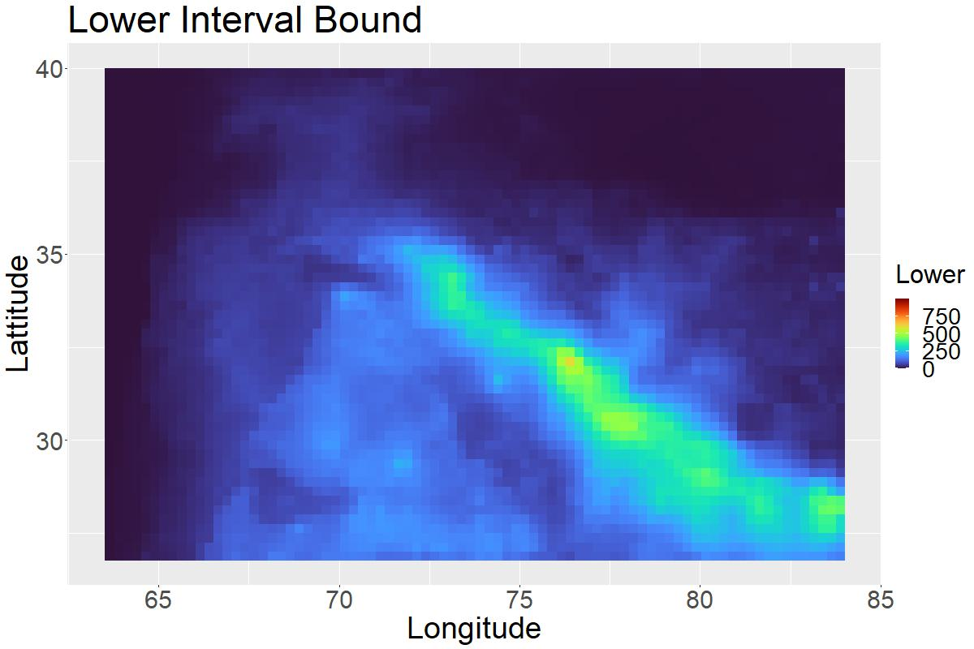

Uncertainty Quantifications
95% Credible Interval on the Autoencoder Consensus

Slide 19
Summary
We propose a Bayesian autoencoder that combines various data products in way that captures unique spatial features.
  Our model includes spatial correlation by constructing the autoencoder weights with spatial basis functions.
  The Consensus node at the center of our autoencoder is made interpretable by constraints inspired by confirmatory factory analysis.
  Using a Bayesian framework allows for uncertainty quantifications

Slide 20
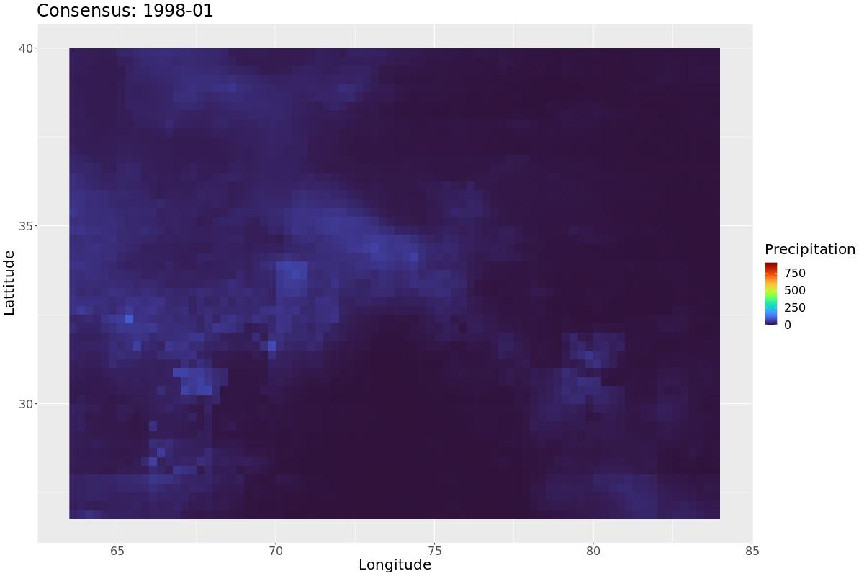
Questions

Slide 21


Read the Full Paper on arXiv
Code Files Available on GitHub

Slide 22
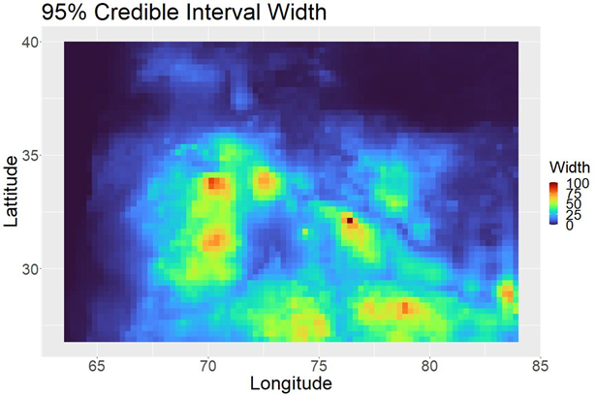
Uncertainty Quantifications
95% Credible Interval Width

Slide 23
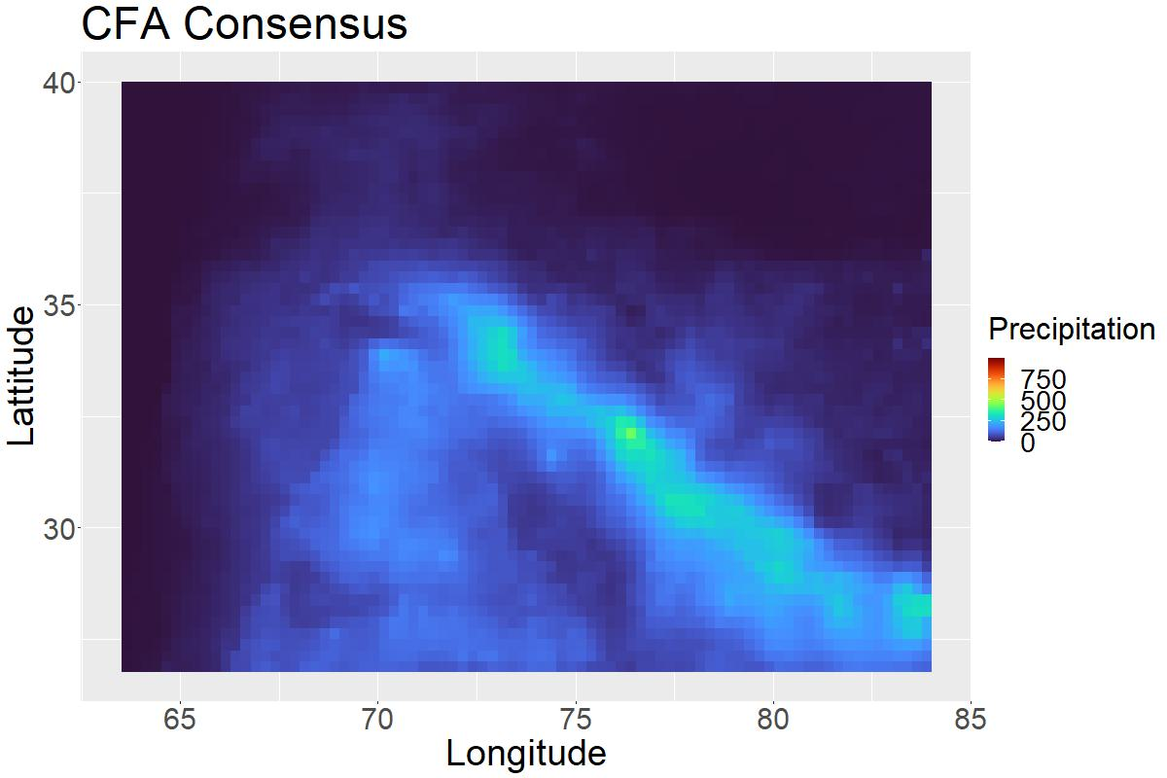
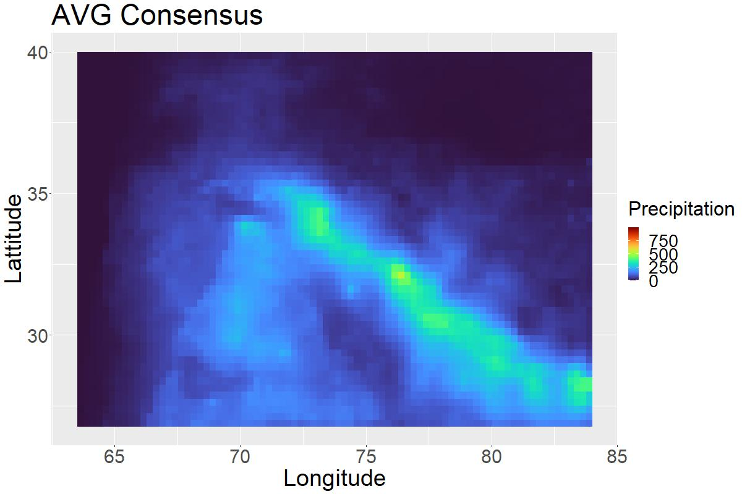



difference between techniques
$$R^{2}:$$
0.665
$$R^{2}:$$
0.677
$$R^{2}:$$
0.654

