Slide 1
Group-4 Repeat Buyers Prediction for E-Commerce
Project by-
Joseph Chorbajian, Aniruddha Gawande, Abhishek Jajoo, Satyam Sharma, and Ishan Unnarkar

Slide 2
Problem Statement
The problem at hand is to distinguish between one-time buyers and potential loyal customers based on their behavior.
We can use machine learning algorithms to analyze customer behavior and predict their likelihood of becoming loyal customers.
The output of the machine learning algorithm will reflect the probability a particular customer can be a long time one.
This approach can help merchants maximize ROI by reducing promotion costs and increasing customer lifetime value.

Slide 3
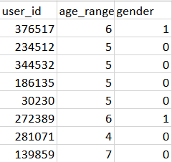
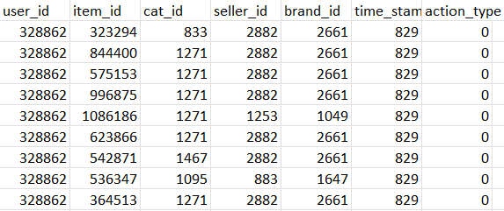
Data Exploration (Format 1)
User info data provides us with unique user IDs, age range where 1 is for <18, 2 for [18,24], 3 for [25,29], 4 for [30,34], 5 for [35,39], 6 for [40,49], 7 and 8 for >= 50, and 0 and NULL for unknown. Lastly, gender is encoded as 0 for female, 1 for male and NULL for unknown.
User log data records every unique user's interaction with an item, including item ID, category, merchant ID, brand, timestamp, and action type (0 for click, 1 for add to cart, 2 for purchase, and 3 for added to favorites).

Slide 4
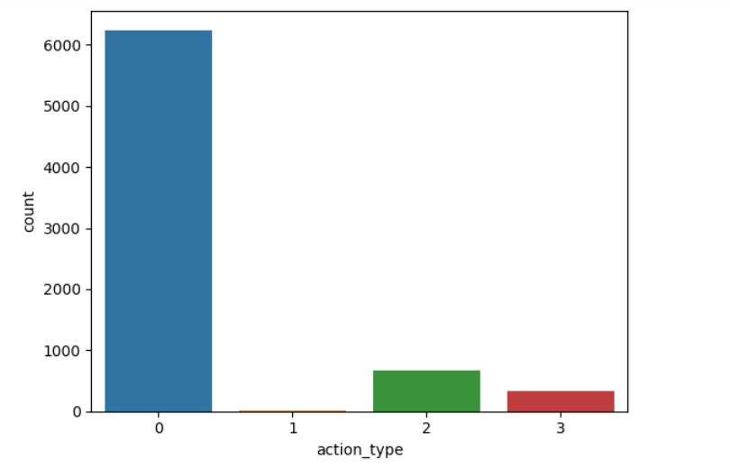
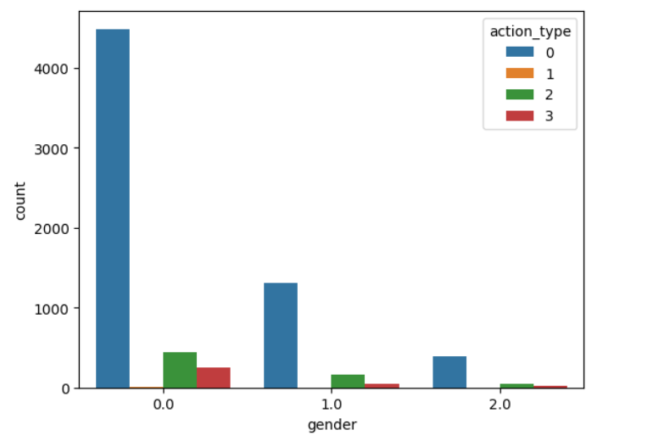
Data Exploration
Engagement by action type
Gender Distribution

Slide 5
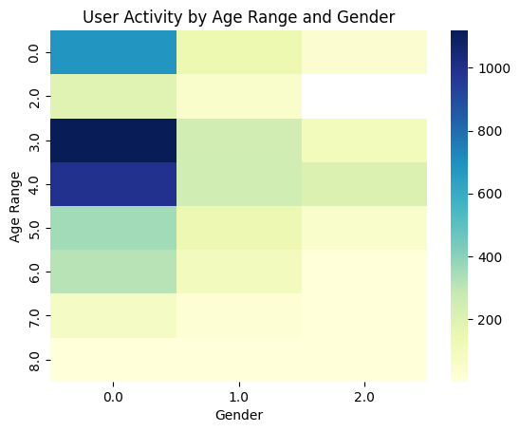
Data Exploration
We co-related user activity with age range and the gender as well.
Users between the age 25 to 29 are the most active when it comes to males.
Users from 25 to 34 are most active when it comes to females.

Slide 6
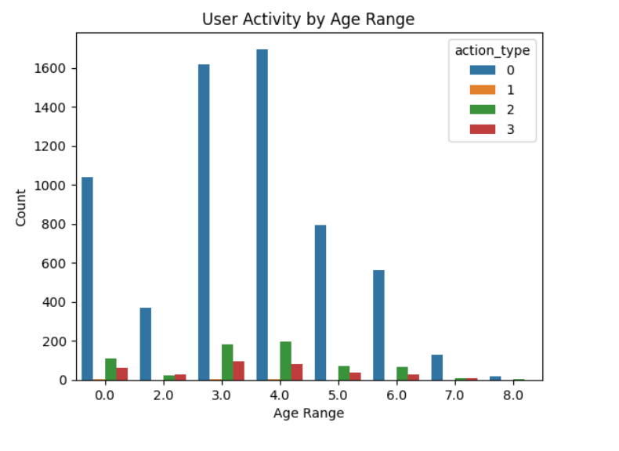
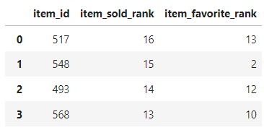
Data Exploration
Action type by age group.
Best-selling items in terms of frequency.

Slide 7
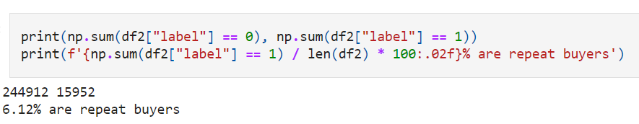
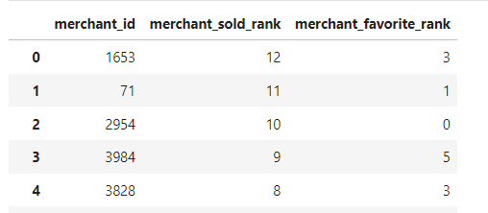
Data Exploration
# of repeat buyers in our Item-range
Only 6.12% of buyers come after promotions
Getting merchant ranks based on footprint
This will help us identify the best-selling merchants and the diversity that they create

Slide 8
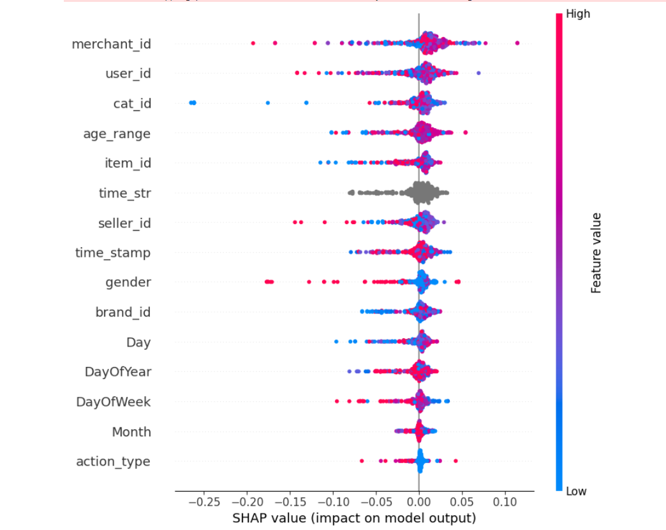
Data Exploration
Outcome of Shapley played an important role in the final output.
Clearly time when the item was purchased plays a huge role, followed by the age range

Slide 9
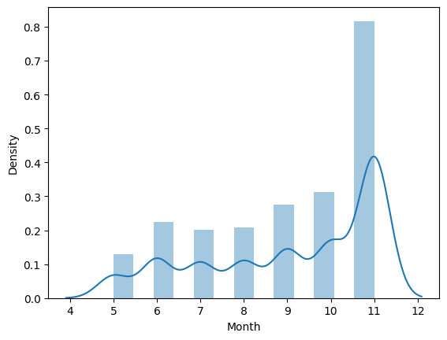
Feature Engineering
The exploration began by analyzing the day of the year and the corresponding day of the week when a user performed an action.
Visualization of the density of actions committed, irrespective of their type against the months of the year.
Visibly, November was the busiest.

Slide 10
Feature Engineering
We also experimented with action type. Our assumptions were that customers purchasing and adding items to favorites would serve as potential long-term customers.
Customers who purchased and added items to favorites came up to a total of 34 such users.
 | user_id | user_purchase_count | user_Add_to_favorite_count | purchase_&_favorite_count
0 | 192 | 0 | 0 | 0
1 | 289 | 0 | 0 | 0
2 | 436 | 0 | 1 | 0
3 | 445 | 0 | 0 | 0
4 | 616 | 0 | 0 | 0

Slide 11


Feature Engineering
User-Seller viewpoint
We used the intuition of given training data to find insight of user data
Group by Category

Slide 12
Feature Engineering
Feature | Description
Day | The extracted day from the time stamp. Ranges from 1 to 31.
Month | The extracted month from the time stamp. Ranges from 1 to 12.
Day of year | The day in the current year, taking into account months with different amounts of days. Possible ranges from 1-365, but actual ranges are from 131-315.
Day of week | The day of the week. Ranges from 0-6. Unknown offset.

Slide 13
Feature Ranking
We ventured into 4 models and algorithms to determine which features are important.
Algorithm | Description
Random Forest | An ensemble classifier, fitting multiple decision trees in order to best explain the structure of the data.
Shapley analysis (on Random Forest) | Determines the importance of each feature, taking an average of its contribution to the output.
PCA | Reduces the number of dimensions on the data. While the output of PCA doesn’t correspond to a singular feature, it captures the most amount of features within the given number of components.
LDA | Linear discriminant analysis finds the most discriminating vectors for the data on a lower-dimensional dataset. The most important features will be those that separate the output the best.

Slide 14
Feature Ranking
We see that user and merchant interaction dominate the top 5 features. Dates also play a significant role.
Random Forest | Shapley | LDA
user_id | merchant_favorite_rank | month
merchant_id | user_id | user_interaction_count
merchant_sold_rank | merchant_id | user_uniq_interaction_count
merchant_favorite_rank | day_of_year | user_cat_interaction_count
item_favorite_rank | merchant_sold_rank | user_item_interaction_count

Slide 15
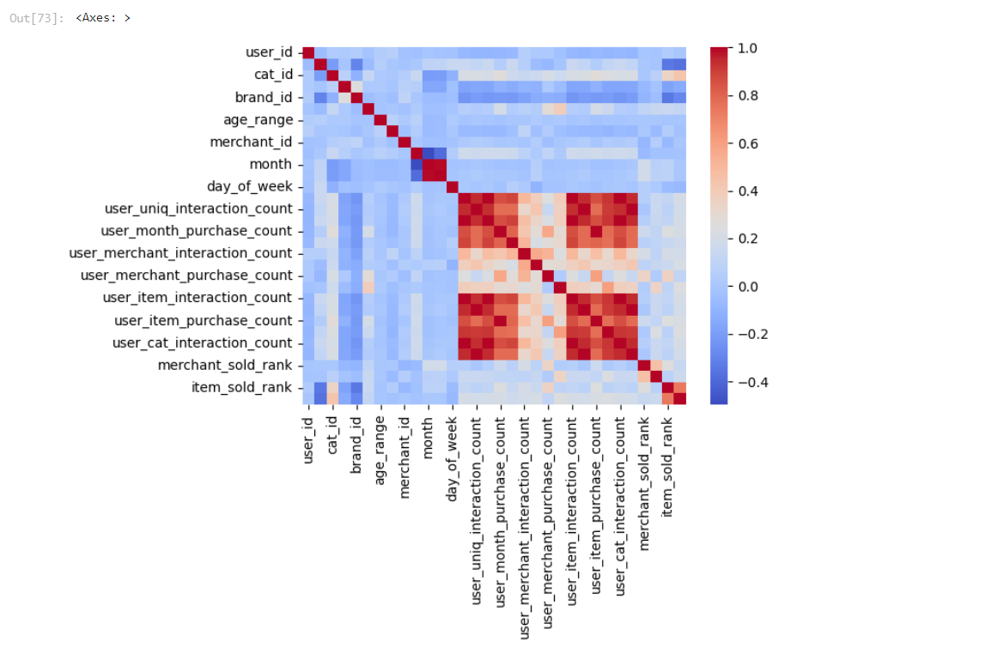
Feature Ranking​

Slide 16
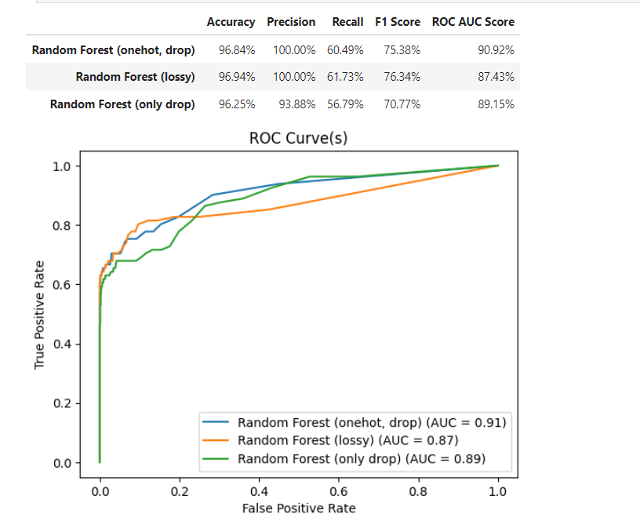
Model Selection
Random Forest
Random Forest with onehot encoding and drop: In this case, we can see that adding onehot encoding to the Random Forest improved the ROC AUC score, which measures the trade-off between true positive rate and false positive rate and yields the highest accuracy.
Random Forest with only drop: On the other hand, we can see that using only drop preprocessing resulted in the least accuracy, precision, recall, and F1 score among all the Random Forest models evaluated.

Slide 17
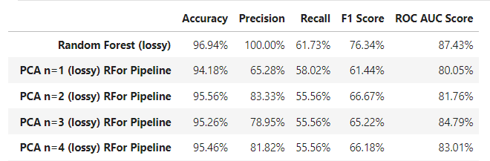
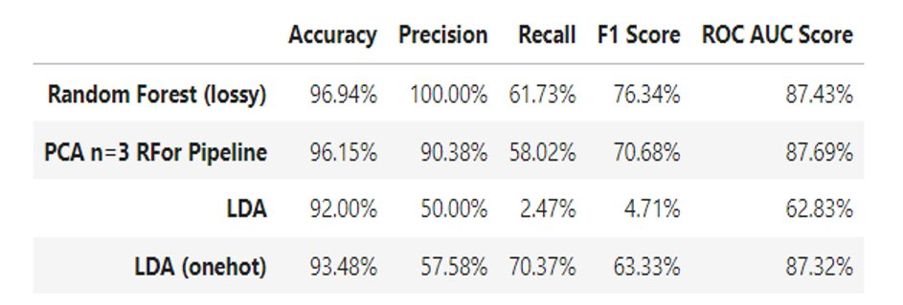
2. PCA
Model Selection
Performing PCA on one-hot encoded columns, while dropping the least ranked features.
3. LDA
Performing LDA doesn’t yield a significant result since the data is not normally distributed.

Slide 18
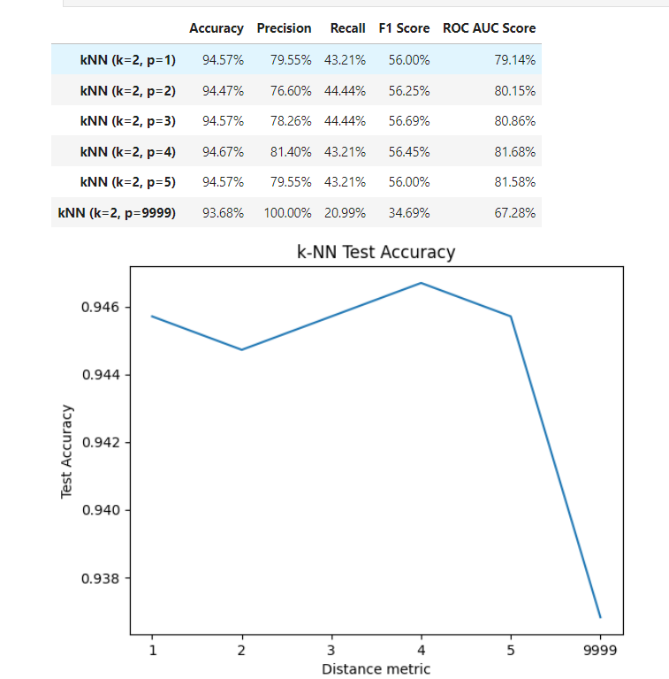
4. K-Nearest Neighbors
Model Selection
After performing a series of calculations to determine k on data we found k=2 performs best.
We fix the value of k as 2 and parameterize p to find out model works best when p=4.

Slide 19
Turning Point
Initially, we focused on user activity log combined with user information data to train the model.
Through this approach, we concluded that age_range, day were the most important features.
But after looking at train and test data values, we figured that we had to do feature engineering, which would give us deep insights into our data.
This approach gave us information about item rank based on total sales, user unique category interaction count, user item interaction count.
These attributes ranked higher according to Shapley analysis.

Slide 20
Future Scope
Additional models may produce more accurate results
Advanced neural networks may understand patterns for repeat buyers better
Further observations on implemented recommendations changes appropriate model

Slide 21
Conclusion
We performed feature engineering on a large subset of data and generated so many features only to conclude that information about merchant and user are the most significant.
Feature engineering played a crucial role in achieving high accuracy in the classification model, and the team used 32 features in their final model.
The team tried different techniques to handle the class imbalance issue, and stratifying the data during the train-test split had a slight positive impact on the model's accuracy.
The Random Forest model outperformed other models with 96.94% accuracy and a ROC AUC score of 87.43%. However, to address overfitting, further analysis of neural networks through custom evaluation bench is required.

