Slide 1
Monads

Slide 2
What means Monad
In philosophy
In mathematics
In computer programming
A Monad Example
Another Monad Example ( most known )
A Mathematical Representation
The Ultimate Monad Representation

Slide 3
Greek:
μονάς monas, "unit"
μόνος monos, "alone“

Slide 4
Gottfried Wilhelm Leibniz
“The Monad, of which we shall here speak, is nothing but a simple substance, which enters into compounds. By 'simple' is meant 'without parts.'”
“And there must be simple substances, since there are compounds; for a compound is nothing but a collection or aggregatum of simple things”
The Monadology

Slide 5
In “Category Theory”
“A monad is an endofunctor together with two associated natural transformations”
http://www.euclideanspace.com/maths/discrete/category/monad/index.htm
This site helps... Really!
It will make any sense in a minute.

Slide 6
In “Computer Programming”
The Essence of Functional Programming
Philip Wader
https://wiki.ittc.ku.edu/lambda/images/1/12/Wadler_-_The_essence_of_functional_programming_%281992%29.pdf

Slide 7
A Simple Example
In C#

Slide 8
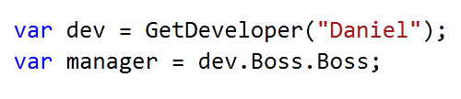

Slide 9
What if “dev” is null?

Slide 10
What if one of the “Boss” is null?

Slide 11
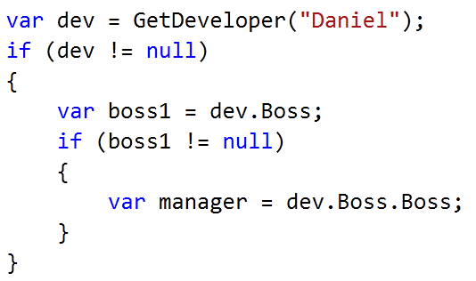

Slide 12
Ugly!!
and violates the called “Law of Demeter”

Slide 13
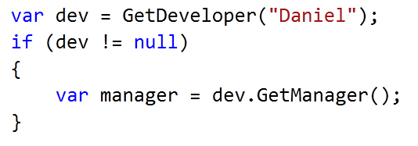
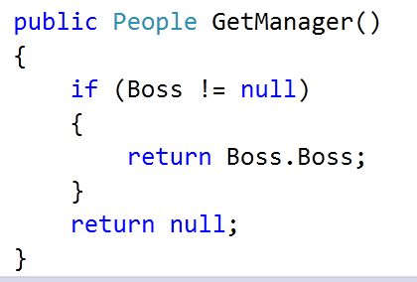

Slide 14
Is this better?
Really better?
Really really better?

Slide 15
So, for this particular case:
The Null Object Pattern
Bobby Woolf
“Provide a surrogate for another object that shares the same interface but does nothing. The Null Object encapsulates the implementation decisions of how to “do nothing” and hides those details from its collaborators.”
* This pattern has others uses besides this one.

Slide 16

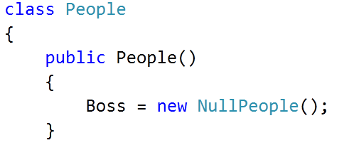
Boss is never null, now!

Slide 17

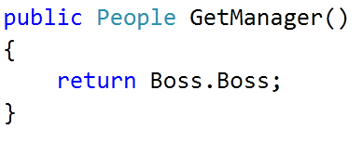
Now this is safe.
This is also safe.

Slide 18
Now this is safe.
This is also safe.

Slide 19
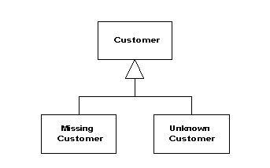
Is this good?
Of course it is... It is “A PATTERN”.
Even Fowler uses it:
http://martinfowler.com/eaaCatalog/specialCase.html

Slide 20
Seriously...
It is a good solution for a Object Oriented Languague...
But there is life outside OO!!

Slide 21
Coming back to Monads...
We do not know if the value
is null or not.

Slide 22
Although any class can be null, let us say that method was declared like this:

Slide 23
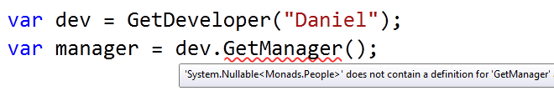
We have a problem now:
Any code that works with “People” class does not work with Nullable<People>.

Slide 24
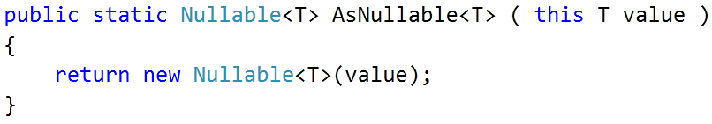
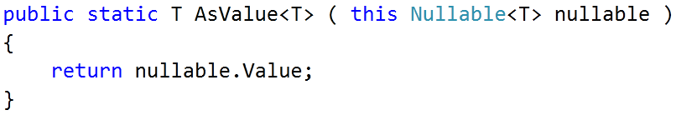
We need two transformations:
People
Nullable<People>
People
Nullable<People>

Slide 25
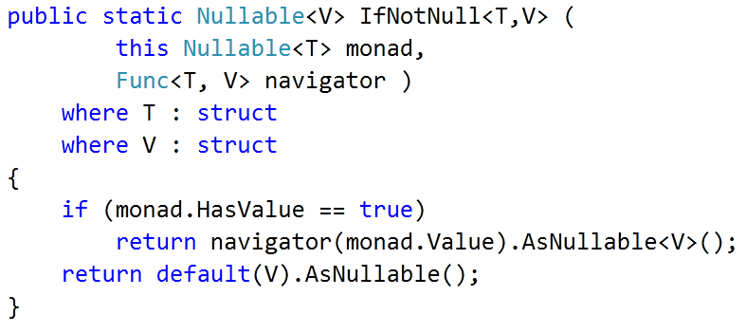
Let us analyse the following extension method:

Slide 26
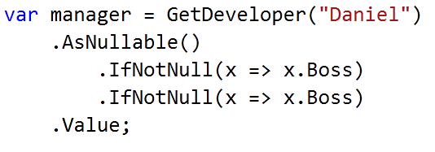
This allows me to do the following code:
I still do not know if manager is null or not...
But i do not throw any exception
And...

Slide 27
Before “and...”
Where is the monad??

Slide 28
Before “and...”
Where is the monad??
Entering in the monad

Slide 29
Before “and...”
Where is the monad??
Working in the monad.

Slide 30
Before “and...”
Where is the monad??
Still working in the monad.

Slide 31
Before “and...”
Where is the monad??
Leaving the monad.

Slide 32
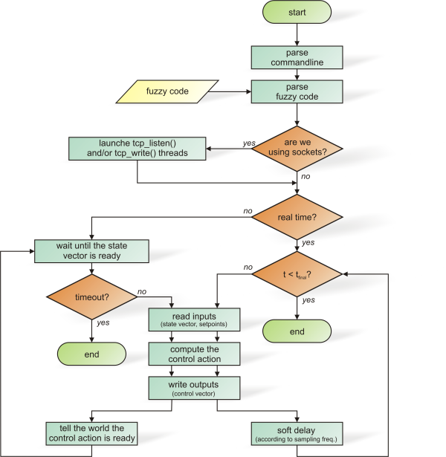
A monad is a “abstract unit of composition of a domain”.
We use monad everywhere!!
Examples?

Slide 33
We just did the “Maybe Monad”
http://www.haskell.org/all_about_monads/html/maybemonad.html
You sincerely will not want to see the Haskell code copied here...
Belive me...

Slide 34
Reading the paper

Slide 35


Slide 36
Entering the monad
In the example:
T -> Nullable<T>

Slide 37
unitM is a method that accepts
any type ( named “a”) and return its associated monadic type ( named “M a” )

Slide 38
bindM is a method that accepts
a monad and a function that transform a monad and return this tranformed monad

Slide 39
unitM
Monad constructor.
bindM
Abstract composition of the monad.

Slide 40
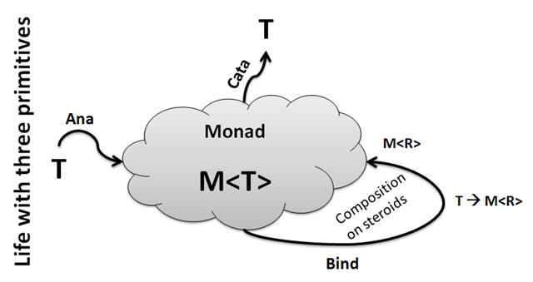
LINQ is also a monad...
The “List Monad”

Slide 41
Anamorphism is the entrance in the monad.
Enumerable.Range()
AsEnumerable()
Catamorphism is the exit of the monad.
Sum()
First()

Slide 42
SelectMany is the BindM
Where, Skip, Take, etc... are specifs uses of SelectMany

Slide 43
Mathematical Representation
Monads as sets

Slide 44
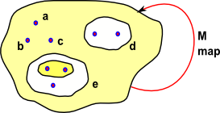
We start with a set which contains elements such as a,b & c, it may also contain subsets which themselves consist of elements like these and subsets of subsets and so on.

Slide 45
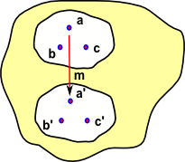
Imagine that we have some mapping 'm' that maps say a->a' (or in a different notation a -> m a)

Slide 46
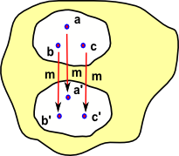
Now imagine that b and c are also compatible with this mapping so we can add similar maps b->b' and c->c' and so on.

Slide 47
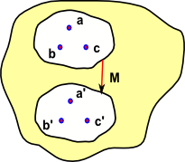
It would be useful to be able to avoid the need to iterate over the elements and map them individulally. We can map the whole set as a complete object provided that:
M {a,b,c} = {m a,m b,m c}
Usually in mathematical terminology we don't make a distinction between M and m, we use the same symbol regardless of whether we are mapping elements or whole subsets.

Slide 48
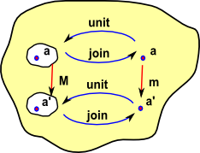
We can add two functions:
unit: maps 'a' to a set (a subset inside the main set) containing a.
join: maps 'a set containing a' to a.
So 'unit' and 'join' are inverses.

Slide 49
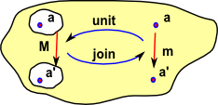
In the same way that we can use 'M' to map elements or whole sets we can use 'unit' and 'join' to map elements, sets or mappings.
So here 'unit' and 'join' represent mappings of mappings. In fact they are natural transormations.

Slide 50
Must Reads!
http://www.euclideanspace.com/maths/discrete/category/monad/index.htm
https://wiki.ittc.ku.edu/lambda/images/1/12/Wadler_-_The_essence_of_functional_programming_%281992%29.pdf
http://www.haskell.org/all_about_monads/html/maybemonad.html
http://blogs.msdn.com/b/wesdyer/archive/2008/01/11/the-marvels-of-monads.aspx
http://community.bartdesmet.net/blogs/bart/archive/2010/01/01/the-essence-of-linq-minlinq.aspx

Slide 51
And now...
The Pythagorean Representation of a monad...

Slide 52
