Slide 2
Simple aplicação Web
Autenticação Federada
Integração entre Sistemas
Enterprise Service Bus
Web API
Cloud

Slide 3
Sprint 1
Preciso de uma aplicação para cadastrar os meus principais ativos.

Slide 4
Simples Aplicação Web
Risk Manager
Asset

Slide 5
Simples Aplicação Web
Presentation Layer
Business Layer
Data Access Layer

Slide 6
Simples Aplicação Web
ASP NET WebForms
MVP
Services
Inversão de Controle
Domain
ORM
Repositories

Slide 7
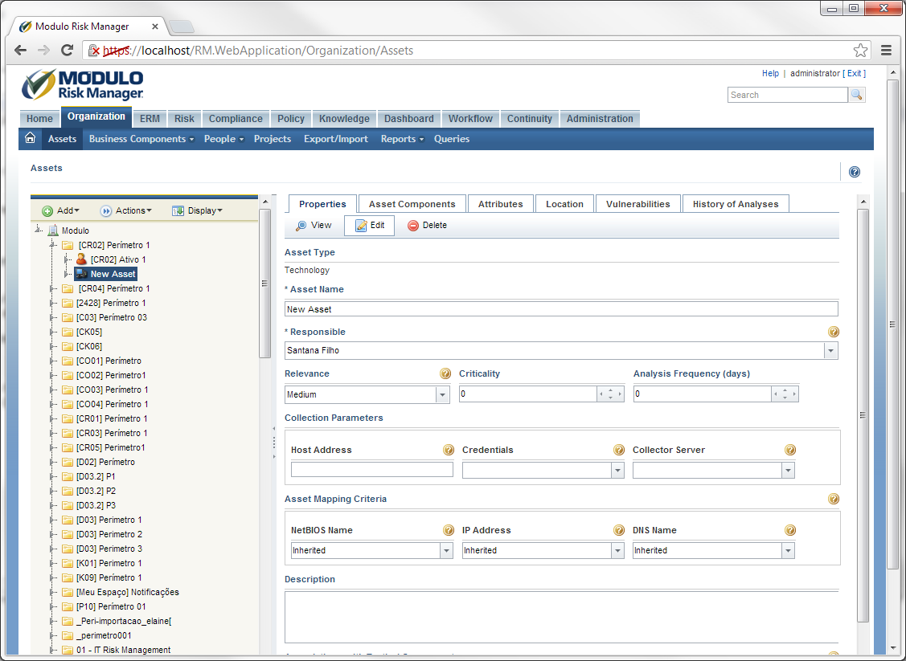

Slide 8


ASP NET Webforms
ASP NET MVC
Layering
Domain Model
Service Layer
Unit of Work
Identity Map
Single-Table/Class-Table Mapping
Query Object
etc...

Slide 9
Sprint 2
Ficou muito bom! Porém, possuímos dois clientes que não gostaram da nossa autenticação. Um deles possui um framework próprio feito em Java e o outro gostaria de usar o Activery Directory da Microsoft.

Slide 10
Autenticação Federada
Identity Provider
Risk Manager

Slide 11
Autenticação Federada
Identity Provider
Risk Manager

Slide 12
Autenticação Federada
Identity Provider
Risk Manager

Slide 13
Autenticação Federada
Identity Provider
Risk Manager
https://www.modulo.com.br/RM/login.aspx?client=1

Slide 14
Autenticação Federada
Identity Provider
Risk Manager
302 https://www.client1.com.br/login

Slide 15
Autenticação Federada
Identity Provider
Risk Manager
https://www.client1.com.br/login?goto=https://www.modulo.com.br/rm/sso.aspx

Slide 16
Autenticação Federada
Identity Provider
Risk Manager
302 https://www.modulo.com.br/rm/sso.aspx
Set-Cookie: <TOKEN>

Slide 17
Autenticação Federada
Identity Provider
Risk Manager
GET https://www.modulo.com.br/rm/sso.aspx
Cookie: <TOKEN>

Slide 18
Autenticação Federada
Identity Provider
Nome=Daniel
Risk Manager

Slide 19
Autenticação Federada
Identity Provider
Risk Manager
302 /RM/Default.aspx

Slide 20
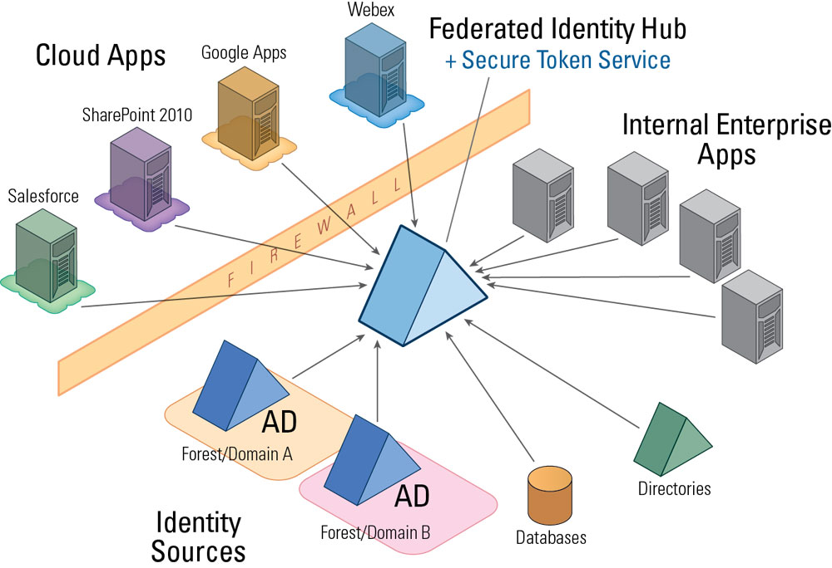

Slide 21
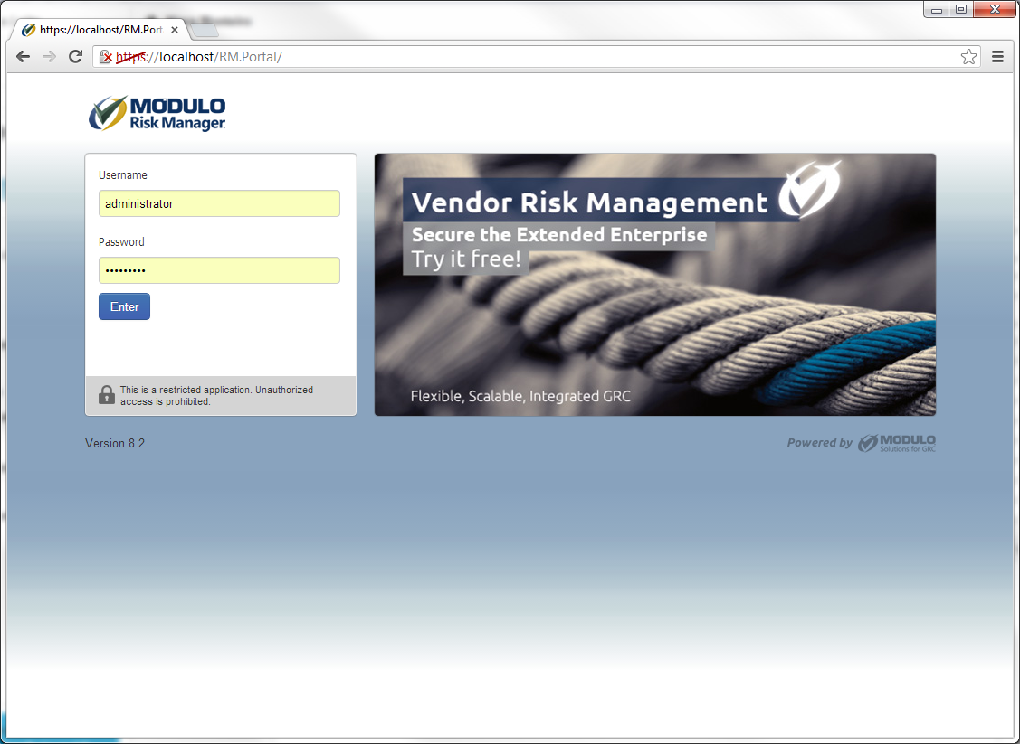

Slide 22


Slide 23


Windows Authentication Foundation
Claims-based Identity
SAML
Identity Provider/Sources
Secure Token Service
Criptografia Assimétrica
Certificados
Assinatura Digital
Public Key Infrastructure

Slide 24
Sprint 3
Ficou muito bom! Porém, agora precisamos identificar quais os ativos que estão com risco muito alto e mandá-los para tratamento. Para isso preciso de um módulo que administre os passos para o tratamento desse risco.

Slide 25
Sprint 3
Risk Manager
Asset
RM

Slide 26
Sprint 3
Risk Manager
Workflow Manager
Asset
Event
RM

Slide 27
Sprint 3
Risk Manager Presentations
Workflow Manager Presentations
Risk Manager Business Logic
Workflow Manager Business Logic
Risk Manager Data Access Layer
Workflow Manager Data Access Layer

Slide 28
Sprint 3
AH! Esqueci de um detalhe! As alterações no ativo que são feitas no Risk Manager não podem alterar as informações no Workflow Manager. Isso muda muita coisa??
Risk Manager Presentations
Workflow Manager Presentations
Risk Manager Business Logic
Workflow Manager Business Logic
Risk Manager Data Access Layer
Workflow Manager Data Access Layer

Slide 29
Sprint 3
Risk Manager
Workflow Manager
Asset
Event
RM

Slide 30
Sprint 3
Risk Manager
Workflow Manager
Asset
Asset
Event
RM
WM

Slide 31
Sprint 3
AH! Esqueci de outro detalhe! O nome quando for alterado tem que mudar no Workflow Manager, as outras propriedades não podem mudar.
Risk Manager
Workflow Manager
Asset
Asset
Event
RM
WM

Slide 32
Sprint 3
Risk Manager
Workflow Manager
Asset
Asset
Event
RM
WM

Slide 33
Sprint 3
Risk Manager
Workflow Manager
CreateEvent()
UpdateAssetName()

Slide 34
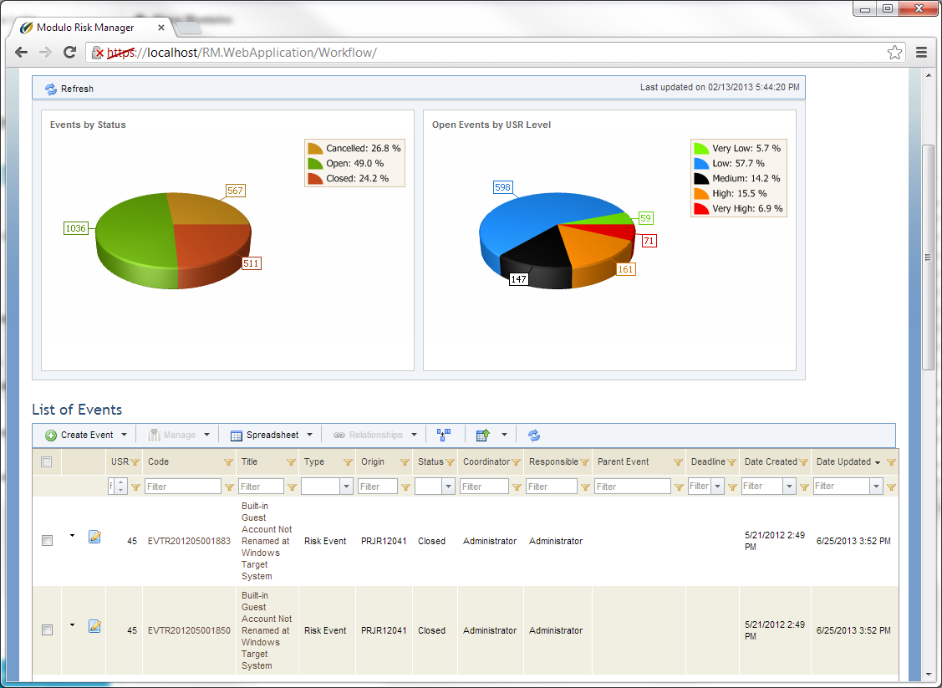

Slide 35


Bounded Context
Context-Map
Anti-Corruption Layer
Remote Service
Windows Comunication Foundation
SOAP

Slide 36
Sprint 4
A integração ficou muito boa! Agora precisamos que seja feita outra integração com o sisteam de BCM. Porém temos uma peculariedade: os ativos no BCM precisam congelar caso exista algum plano associados àquele ativo.

Slide 37
Sprint 3
BCM
Risk Manager
Workflow Manager
Asset
Asset
Asset
Event
BCM
RM
WM

Slide 38
Sprint 3
BCM
Risk Manager
Workflow Manager
Asset
Asset
Asset
Event
BCM
RM
WM

Slide 39
RM Business Logic
WM Business Logic
BCM Business Logic
Update Asset
Update Asset
Update Asset

Slide 40
RM Business Logic
WM Business Logic
BCM Business Logic
Update Asset
Update Asset
Update Asset

Slide 41
???
RM Business Logic
WM Business Logic
BCM Business Logic
Update Asset
Update Asset
Update Asset

Slide 42
RM Presentation
RM Business Logic
WM Business Logic
BCM Business Logic
Update Asset
Update Asset
Update Asset

Slide 43
RM Business Logic
WM Business Logic
BCM Business Logic
Update Asset
Update Asset
Update Asset

Slide 44
Sprint 3
BCM
Risk Manager
Workflow Manager
Asset
Asset
Asset
Event
BCM
RM
WM

Slide 45
Risk Manager
Workflow Manager
Enterprise Service Bus
BCM

Slide 46
Loose Coupling
A node can produce an event without any need to know who are the subscribers.
A node can subscribe to an event (or event type) without any knowledge of possible publishers of this kind of event.
Routing
The event stream can be filtered according to arbitrary criteria.
The subscribers are able to define the classification of interesting events as broad or as narrow they want.
Service Catalog
The event set can be dynamically enlarged to include new events or event types.
Subscribing/Unsubscribing
There can exist a multitude of possible publishers of an event type.
The notification system is wholly dynamical and the sets of publishers and subscribers
are independent.
The subscribers can draw a list of the events critical to them and subscribe to all.

Slide 47
Risk Manager
Workflow Manager
Publication
API
Subscription API
Core
Routing
Orchestration
Mediation

Slide 48
Routing
Topic based
Type based
Content based
Context based
Orchestration
Workflow Foundation
WS-BPEL
WS-CDL

Slide 49
Sprint 3
BCM
Risk Manager
Workflow Manager
Asset
Asset
Asset
Event
BCM
RM
WM

Slide 50
Sprint 3
BCM
Risk Manager
Workflow Manager
Asset
Asset
Asset
Event
BCM
RM
WM

Slide 51
Sprint 3
BCM
Risk Manager
Workflow Manager
Asset
Asset
Asset
Event
BCM
RM
WM

Slide 52
Sprint 3
BCM
Risk Manager
Workflow Manager
Asset
Asset
Asset
Event
BCM
RM
WM

Slide 53
Risk Manager Presentations
Workflow Manager Presentations
Risk Manager Business Logic
Workflow Manager Business Logic
Risk Manager Data Access Layer
Workflow Manager Data Access Layer

Slide 54
Risk Manager Presentations
Workflow Manager Presentations
Risk Manager Business Logic
Workflow Manager Business Logic
Risk Manager Data Access Layer
Workflow Manager Data Access Layer

Slide 55

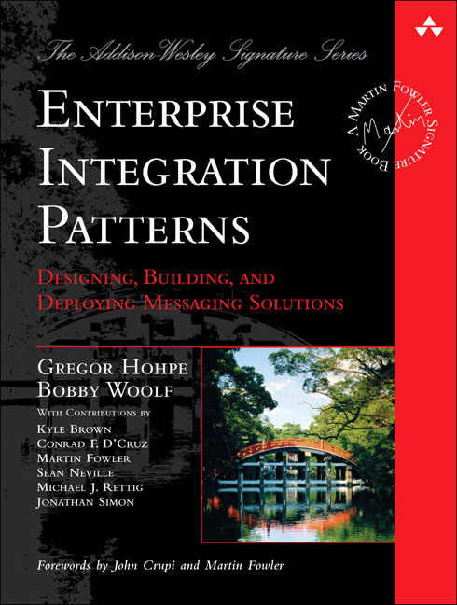
Complex Event Processing
Actor based programming
Reactive Programming
Rx
TPL Dataflow
Pub/Sub
Broker Pattern
Observer Pattern
Pipe and Filters Architecture
Routing
Publish-Subscriber Channel
Message Transformation

Slide 56
Sprint 5
Agora que ficou muito mais simples integrar os nossos sistemas, precisamos um modo simples de permitir que os usuários na internet interajam com o sistema.

Slide 57
Risk Manager
ESB
API
Workflow Manager
BCM

Slide 58
REST
Representational State Transfer
Architectural style for distributed hypermedia systems
Representations
A representation is a sequence of bytes, plus representation metadata to describe those bytes.
State
Application State
Transfer
The model application is therefore an engine that moves from one state to the next by examining and choosing from among the alternative state transitions in the current set of representations.

Slide 59
“a network of web pages (a virtual state-machine), where the user progresses through the application by selecting links (state transitions), resulting in the next page (representing the next state of the application) being transferred to the user and rendered for their use.”

Slide 60
GET /api/assets/1
{
“Name”:”Ativo 1”
“_transfers”: [
{ “vulnerabilities”, “https://fqdn/api/assets/1/vulnerabilities”},
{ “treat”, “https://fqdn/api/assets/1/events/{id}”}
]
}

Slide 61
PUT /api/assets/1/events/1
{
“Name”:”Tratamento da Vulnerabilidade1”
“_transfers”: [
{ “cancel”, “https://fqdn/api/assets/1/vulnerabilities”}
]
}

Slide 62

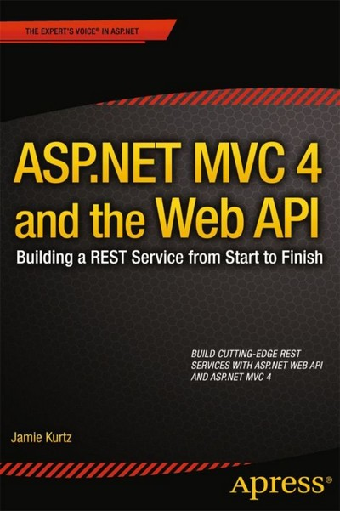
REST
Oauth
ASPNET Web API

Slide 63
Sprint 6
O sitema ficou ótimo! Agora precisamos ter capacidade de atender o SLA dos nossos clientes que estão rodando em SAAS.

Slide 64
Worker
Web Server
Worker
Queue
Worker

Slide 65
Worker
Web Server
Worker
Queue
Worker
Windows Azure Web Server Role
Windows Azure Background Worker
Windows Azure Queue

Slide 66
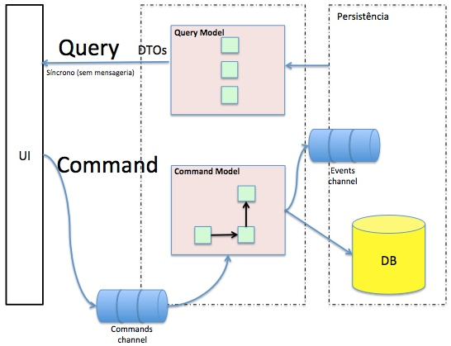

Slide 67
The problem is:
Windows Azure is an option... but the system must run on “public” and “private” cloud. Actually, it must run on only one server also.
Solution:
Implement a framework that looks like the Windows Azure, but run on our code.

Slide 68
Lease API
Queue API
Task Runner API
Task Scheduler API

Slide 69
Lease API
LEASE
API
API
GET /Lease/<ID>
PUT /Lease/<ID>
DELETE /Lease/<ID>
API
API
DB

Slide 70
Queue
Queue Worker
Queue Worker
Queue Worker
Mensagem revive na fila por timeout para garantir que será consumida pelo menos uma vez
“Worker” é stateless e não precisa de consenso
API
GET /Queue/<ID>
PUT /Queue/<ID>
API
API
API
DB

Slide 71
TASK SCHEDULER
LEASE API
Scheduler Worker
Scheduler Worker
Scheduler Worker
QUEUE
API
API é multi instance para garantir HA (Sempre consigo agendar uma tarefa)
Scheduler Worker é multi instance para garantir que ao menos uma mensagem entrará na fila
Consenso dos Workers é “garantido” pelo timer de atualização.
Caso seja necessário existe o algoritmo Paxos.
API
API
DB

Slide 72
TASK SCHEDULER
LEASE API
Runner Worker
Runner Worker
Runner Worker
QUEUE
JOB
Runner Worker
JOB
JOB
JOB
API
API é multi instance para garantir HA
Visibilidade da mensagem garante que a mensagem é consumida somente uma vez
Lease garante que a mensagem não será consumida mais do que uma vez
API
API
JOB DB
DB

Slide 73
Fluxos
Scheduler sendo agendado
Scheduler entrando na fila
Runner consumindo a fila
#1 demora a deletar a mensagem
#1 demora a renovar o lease
Job lifecycle
Concorrência de Jobs
Mensagem sem Lease

Slide 74
Scheduler sendo agendado
Scheduler #1 pega o Lease <TENANT>.<SCHEDULEID>
Scheduler #1 salva no banco
Scheduler #1 libera o Lease
Scheduler #2 pega o Lease <TENANT>.<SCHEDULEID>
Scheduler #2 salva no banco

Slide 75
Runner consumindo a fila
GET /Token/<TASK><SIG><DATE>Bus
PUT /Bus/<ID>
DELETE /Token/<TASK><SIG><DATE>Bus
GET /Bus/First
GET /Token/<TENANCY>.<TASK>
PUT /Token/<TENANCY>.<TASK>
PUT /Token/<TENANCY>.<TASK>
DELETE /Bus/<ID>

Slide 76
#1 demora a deletar a mensagem
Mensagem revive na fila
GET LEASE negado
Tarefa se finaliza com erro

Slide 77
Lease API
LEASE
API
API
GET /Lease/<ID>
PUT /Lease/<ID>
DELETE /Lease/<ID>
API
API
DB

Slide 78
Lease API
Single Point of Failure
LEASE
API
API
GET /Lease/<ID>
PUT /Lease/<ID>
DELETE /Lease/<ID>
API
API
ERRO
DB

Slide 79
Lease API
LEASE
Lease
Lease
Lease
Lease
Lease
API
API
GET /Lease/<ID>
PUT /Lease/<ID>
DELETE /Lease/<ID>
API
API
Load Balancer

Slide 80
Lease API
int Get(<leaseID>)
bool Put(<leaseID>, <status>)
Hash Table
Distributed Hash Table
Consistent Hashing

Slide 81
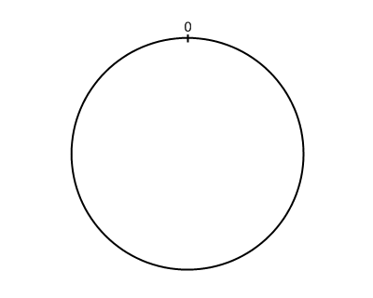

Slide 82
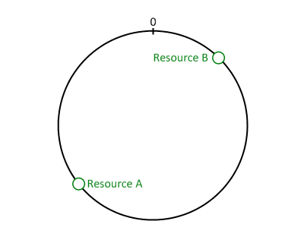

Slide 83
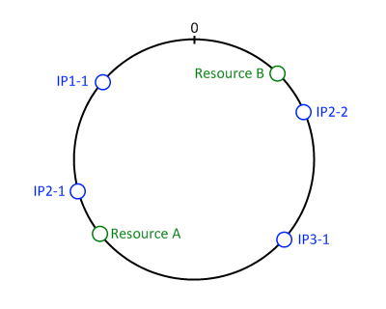

Slide 85
Write Strategies
Write-All
Write to everyone and waits everybody
Write-Quorum
Write to everyone and waits the majority to return
Read Strategies
Read-Any
Reads everyone and uses the first response
Read-Quorum
Reads everyone, uses the quorum and update values if answers do not match

Slide 86
THE END

Slide 87
Daniel Frederico Lins Leite
dleite@modulo.com.br

