Slide 1

MGrammar

Slide 2
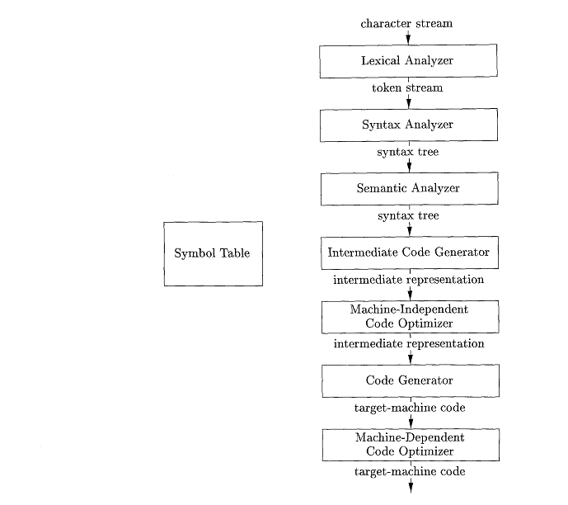

Slide 3
MGrammar

Slide 4
Position = initial + rate * 60
<id,1>< = ><id,2><+><id,3><*><number,4>
Lexical
Analyser

Slide 5
<id,1>< = ><id,2><+><id,3><*><number,4>
Syntax
Analyser
=
<id,1>
+
<id,2>
*
<id,3>
<number,4>

Slide 6
=
<id,1>
+
<id,2>
*
<id,3>
<number,4>
Semantic
Analyser
=
<id,1>
+
<id,2>
*
<id,3>
IntToFloat
<60>

Slide 7
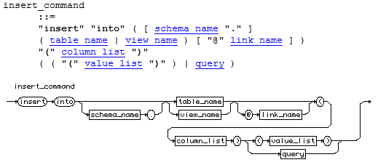
Backus–Naur Form
Exemplo de BNF

Slide 8
Backus–Naur Form
A set of terminal symbols, sometimes referred to as "tokens." The terminals are the elementary symbols of the language defined by the grammar.
Token
Exemplo

Slide 9
Backus–Naur Form
A set of nonterminals, sometimes called "syntactic variables." Each nonterminal represents a set of […] of terminals[…]
Exemplo
Syntatic Variable

Slide 10
Backus–Naur Form
Production
A set of productions, where each production consists of a nonterminal,
called the head or left side of the production, an arrow, and a sequence of terminals and/or nonterminals, called the body or right side of the produc-
tion. The intuitive intent of a production is to specify one of the written
forms of a construct; if the head nonterminal represents a construct, then
the body represents a written form of the construct.
Exemplo

Slide 11
A designation of one of the nonterminals as the start symbol.

Slide 12
Exemplo do MGrammar
module Modulo
{
language Complex
{
token digit = "0".."9";
token number = digit+;
token realNumber = number "." number | number;
syntax complexNumber = realNumber "+" realNumber "i";
syntax Main = complexNumber;
}
}

Slide 13
Problemas
Ambiguidade
module Modulo
{
language Ambiguity
{
syntax Main = Main "+" Main | Main "-" Main
| "0" | "1" | "2" | "3" | "4" | "5" |
"6" | "7" | "8" | "9" ;
}
}

Slide 14
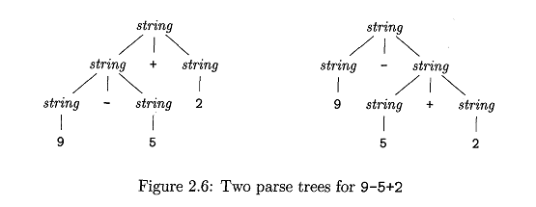

Slide 15
Associatividade
We say that the operator + associates to the left, because an operand with plus signs on both sides of it belongs to the operator to its left

Slide 16
Solução
module Modulo
{
language Ambiguity
{
syntax Main = Main left(1)"+" Main | Main left(1)"-" Main
| "0" | "1" | "2" | "3" | "4" | "5" |
"6" | "7" | "8" | "9" ;
}
}

Slide 17
Problema
Precedência
module Modulo
{
language Ambiguity
{
syntax Main = Main left(1)"+" Main | Main left(1)"*" Main
| "0" | "1" | "2" | "3" | "4" | "5" |
"6" | "7" | "8" | "9" ;
}
}

Slide 18
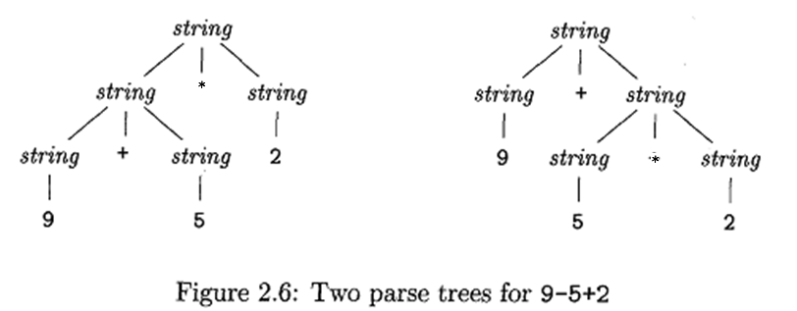

Slide 19
Solução
module Modulo
{
language Ambiguity
{
syntax Main = Main left(1)"+" Main | Main left(2)"*" Main
| "0" | "1" | "2" | "3" | "4" | "5" |
"6" | "7" | "8" | "9" ;
}
}

Slide 20
Interleave
module Modulo
{
language Ambiguity
{
syntax Main = Main left(1)"+" Main | Main left(2)"*" Main
| "0" | "1" | "2" | "3" | "4" | "5" |
"6" | "7" | "8" | "9" ;
interleave Ignore = " ";
}
}

Slide 21
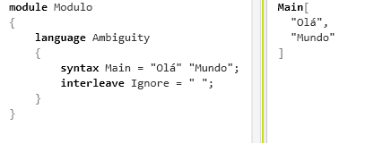
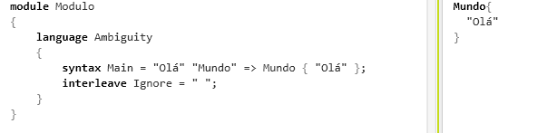
Projeção

Slide 22
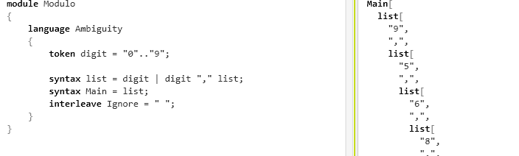
valuesof

Slide 23
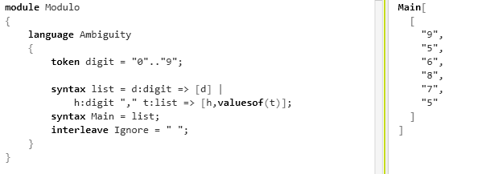
valuesof

