Slide 1

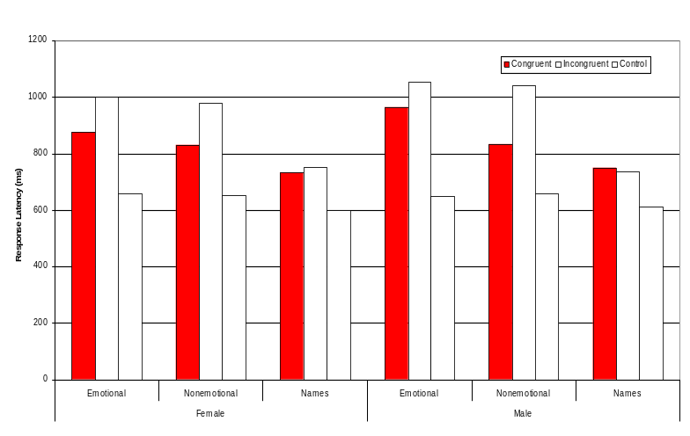
Title
Shauna Student
Department of Psychology, St. Cloud State University
Leslie Valdes, Sponsor
Background
What is the background information?
Past research has found what?
What are the important concepts in the study?
What is the purpose of your study?
Background. Background. Background. Background. Background. Background. Background. Background. Background. Background. Background. Background. Background. Background. Background. Background. Background. Background. Background. Background. Background. Background. Background. Background. Background. Background. Background. Background. Background. Background. Background. Background. Background. Background. Background. Background.
Method
Participants
Who presented
Stimuli
What were tests, questionnaires, tasks, etc.
Design
What were the variables
Conclusions
Hypothesis supported? What do the results mean?
Implications. Implications. Implications. Implications. Implications. Implications. Implications. Implications. Implications. Implications. Implications. Implications. Implications. Implications. Implications. Implications. Implications. Implications. Implications. Implications. Implications.
Results
What were the results? The descriptive and inferential statistics if appropriate. Reference to table or figure.
References
Reference, D. (2011) Good stuff. New York: Important Press.
Reference, D. (2011) Good stuff. New York: Important Press.
Reference, D. (2011) Good stuff. New York: Important Press.
Reference, D. (2011) Good stuff. New York: Important Press.
Hypothesis
Responses would be slower when participants had to remember women’s names with non-emotional words compared to remembering men’s names with non-emotional words.
Acknowledgements
The author thanks the student government for partially funding this poster and the help of the psychology club.

