Slide 1
A Label-switching Packet Forwarding
Architecture for Multi-hop Wireless LANs
  Arup Acharya Archan Misra
  IBM TJ Watson Research Center
  Sorav Bansal
  Stanford University

Slide 2

Motivation : Future of multi-hop WLANs
Emergence of high-speed and variable rate WLANs
  1,2,..,11, ..,22, ..,54, 108 Mbps
  Larger bit-rate  smaller coverage area
Multi-hop architecture for fixed wireless networks
  Start with a large cell; as nodes increase split into (higher rate) smaller cells
  Multi-hop wireless path to wireline gateway
Much of current work in ad-hoc networks on routing protocols and (single-cell) MAC
Efficient packet forwarding has not been studied : focus of this paper
54
22
11
Notes:
As motivation for our work, we think as higher rate wlans emerge, we will see multi-hop archiectures for fixed wireless networks. Currentlt, bit-rates for wlans can go upto 108mbps. However, as the bit-rate increases, the range goes down. We can then think of a cellular like architecture, where we start a large cell, say at 11Mbps, and as the number of nodes increase, we progressivley split the cell into smaller cells with higher data rates (show figure). An application for such an idea could be a multi-hop wireless path to a wireline gateway, for neighborhood networks, in large warehouses
Current work in ad-hoc networks has been focused on routing and MAC schemes, In this paper we look at the datapath instead , specifically what are the issues and what is a good architecture for packet fwd’ing specifically for multi-hop wireless networks. Note that in wired networks, packet forwarding has been studied quite well, such as different fast IP lookup schemes resulting in gigabit routers. So, what are the issues unique to the multi-hop networks : that is the focus of this paper.

Slide 3
Motivation (contd.)
A wireline router requires at least two network interfaces for packet forwarding
    A router is a specialized node
A wireless node can forward packets with a single network interface card (NIC)
      Node B can reach both nodes A and C using the same wireless interface
      (Nodes A and C out of range of each other)
  Any intermediate node in a multi-hop wireless network can operate as a router
    ◆ wide-applicability for a packet forwarding architecture
A
C
B
A
C
B

Slide 4
Background : Packet Forwarding using 802.11 DCF
Channel access by upstream node A (RTS/CTS/ DATA/ACK)
Receive packet at node B’s network interface card
  Transfer packet from NIC to host memory
    Remove MAC header
    Lookup route, next hop IP/MAC address
    Add new MAC header (destination address C)
  Transfer packet from host memory to NIC
Channel access by node B (RTS/CTS/DATA/ACK)
What is a good architecture for packet forwarding ?
Timer Expiry
Upstream Transfer
Transfer packet to host for IP route lookup
DATA
A
DIFS
RTS
DATA
RTS
B
CTS
ACK
DIFS
C
CTS
ACK
Downstream Transfer
Notes:
As background, let walk through the steps for sending a packet from A to C via a forwarding node B. The first step is the upstream channel access by A and B : this follows the standard RTS/CTS/DATA/ACK sequence. The next step is packet processing at node B : it receives the packet on its NIC, transfers the packet to the host which looks up the next hop IP and MAC address based oin the packet’s destination IP address, transfers the pacekt back to the NIC. The third step is downstream channel access by B and C, followed by packet transmission to C. Points to note : 2 INDEPENDENT channel accesses which means double the control overhead : the channel has to be sensed free for DIFS period plus a random time intreval TWICE.

Slide 5
Our contribution : Efficient packet forwarding
Architecture for packet forwarding in wireless nodes
  Address lookup using a table of labels in the NIC
    Fixed-length labels enable exact matching, simple implementation
    Packet forwarding entirely within the NIC
      Avoids packet transfer to/from host
  Enhanced 802.11 DCF MAC : combines upstream and downstream channel accesses
    A new ACK/RTS MAC control packet
    ACK/RTS carries a label
Performance study via simulation
host
bus
NIC

Slide 6
Label switching : conceptual operation
C
A
Dest Next-hop Label
C B L1
host
B
IP pkt
MAC_{c}
L2
input
output
IP pkt
MAC_{B}
L1
L2
host
input
output
NIC
L1
MAC_{C}
L2
NIC
NIC
IP pkt
MAC_{c}
L2

Slide 7
NIC/ Host support for label switching
A label-switching table in the NIC
  Enables packet fwd’ing at an intermediate node’s NIC
Table populated by a label distribution protocol in the host
    Similar to use of MPLS (multi-protocol label switching) in wired core networks
  Maps routes/destinations to labels
  First node labels packet based on destination IP
Host
Label
Distribution
Protocol
Routing
Protocol
ARP
IP address
(route entry)
MAC addr
(next hop)
Label
packet queue
Network Interface
packet
buffer
packet
mac
label
MAC
processing
NAV
Data Packet
Transfer
INPUT
Label
OUTPUT
MAC Label
Label switching table
Radio

Slide 8
Enhancements to the 802.11 MAC
Forwarding node (B) combines ACK to upstream (A) with RTS to downstream node (C)
  New ACK/RTS control packet
Include a label in the ACK/RTS corresponding to the final destination
  Allows receiver to determine next-hop : lookup label-switching table in the NIC
      Eliminates the need for a host-based route lookup
SIFS
R
T
S
T
T
DATA
T
A
ACK
Flag
MAC address
C
T
S
A R
C T
K S
RTS
Flag
MAC address
(out) Label
DATA
B
ACK/RTS control packet
C
T
S
A R
C T
K S
DATA
C
C
T
S
D
DATA DRIVEN CUT-THROUGH MAC (DCMA)

Slide 9
MAC enhancements : observations
ACK/RTS packet receives preferential access
  channel reserved for T via CTS
      neighborhood of B silent till end of ACK
  Can cut-through over multiple hops if channel is free
  No need to sense channel for downstream access for DIFS + timer
  Downstream node (C) may deny CTS
      fall back on base 802.11
      independent transfer from B to C
R
T
S
DATA
A
C
T
S
A R
C T
K S
B
T
C
T
S
C

Slide 10
Simulated Performance of DCMA vs 802.11
Result shown on a 7-hop chain
  Significant reduction in latency
Data transfer overhead between NIC and host not included
  Real results should be even more striking.
802.11
DCMA
Throughput vs Packet Size
Latency vs Packet Size
400
3
300
2
Throughput (Kbps)
End-to-End
200
Latency (s)
100
1
0
0
256
512
1024
1536
256
512
1024
1536
Data Packet Size (Bytes)
Data Packet Size (Bytes)

Slide 11
Results on a 4x4 grid
DCMA offers a flow preferential access
  Links suffering from high interference (inner nodes) experience less performance degradation.
Inner rows gain at the expense of outer row→ fairer throughput distribution.
802.11
DCMA
Grid: Throughput (Kbps)
Grid: End-to-End Latency (secs)
600
8
500
7
6
400
5
300
4
200
3
2
100
1
0
0
Column 1
Column 2
Column 3
Column 4
Column 1
Column 2
Column 3
Column 4

Slide 12
Summary
An architecture for packet forwarding by intermediate nodes
  Packet forwarding accomplished within the NIC
  Host to NIC transfers avoided
Components of the architecture
  MAC enhancement : combine ACK and RTS
  Use label-switching
      Destinations/routes mapped to labels
      ACK/RTS carries label
  A label-switching table in the NIC
      (incoming label)  (outgoing label, next-hop MAC address)
Current work : extending 802.11 DCF to allow simultaneous transmissions in neighboring cells
S1
S1
R1
R1
S2
R2
R2
S2

Slide 13
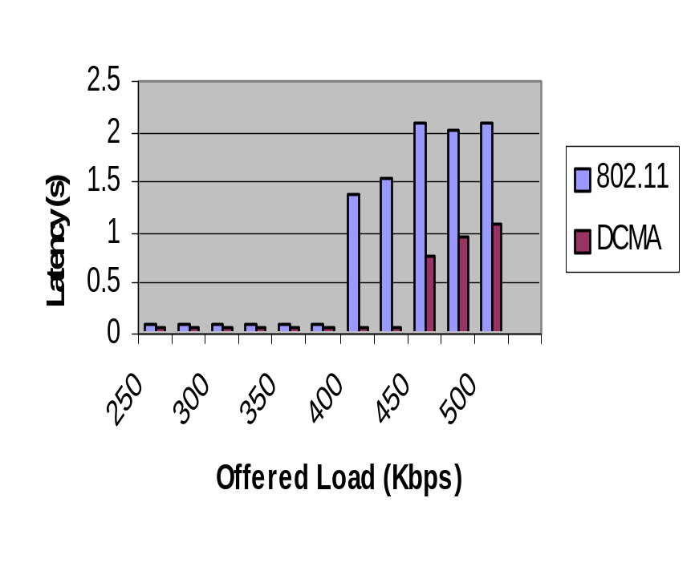
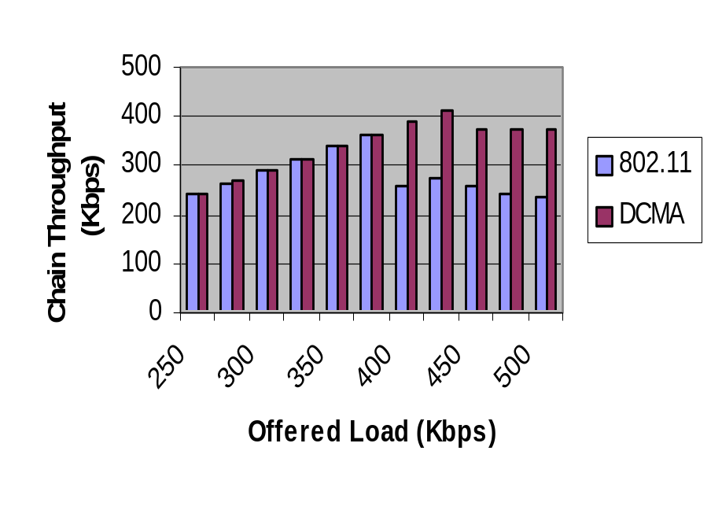
Backup 1: DCMA Performance with Varying Transmission Rates (12 hop chain)
Effect of contention between intra-flow packets is reduced in DCMA.
  Packets move along faster and thus compete less with each other.
DCMA throughput saturates at a higher value of offered load.

Slide 14
Backup 2: Simulation Details
2Mbps channel, 550 meters interference range, 250 meters transmission range.
Node buffer size of 50 packets.
Grid distance = 250 meters → diagonal nodes (425 meters) interfere with one another.
Increase in RTS_TIME and CTS_TIME values; no need to change DIFS or SIFS specifications.
DCMA suffers slower performance degradation as number of hops increases on the path.

Slide 15
802.11 DCF MAC
Four phases
  Request to send (RTS)
  Clear to send (CTS)
  DATA packet
  Acknowledgement (ACK)
SIFS
SIFS
Timer expiry
DIFS
R
T
S
DATA
A
C
T
S
A
C
K
B
SIFS
Time
802.11 DCF MAC

Slide 16
MACA-P : Limitations of 802.11 MAC
Distributed ad-hoc mode of 802.11 MAC based on RTS(request-to-send) / CTS (clear-to-send) : MACA proposal (Karn)
Neighborhoods of both sender and recvr blocked out
data
A
B
RTS
Q
P
Fundamental constraint : a recvr should
not be within range of >1 transmitter
ack
CTS
P
B
Q
A
Q
B
time
MACA-P : Can MACA be enhanced to allow parallel transmissions?
P
P
(1)
(1)
Q
Q
(2)
(2)
A
B
Q
P
(3)
(3)
B
B
(4)
(4)
A
A

