Slide 1
Supporting Concurrent Transmissions in Multi-Hop Wireless Networks
Arup Acharya
Archan Misra
Sorav Bansal
IBM Research
Sep 3, 2002.

Slide 2

High Performance Multi-Hop WLANs
Emergence of high-speed and variable rate WLANs.
  Speeds range within (2, …, 22, 54, 108).. Mbps
  Larger bit-rate→ smaller coverage area
Possible emergence of fixed wireless networks
  Cellular-like architecture
  Multi-hop wireless path to wireline gateway.
Overall Aim: Increase the transmission capacity of such networks.
54
54
22
11

Slide 3
MACA-P : Basic Aim
MACA-P : Can MACA be enhanced to allow parallel transmissions?
Fundamental constraint : a recvr should
not be within range of >1 transmitter
P
Q
A
B
P
P
(1)
(1)
Q
Q
(2)
(2)
A
B
Q
P
B
(3)
(3)
B
A
A
(4)
(4)

Slide 4
802.11 Limitation on Concurrent Transmissions
802.11
  4-way RTS / CTS-based exchange with no gaps.
  Entire neighborhood of both sender and receiver blocked out.
Key Observations
  No gap between RTS/CTS and DATA/ACK phases.
    All phases are contiguous to one another.
  Each node involved in a data packet exchange switches roles between a transmitter and a recipient.
    Role reversal occurs during both RTS/CTS and DATA/ACK pairs.
data
A
RTS
B
Q
P
ack
CTS
B
Q
time

Slide 5
MACA-P : Increasing Concurrent Transmissions
MACA-P Key idea: Let neighbors synchronize their simultaneous transmission activity.
  Preserves 802.11 features such as exponential backoffs, DIFS, SIFS etc.
Introduce variable “control” gap between RTS/CTS and DATA/ACK portions.
  Neighbors use this variable gap to synchronize any feasible transmissions.
  DATA/ACK portion of different transmissions are synchronized.
  Following nodes (those that attempt to synchronize to an existing schedule) set inflexible bit in RTS.
A
B
Q
P
time
T_{ack}
RTS
Tdata
B
A
CTS
Tdata
RTS
Q
P
CTS
Tack

Slide 6
MACA-P : Aligning Neighboring Data Receivers
P
Allow a receiver to change sender’s proposed schedule if receiver has a scheduled reception in its neighborhood
  Receiver sends CTS’ (modifying schedule)
Sender re-transmits RTS’ to informs neighbors of changed schedule
  Also used as RTS-NACK to free channel if CTS is not received.
Q
B
A
Tack
RTS
Tdata
P
Q
CTS
RTS
RTS’
A
CTS`
B
t1
t2

Slide 7
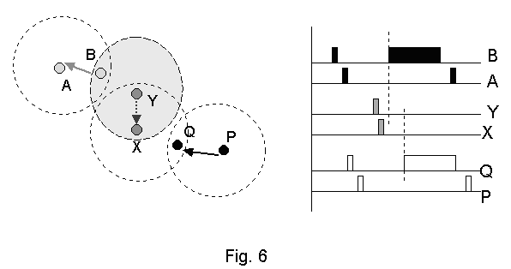
MACA-P: Notion of Master/Slave Schedules
Node initiates master transmission if it is unaware of any existing schedule.
  MACA-P invoked only for large pkt sizes.
Sender-receiver pair scheduling possible if at most only one member of pair has pre-existing master schedule.
  Alignment with >1 masters possible but leads to severe complications.

Slide 8
Implementation Details
  nav maintained as table with following entries.
  Entries must be rolled back/modified on RTS’/RTS-NACK.
Neighbor ID | State (Tx, Rx, Idle) | Tdata | Tack

Slide 9
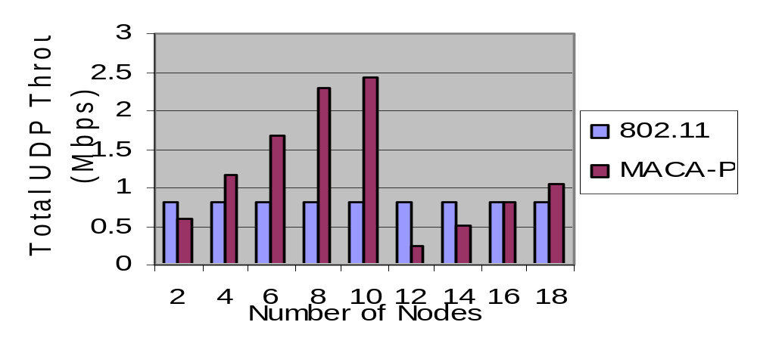
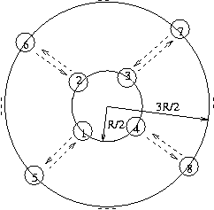
Basic MACA-P: Performance Results

Slide 10
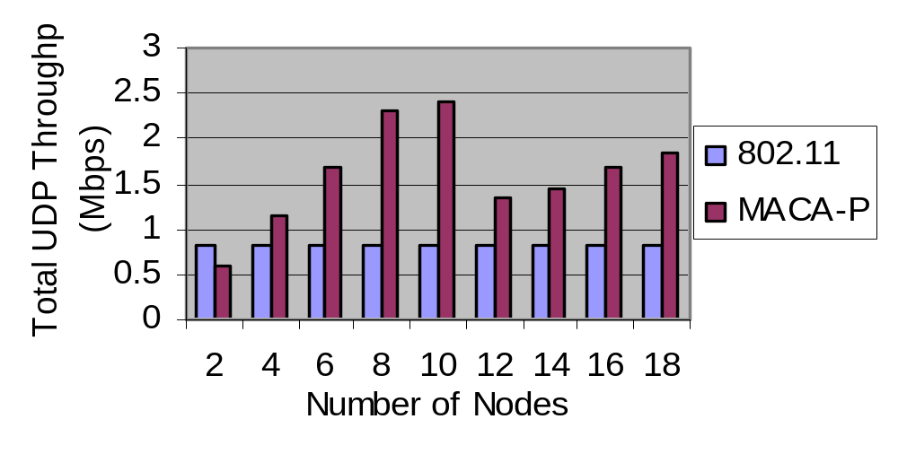
MACA-P: Introducing Adaptive Learning
MACA-P with Adaptive Learning
  F(P) = F(P)∗(1-α) + O∗α,
Senders learn of failed parallelism and update probabilities.
Notes:
The basic problem is that senders try to synchronize without receivers realizing that collisions will occur. (Receivers/senders of different pairs don’t hear one another and don’t know that they’re causing interference to each other. But senders can decide not to try such concurrency.

Slide 11
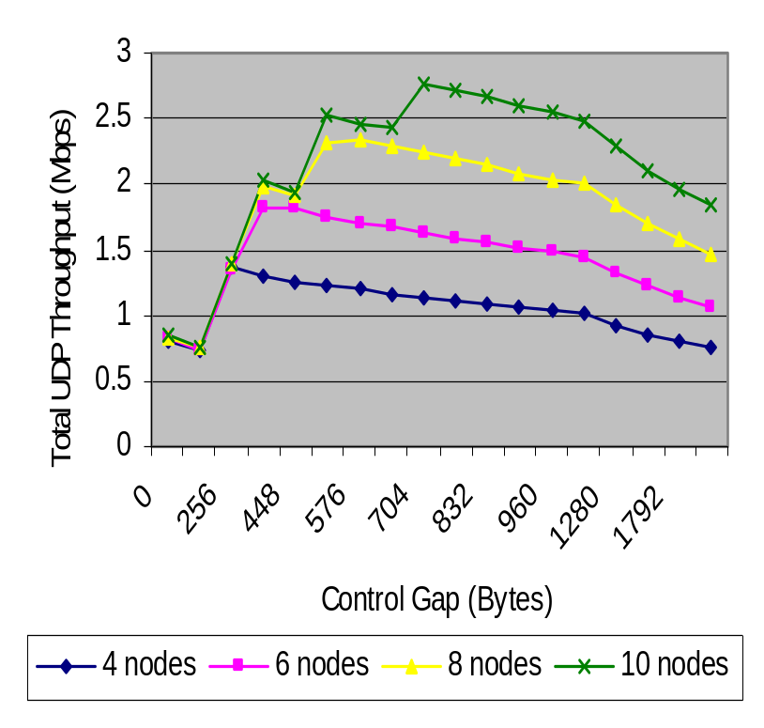
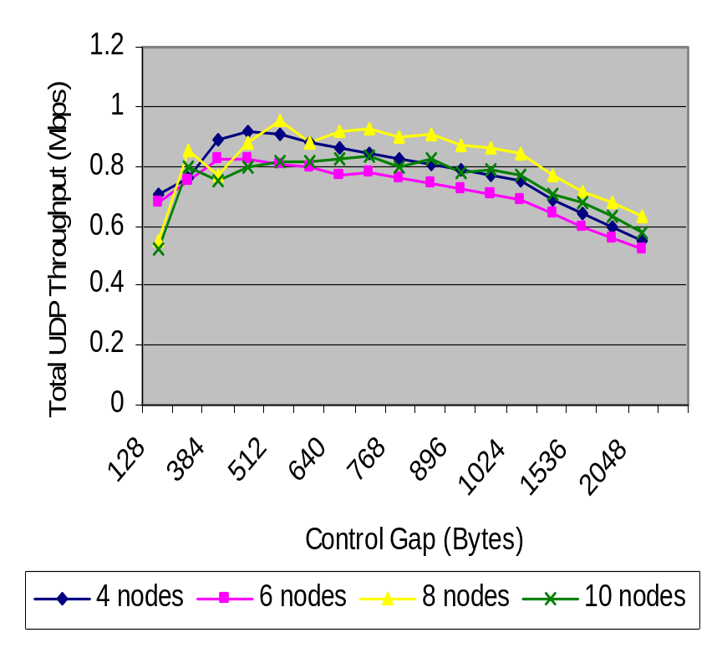
MACA-P: Effect on Control Gap on Performance
MACA-P for varying control gap in the Concentric Ring (Top: Inner Senders, Bottom: Outer Senders)

Slide 12
Conclusions
MACA-P relaxes the 802.11 constraint to increase the number of parallel transmissions.
  Distributed implementation; protocol defaults to 802.11
  Can be combined with power control/adaptive antennas etc.
Outstanding Issues and Questions
  Need to complete our experiments on ad-hoc topologies.
    We have some set-theoretic insight into the potential performance gains with MACA-P.
  MAC protocols can benefit from improvements in radios/PHY layers.
  Other approaches to “high performance” multi-hop wireless.
    Labeled-switched cut-through MAC.
    Flow control to avoid channel access bottlenecks.

