Slide 1
Noise Figure, Noise Factor and Sensitivity
Wireless Systems Instructional Design

Slide 2
Noise
“Any unwanted input”
Limits systems ability to process weak signals
Sources:
  Random noise in resistors and transistors
  Mixer noise
  Undesired cross-coupling noise
  Power supply noise
Dynamic range – capability of detecting weak signals in presence of large-amplitude signals

Slide 3
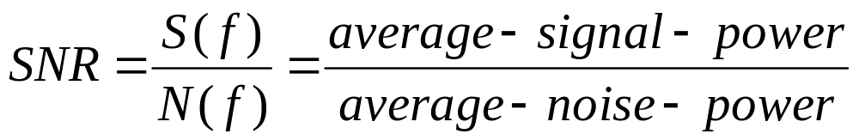
Noise (contd.)
“noisiness” of the signal measure = signal-to-noise ratio (frequency dependant)
Random noise
  External
    Atmospheric
    Interstellar
  Receiver internal
    Thermal
    Flicker noise (low frequency)
    Shot noise

Slide 4
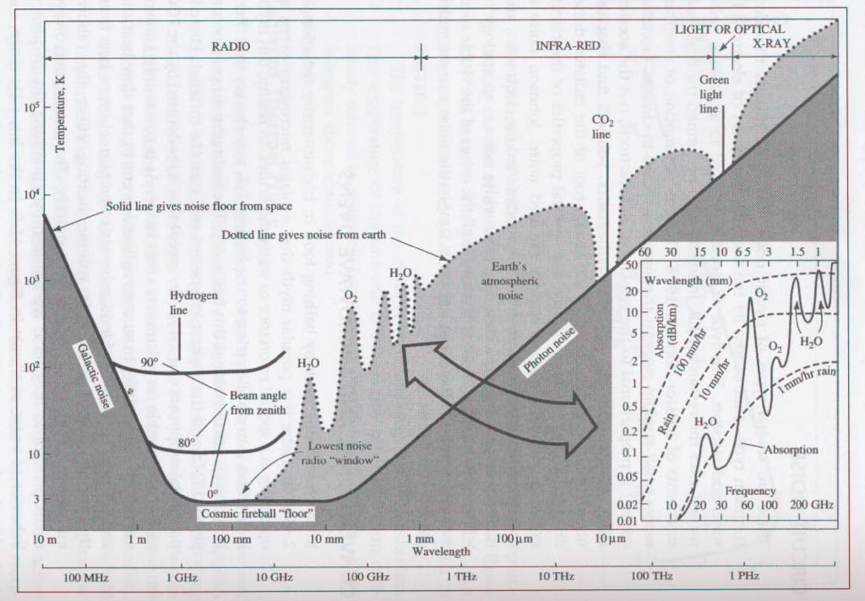
“Sky” Noise

Slide 5
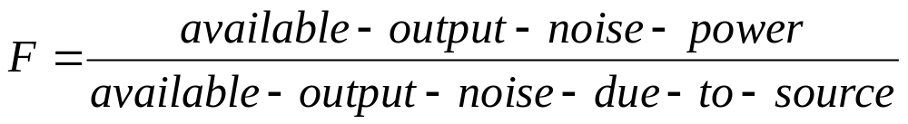
Noise factor
IEEE Standards: “The noise factor, at a specified input frequency, is defined as the ratio of (1) the total noise power per unit bandwidth available at the output port when noise temperature of the input termination is standard (290 K) to (2) that portion of (1) engendered at the input frequency by the input termination.”

Slide 6
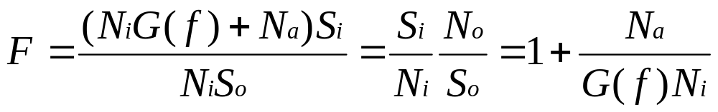
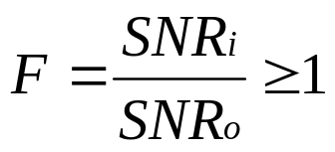
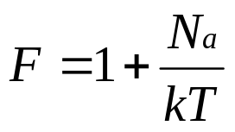
Noise factor (cont.)
It is a measure of the degradation of SNR due to the noise added -
Implies that SNR gets worse as we process the signal
Spot noise factor
The answer is the bandwidth

Slide 7
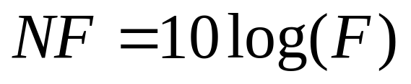
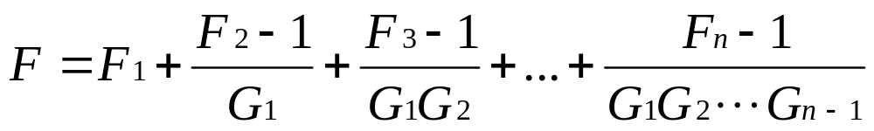
Noise factor (cont.)
Quantitative measure of receiver performance wrt noise for a given bandwidth
Noise figure
  Typically 8-10 db for modern receivers
Multistage (cascaded) system

Slide 8
Sensitivity
Minimum detectable input signal level for a given output SNR (also called noise floor)
Not necessarily related to required output SNR
Example

Slide 9
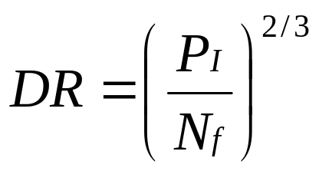
Dynamic range
Intermodulation distortion (harmonic distortion) - measure of how large signals that are close in f to the desired signal affect performance
Intercept point – value of input power for which the IMD power is equal to the output power of the linear term
Ratio of the minimum detectable signal to the signal power that causes the distortion power to be equal to the noise floor
Measure of non-linearity of the receiver

Slide 10

Link Budget
“Quick and dirty” way of estimating RF link performance
Prx,Ptx – received and transmitted power (dB)
Grx,Gtx – antenna gain (dBi)
L – path loss
Amisc – miscellaneous attenuation

Slide 11
Link Budget (cont.)
Path loss (Friis formula):
  L = 40 dB + 20log(d) @ 2.4 GHz
  L = 48 dB + 20log(d) @ 5.7 GHz
Transmit power:
  15 – 20 dBm (30 – 100 mW)
Antenna gain: given in decibels over an isotropic antenna (dBi)
  0dBi (isotropic), 8 dBi (biquad), 15 dBi (helix), 24 dBi (parabolic)

Slide 12
Link Budget (cont.)
Received power (senitivity)
 | Orinocco | Aironet 350 | SNR
11Mbps | -82 dBm | -85 dBm | 16 dB
5.5 Mbps | -87 dBm | -89 dBm | 11 dB
2 Mbps | -91 dBm | -91 dBm | 7 dB
1 Mbps | -94 dBm | -94 dBm | 4 dB

Slide 13
Link Budget (cont.)
Amisc:
  Cables (@ 2.4 GHz)
    RG 174: 2 [dB/m]
    RG 58: 1 [dB/m]
    RG 213: 0.6 [dB/m]
    IEEE 802.3: 0.3 [dB/m]
    LMR-400: 0.22 [dB/m]
  Connectors (BNC, N, SMA)
    0.1 – 1 dB loss

Slide 14
Project
Link characterization with Network Analyzer

