Slide 1
Simulation of Communication Systems
Wireless Systems Instructional Design

Slide 2
Simulation “hierarchy”
Event driven simulations:
ns2, Opnet
Networks
Packets, messages, flows
Time driven simulations:
SPW, Cossap, Simulink/Matlab
Links
Waveforms
DSP
Circuits
RF
Technology
Algorithm simulations:
TI CodeComposer
Circuit simulations:
NC-{VHDL/Verilog}, Scirroco,
RF simulations:
PSpice, ADS,XFDTD

Slide 3
Waveform Level Simulations
Usually used when analytical evaluation of performance is difficult (nonlinearities, ISI caused by bandlimiting filters)
Typically:
  Generate sampled values of the input waveforms (process)
  Process them through system models and generate output
  Estimate the performance by comparing inputs and outputs

Slide 4
Methodology
Ideally model is a perfect replica of the real system – hard to do
Instead we introduce approximations to reduce complexity or run-time:
  Modeling level – simplification of the specific functions
  Performance evaluation level – estimation of performance measures

Slide 5
Methodology (cont.)
Modeling:
  System Modeling - highest level of description; complexity reduction
  Device Modeling – block or subsystem (e.g. transfer function – on every clock cycle: "input-transfer-output”)
  Random Process Modeling:
    Source random process (imitated with pseudo random number generator – RNG)
    Time-variant random channel
    Equivalent random process (ERP)

Slide 6
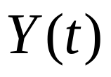



Methodology (cont.)
Monte Carlo simulation – as the name implies relates to game of chance
  Input signals are assumed to be random processes
  Objective is to find statistical properties of
Model of
Communication System
  If we do time evolution of all the waveforms - pure Monte Carlo simulation
    Generating sampled values of all the input processes

Slide 7
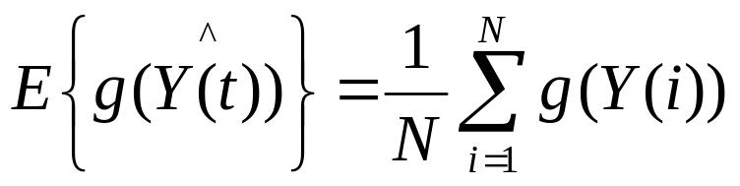
Methodology (cont.)
Procedure:
  Generate sampled values of the inputs
  (e.g. bit sequence {U(k)}, k=1,2,…,N and noise {V(j)}, j=1,2,…,mN)
  Process samples through the model and genarate Y(k) (received bits):
  Estimate the performance by counting errors
In general find expected value of E{g(Y(t)} from the simulation according to:

Slide 8
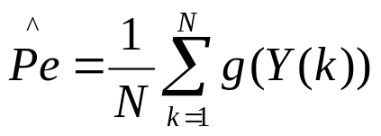
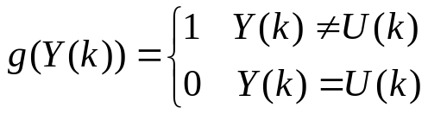
Methodology (cont.)
For our example: where
If only some input processes are simulated explicitly – partial MC (quasianalytical simulation)
Random number generation is essential for MC simulations
Requires RNG generation methods from a wide variety of distributions and with arbitrary autocorrelation (PSD).

Slide 9
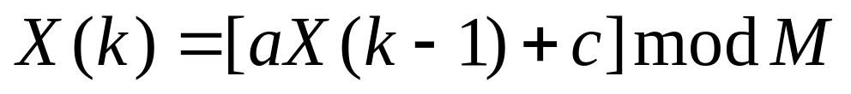
RNG
Important properties:
  Algebraic
    Structure (uncorrelated samples)
    Period
  Statistical
    Distribution
Uniform RNG
  Congruental or the power residue method

Slide 10
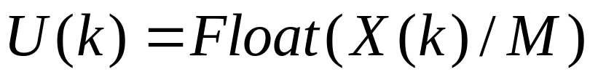
RNG (cont)
where
  M>0 large (prime) integer - modulus
  0<a<M - multiplier
  c {0,1} – increment
  0 <= X(0) <= M-1 – seed
Generates random sequence of integers 0<= X(k) <= M-1
Uniform RNG

Slide 11
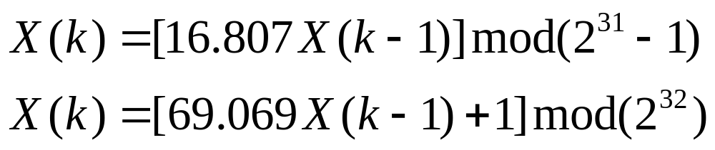
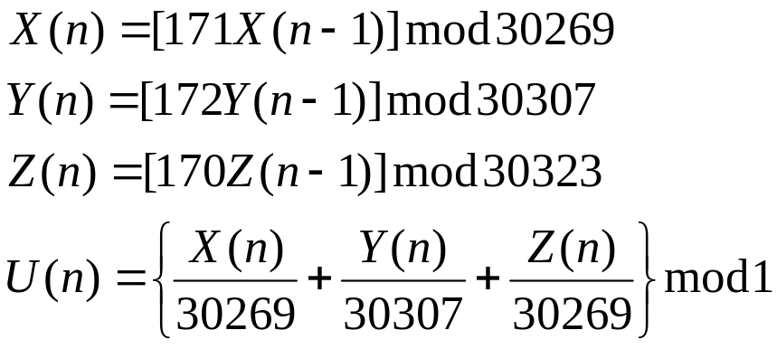

RNG (cont)
“Few good men” (for 32 bit machines)
For longer periods
  Wichman-Hill Algorithm – combines 3 RNGs:
  period

Slide 12
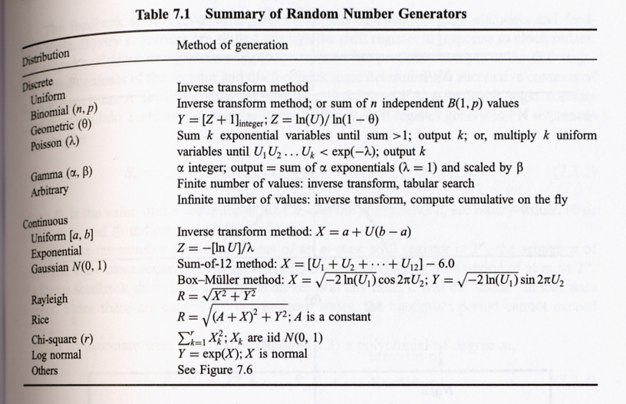
RNG (cont)

