Slide 1
Wireless, mobile networking
Badri Nath
Dept of Computer Science
Rutgers University
http://www.cs.rutgers.edu/~badri
badri@cs.rutgers.edu

Slide 2
Wireless TCP
Packet loss in wireless networks may be due to
  Bit errors
  Handoffs
  Congestion (rarely)
  Reordering (rarely, except in ad-hoc networks (mobile))
TCP assumes packet loss is due to
  Congestion
  Reordering (rarely)
TCP’s congestion responses are triggered by wireless packet loss but interact poorly with wireless nets

Slide 3
Approaches
Link layer enhancements (FEC, retransmissions)
  Interacts with RTT, higher variance may still lead to timeouts
  Not a problem with coarse grain timeouts
  But a problem in slow wireless links, as RTO estimates may be high
  Interested see (Reiner Ludwig’s paper at Infocom)
Transport layer I-TCP [BakreBadri95]
TCP aware Link layer aware (Snoop)[Hari et al 96]
Explicit Loss Notification schemes

Slide 4
Link Level Retransmissions
Issues
How many times to retransmit at the link level before giving up?
  Finite bound -- semi-reliable link layer
  No bound -- reliable link layer
What triggers link level retransmissions?
  Link layer timeout mechanism
  Link level acks (negative acks, dupacks, sacks)
How much time is required for a link layer retransmission?
  Small fraction of end-to-end TCP RTT
  Large fraction/multiple of end-to-end TCP RTT
Should the link layer deliver packets as they arrive, or deliver them in-order?
  Link layer may need to buffer packets and reorder if necessary so as to deliver packets in-order

Slide 5
Link Layer Schemes applicability
When is a reliable link layer beneficial to TCP performance?
if it provides almost in-order delivery and
TCP retransmission timeout large enough to tolerate additional delays due to link level retransmits
Another headache, link layer packets may be smaller than MSS of TCP packets
GSM protocol a good example (Ludwigs paper)

Slide 6



3G Network
User Equipment(UE), Radio Access Network (UTRAN), Core Network (CN)
  UE consists of USIM + ME
  RAN consists of Base stations (node B) and radio network controllers
  Core network (CN) consists of voice circuit elements (GSM) and data network elements (GPRS)
UE
RAN
CN
USIM
B
RNC
MSC
GMSC
PLMN, PSTN
B
HLR
B
RNC
Phone, PDA
B
SGSN
GGSN
Internet

Slide 7
Link Level Retransmissions
Issues
Retransmissions can cause congestion losses
Attempting to retransmit a packet at the front of the queue, effectively reduces the available bandwidth, potentially making the queue at base station longer
If the queue gets full, packets may be lost, indicating congestion to the sender
Channel scheduling introduces rate variability
Is this desirable or not ?
Receiver 1
Base station
Receiver 2

Slide 8
RTO Variations
Wireless
Packet loss
RTT sample
RTO
Vary between 179 msec and 1 sec (chan and ramjee mobicom 2002)

Slide 9
Impact of rate and delay variance
Ack compression
Bursty ack arrival leads to bursty release of packets
Burst arrival at a bad link results in multiple packet losses
Multiple packet losses result in significant degradation in TCP throughput

Slide 10
Use of ACK regulator
Keep a count of ack releases (packets expected)
Reserve buffer space to match the packets that can be expected
Data queue
Wired network
wireless
Ack queue

Slide 11
I-TCP
Uses a split connection
  End-to-end connection is broken into one connection for the wired part and another connection for the wireless part
  Wireless part of the TCP can be optimized for wireless
  TCP optimization close to where it is needed
FH
1-TCP
MSR
2-TCP
MH

Slide 12
Split connection approach
Split connection results in two independent flows. Hence, independent decision of what do with packet loss
On wireless, loss ➔try harder
On fixed, loss ➔ backoff
Tune TCP stack to get this behavior

Slide 13
Establishing TCP connections
FH should see a TCP connection coming from MH and not from MSR
MH should open a TCP connection to FH and should not be aware that the connection is going to MSR
MH has a I-TCP library that intercepts connection requests and opens a connection to MSR
MSR opens a connection to FH but with the <address of MH and port #> sent by FH
<mh, port_mh, FH, port_FH>
<mh, port_mh, msr, port_msr>
msr, port_msr, mh, port_mh
FH, port_FH,mh,port-mh

Slide 14
I-TCP handoff
When a MH moves to a new location, it establishes a connection with the new MSR
The new MSR get the TCP state from the old MSR and continues the TCP connection
msr1addr, msr1port, mhaddr, mhport
msr2addr, msr2port,mhaddr, mhport
Handoff
mhaddr, mhport, fhaddr, fhport
mhaddr, mhport, fhaddr, fhport
FH

Slide 15
I-TCP features
Hides packet loss due to wireless from sender
Wireless TCP can be independently optimized
Good performance in case of wide-area networks
Retransmission occurs only on the bad link
Faster recovery due to relatively short RTT for wireless link
Handoff requires state transfer
Buffer space needed, extra copying at MSR
End-to-end semantics violation needs to be augmented by application level actions
Base station (MSR) failure may cause loss of TCP state

Slide 16
Snoop features
Unlike I-TCP, end-to-end semantics retained
High throughput at medium error rates
Not useful if TCP headers are encrypted
Cannot be used on asymmetric links

Slide 17
Snoop : Basic Idea
Data from FH -> MH
Cache unacknowledged TCP data
Perform local retransmissions
Data from MH -> FH
Detect missing packets
Perform negative acknowledgements

Slide 18
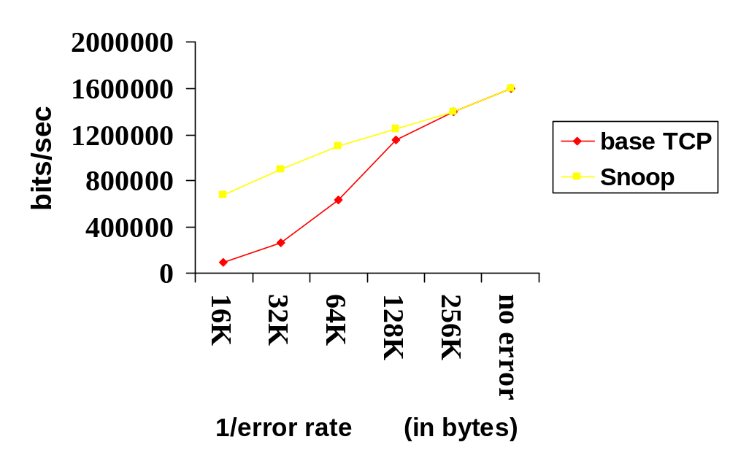
Snoop- performance
2 Mbps Wireless link

Slide 19
Snoop Protocol-advantages
Snoop prevents fast retransmit from sender despite transmission errors, and out-of-order delivery on the wireless link
What about for small window sizes
TCP_new reno scheme
Snoop should help as well

Slide 20
Snoop Protocol disadvantages
Link layer at base station needs to be TCP-aware
Not useful if TCP headers are encrypted (IPsec)
Cannot be used if TCP data and TCP acks traverse different paths (both do not go through the base station)

Slide 21
FH -> MH : Snoop_data() – case 1 and 2
New Packet in normal TCP sequence
Normal case
Add to snoop cache
Forward to MH
Out of sequence packet cached earlier
Fast Retransmission/timeout at sender due to
A)Loss in wireless link (if last ACK is < current seq.no.): Forward to MH
B) Loss of previous ACK (if last ACK > current seq.no.): Send ACK to FH (similar to last one seen) with MH address and port
6
5
5
3
3
Last ack seen 4
Last seq no 6
4
2
Snoop cache

Slide 22
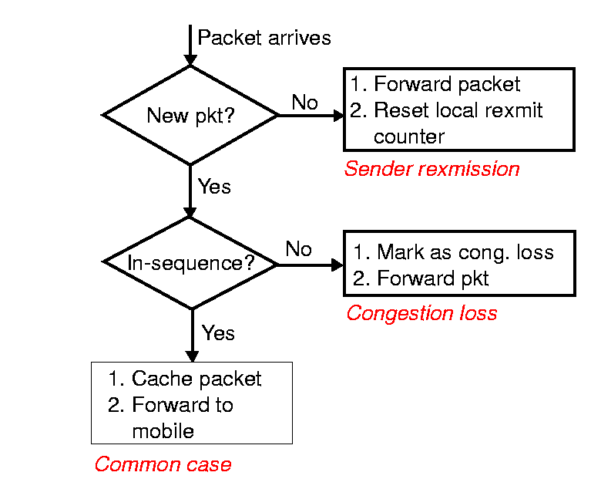
Snoop: FH -> MH
Data Processing

Slide 23
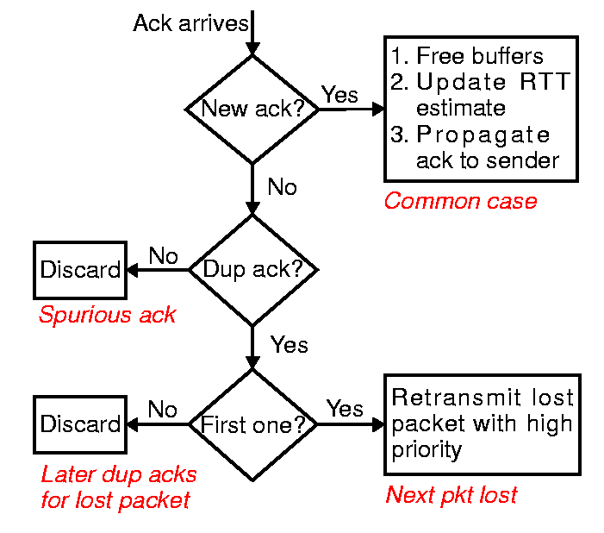
Snoop: ACK Processing

Slide 24
Issues
Wireless networking
  Problems due to losses
Wireless networking
  Problems due to variability in delay, rate
End point mobility
  Naming changes as end point moves
Topology variations
  Network configuration changes as nodes move

Slide 25
Mobile users
Explosion in usage of hand helds
Anytime, anywhere wireless services
  Some connectivity everywhere
  Many-time, many-where (Infostations)
Users can be connected when moving
Users can be connect and disconnect to different networks

Slide 26
Mobility vs connectivity
New research problems
  Continuous connectivity for a mobile host
  Seamless movement between networks
Mobile systems
  Move from place to place while being wireless
  Move from place to place by plugging-in at different attachment points
Why maintain connectivity?
  Avoid restarting applications/networks

Slide 27
IP address problem
Internet hosts/interfaces are identified by IP address
  Domain name service translates host name to IP address
  IP address identifies host/interface and locates its network
  Mixes naming and location
Moving to another network requires different network address
  But this would change the host’s identity
  How can we still reach that host?

Slide 28
Basic idea
Home Agent
Foreign Agent
MH = Mobile Host
CH = correspondent HOST

Slide 29
Basic idea
Mobile hosts attaches to foreign network and obtains guest address
Via DHCP
Via Foreign agent
Registration with local agent
LA has list of all foreign hosts visiting the network

Slide 30
Routing for mobile hosts
MH = mobile host
CH
CH = correspondent host
Home network
Foreign network
MH
How to direct packets to moving hosts transparently?
CH
Home network
Foreign network
MH

Slide 31
Mobile IP (Dave Johnson, C Perkins)
Paper describes Internet Mobile Host protocol
Correspondent hosts don’t need to know about mobility
Allow a mobile host to send and receive packets with its permanent IP addres
Maintain tcp connections across moves
Simple
Provides for route optimization
Many possible techniques, many variants

Slide 32
Use Arp
A designated router proxy-arps for mobile host
H4
I have MH1
Who has MH1?
Know? – mh1@h4
MH1

Slide 33
Basic Mobile IP – to mobile hosts
MH = mobile host
CH = correspondent host
HA = home agent
FA = foreign agent
CH
Home network
Foreign network
HA
FA
MH
MH registers new “care-of address” (FA) with HA
HA tunnels packets to FA
FA decapsulates packets and delivers them to MH

Slide 34
IP-in-IP (Packet encapsulation)
Packet from CH to MH
Source address = address of CH
Destination address = home IP address of MH
Payload
Home agent intercepts above packet and tunnels it
Source address = address of HA
Destination address = care-of address of MH
Source address = address of CH
Destination address = home IP address of MH
Original payload

Slide 35
When mobile host moves again
CH
Home network
Foreign network #1
HA
FA #1
MH
Foreign network #2
FA #2
MH
MH registers new address (FA #2) with HA & FA #1
HA tunnels packets to FA #2, which delivers them to MH
Packets in flight can be forwarded from FA #1 to FA #2

Slide 36
Basic Mobile IP - from mobile hosts
Mobile hosts also send packets
CH
Home network
Foreign network
HA
FA
MH
    Mobile host uses its home IP address as source address
      Lower latency
      Still transparent to correspondent host
      No obvious need to encapsulate packet to CH
This is called a “triangle route”

Slide 37
Problems with ingress/egress filtering
Home network
Foreign network
CH
HA
MH
Mobile host uses its home IP address as source address
Security-conscious boundary routers will drop this packet

Slide 38
Solution: bi-directional tunnel
Home network
Foreign network
CH
HA
MH
Provide choice of “safe” route through home agent both ways
This is the slowest but most conservative option
This is known as quadrilateral routing

Slide 39
Solution: yet more flexibility
CH
Home network
Foreign network
HA
MH
Use current care-of address and send packet directly
  This is regular IP!
More generally:
  MH should have flexibility to adapt to circumstances

Slide 40

Network Architecture (1xRTT)
MSC
SMS-SC
VLR
Location Management
Authentication
HLR/AAA
BTS
EIR
MSC
IWF
ISDN
Internet
BSC
PSTN
BTS
Circuit switched
PDSN
BSC
Packet switched
AAA
BTS
Firewall
Packet data service node

Slide 41
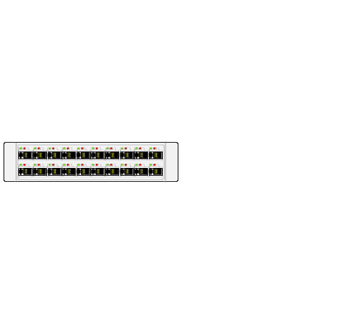

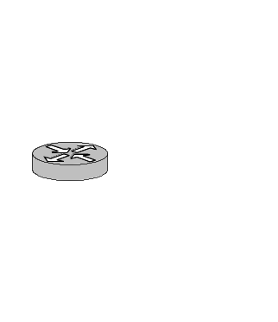
IP Support
Internet
BTS
BSC
PDSN
Host
PPP
IP
PDSN terminates PPP connection
IP address assigned via a DHCP
  IP belongs to the domain of PSDN
IP address changes when mobile moves to new PSDN
PPP connection has to be initiated from the mobile and not the network

Slide 42
Internet Mobility 4x4.
Proceedings of the ACM Mobility 4x4 (S. Cheshire, M. Baker SIGCOMM'96 Conference)
 | Outgoing Indirect, Encapsulated | Outgoing Direct, Encapsulated | Outgoing Direct, Home Address | Outgoing Direct, Temp. Address
Incoming Indirect, Encapsulated | Most reliable, least efficient | Requires decapsulation on CH | No security-conscious routers on path
Incoming Direct, Encapsulated |  | Requires fully mobile-aware CH | No security-conscious routers on path
Incoming Direct, Home Address |  |  | Requires both hosts to be on same net. seg.
Incoming Direct, Temp. Address |  |  |  | Most efficient, no mobility support

Slide 43
GPRS
Packet-switched network
Delivers packets to mobile platforms
Coexists with GSM network (voice, SMS)
Packet-switched and circuit-switched services share the same radio resources
No store-and-forward for GPRS
IP packets can be sent/received from the GPRS network

Slide 44
GPRS Cloud
IP packets
Internet
GGSN
Hierarchy of network elements route IP packets to the mobile
GGSN
SGSN
BSC
BTS

Slide 45
GPRS Addressing
1.2.3.1, APN1
4.5.6.2, APN2
APN1
APN2
GGSN
1.2.3.x
4.5.6.y
Subnet for GPRS
Users in APN1
Subnet for GPRS
Users in APN2

Slide 46
Routing IP Packets to Mobile
Mobile address belongs to the operator
APN will be the operator network and addresses obtained from operator space
Mobile address belongs to the enterprise
APN will be the enterprise hook into GGSN
Edge router should be connected to GGSN and default route for GPRS addresses set to GGSN link
Mobile address is private
Mobile address is public

Slide 47
Roaming
While attached to the visiting service provider, the subscriber can use APN provided by home network or visited network
User can either select visiting network APN, home network APN, or have a choice.
Two possible routing schemes based on the APN choice:
  1) quadrilateral routing or 2) triangle routing
In case of 1) SGSN finds the home GGSN and tunnels all out bound packets to home GGSN
Packets inbound to mobile finds its way from home GGSN to visited GGSN
In case of 2) outbound traffic gets out to the network via the visiting APN (GGSN)

Slide 48
Roaming
visited.isp.dns.gprs.com
Root DNS
my.isp_GGSN.com
my.isp.dns.gprs.com
APN=<my.isp_GGSN.com,my.isp.dns.gprs.com>
…. Find IP address of home GGSN by contacting local DNS, root DNS, and home DNS using info in APN
Establish IP tunnel from SGSN to home GGSN

Slide 49
Routing protocols for ad-hoc networks
Two classes
Proactive
  Continously update reachability information in the network
  When a route is needed, it is immediately available
    DSDV by Perkins and Bhagwat (SIGCOMM 94)
    Destination Sequenced Distance vector
Reactive
  Routing discovery is initiated only when needed
  Route maintenance is needed to provide information about invalid routes
    DSR by Johnson and Maltz
    AODV by Perkins and Royer
Hybrid
  Zone routing protocol (ZRP)

Slide 50
DSDV (Perkins, Bhagwat)
Each node maintains a routing table
Node ID, no of hops, sequence number (originated by the destination)
  Note this is similar to RIP (except for the sequence number)
  They need to overcome the “bad news” travels slowly problem of RIP
Each mobile station advertises, to each of its current neighbors, its own routing table
DSDV provides a single path for routing between each destination/source pair
  Parameters: Update interval (how often to broadcast), settling time (how long to wait before forwarding new routes), how long to wait before declaring a route to be stale

Slide 51
Sequence numbers
DSDV tags each route with a sequence number and considers a route r more favorable than r’ if r has a greater sequence number or if both have the same sequence number but r has a lower metric (hop count)
Each node in the network advertises a monotonically increasing even sequence number for itself
When a node B decides that its route to destination C is broken, it advertises the route to D with an infinite metric and an odd sequence number (one greater than the previous sequence number)

Slide 52

DSDV
<d, c, 2, seq_d_2>
<c, c,1,seq_c_20>
Destination_addr, next hop, metric, dest_Sequence number
A
<d, d, 1, seq_d_2>
A
D
D
C
C
B
<d, -, 0, seq_d_2>
B
<d, d, , seq_d_3>
<d, c, 2, seq_d_2>
<c,c,1,seq_c_20>
New updates are sent as even numbers
Broken links are sent as odd numbers (one higher than sent by D)
Note that <d, d, ,seq_d_3> is generated by Node C
When a node receives an update with metric and a later sequence number with a finite metric is lower then update propagated immediately
Information travels fast, and used by all nodes to detect that it is broken

Slide 53
Route propagation
When a new route is received, it may be worthwhile to wait for the best metric route to show up
Use the route with a later sequence number for routing but wait before advertising that route
Two tables: Route table and advertising table
Maintain a running average of time for recent updates
Delay until beta*average settling time for this destination

Slide 54
Issues
When to trigger a routing update
On receiving infinite metric?
  immediately
On receiving a new sequence number
  Paper is not clear (immediate or defer)
On receiving a new metric
  Wait for some time to propagate
  But use this new route for forwarding
Good for low to medium mobility

Slide 55
Dynamic source routing (DSR)
Johnson, Maltz, Broch
Reactive routing protocol
Avoids large periodic updates
  Overcomes problems with chatty protocols for wireless (power, bandwidth, redundancy)
Routes are specified as complete paths from S to D
Intermediate nodes need not have uptodate information
No periodic route propagation, no neighbor detection protocols

Slide 56
Route discovery
The source floods the network with a route discovery packet
The RREQ packet identifies the destination (target) host
If the route discovery is successful, the initiating host receives a route reply packet listing the sequence of hops through which it may reach the target
Some other node that knows a route to target can also reply
Nodes remember/overhear routes
  Route cache used to limit propagation of route requests

Slide 57
Route discovery
Β
E
A E
A-B E
Α
A-C-D E
A-C, E
D
C
A E
A-C E
Route reply can be sent as reverse route
Or can be sent using any route to the destination
Or can be piggybacked on a new route request packet to the source

Slide 58
Route Reply in DSR
Route Reply can be sent by reversing the route in Route Request (RREQ) only if links are guaranteed to be bi-directional
  To ensure this, RREQ should be forwarded only if it received on a link that is known to be bi-directional
If unidirectional (asymmetric) links are allowed, then RREP may need a route discovery for S from node D
  Unless node D already knows a route to node S
  If a route discovery is initiated by D for a route to S, then the Route Reply is piggybacked on the Route Request from D.

Slide 59
DSR Optimization: Route Caching
Each node caches a new route it learns by any and all means
S sends RREQ and gets RREP for a route to D
  When node S finds route [S,A, B, C,D] to node D, node S also learns route [S,A,B] to node B and [S, A, B, C] to node C
D receives RREQ from some other node
  When node D receives RREQ [S,A,B,C] destined for node C, node D learns route [B, A,S] to node S
D forwards RREP to some node
  When node D forwards Route Reply RREP [S,A,D,C,F], node D learns route [D,C,F] to node F
When node B forwards Data [S,A, B, C,D] it learns route [C,D] to node D

Slide 60
Use of Route Caching
When node S learns that a route to node D is broken, it uses another route from its local cache, if such a route to D exists in its cache. Otherwise, node S initiates route discovery by sending a route request
Node X on receiving a Route Request for some node D can send a Route Reply if node X knows a route to node D
Use of route cache
  can speed up route discovery
  can reduce propagation of route requests

Slide 61
Side effects of Route Caching
Stale caches can adversely affect performance
With passage of time and host mobility, cached routes may become invalid
A sender host may try several stale routes (obtained from local cache, or replied from cache by other nodes), before finding a good route

Slide 62
Performance comparison
DSDV performs well under low node mobility
  High delivery rate (low packet loss)
  Fails to converge for increased mobility
DSR performs well at all mobility rates
  Increased overhead of routing tables and control packets
  Scalability for dense networks

Slide 63
Ad Hoc On-Demand Distance Vector Routing (AODV) [Perkins and Royer]
DSR includes source routes in packet headers
Resulting large headers can sometimes degrade performance
  particularly when data contents of a packet are small
AODV attempts to improve on DSR by maintaining routing tables (reverse paths) at the nodes, so that data packets do not have to contain routes
AODV retains the desirable feature of DSR that routes are maintained only between nodes which need to communicate

Slide 64
AODV
Route Requests (RREQ) are forwarded in a manner similar to DSR
When a node re-broadcasts a Route Request, it sets up a reverse path pointing towards the source
  AODV assumes symmetric (bi-directional) links
When the intended destination receives a Route Request, it replies by sending a Route Reply
Route Reply travels along the reverse path set-up when Route Request is forwarded

Slide 65

Route Requests in AODV
Y
Z
S
E
F
B
C
M
L
J
A
G
H
D
K
I
N
Represents a node that has received RREQ for D from S

Slide 66
Route Requests in AODV
Y
Broadcast transmission
Z
S
E
F
B
C
M
L
J
A
G
H
D
K
I
N
Represents transmission of RREQ

Slide 67
Reverse Path Setup in AODV
Y
Z
S
E
F
B
C
M
L
J
A
G
H
D
K
I
N
Node D does not forward RREQ, because node D
is the intended target of the RREQ

Slide 68
Route Reply in AODV
Y
Z
S
E
F
B
C
M
L
J
A
G
H
D
K
I
N
Represents links on path taken by RREP

Slide 69
Route Reply in AODV
An intermediate node (not the destination) may also send a Route Reply (RREP) provided that it knows a more recent path than the one previously known to sender S
To determine whether the path known to an intermediate node is more recent, destination sequence numbers are used
The likelihood that an intermediate node will send a Route Reply when using AODV not as high as DSR
  A new Route Request by node S for a destination is assigned a higher destination sequence number. An intermediate node which knows a route, but with a smaller sequence number, cannot send Route Reply

Slide 70
Data Delivery in AODV
Y
DATA
Z
S
E
F
B
C
M
L
J
A
G
H
D
K
I
N
Routing table entries used to forward data packet.
Route is not included in packet header.

Slide 71
Destination Sequence Number
Continuing from the previous slide …
When node D receives the route request with destination sequence number N, node D will set its sequence number to N, unless it is already larger than N

Slide 72
Why Sequence Numbers in AODV
To avoid using old/broken routes
  To determine which route is newer
To prevent formation of loops
  Assume that A does not know about failure of link C-D because RERR sent by C is lost
  Now C performs a route discovery for D. Node A receives the RREQ (say, via path C-E-A)
  Node A will reply since A knows a route to D via node B
  Results in a loop (for instance, C-E-A-B-C )
A
B
C
D
E

Slide 73
Summary: AODV
Routes need not be included in packet headers
Nodes maintain routing tables containing entries only for routes that are in active use
At most one next-hop per destination maintained at each node
  DSR may maintain several routes for a single destination
Unused routes expire even if topology does not change

Slide 74
Location-Aided Routing (LAR)
Uses position information to enhance the route discovery phase
Exploits location information to limit scope of route request flood
  Location information may be obtained using GPS
When S wants to establish a route path to D, it computes an expected zone for D
Expected Zone is determined as a region that is expected to hold the current location of the destination
  Expected region determined based on potentially old location information, and knowledge of the destination’s speed
Route requests limited to a request zone that contains the Expected Zone and location of the sender node
[KoVa98Mobicom, 00 Journal paper]

Slide 75
Concept of two zones
LAR utilizes a notion of expected zone where the source has an idea of the whereabouts of destination D
  Else reduces to DSR type of flooding
LAR utilizes location information to limit the area for discovering a new route to a smaller requested zone
The operation is similar to DSR : LAR performs the route discovery through limited flooding

Slide 76
Expected Zone in LAR
X = last known location of node
D, at time t₀
Y = location of node D at current
time t₁, unknown to node S
r = (t₁ - t₀) * estimate of D’s speed
X
r
Y
Expected Zone

Slide 77
Request Zone in LAR
Network Space
Request Zone
X
r
B
A
Y
S

Slide 78
LAR Scheme 1
  Determine the requested zone
Scheme1:
estimating a circular area in which the destination is expected to be found
During the route request flood, only nodes inside the request zone forward the request message
RREP can use the same technique to return the message back to the source

Slide 79
LAR
Only nodes within the request zone forward route requests
If route discovery using the smaller request zone fails to find a route, the sender initiates another route discovery (after a timeout) using a larger request zone
  the larger request zone may be the entire network
Rest of route discovery protocol similar to DSR

Slide 80
LAR Scheme 2
Calculate the estimated distance to destination
The distance is included in a route request message
A node relays a request message only if its distance to the destination is less than or equal to the distance included in the request message (or atmost δ farther away from the destination)
The distance field is updated before relaying the request

Slide 81
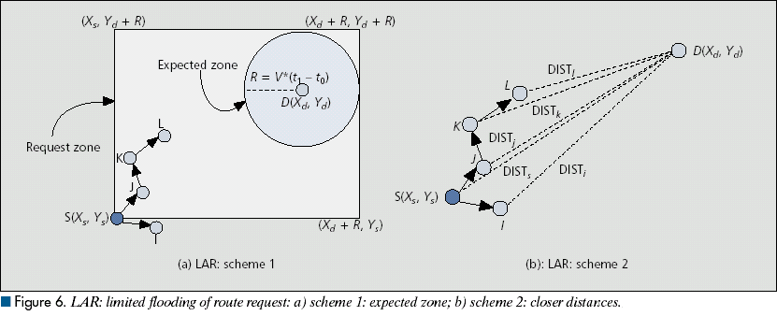
LAR schemes

Slide 82
LAR Variations: Adaptive Request Zone
Each node may modify the request zone included in the forwarded request
Modified request zone may be determined using more recent/accurate information, and may be smaller than the original request zone
B
S
Request zone adapted by B
Request zone defined by sender S

Slide 83
LAR Variations: Implicit Request Zone
In the previous scheme, a route request explicitly specified a request zone
Alternative approach: A node X forwards a route request received from Y if node X is deemed to be closer to the expected zone as compared to Y
The motivation is to attempt to bring the route request physically closer to the destination node after each forwarding

Slide 84
Location Aided Routing (LAR)
Advantages
  reduces the scope of route request flood
  reduces overhead of route discovery
Disadvantages
  Nodes need to know their physical locations
  Does not take into account possible existence of obstructions for radio transmissions

Slide 85
Hybrid Protocols

Slide 86
Zone Routing Protocol (ZRP) [Haas98]
Zone routing protocol combines
Proactive protocol: which pro-actively updates network state and maintains route regardless of whether any data traffic exists or not
Reactive protocol: which only determines route to a destination if there is some data to be sent to the destination

Slide 87
ZRP
All nodes within hop distance at most d from a node X are said to be in the routing zone of node X
All nodes at hop distance exactly d are said to be peripheral nodes of node X’s routing zone

Slide 88
ZRP
Intra-zone routing: Pro-actively maintain state information for links within a short distance from any given node
  Routes to nodes within short distance are thus maintained proactively (using, say, link state or distance vector protocol)
Inter-zone routing: Use a route discovery protocol for determining routes to far away nodes. Route discovery is similar to DSR with the exception that route requests are propagated via peripheral nodes.

Slide 89
ZRP: Example with
Zone Radius = d = 2
S performs route
discovery for D
B
S
A
C
D
E
F
Denotes route request

Slide 90
ZRP: Example with d = 2
S performs route
discovery for D
B
S
A
C
D
E
F
E knows route from E to D,
so route request need not be
forwarded to D from E
Denotes route reply

Slide 91
ZRP: Example with d = 2
S performs route
discovery for D
B
S
A
C
D
E
F
Denotes route taken by Data

