Slide 1
Summary of Path Loss in Propagation
Narayan Mandayam

Slide 2
Understanding RF Propagation
Goals
Estimate radio coverage area
Estimate link performance
Estimate network design parameters
  Transmitters and their location
  Transmit power
  Antenna type
Notes:
How many APs will be needed to cover IITK campus?

Slide 3
Interesting Scenarios
At which locations will correct reception take place?

Slide 4
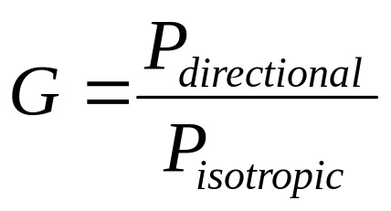
Antenna Basics
Isotropic
Dipole
High gain
directional
0 dB_{i}
2.2 dB_{i}
14 dB_{i}

Slide 5
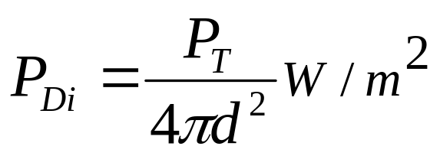
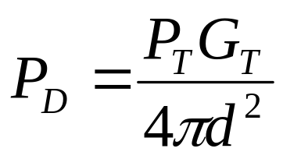
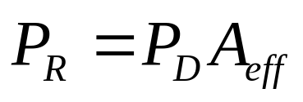
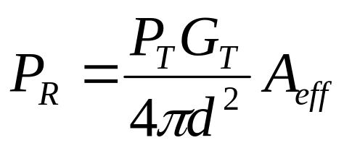
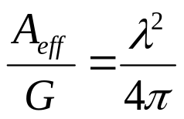
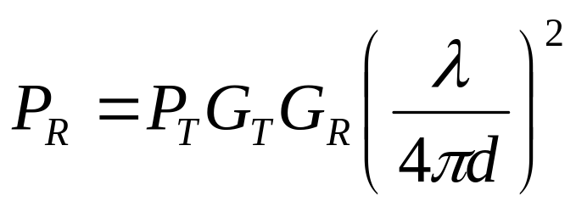
Free Space Propagation Model
Isotropic power
density
P_{R}
d
P_{T}
Power density along
the direction of
maximum radiation
Power received by
Antenna
Predict received signal
strength when the transmitter
and receiver have a clear
line-of-sight path between them
Also known
as Friis free
space formula

Slide 6
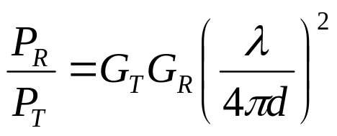
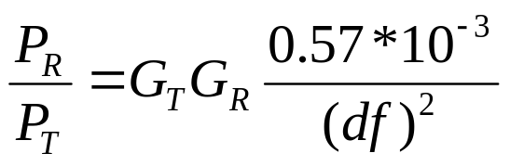
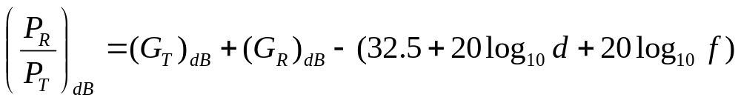
Path Loss (relative measure)
P_{R}
P_{t}
f is in MHz
d is in Km
Path Loss represents signal attenuation
(measured on dB) between the effective
transmitted power and the receive power
(excluding antenna gains)

Slide 7
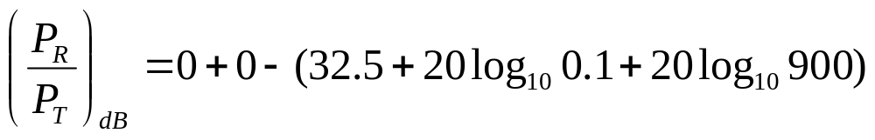
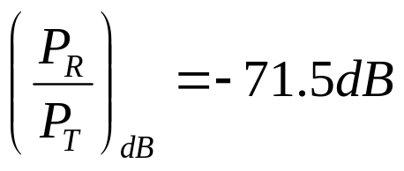
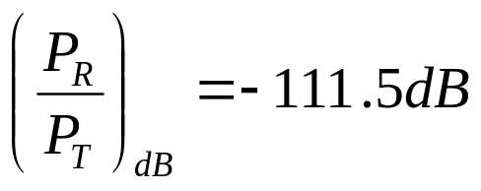


Path Loss (Example)
Assume that antennas are isotropic.
Calculate receive power (in dBm) at free space distance of 100m from the antenna. What is P_{R} at 10Km?
P_{R}
P_{t}
50 W
= 47 dBm
59
-20 (for d = 0.1)
20 (for d = 10)

Slide 8
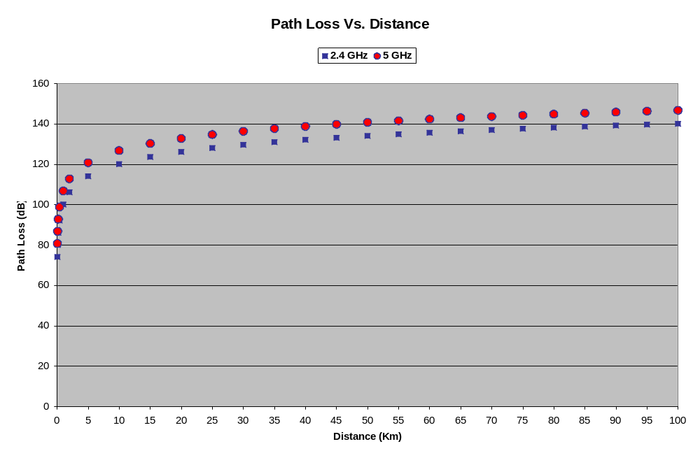
Path Loss (another example)

Slide 9
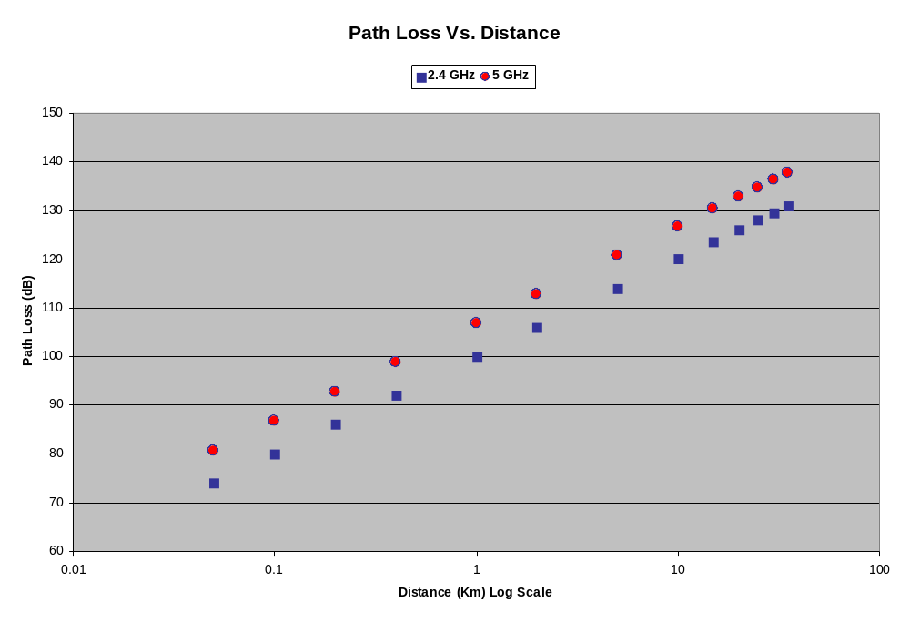
Path Loss (another example)

Slide 10
Radio propagation: path loss
near field
path loss in 2.4 Ghz band
P_{r}
r ≤ 8m
r > 8m
P_{t}
near field
far field
r
∝
r²
∝
r^{3.3}
P_{r}
path loss = 10 log (4πr²/λ) r ≤ 8m
= 58.3 + 10 log (r^{3.3} /8) r > 8m

Slide 11
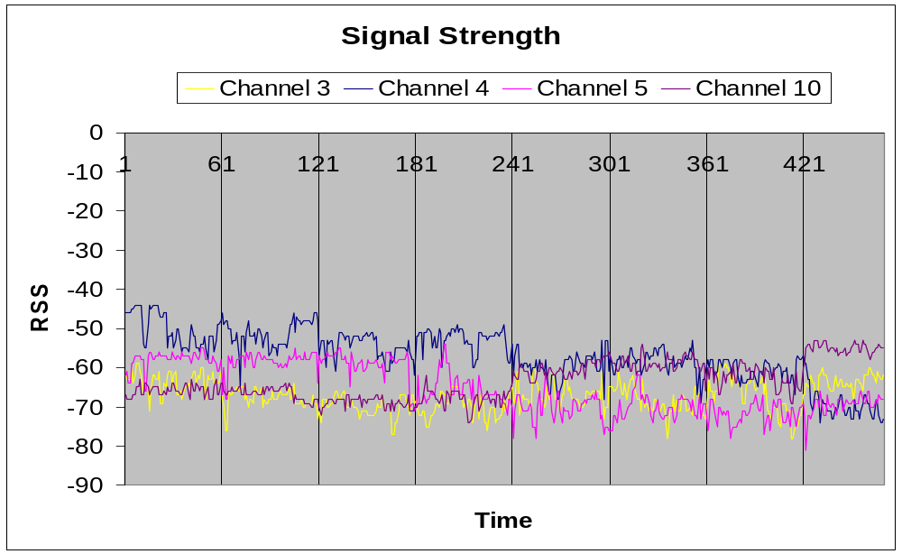
Indoor Signal Measurement

Slide 12
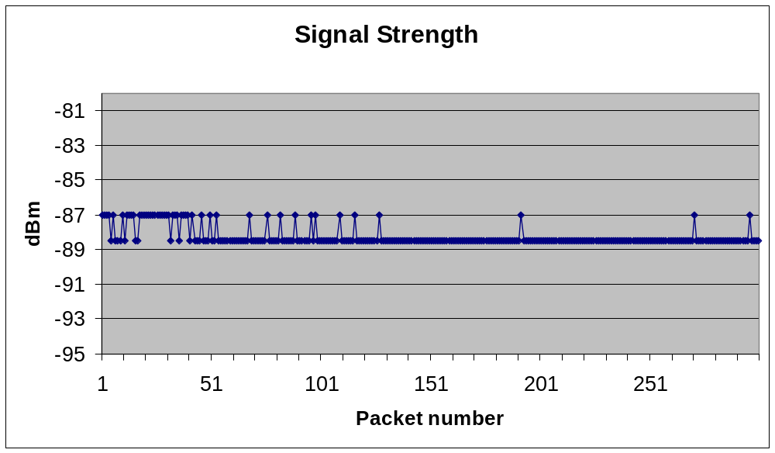
Outdoor P2P Link Signal Measurement

