Slide 1
Basics of Small Scale Fading: Towards choice of PHY
Narayan Mandayam

Slide 2
Basic Questions
T_{x}
What will happen if the transmitter
changes transmit power ?
changes frequency ?
operates at higher speed ?
Transmit power, data rate,
signal bandwidth, frequency
tradeoff
What will happen if we conduct
this experiment in different types
of environments?
Desert
Metro
Street
Indoor
Channel efffects
R_{x}
What will happen if
the receiver moves?
Effect of mobility

Slide 3
Review of basic concepts
Channel Impulse response
Power delay profile
Inter Symbol Interference
Coherence bandwidth
Coherence time

Slide 4


Channel Impulse Response
Channel

Slide 5
Power delay Profile
-90
RMS Delay Spread (σ_{τ}) = 46.4 ns
-90
Mean Excess delay (τ) = 45 ns
-95
Received Signal Level (dBm)
Maximum Excess delay < 10 dB = 110 ns
-100
Noise threshold
-105
0
50
100
150
200
250
300
350
400
450
Excess Delay (ns)

Slide 6
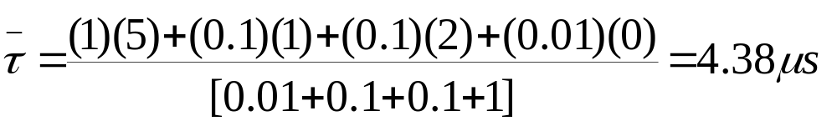
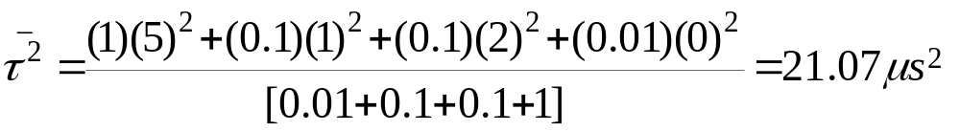
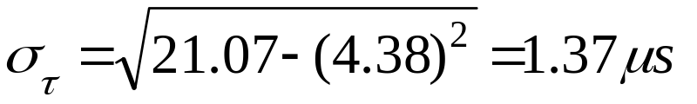
Example (Power delay profile)
P_{r}(τ)
4.38 µs
1.37 µs
0 dB
-10 dB
-20 dB
-30 dB
τ
0
1
2
5
(µs)

Slide 7
RMS Delay Spread: Typical values
Delay spread is a good measure of Multipath
Manhattan
San Francisco
Suburban
Office building 2
SFO
Office building 1
10ns
50ns
150ns
500ns
1µs
2µs
5µs
10µs
25µs
3m
15m
45m
150m
300m
600m
3Km
7.5Km

Slide 8
Inter Symbol Interference
Symbol time
P_{r}(τ)
4.38 µs
1.37 µs
0 dB
-10 dB
-20 dB
σ_{τ}
-30 dB
τ
0
1
2
5
(µs)
0
1
2
5
(µs)
4.38
Symbol time > 10* σ_{τ} --- No equalization required
Symbol time < 10* σ_{τ} --- Equalization will be required to
deal with ISI
In the above example, symbol time should be more than 14µs to avoid ISI.
This means that link speed must be less than 70Kbps (approx)

Slide 9

Coherence Bandwidth
Time domain view
Freq. domain view
Range of freq over
which response is flat
σ_{τ} delay spread
B_{c}
High correlation of amplitude
between two different freq.
components

Slide 10
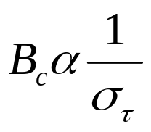

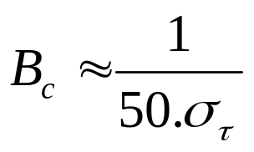
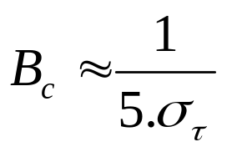
RMS delay spread and coherence b/w
RMS delay spread and coherence b/w (B_{c}) are inversely proportional
For 0.9 correlation
For 0.5 correlation

Slide 11
Time dispersive nature of channel
Delay spread and coherence bandwidth are parameters which
describe the time dispersive nature of the channel.
Time domain view
Freq domain view
signal 1
Signal
signal 2
Symbol Time (T_{s})
Signal bandwidth (B_{s})
channel 1
channel 2
Channel
channel 3
RMS delay spread (σ_{τ})
Coherence b/w (B_{c})

Slide 12
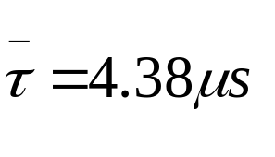
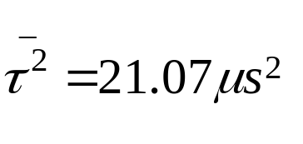

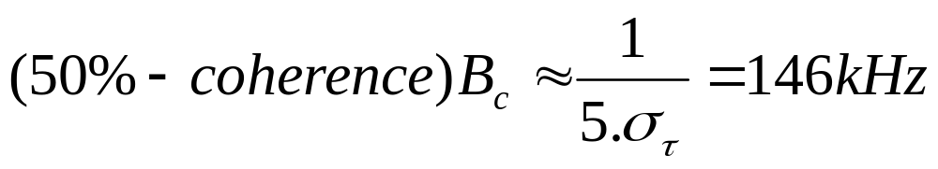
Revisit Example (Power delay profile)
P_{r}(τ)
4.38 µs
1.37 µs
0 dB
-10 dB
-20 dB
-30 dB
τ
0
1
2
5
(µs)
Signal bandwidth for Analog Cellular = 30 KHz
Signal bandwidht for GSM = 200 KHz

Slide 13

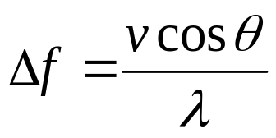
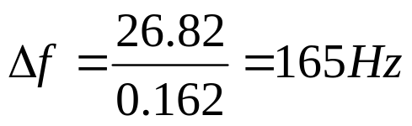

Doppler Shift
θ
v
Doppler shift
Example
Carrier frequency f_{c} = 1850 MHz (i.e. λ = 16.2 cm)
Vehicle speed v = 60 mph = 26.82 m/s
If the vehicle is moving directly towards the transmitter
If the vehicle is moving perpendicular to the angle of arrival of the transmitted signal

Slide 14
Coherence Time
Time domain view
Frequency domain view
symbol time
signal bandwidth
f_{c}-f_{d}
f_{c}+f_{d}
T_{c}
Coherence Time: Time interval
over which channel impulse
responses are highly
correlated

Slide 15
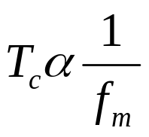
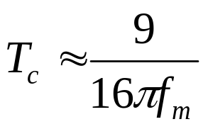
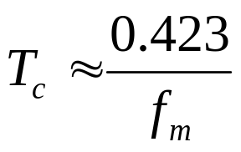
Doppler spread and coherence time
Doppler spread and coherence time (T_{c}) are inversely proportional
f_{m} is the max doppler shift
For 0.5 correlation
Rule of thumb

Slide 16
Time varying nature of channel
Doppler spread and coherence time are parameters which
describe the time varying nature of the channel.
Time domain view
Freq domain view
signal 1
Signal
signal 2
Symbol Time (T_{S})
Signal bandwidth (B_{S})
channel 1
channel 2
Channel
channel 3
Coherence Time (T_{C})
Doppler spread (B_{D})

Slide 17
Small scale fading
B_{S}
Flat fading
B_{C}
Multi path time delay
B_{S}
Frequency selective fading
B_{C}
fading
T_{S}
Fast fading
T_{C}
Doppler spread
T_{S}
Slow fading
T_{C}

Slide 18
PHY Layer Design Choices ?
Required Data Rates
  Determines channel : frequency selective or flat fading; fast or slow fading
Required QoS at the PHY: bit-error-rate (BER), packet-error-rate (PER), Frame-error-rate (FER)
  May be determined by application needs (higher layers)
  Affected by Interference and Noise levels
PHY layer choices include selection of
  Modulation/Demodulation
  Techniques to mitigate fading: diversity, equalization, OFDM, MIMO
  Techniques to mitigate interference (if necessary)
  Error correction Coding

