Slide 1
802.11 specifications
overview

Slide 2
802.11 Specifications
Applications
Control
LLC
WEP
MAC
Mgmt
MAC
MIB
PHY
DSSS
FH
IR
OFDM
Specification of layers below LLC
Associated management/control interfaces

Slide 3
802.11 Specifications
LLC
MAC Mgmt Service
Interface
MAC Service
Interface
LLC
MAC sublayer
MAC Layer
Management
WEP
MAC
Mgmt
MAC
MIB
PHY Service
Interface
PHY Mgmt Service
Interface
PHY
PLCP Sublayer
PHY layer Management
DSSS
FH
IR
OFDM
PMD Sublayer

Slide 4
802.11 Specifications
LLC
MAC Service
Interface
(clause 6)
MAC Mgmt Service
Interface (clause 10)
MAC sublayer
MAC Management
MAC framing (clause 7)
MAC operation (clause 9)
WEP (clause 8)
State Machines (Annex C)
Protocols (clause 11)
State Machines (Annex C)
MIBs (Annex D)
PHY Service
Interface (clause 12)
PHY Mgmt Service
Interface (clause 13)
PHY Layer
PHY Management
FH (clause 14)
DSSS (clause 15)
Infrared (clause 16)
OFDM (clause 17)
High rate DSSS (clause 18)
MIBs (Annex D)

Slide 5
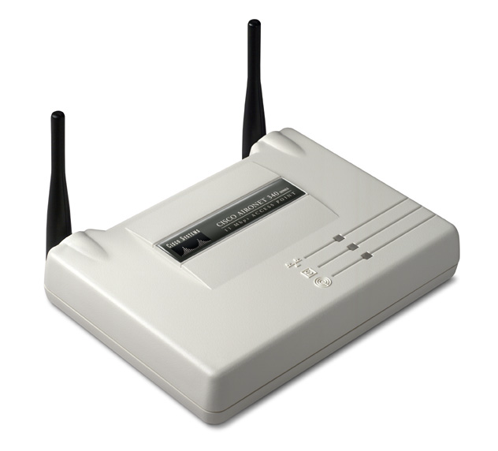
802.11 System Architecture
Basic Service Set (BSS): a set of stations which communicate with one another
Independent Basic Service Set (IBSS)
Infrastructure Basic Service Set (BSS)
only direct communication possible
no relay function
AP provides
  connection to wired network
  relay function
stations not allowed to communicate directly

Slide 6
Extended Service Set
ESS: a set of BSSs interconnected by a distribution system (DS)
ESS and all of its stations appear to be a single MAC layer
AP communicate among themselves to forward traffic
Station mobility within an ESS is invisible to the higher layers

Slide 7
802.11 PHY
Applications
Control
LLC
WEP
MAC
Mgmt
MAC
MIB
PHY
DSSS
FH
IR
OFDM

Slide 8
802.11 PHY
Sender
Receiver
MAC Protcol Data
Unit (MPDU)
MAC Protcol Data
Unit (MPDU)
MAC
PHY
PLCP
header
MAC Protcol Data
Unit (MPDU)
PLCP
header
MAC Protcol Data
Unit (MPDU)
Physical Media
Dependent (PMD) layer
PMD layer
Frequency Hopping Spread Spectrum (FHSS) PHY
1, 2 Mbps
Direct Sequence Spread Spectrum (DSSS) PHY
1,2 Mbps
Infrared (IR) PHY
1,2 Mbps
Orthogonal Frequency Division Multiplexing (OFDM) PHY
6,9,12,18,24,36,48,54 Mbps
802.11a
Higher rate (DSSS) PHY
20+ Mbps
802.11g
High rate (DSSS) PHY
11, 5.5 Mbps
802.11b
2.4 GHz
5.7 GHz
Notes:
Mention that over SCO link you cannot carry any other real-time traffic. There is no protocol-id field in the SCO header/payload. Is this really true?

Slide 9
DSSS PHY
Preamble
Header
MPDU
Preamble
Header
MPDU
1 Mbps
1, 2 Mbps
1 Mbps
1, 2 Mbps
DPSK
modulation
DPSK
de-modulation
Spread the signal using Barker word (11 bits)
+1, -1, +1, +1, -1, +1, +1, +1, -1, -1, -1
Transmitter
baseband signal
Transmitted signal after spreading
Received signal after despreading
Baseband signal is spread using Barker word (10 dB processing gain)
Spread signal occupies approximately 22 Mhz bandwidth
Receiver recovers the signal by applying the same Barker word
DSSS provides good immunity against narrowband interferer
CDMA (multiple access) capability is not possible
Notes:
Mention that over SCO link you cannot carry any other real-time traffic. There is no protocol-id field in the SCO header/payload. Is this really true?

Slide 10
DSSS PHY
Ch 1
Ch 6
Ch 11
22 Mhz
83.5 Mhz
Direct sequence spread spectrum
  Each channel is 22 Mhz wide
Symbol rate
  1 Mb/s with DBPSK modulatio
  2 Mbps with DQPSK modulation
  11, 5.5 Mb/ps with CCK modulation
Max transmit power
  100 Mw

Slide 11
802.11 MAC
Applications
Control
LLC
WEP
MAC
Mgmt
MAC
MIB
PHY
DSSS
FH
IR
OFDM

Slide 12
802.11 MAC
Carrier sensing (CSMA)
  Rules:
    carrier ==> do not transmit
    no carrier ==> OK to transmit
  But the above rules do not always apply to wireless.
    Solution: RTS/CTS
Collision detection (CD)
  Does not work over wireless
  Therefore, use collision avoidance (CA)
    random backoff
    priority ack protocol

Slide 13
802.11 MAC protocol: CSMA/CA
contention
window
DIFS
Busy medium
Next Frame
slot time
Defer access
Use CSMA with collision Avoidance
  Based on carrier sense function in PHY called Clear Channel Assessment (CCA)
Reduce collision probability where mostly needed
Efficient backoff algorithm stable at high loads
Possible to implement different fixed priority levels

Slide 14
802.11 MAC : Contention window
1023
CW max
For DSSS PHY
Slot time = 20 μs
511
255
127
63
CW min
31
Fifth retransmission
Fourth retransmission
Third retransmission
Second retransmission
First retransmission
Initial attempt

