Slide 1
IEEE 802.11b and 802.11a
PHY Layer Specifications

Slide 2
Key Resource
Spectrum:
  802.11 operates in the unlicensed band (ISM – Industrial Scientific and Medical band) ~ 3 such bands
    Cordless Telephony: 902 to 928 MHz
    802.11b: 2.4 to 2.483 GHz
    3rd ISM Band: 5.725 to 5.875 GHz
    802.11a: 5.15 to 5.825 GHz

Slide 3
Data Rates and Range
802.11: 2Mbps (Proposed in 1997)
802.11b: 1, 2, 5.5 and 11 Mbps, 100mts. range (product released in 1999, no product for 1 or 2 Mbps)
802.11g: 54Mbps, 100mts. range (uses OFDM; product expected in 2003)
802.11a: 6 to 54 Mbps, 50mts. range (uses OFDM)

Slide 4
802.11x
a → OFDM in the 5GHz band
b → High Rate DSSS in the 2.4GHz band
c → Bridge Operation Procedures
e → MAC Enhancements for QoS to improve
QoS for better support of audio and video
(such as MPEG-2) applications.
g → OFDM based 2.4 GHz WLAN.
i → Medium Access Method (MAC) Security
Enhancements: enhance security and
authentication mechanisms.

Slide 5
IEEE 802.11a
  5 GHz (5.15-5.25, 5.25-5.35,
  5.725-5.825 GHz)
  OFDM (Orthogonal Freq. Div. Multiplexing)
  52 Subcarriers in OFDM
  BPSK/QPSK/QAM
  Forward Error Correction (Convolutional)
  Rates: 6, 9, 12, 18, 24, 36, 48, 54 Mbps
ISM
Notes:
Only slotted channels are available (5.15 –5.25, etc.)
6,12 and 24 Mbps mandatory, while 9,18,48,54 are optional.

Slide 6
Base specifications:
Common MAC (Medium Access Control) for all 802.11 family
Three Physical Layers:
  FHSS (Frequency Hopping Spread Spectrum)
  DSSS (Direct Sequence Spread Spectrum)
  OFDM (Orthogonal Frequency Division Multiplexing)

Slide 7
802.11b Physical Layer

Slide 8
Overview

Slide 9
Data Rates
GSM
EDGE
IEEE
802.11b
HSPDA
Data Rates
(Mbps) 0.384 11 20
Channel Bandwidth
(MHz) 0.200 22 5
Modulation Scheme 8-PSK PSK QPSK
CCK 16 QAM
Spreading ---- Barker(11) OVSF (16)
Access Method TDMA CDMA CDMA
Frequency (MHz) GSM ISM (2.4) 3G
* Currently (2002) 3GPP is undertaking a feasibility study on HSPAD
( high-speed downlink packet access).

Slide 10
802.11b PHY FRAME
Scrambled 1’s
Data Rate
Locked clock, mod. select
Start of Frame
SYNC
(128)
SFD
(16)
SIGNAL
(8)
SERVICE
(8)
LENGTH
(8)
CRC
(16)
Frame Details
(data rate, size)
Lock/Acquire Frame
PLCP Preamble
(144)
PLCP Header
(48)
PSDU
(2304 max)
Preamble at 1Mbps (DBPSK)
2Mbps (DQPSK)
5.5 and 11 Mbps
(CCK)
PPDU
(PLCP Protocol Data Unit)
Notes:
PLCP: Physical Layer Convergence Procedure
PSDU: PLCP Service data unit
PPDU: PLCP Protocol Data Unit
Mention that header is transmitted at 1 Mbps while the payload can go at 1, 2, 5.5 or 11 Mbps.

Slide 11
PLCP Preamble: Synchronizes the Tx and Rx
  Sync: 128 bits of all ones, scrambled before transmission
  SFD (Start Frame Delimiter): allows the Rx to find the start of the frame
PLCP Header: has PHY specific parameters in four fields
  Signal: used to identify the transmission rate of the encapsulated MAC frame
  Service: b0 to b7:
    b7 extends the length field by 1 bit
    b3 indicates whether transmit freq. and the symbol clock use the same oscillator
    b4 type of coding, say CCK or PBCC (Packet Binary Convolutional Coding)
  Length: no. of micro-secs. required to transmit the frame
  CRC (Cyclic Redundancy Check): protect against corruption by the radio link.

Slide 12
802.11b DSS Operating Channels
DSS PHY has 14 channels, each 22MHz wide, placed 5MHz apart
Channel 1 is placed at center freq. 2.412 GHz, Channel 2 at 2.417 GHz, and so on up to Channel 14 placed at 2.477 GHz
Allowed channels
  US/Canada 1 to 11 (2.412 – 2.462 GHz)
  Europe (excluding France & Spain) 1 to 13 (2.412-2.472 GHz)
  France 10 to 13 (2.457-2.462 GHz)
  Spain 10 to 11 (2.457-2.462 GHz)
  Japan 14 (2.477 GHz)
3 non-overlapping channels

Slide 13
Operating Channels …
Non Overlapping channels.
2412
2437
2462
Overlapping channels.
2400
2400
2412
2422
2432
2442
2452
2462
2472
2483.5
Notes:
Mention that different countries have diff. no. of operating channels. Take an example of US.

Slide 14
FHSS (only 1 and 2 Mbps)
Band 2400-2483.5 MHz
GFSK (Gaussian Frequency Shift Keying)
Sub-channels of 1 MHz
Only 79 channels of the 83 are used
Slow hopping ( 2.5 hops per second)
3 main sets each with 26 different hopping sequences

Slide 15
FHSS (Cont.)
Time
400 ms
1 MHz
Frequency
Hopping distance >= 6 sub-channels
(The distance in frequency between two consecutive hops)
Sub-channel
Source: Tamer Khattab and George Wong.
(UBC, Ca.)
Notes:
1. Violet color represents interference between the blue user and the pink user
2. add the source.

Slide 16
FHSS (Cont.)
Sequences within same set collide at max. on 5 channels
Min. hopping distance of 6 channels.
No CDMA within same BSS
Coexisting BSS in the same coverage area use different sequences from the same hopping set.

Slide 17
Overview
Transmitter

Slide 18
Baseband Processing
For 1 and 2 Mbps data rates
Pulse
Shaping →
I & Q
Spreading
Modulation
Scrambling

Slide 19
Baseband Processing
For 5.5 and 11 Mbps (High Data Rate)
header (192 bits)
spread using barker
Pulse
shaping;
I and Q
Mac
Frame
Scrambler
1 or 2
Mbps
5.5 or 11 Mbps
Modulation
(CCK)
first transmit header
and then CCK modualted
signal

Slide 20
Spreading using Barker Sequence
Barker sequences are short codes
(3 to 13 bits) with very good autocorrelation
properties.
Since FCC (US) defines processing gain for
a SS system to be minimum 10dB, 11 bit barker
sequence was chosen.

Slide 21
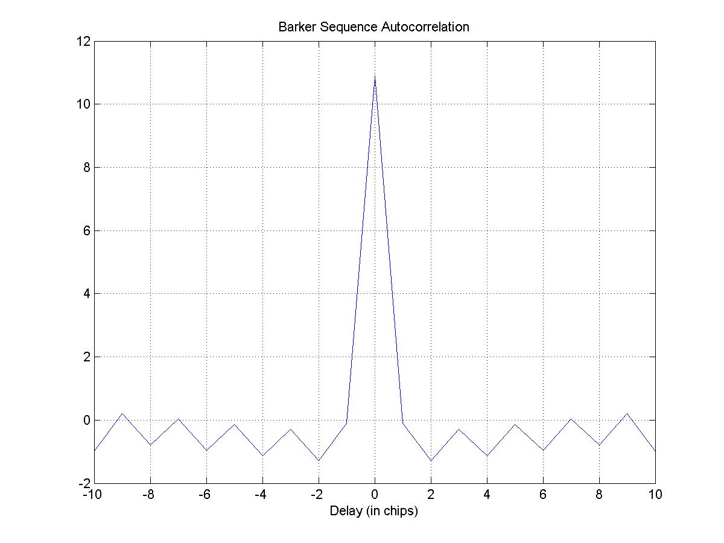
Barker Autocorrelation

Slide 22
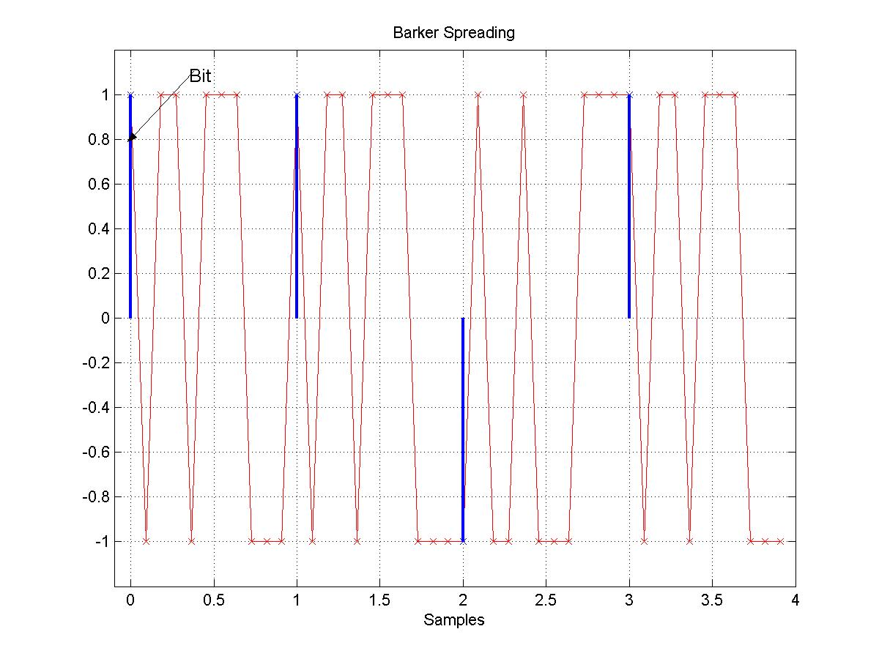
Barker Spreading

Slide 23
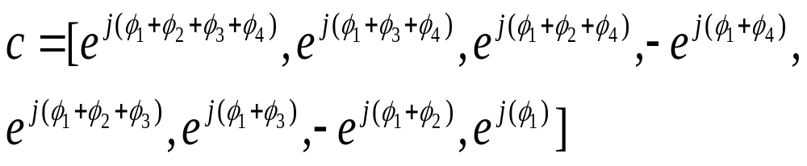
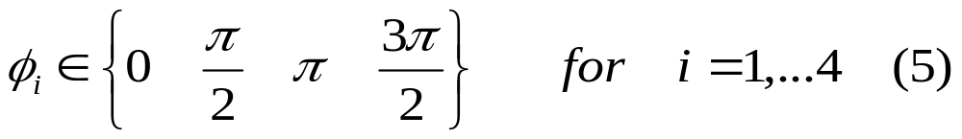
Complementary Code Keying (CCK)
The complementary codes in 802.11b are defined by a set of 256 8-chip code words.
where
Notes:
1. 8 chip complex code -> 16 x 1 vector -> 4096 complex 8 bit sequences out of which only 64 of them have good orthogonality property.

Slide 24
DQPSK encoding table
(Φ1)
Dibit pattern (di,d(i+1)) (di being first in time) | Phase
00 | 0
01 | π/2
11 | π
10 | 3π/2

Slide 25
The φ’s[φ2 to φ4] are chosen as per the following table:
Dibit pattern (di,d(i+1)) (di being first in time) | Phase
00 | 0
01 | π/2
10 | π
11 | 3π/2
Table for 11 Mbps data rate

Slide 26
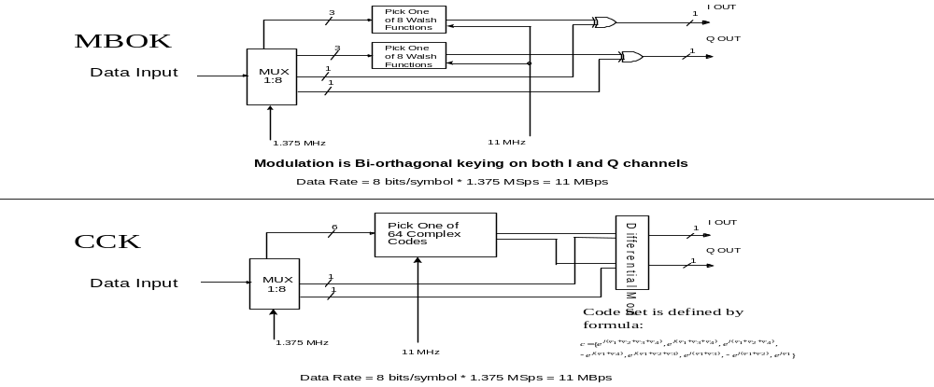
CCK Encoder

Slide 27
Example …
Input Bit Sequence d7…..d0 = 1 1 0 1 1 0 0 0
d1,d0 = 00 → φ1 = 0
d3,d2 = 01 → φ2 = π
d5,d4 = 11 → φ3 = -π/2
d7,d6 = 10 → φ4 = π/2
Hence the formula yields cck bit stream
C = [1 –j -1 -j j -j j -1];
This is transmitted on I and Q streams.
For 5.5 Mbps 4 bits per symbol are transmitted.

Slide 28
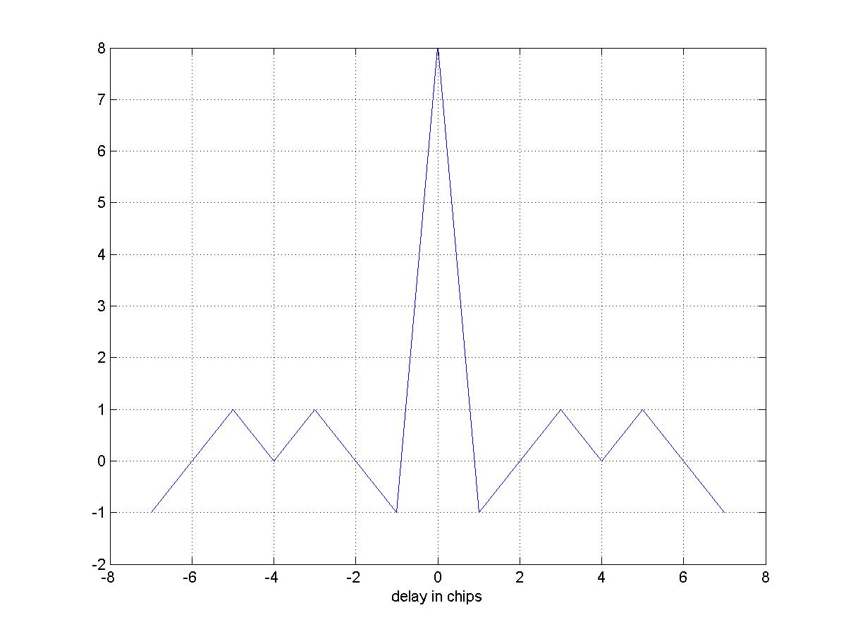
Complementary codes yield very good
correlation properties hence have better resilience to
multipath.
It provides a coding gain of 11 dB after despreading.
Notes:
The greatest advantage being that while in barker spreading each bit is replaced by 11 chips, in CCK 8 bits are replaced by 8 chips. Hence u get an advantage in rate.

Slide 29
The spectral masking requirements for IEEE 802.11b
are not very strict.
The limits are as follows:
The power should be less than –30dBr (relative to sin(x)/x peak) for
fc - 22MHz < f < fc - 11MHz
fc + 11MHz < f < fc + 22MHz
and less than –50dBr for
f < fc – 22 MHz; and
f > fc + 22 MHz
where fc is the channel center frequency.
-30dBr
-50dBr
fc
fc+11
fc+22

Slide 30
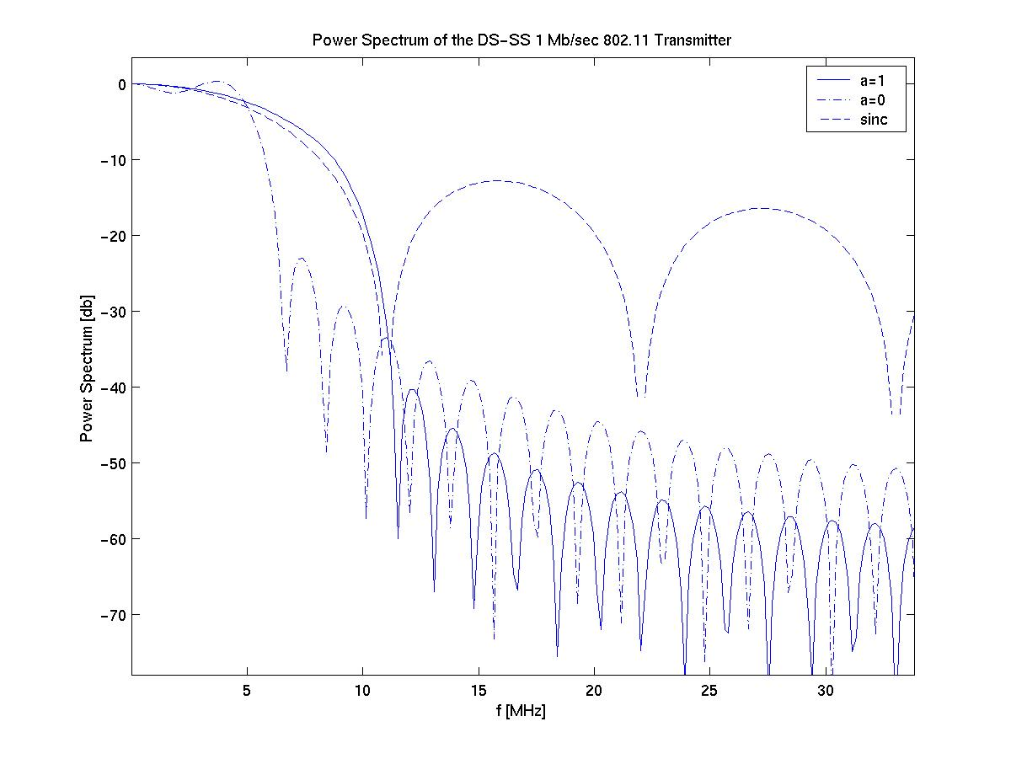
Spectral Masking
Comparing Sinc with RC Filter in Frequency domain
(roll off factor of 0 and 1)

Slide 31
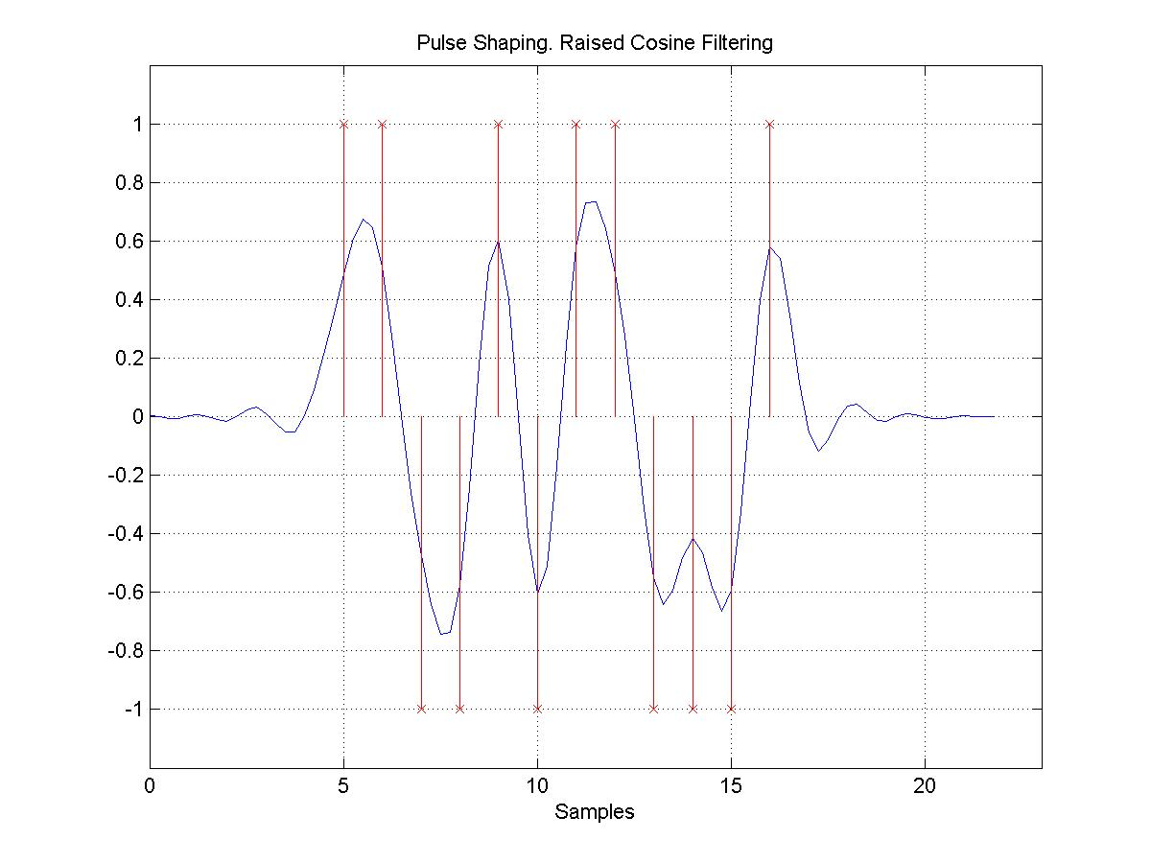
Raised Cosine Shaping Example

Slide 32
Overview
Transmitter
Receiver

Slide 33
Receiver Structure
Rake Combiner
Frequency tracking
Timing Recovery
CCK Decoder (Fast Walsh Transform)
Equalization (DFE ~ Decision Feedback
Equalizer)

Slide 34
Receiver for High Data Rate
timing
recovery
correlator
(Rake)
DQPSK
demod.
CCK
decoder
Equalizer
descrambler
To MAC

Slide 35
RAKE
RAKE combiner
A rake combines all the incoming paths (strong).
A rake combiner is ideal for channels with negligible ISI. (bit duration >> delay spread)
For large ISI (say corresponding to 120ns delay spread), the rake output can be improved by having an equalizer
For each incoming path of significant amplitude a
“rake finger” is allocated.
  Also referred to a channel matched filter

Slide 36
Equalization
Performed to counter channel effects.
Various ways of channel equalization are available.
Equalization is usually achieved by transmitting a known
pilot signal (training based equalization).
Often in practice, equalization achieved with the incoming
signal sampled at higher than the symbol rate. These are
referred to as Fractionally Spaced Equalizer (FSE).
A FSE has higher immunity to timing errors.

Slide 37
Decision Feedback Equalization
Feedforward
Decision
Decision Feedback Equalizer has two
filters :
A feedforward and a feedback filter.
The feedback filter has as its
input the sequence of decisions on
previously detected symbols.
Used to remove ISI from present
estimate caused by previously
detected symbols.
+
LMS/RLS
-
LMS
Feedback

