Slide 1
Introduction to OFDM and the IEEE 802.11a Standard

Slide 2
Motivation
High bit-rate wireless applications in a multipath radio
environment.
OFDM can enable such applications without a high
complexity receiver.
OFDM is part of WLAN, DVB, and BWA standards
and is a strong candidate for some of the 4G wireless
technologies.

Slide 3
Multipath Transmission
Fading due to constructive and destructive addition of
multipath signals.
Channel delay spread can cause ISI.
Flat fading occurs when the symbol period is large compared
to the delay spread.
Frequency selective fading and ISI go together.

Slide 4
Delay Spread
Power delay profile conveys the multipath delay spread
effects of the channel.
RMS delay spread quantifies the severity of the ISI
phenomenon.
The ratio of RMS delay spread to the data symbol period
determines the severity of the ISI.
Notes:
. Figure of a typical PDP used in WLAN say Channel A should be given along with the rms delay spread, this figure is available in the electronic format
. Give an indication of the severity of the ISI in terms of the number of data symbols to the rms/max. delay spread .. Take the WLAN example

Slide 5
A Solution for ISI channels
Conversion of a high-data rate stream into several low-rate
streams.
Parallel streams are modulated onto orthogonal carriers.
Data symbols modulated on these carriers can be recovered
without mutual interference.
Overlap of the modulated carriers in the frequency domain -
different from FDM.
Notes:
- figure difference between OFDM and FDM would be useful here

Slide 6
OFDM
OFDM is a multicarrier block transmission system.
Block of ‘N’ symbols are grouped and sent parallely.
No interference among the data symbols
sent in a block.

Slide 7
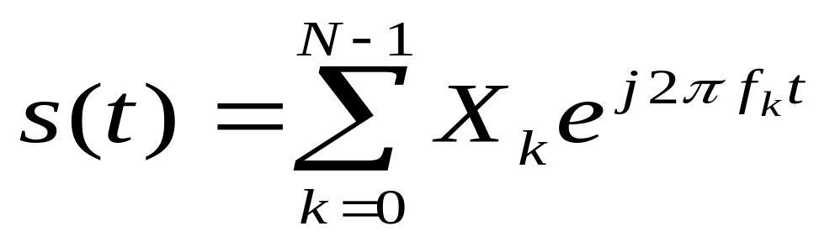
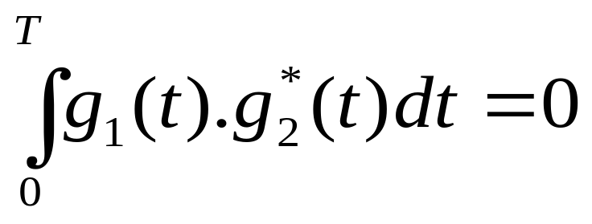
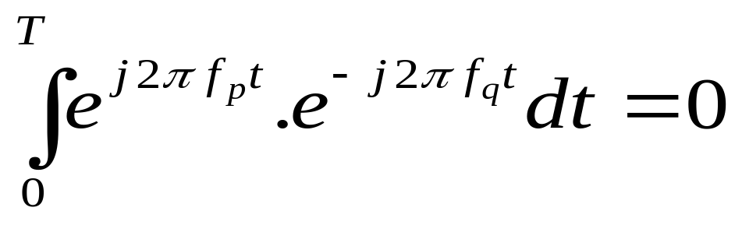
OFDM Mathematics
t ≡ [ 0,Τ_{os}]
Orthogonality Condition
In our case
For p ≠ q Where f_{k}=k/T

Slide 8
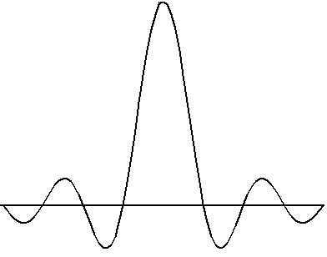
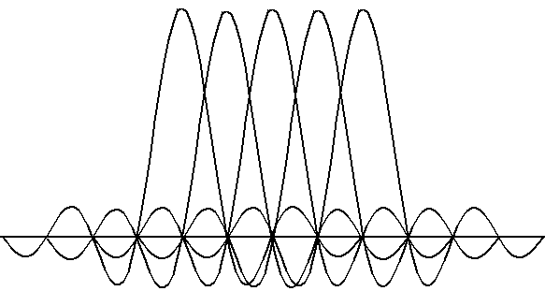
Transmitted Spectrum

Slide 9
OFDM terminology
Orthogonal carriers referred to as subcarriers {f_{i},i=0,....N-1}.
OFDM symbol period {T_{os}=N x T_{s}}.
Subcarrier spacing Δf = 1/T_{os}.

Slide 10
OFDM and FFT
Samples of the multicarrier signal can be obtained using
the IFFT of the data symbols - a key issue.
FFT can be used at the receiver to obtain the data symbols.
No need for ‘N’ oscillators,filters etc.
Popularity of OFDM is due to the use of IFFT/FFT which
have efficient implementations.

Slide 11
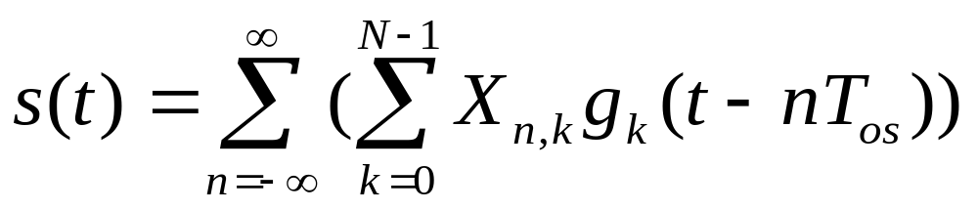
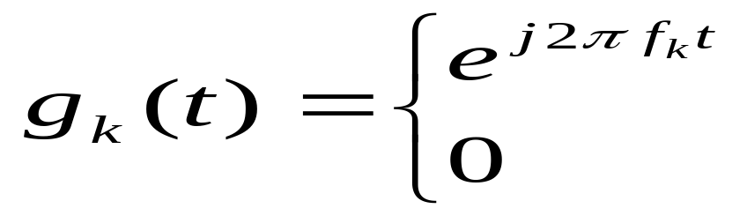
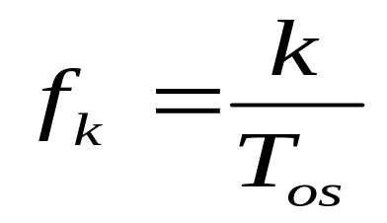
OFDM Signal
t ≡ [ 0,Τ_{os}]
Otherwise
K=0,..........N-1

Slide 12
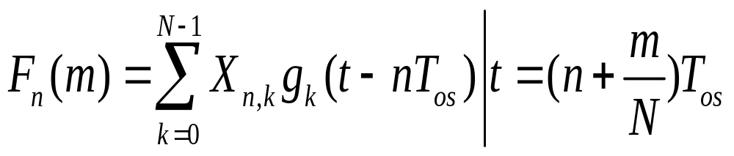
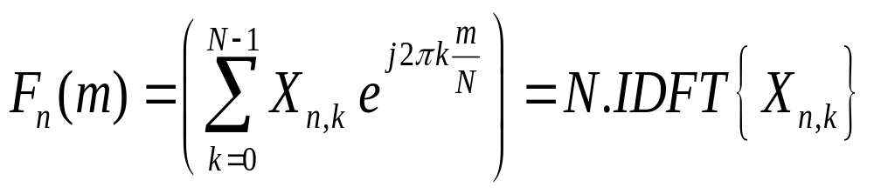
By sampling the low pass equivalent signal at a rate N times
higher than the OFDM symbol rate 1/T_{os}, OFDM frame
can be expressed as:
m = 0....N-1

Slide 13
Interpretation of IFFT&FFT
IFFT at the transmitter & FFT at the receiver
Data symbols modulate the spectrum and the time domain symbols are obtained using the IFFT.
Time domain symbols are then sent on the channel.
FFT at the receiver to obtain the data.

Slide 14
Interference between OFDM Symbols
Transmitted Signal
OS1
OS2
OS3
Due to delay spread ISI occurs
Delay Spread
IOSI
Solution could be guard interval between OFDM symbols

Slide 15
Cyclic Prefix
Zeros used in the guard time can alleviate interference
between OFDM symbols (IOSI problem).
Orthogonality of carriers is lost when multipath channels
are involved.
Cyclic prefix can restore the orthogonality.

Slide 16
Cyclic Prefix
Convert a linear convolution channel into a circular
convolution channel.
This restores the orthogonality at the receiver.
Energy is wasted in the cyclic prefix samples.

Slide 17
Cyclic Prefix Illustration
T_{g}
T_{os}
OS 1
OS 2
Cyclic Prefix
OS1,OS2 - OFDM Symbols
T_{g} - Guard Time Interval
T_{s} - Data Symbol Period
T_{os} - OFDM Symbol Period - N * T_{s}

Slide 18
OFDM Transmitter
X₀
x₀
Parallel
to
Serial
and
add CP
Input
Symbols
Serial
to
Parallel
IFFT
Add
CP
X_{N-1}
x_{N-1}
RF Section
DAC
Windowing

Slide 19
OFDM Receiver
x₀
X₀
ADC
and
Remove
CP
Parallel
to Serial
and
Decoder
Serial to
Parallel
Output
Symbols
FFT
x_{N-1}
X_{N-1}

Slide 20
Synchronization
Timing and frequency offset can influence performance.
Frequency offset can influence orthogonality of subcarriers.
Loss of orthogonality leads to Inter Carrier Interference.

Slide 21
Peak to Average Ratio
Multicarrier signals have high PAR as compared to single
carrier systems.
PAR increases with the number of subcarriers.
Affects power amplifier design and usage.

Slide 22
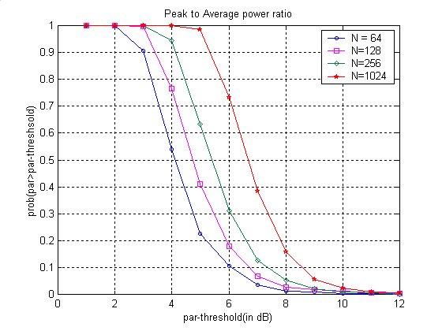
Peak to Average Power Ratio

Slide 23
The IEEE 802.11a Standard
Belongs to the IEEE 802.11 system of specifications for wireless LANs.
802.11 covers both MAC and PHY layers.
Five different PHY layers.
802.11a belongs to the High Speed WLAN category with peak data rate of 54Mbps
PHY Layer very similar to ETSI’s HIPERLAN Type 2

Slide 24
Key Physical Layer Things
Use of OFDM for transmission.
Multiple data rate modes supported using
modulation and coding/puncturing.

Slide 25
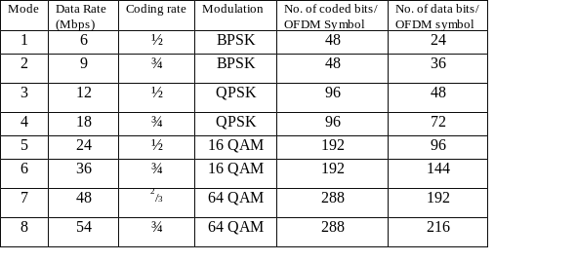
Multiple Data Rates/Modes

Slide 26
OFDM Parameters
Useful Symbol Duration - 3.2μs
Guard Interval Duration - 0.8μs
FFT Size - 64
Number of Data Subcarriers - 48
Number of Pilot Subcarriers - 4
Subcarrier Spacing - 312.5 kHz

Slide 27
OFDM Transmitter
BPSK/
QPSK/
64QAM/
16QAM
Constellation
Mapping
Input
Bits
Convolution
Encoder
Scrambler
Interleaver
IFFT
and
Add CP
OFDM
Symbol
Construction
DAC

Slide 28
Transmitter Features
1/2 rate convolution encoder combined with puncturing
to obtain different coding rates
Interleaving of bits within an OFDM symbol.
Variable number of bits within an OFDM symbol.
Sampling period-50ns-64 data samples,16 samples for the
cyclic prefix.
Windowing operation for pulse shaping.

Slide 29
Data Subcarriers
DC subcarrier (0th) not used since it can cause problems in the DAC
-32 to -27 and 28 to 32 not used.(Guard band on both extremes)
Null subcarriers help in reducing out of band power

Slide 30
Receiver
Synchronization
Channel Estimation and Equalization
FFT (OFDM demodulation)
Demapping
De-Interleaver
Viterbi Decoder
De-Scrambling

Slide 31
802.11a Receiver
Channel
Estimation
And
Equalization
Received
Samples
Synchro-
nization
FFT
Demapping
Descrambler
Viterbi
Decoder
Data
Deinterleaver

Slide 32
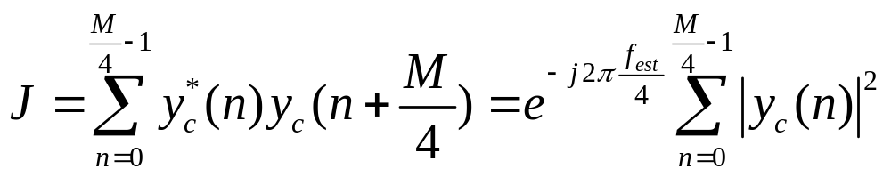
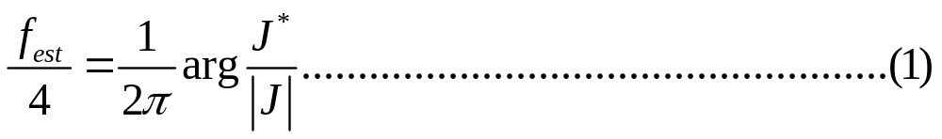

Frequency offset estimation continued….
Implementing the self correlation scheme for short preamble sequence,
so that;
Number of samples in the short preamble.

Slide 33
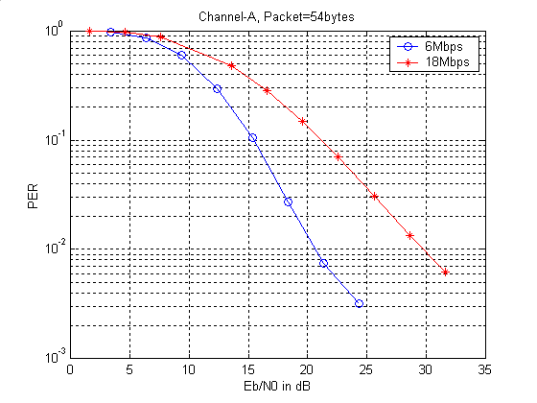

Slide 34
