Slide 1
Basic File IO
md. Jakaria
Lecturer
Dept. of cse, mist

Slide 2
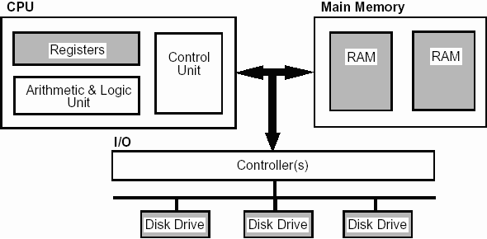
Two different types of memory
https://www.doc.ic.ac.uk/~eedwards/compsys/memory/index.html
https://www.ibm.com/developerworks/library/pa-dalign/index.html

Slide 3
Two different types of memory
Volatile storage
Persistent storage
https://www.doc.ic.ac.uk/~eedwards/compsys/memory/index.html
https://www.ibm.com/developerworks/library/pa-dalign/index.html

Slide 4
Why files are needed?
When a program is terminated, the entire data is lost. Storing in a file will preserve your data even if the program terminates.
If you have to enter a large number of data, it will take a lot of time to enter them all. However, if you have a file containing all the data, you can easily access the contents of the file using few commands in C.
You can easily move your data from one computer to another without any changes.

Slide 5


Two types of files
Text Files
(Human Readable)
Binary Files
(Only Machine Readable)

Slide 6
Supported File Operations
Creating a new file
Opening an existing file
Closing a file
Reading from and writing information to a file

Slide 7

Concept of writing in a File

Slide 8
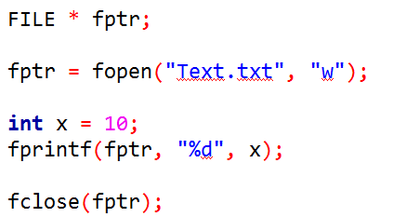
Concept of writing in a File
fptr

Slide 9
Concept of writing in a File
fptr

Slide 10
Concept of writing in a File
fptr
Text.txt
File Mode | Meaning of Mode | During Inexistence of File
w | Open for writing. | If the file does not exist, it will be created. If the file exists, its contents are overwritten.

Slide 11
Concept of writing in a File
fptr
10
Text.txt
File Mode | Meaning of Mode | During Inexistence of File
w | Open for writing. | If the file does not exist, it will be created. If the file exists, its contents are overwritten.

Slide 12
Concept of writing in a File
fptr

Slide 13
Concept of writing in a File
fptr

Slide 14
Concept of writing in a File
fptr
Text.txt
File Mode | Meaning of Mode | During Inexistence of File
w | Open for writing. | If the file does not exist, it will be created. If the file exists, its contents are overwritten.

Slide 15
Concept of writing in a File
fptr
Text.txt
File Mode | Meaning of Mode | During Inexistence of File
w | Open for writing. | If the file does not exist, it will be created. If the file exists, its contents are overwritten.

Slide 16
Concept of writing in a File
fptr
10
Text.txt
File Mode | Meaning of Mode | During Inexistence of File
w | Open for writing. | If the file does not exist, it will be created. If the file exists, its contents are overwritten.

Slide 17
Task 1
Take an int and a float as user input
Write it in a file

Slide 18
Task 2
Take the name, roll and cgpa of a student as input
Write it in a file

Slide 19
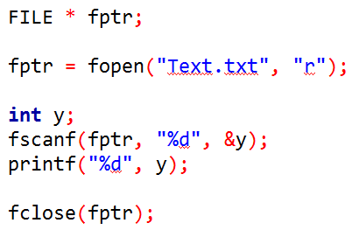
Reading from a file
File Mode | Meaning of Mode | During Inexistence of File
r | Open for reading. | If the file does not exist, fopen() returns NULL.

Slide 20
Task 3
Display the information written in Task 2 in console

Slide 21

Append mode
File Mode | Meaning of Mode | During Inexistence of File
a | Open for append. i.e, Data is added to end of file. | If the file does not exists, it will be created.

Slide 22
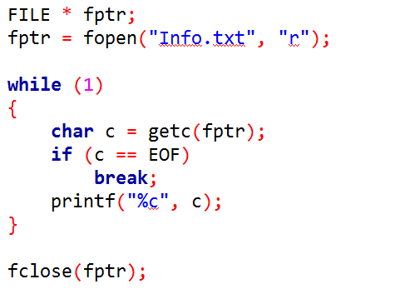
Reading chars until end of file

Slide 23
Displaying chars until end of file

