Slide 1
Dynamic Memory Allocation
Scope
Dynamic memory Allocation
Malloc
Calloc
Realloc
Alternative to Dynamic Memory
Md. Jakaria
Lecturer
Dept. of CSE, MIST
Notes:
1

Slide 2
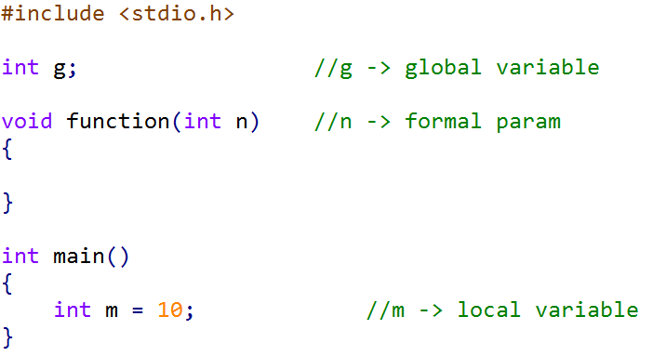
Scope of a Variable
Three places

Slide 3
Scope of a Variable
Scope of n and m

Slide 4
Scope of a Variable
Scope of g

Slide 5
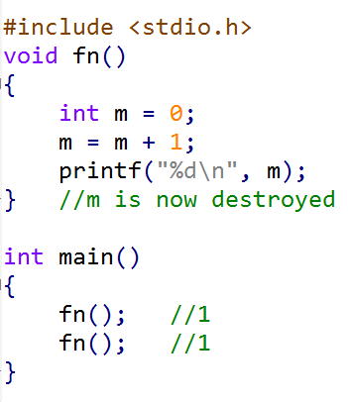
Lifetime of a local variable
Local variables are destroyed when they go out-of-scope

Slide 6
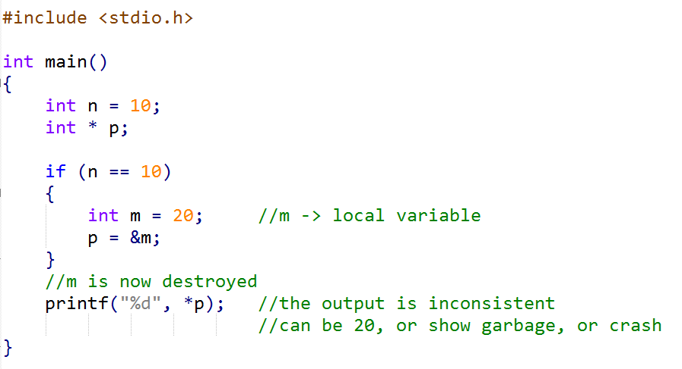
Reference to Local
Pointer referring to expired local variable

Slide 7
Reference to Local
Pointer referring to expired local variable

Slide 8
Reference to Local
Pointer referring to expired local variable (Dangling Pointer)

Slide 9
Reference to Local
Pointer referring to expired local variable (Dangling Pointer)

Slide 10
Dynamic Memory Allocation
The concept
Out-of-Scope

Slide 11
Dynamic Memory Allocation
The concept
Out-of-Scope

Slide 12
Dynamic Memory Allocation
The concept
Out-of-Scope
Out-of-Scope

Slide 13
Dynamic Memory Allocation
The concept
Out-of-Scope
Out-of-Scope

Slide 14
Dynamic Memory Allocation
The concept
Out-of-Scope
Out-of-Scope

Slide 15
Dynamic Memory Allocation
The concept
Out-of-Scope
Out-of-Scope

Slide 16
Dynamic Memory Allocation
The concept
Out-of-Scope
Out-of-Scope

Slide 17
The malloc function
void * malloc (size_t size);
Memory required in byte
e.g. sizeof (int)
Returns pointer to the beginning of the block
According to the 1999 ISO C standard (C99), size_t is an unsigned integer type of at least 16 bit. This type is used to represent the size of an object.
https://en.wikipedia.org/wiki/C_data_types#stddef.h
https://stackoverflow.com/questions/2550774/what-is-size-t-in-c

Slide 18
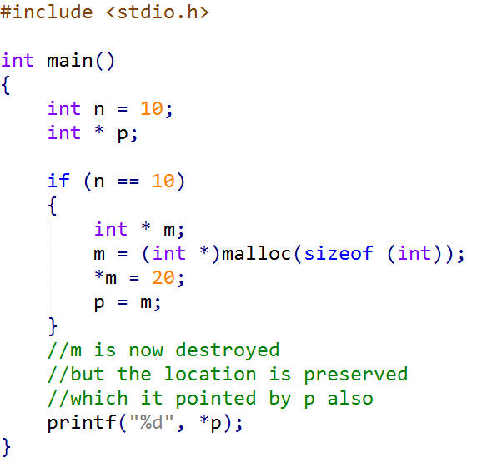
The malloc function

Slide 19
Usage of malloc function
Dynamic allocation of
Array
Struct
Factory Methods

Slide 20
Destruction of Dynamic Memory
When is it destroyed?
Out-of-Scope
Not destroyed automatically
(Memory leak)

Slide 21
The free function
When the outside (dynamic) memory is no longer needed
void free(void *ptr)

Slide 22
The free function
When the outside (dynamic) memory is no longer needed
void free(void *ptr)
free( )

Slide 23
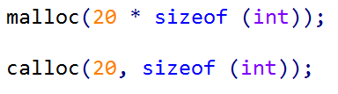
The calloc function
Same as malloc
void *calloc(size_t nitems, size_t size)
How many items?
Size of each item
The following two lines produces similar allocation

Slide 24
The calloc function
void *calloc(size_t nitems, size_t size)
Initializes every bit to zero
Slower than malloc

Slide 25
The realloc function
For resizing existing dynamic memory
void *realloc(void *ptr, size_t size)
Existing pointer
New size
Either memory is extended,
Or Previous items are copied to new larger location

Slide 26
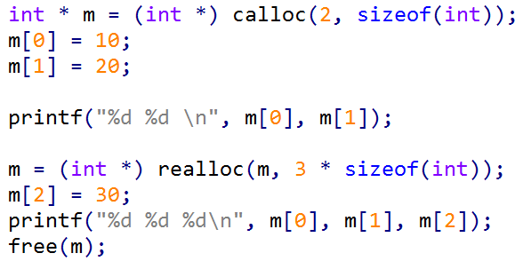
The realloc function
void *realloc(void *ptr, size_t size)
Existing pointer
New size

Slide 27
The realloc function
void *realloc(void *ptr, size_t size)
Existing pointer
New size

Slide 28
The realloc function
void *realloc(void *ptr, size_t size)
Existing pointer
New size

Slide 29
The realloc function
void *realloc(void *ptr, size_t size)
Existing pointer
New size

Slide 30
The realloc function
void *realloc(void *ptr, size_t size)
Existing pointer
New size

Slide 31
Alternative to Dynamic memory
Global variables (Scope is increased)
Static variables (Life-time is increased)

Slide 32
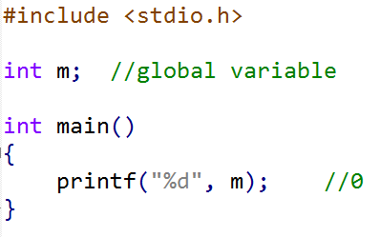
Global Variable Initialization
Automatically initialized

Slide 33
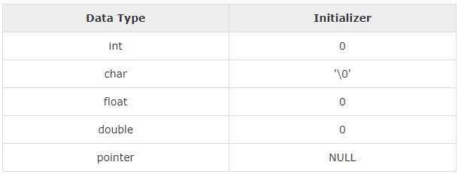
Global Variable Initialization
Automatically initialized
Credit: https://www.tutorialspoint.com/cplusplus/cpp_variable_scope.htm

Slide 34
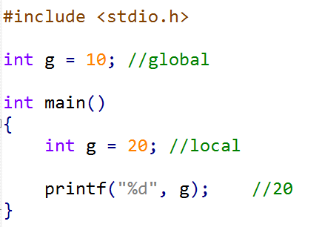
Variable Shadowing
In case of same name, local variable takes preference

Slide 35
The static Keyword
Prevents local variable from being destroyed until the program terminates

Slide 36
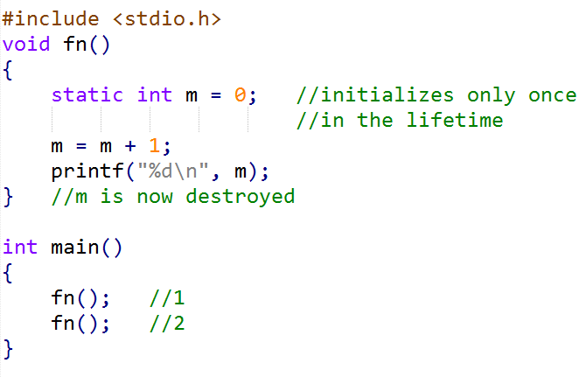
The static Keyword
Prevents local variable from being destroyed until the program terminates

Slide 37
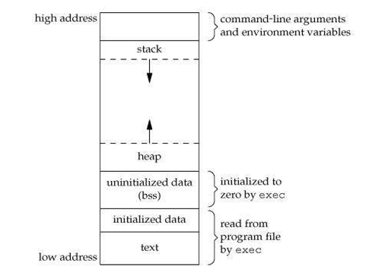
Memory Layout of a C Program
https://www.hackerearth.com/practice/notes/memory-layout-of-c-program/

Slide 38
Task 1
Create a resizable array of integers with the following options
Add a new number to the array
Display all numbers in the array
Delete an existing integer (by index)
The storage should be flexible so that no memory is wasted.

Slide 39
Task 2
Task 2
Design a record book that will hold the name, id and total marks of a student. The following options should be available.
Add a new record
Display all records
Edit an existing record
Delete an existing record
Search for a record by name or id
The storage should be flexible so that no memory is wasted.

Slide 40
Task 3
Task 3
Integrate Persistent storage (File) in Task 2, i.e. all the contents of the array should be written to file at the end of the program, and it should load all the contents from the file at the beginning of the program.

