Slide 1
Structure
Md. Jakaria
Lecturer
Dept. of cse, mist
Notes:
1

Slide 2
Primitive data-types
Until now, we are able to store only the following types.
int mark = 87;
float cgpa = 3.5;
double pi = 3.1415926535897;
char c = ‘p’;

Slide 3
Custom data-type
What if we want to store the following information?
24/09/2018
24 September, 2018
09:23:00 am
34, College Avenue, Mirpur, Dhaka.
Mr. Raihan, Age: 20, Contact Number: 1234

Slide 4
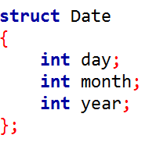


Our own Date data-type

Slide 5
Our own Date data-type
This is the type of the variable.
Similar to the int here

Slide 6
Our own Date data-type
This is the identifier (name of the variable)
Similar to mark here

Slide 7

A Shortcut
From now, this can also be written as this

Slide 8
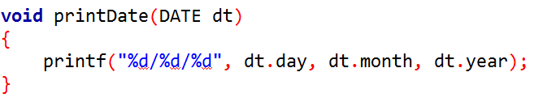
A dedicated function

Slide 9
Task 1
Design a struct that can hold the following information
12 : 23 : 13 am
Typedef it
Declare a variable, assign values to it.
Write a function to display it.

Slide 10
What if we want to store this?
24 September, 2018

Slide 11
Task 2
Design a struct that can hold the following information
Student Name
Roll
Batch
Cgpa
Typedef it
Declare a variable, assign values to it.

Slide 12
What if we want to store date of birth?
Student Name
Roll
Batch
cgpa
Date of Birth

Slide 13
Task 3
Design a struct that can hold the following information
Student Name
Roll
Batch
cgpa
Date of Birth
Address (May contain house no, street, city etc.)
Typedef it
Declare a variable, assign values to it.

