Slide 1
String
md. Jakaria
Lecturer
Dept. of cse, mist

Slide 2

String
Basically a character array

Slide 3
String
In place initialization
Null character

Slide 4

String
In place initialization
Null character
We can also write
str:
H | e | l | l | o | \0

Slide 5
String
Why null character?
H | e | l | l | o | \0

Slide 6
String
Why null character?
H | e | l | l | o | \0
To mark the end of string
[C compiler automatically adds null character here]

Slide 7

String
Another more useful way of initialization (without length)
[C compiler automatically assigns required size]

Slide 8
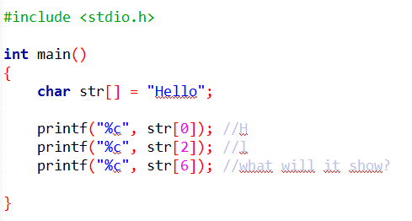
Accessing char by char
0 | 1 | 2 | 3 | 4 | 5
H | e | l | l | o | \0

Slide 9
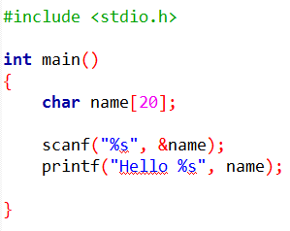
Reading word from user

Slide 10
Reading word from user
scanf terminates when a whitespace is found.
So we cannot use %s for reading a line

Slide 11
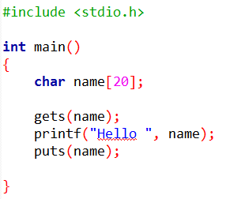
Reading/writing line
Usage of gets() and puts()

Slide 12

Finding the length of the string
Is it 20?

Slide 13
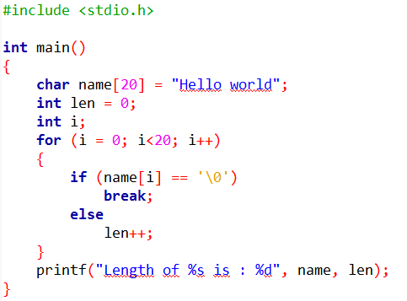
Finding the length of the string
How do we know the end of string?

Slide 14
Finding the length of the string
How do we know the end of string?

Slide 15
Finding the length of the string
Why 20?

Slide 16
Finding the length of the string
What will happen if null char is found? Else?

Slide 17
Finding the length of the string
What will happen if null char is found? Else?

Slide 18
Finding the length of the string
What now?

Slide 19
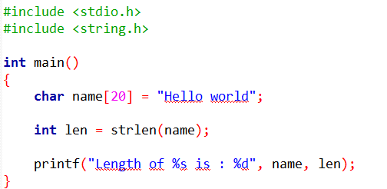
Finding the length of the string
We can also use the library function

Slide 20
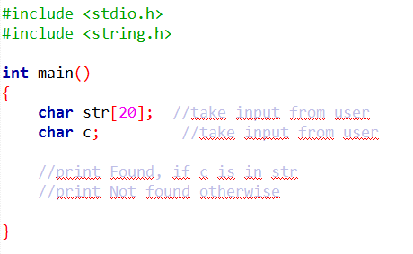
Task 1: Search a character in a string

Slide 21
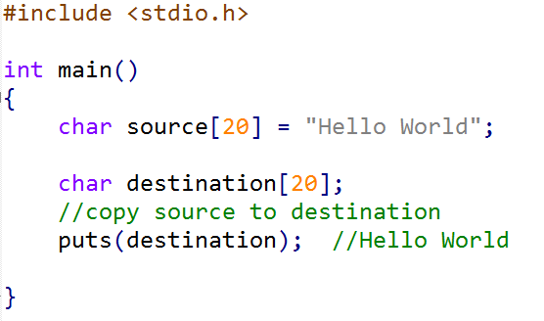
Task 2: Copying one String to another

Slide 22
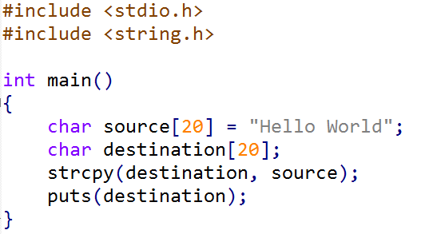
Task 2: Copying one String to another
We can also use the library function

Slide 23

Task 3: Concatenation (joining)

Slide 24
Task 3: Concatenation (joining)
0 | 1 | 2 | 3 | 4 | 5 | 6 | 7
C | o | u | n | t | \0

Slide 25

Task 3: Concatenation (joining)
0 | 1 | 2 | 3 | 4 | 5 | 6 | 7
C | o | u | n | t | \0

Slide 26
Task 3: Concatenation (joining)
0 | 1 | 2 | 3 | 4 | 5 | 6 | 7
C | o | u | n | t | \0
0 | 1 | 2 | 3 | 4
r | y | \0

Slide 27
Task 3: Concatenation (joining)
0 | 1 | 2 | 3 | 4 | 5 | 6 | 7
C | o | u | n | t | \0
str1
0 | 1 | 2 | 3 | 4
r | y | \0
str2

Slide 28
Task 3: Concatenation (joining)
0 | 1 | 2 | 3 | 4 | 5 | 6 | 7
C | o | u | n | t | \0
str1
0 | 1 | 2 | 3 | 4
r | y | \0
str2

Slide 29
Task 3: Concatenation (joining)
0 | 1 | 2 | 3 | 4 | 5 | 6 | 7
C | o | u | n | t | r
str1
0 | 1 | 2 | 3 | 4
r | y | \0
str2

Slide 30
Task 3: Concatenation (joining)
0 | 1 | 2 | 3 | 4 | 5 | 6 | 7
C | o | u | n | t | r | y
str1
0 | 1 | 2 | 3 | 4
r | y | \0
str2

Slide 31
Task 3: Concatenation (joining)
0 | 1 | 2 | 3 | 4 | 5 | 6 | 7
C | o | u | n | t | r | y | \0
str1
0 | 1 | 2 | 3 | 4
r | y | \0
str2

Slide 32
Task 3: Concatenation (joining)
0 | 1 | 2 | 3 | 4 | 5 | 6 | 7
C | o | u | n | t | \0
str1
0 | 1 | 2 | 3 | 4
r | y | \0
str2
What will be the starting value of i?

Slide 33
Task 3: Concatenation (joining)
0 | 1 | 2 | 3 | 4 | 5 | 6 | 7
C | o | u | n | t | \0
str1
0 | 1 | 2 | 3 | 4
r | y | \0
str2
What will be the starting value of i?
for (i = 0;

Slide 34
Task 3: Concatenation (joining)
0 | 1 | 2 | 3 | 4 | 5 | 6 | 7
C | o | u | n | t | \0
str1
0 | 1 | 2 | 3 | 4
r | y | \0
len1 = strlen(str1);
len2 = strlen(str2);
str2
What will be the ending value of i?
for (i = 0;

Slide 35
Task 3: Concatenation (joining)
0 | 1 | 2 | 3 | 4 | 5 | 6 | 7
C | o | u | n | t | r | y
str1
0 | 1 | 2 | 3 | 4
r | y | \0
len1 = strlen(str1);
len2 = strlen(str2);
str2
What will be the ending value of i?
for (i = 0;

Slide 36
Task 3: Concatenation (joining)
0 | 1 | 2 | 3 | 4 | 5 | 6 | 7
C | o | u | n | t | r | y | \0
str1
0 | 1 | 2 | 3 | 4
r | y | \0
len1 = strlen(str1);
len2 = strlen(str2);
str2
What will be the ending value of i?
for (i = 0;

Slide 37
Task 3: Concatenation (joining)
0 | 1 | 2 | 3 | 4 | 5 | 6 | 7
C | o | u | n | t | r | y | \0
str1
0 | 1 | 2 | 3 | 4
r | y | \0
len1 = strlen(str1);
len2 = strlen(str2);
str2
What will be the ending value of i?
for (i = 0; i<=len2; i++)

Slide 38
Task 3: Concatenation (joining)
0 | 1 | 2 | 3 | 4 | 5 | 6 | 7
C | o | u | n | t | r | y | \0
str1
0 | 1 | 2 | 3 | 4
r | y | \0
len1 = strlen(str1);
len2 = strlen(str2);
str2
What is happening in each iteration?
for (i = 0; i<=len2; i++)
{ str1[ ? ] = str2[ ? ]; }

Slide 39
Task 3: Concatenation (joining)
0 | 1 | 2 | 3 | 4 | 5 | 6 | 7
C | o | u | n | t | r | y | \0
str1
0 | 1 | 2 | 3 | 4
r | y | \0
len1 = strlen(str1);
len2 = strlen(str2);
str2
What is happening in each iteration?
for (i = 0; i<=len2; i++)
{ str1[ ? ] = str2[ i ]; }

Slide 40
Task 3: Concatenation (joining)
0 | 1 | 2 | 3 | 4 | 5 | 6 | 7
C | o | u | n | t | r | y | \0
str1
0 | 1 | 2 | 3 | 4
r | y | \0
len1 = strlen(str1);
len2 = strlen(str2);
str2
What is happening in each iteration?
for (i = 0; i<=len2; i++)
{ str1[ ? ] = str2[ i ]; }

Slide 41
Task 3: Concatenation (joining)
0 | 1 | 2 | 3 | 4 | 5 | 6 | 7
C | o | u | n | t | r | y | \0
str1
0 | 1 | 2 | 3 | 4
r | y | \0
len1 = strlen(str1);
len2 = strlen(str2);
str2
What is happening in each iteration?
for (i = 0; i<=len2; i++)
{ str1[i + len1 ] = str2[ i ]; }

Slide 42
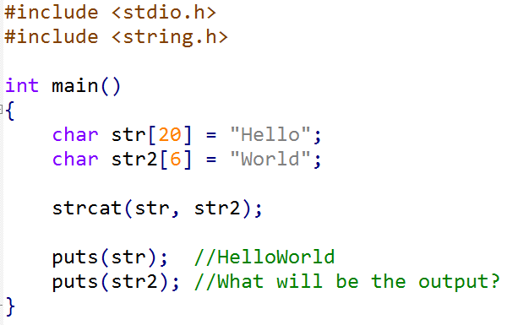
Task 3: Concatenation (joining)
We can also use the library function

Slide 43
Task 3: Concatenation (joining)
We can also use the library function

Slide 44
Task 4: Reversing a string
0 | 1 | 2 | 3 | 4 | 5 | 6 | 7
A | B | C | D | E | \0
str1

Slide 45
Task 4: Reversing a string
0 | 1 | 2 | 3 | 4 | 5 | 6 | 7
A | B | C | D | E | \0
str1
0 | 1 | 2 | 3 | 4 | 5 | 6 | 7
E | D | C | B | A | \0
str1

Slide 46
Task 4: Reversing a string
0 | 1 | 2 | 3 | 4 | 5 | 6 | 7
A | B | C | D | E | \0
str1

Slide 47
Task 4: Reversing a string
0 | 1 | 2 | 3 | 4 | 5 | 6 | 7
E | B | C | D | A | \0
str1

Slide 48
Task 4: Reversing a string
0 | 1 | 2 | 3 | 4 | 5 | 6 | 7
E | B | C | D | A | \0
str1

Slide 49
Task 4: Reversing a string
0 | 1 | 2 | 3 | 4 | 5 | 6 | 7
E | D | C | B | A | \0
str1

Slide 50
Task 4: Reversing a string
0 | 1 | 2 | 3 | 4 | 5 | 6 | 7
E | D | C | B | A | \0
str1

Slide 51
Task 4: Reversing a string
0 | 1 | 2 | 3 | 4 | 5 | 6 | 7
E | D | C | B | A | \0
str1

Slide 52
Task 4: Reversing a string
0 | 1 | 2 | 3 | 4 | 5 | 6 | 7
A | B | C | D | E | \0
str1
int len1 = strlen(str1);
- How many times should the loop run?
len1 times?

Slide 53
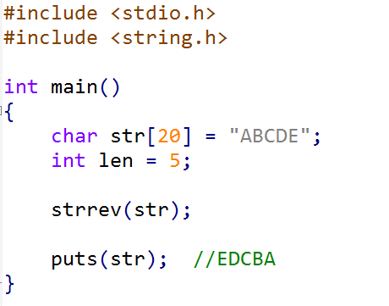
Task 4: Reversing a string
We can also use the library function

Slide 54
Task 5: Checking is two strings are equal
0 | 1 | 2 | 3 | 4 | 5 | 6 | 7
A | B | C | D | E | \0
str1
0 | 1 | 2 | 3 | 4 | 5 | 6 | 7
A | B | C | 1 | 2 | \0
str2

Slide 55
Task 5: Checking is two strings are equal
0 | 1 | 2 | 3 | 4 | 5 | 6 | 7
A | B | C | D | E | \0
0 | 1 | 2 | 3 | 4 | 5 | 6 | 7
A | B | C | D | E | \0
str1
str1
0 | 1 | 2 | 3 | 4 | 5 | 6 | 7
A | B | C | 1 | 2 | \0
0 | 1 | 2 | 3 | 4 | 5 | 6 | 7
A | B | C | 1 | 2 | \0
str2
str2

Slide 56
Task 5: Checking is two strings are equal
0 | 1 | 2 | 3 | 4 | 5 | 6 | 7
A | B | C | D | E | \0
0 | 1 | 2 | 3 | 4 | 5 | 6 | 7
A | B | C | D | E | \0
str1
str1
0 | 1 | 2 | 3 | 4 | 5 | 6 | 7
A | B | C | 1 | 2 | \0
0 | 1 | 2 | 3 | 4 | 5 | 6 | 7
A | B | C | 1 | 2 | \0
str2
str2

Slide 57
Task 5: Checking is two strings are equal
0 | 1 | 2 | 3 | 4 | 5 | 6 | 7
A | B | C | D | E | \0
0 | 1 | 2 | 3 | 4 | 5 | 6 | 7
A | B | C | D | E | \0
str1
str1
0 | 1 | 2 | 3 | 4 | 5 | 6 | 7
A | B | C | 1 | 2 | \0
0 | 1 | 2 | 3 | 4 | 5 | 6 | 7
A | B | C | 1 | 2 | \0
str2
str2

Slide 58
Task 5: Checking is two strings are equal
0 | 1 | 2 | 3 | 4 | 5 | 6 | 7
A | B | C | D | E | \0
0 | 1 | 2 | 3 | 4 | 5 | 6 | 7
A | B | C | D | E | \0
str1
str1
0 | 1 | 2 | 3 | 4 | 5 | 6 | 7
A | B | C | 1 | 2 | \0
0 | 1 | 2 | 3 | 4 | 5 | 6 | 7
A | B | C | 1 | 2 | \0
str2
str2

Slide 59
Task 5: Checking is two strings are equal
0 | 1 | 2 | 3 | 4 | 5 | 6 | 7
A | B | C | D | E | \0
0 | 1 | 2 | 3 | 4 | 5 | 6 | 7
A | B | C | D | E | \0
str1
str1
0 | 1 | 2 | 3 | 4 | 5 | 6 | 7
A | B | C | D | E | \0
str2
str2

Slide 60
Task 5: Checking is two strings are equal
0 | 1 | 2 | 3 | 4 | 5 | 6 | 7
A | B | C | D | E | \0
0 | 1 | 2 | 3 | 4 | 5 | 6 | 7
A | B | C | D | E | \0
str1
str1
0 | 1 | 2 | 3 | 4 | 5 | 6 | 7
A | B | C | D | E | \0
str2
str2

Slide 61
Task 5: Checking is two strings are equal
0 | 1 | 2 | 3 | 4 | 5 | 6 | 7
A | B | C | D | E | \0
0 | 1 | 2 | 3 | 4 | 5 | 6 | 7
A | B | C | D | E | \0
str1
str1
0 | 1 | 2 | 3 | 4 | 5 | 6 | 7
A | B | C | D | E | \0
str2
str2

Slide 62
Task 5: Checking is two strings are equal
0 | 1 | 2 | 3 | 4 | 5 | 6 | 7
A | B | C | D | E | \0
0 | 1 | 2 | 3 | 4 | 5 | 6 | 7
A | B | C | D | E | \0
str1
str1
0 | 1 | 2 | 3 | 4 | 5 | 6 | 7
A | B | C | D | E | \0
0 | 1 | 2 | 3 | 4 | 5 | 6 | 7
A | B | C | D |  | \0
str2
str2

Slide 63
Task 5: Checking is two strings are equal
0 | 1 | 2 | 3 | 4 | 5 | 6 | 7
A | B | C | D | E | \0
0 | 1 | 2 | 3 | 4 | 5 | 6 | 7
A | B | C | D | E | \0
str1
str1
0 | 1 | 2 | 3 | 4 | 5 | 6 | 7
A | B | C | D | E | \0
0 | 1 | 2 | 3 | 4 | 5 | 6 | 7
A | B | C | D | E | \0
str2
str2

Slide 64
Task 5: Checking is two strings are equal
0 | 1 | 2 | 3 | 4 | 5 | 6 | 7
A | B | C | D | E | \0
0 | 1 | 2 | 3 | 4 | 5 | 6 | 7
A | B | C | D | E | \0
str1
str1
0 | 1 | 2 | 3 | 4 | 5 | 6 | 7
A | B | C | D | E | \0
0 | 1 | 2 | 3 | 4 | 5 | 6 | 7
A | B | C | D | E | \0
str2
str2

Slide 65
Task 5: Checking is two strings are equal
0 | 1 | 2 | 3 | 4 | 5 | 6 | 7
A | B | C | D | E | \0
str1
0 | 1 | 2 | 3 | 4 | 5 | 6 | 7
A | B | C | D | E | \0
str2

Slide 66
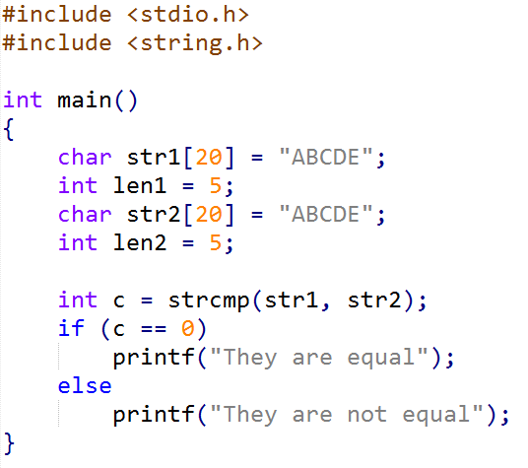
Task 5: Checking is two strings are equal
As usual, we can also use the library function

Slide 67
Task 5: Checking is two strings are equal
As usual, we can also use the library function
c < 0 means str1 is less than str2
Which means,
In dictionary, str1 comes before str2

Slide 68
Task 5: Checking is two strings are equal
As usual, we can also use the library function
c < 0 means str1 is less than str2
Which means,
In dictionary, str1 comes before str2
*str1 appears before str2 in lexicographic order.
0 | 1 | 2 | 3
C | A | B | \0
str1
0 | 1 | 2 | 3
C | A | T | \0
str2

Slide 69
Task 5: Checking is two strings are equal
As usual, we can also use the library function
c > 0 means str1 is greater than str2
Which means,
In dictionary, str1 comes after str2

Slide 70
Task 5: Checking is two strings are equal
As usual, we can also use the library function
c > 0 means str1 is greater than str2
Which means,
In dictionary, str1 comes after str2
0 | 1 | 2 | 3
C | U | B | \0
str1
0 | 1 | 2 | 3
C | A | T | \0
str2

