Slide 1
Union and Enum
md. Jakaria
Lecturer
Dept. of cse, mist
Notes:
1

Slide 2
Union
A different type of structure.
A single piece of memory shared by two or more variables.
Variables maybe of different types.
Only one variable maybe in use at a time.

Slide 3
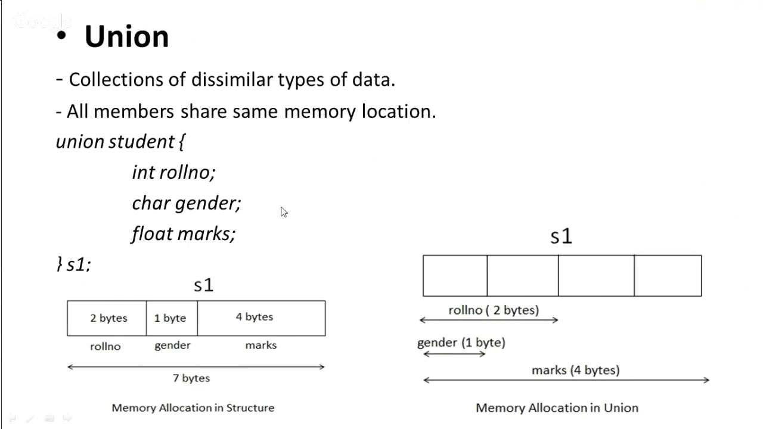
Union
Stores different data types in the same memory location.

Slide 4
Union
Stores different data types in the same memory location.

Slide 5
Union
Stores different data types in the same memory location.

Slide 6
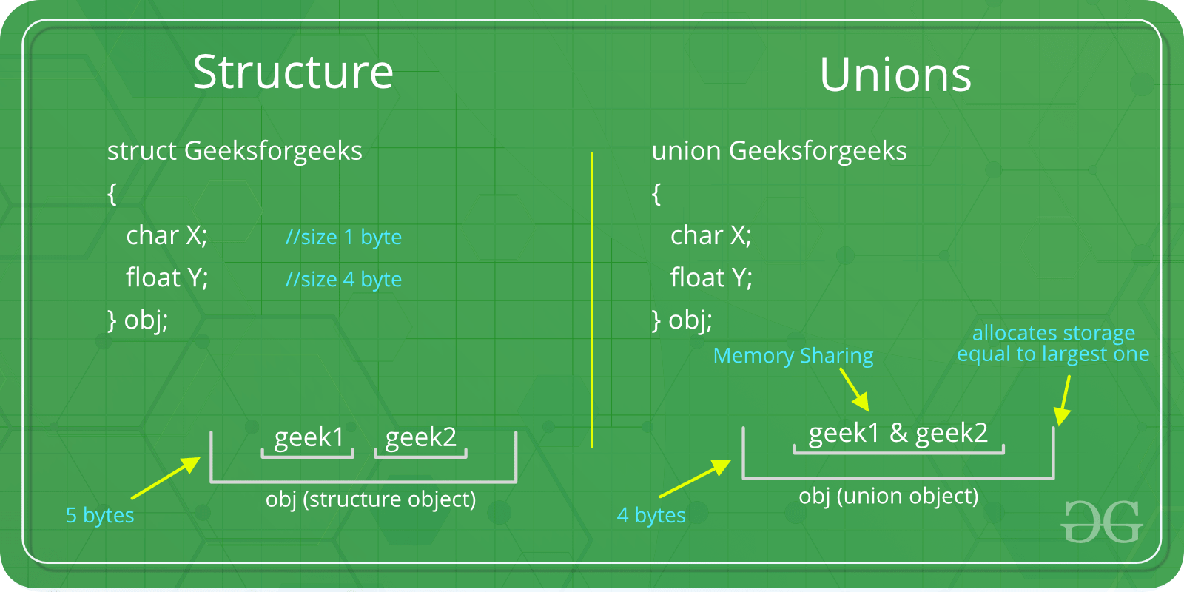
Union

Slide 7
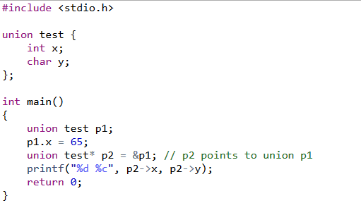
Union

Slide 8
Enum
Enumeration (enum) is a user-defined datatype.
An enumeration consists of integral constants.
Mainly used to assign names to integral constants
To define an enumeration, keyword enum is used.
enum enum_name { element1, element2, element3, …};

Slide 9
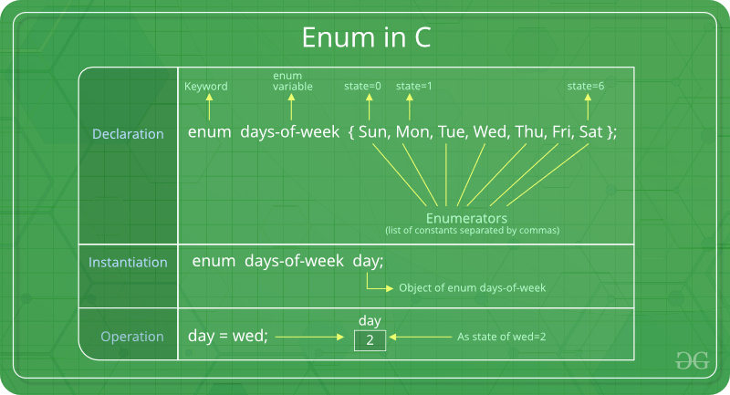
Enum

Slide 10
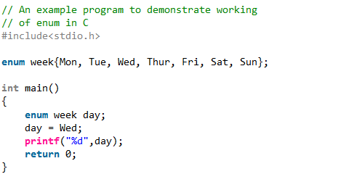
Enum

Slide 11
Enum
Custom values can be assigned to an Enum, the rest will be incremented automatically.
enum month {JAN = 1, FEB, MARCH, AUG = 8, SEP};
A keyword used in an enum cannot be used in another.

