Slide 1
CSE-291 Computer Programming
MD. Jakaria
Lecturer
Dept. of CSE, mist

Slide 2
ARRAYS
Consider the following issue:
Can you imagine how long we have to write the declaration part by using normal variable declaration?
Is there any alternative?
"We have a list of 1000 students' marks of an integer type. If using the basic data type (int), we will declare something like the following…"
int studMark0, studMark1, studMark2, ..., studMark999;

Slide 3
ARRAYS
An array is a collection of elements of the same type that are referenced by a common name. An individual variable in the array is called an array element.
All the elements of an array occupy a set of contiguous memory locations.
Arrays allow programmers to group related items of the same data type in one variable.
However, when referring to an array, one has to specify not only the array or variable name but also the index number of interest.

Slide 4

ARRAYS
int var[10];
float venus[20];
double earth[5];
char pluto[7];

Slide 5
ARRAYS
Array is a collection - Array is a container that can hold a collection of data.
Array is finite - The collection of data in array is always finite, which is determined prior to its use.
Array is sequential - Array stores collection of data sequentially in memory.
Array contains homogeneous data - The collection of data in array must share a same data type.

Slide 6
ARRAYS
We can divide arrays in two categories.
One-dimensional array
Multi-dimensional array

Slide 7
ARRAYS
Consider the same issue:
By using an array, we just declare like this,
int studMark[1000];
This will reserve 1000 contiguous memory locations for storing the students’ marks.
"We have a list of 1000 students' marks of an integer type. If using the basic data type (int), we will declare something like the following…"
int studMark0, studMark1, studMark2, ..., studMark999;

Slide 8
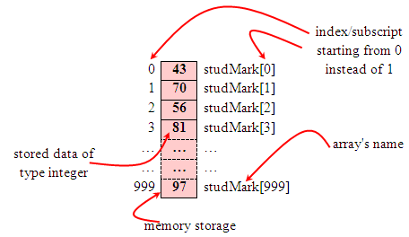
ARRAYS
Graphically, this can be depicted as in the following figure.

Slide 9
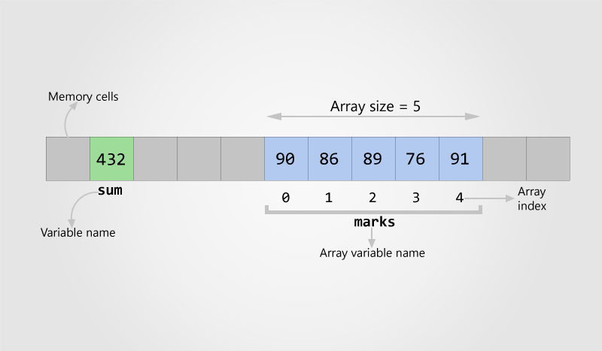
ARRAYS

Slide 10
Array Applications
Given a list of test scores, determine the maximum and minimum scores.
Read in a list of student names and rearrange them in alphabetical order (sorting).
Given the height measurements of students in a class, output the names of those students who are taller than average.

Slide 11
Array Declaration
Syntax:
data_type arrayName [array_size]
int studMark [1000];
<data_type> define the base type of the array, which is the type of each element in the array i.e., common to all array elements.
<array_size> The size of the array is indicated by the number of elements in the array. How big the array is.

Slide 12
ARRAYS Declaration
Graphically, this can be depicted as in the following figure.

Slide 13
Array Declaration
Array of 10 uninitialized integers
int ar[10];
0
1
2
3
4
5
6
7
8
9
ar
--
--
--
--
--
--
--
--
--
--
0
1
2
3
4
9

Slide 14
Array Declaration
Array of 10 uninitialized integers
The expression in the brackets is known as the index/Subscript.
First element of array has index 0.
Second element of array has index 1, and so on.
Last element has an index one less than the size of the array.
Array indexes always start at zero in C
0
1
2
3
4
5
6
7
8
9
ar
--
--
--
--
--
--
--
--
--
--

Slide 15
Array Subscripting
Array of 10 uninitialized integers
int ar[10];
Define some value to some index
ar[3] = 18;
0
1
2
3
4
5
6
7
8
9
ar
--
--
--
--
--
--
--
--
--
--
0
1
2
3
4
5
6
7
8
9
ar
--
--
--
18
--
--
--
--
--
--

Slide 16
Array Initialization
Static array initialization - Initializes all elements of array during its declaration.
int ar[10] = {9, 8, 7, 6, 5, 4, 3, 2, 1, 0};
Dynamic array initialization - The declared array is initialized some time later during execution of program
int ar[10] ; ar[3] = -1;
0
1
2
3
4
5
6
7
8
9
ar
9
8
7
6
5
4
3
2
1
0
0
1
2
3
4
5
6
7
8
9
ar
--
--
--
-1
--
--
--
--
--
--

Slide 17
Array Initialization
int A[5] = {2, 4, 8, 16, 32};
Static or automatic
int B[20] = {2, 4, 8, 16, 32};
Unspecified elements are guaranteed to be zero
int C[4] = {2, 4, 8, 16, 32};
Error — compiler detects too many initial values, extra values are discarded

Slide 18
Sample Program
#include<stdio.h>
int main()
{
int ar[10];
int i;
for (i=0; i<10; i++) // for Initializing Array
{
ar[i]=i;
}
for (i=0; i<10; i++) // for displaying Array
{
printf("%d ", ar[i]);
}
}
Dynamic array initialization

Slide 19
Array Initialization Paradigm
int var[7] = {14, 22, 31, 18, 19, 7, 23};
int var[ ] = {14, 22, 31, 18, 19, 7, 23};
int var[7] = {14, 22, 31};
Size of array is optional when declaring and initializing array at once. The C compiler automatically determines array size using number of array elements
0
1
2
3
4
5
6
14
22
31
18
19
7
23
0
1
2
3
4
5
6
14
22
31
0
0
0
0

Slide 20
Array Initialization Paradigm
int var[7] = {9, 14, 0};
int var[7] = {9};
int var[7] = {0};
0
1
2
3
4
5
6
9
14
0
0
0
0
0
0
1
2
3
4
5
6
9
0
0
0
0
0
0
0
1
2
3
4
5
6
0
0
0
0
0
0
0

Slide 21
Array Bounds Checking
C, unlike many languages, does NOT check array bounds subscripts during:
Compilation (some C compilers will check literals)
Runtime (bounds are never checked)
If you access off the ends of any array, it will calculate the address it expects the data to be at, and then attempts to use it anyways
may get “something…”
may get a memory exception (segmentation fault, bus error, core dump error)
It is the programmer’s responsibility to ensure that their programs are correctly written and debugged!
This does have some advantages but it does give you all the rope you need to hang yourself!

Slide 22
Program with Arrays-1
Finding sum of array's element: 6,4,2,3,5,10,12
#include <stdio.h>
int main(void)
{
int num [10] = {6,4,2,3,5,10,12};
int index, sum = 0;
for (index=0; index<10; index++)
{
printf("%d ", num[index]); // display the array contents
sum = sum + num[index]; // do the summing up
}
// display the sum
printf("\nSum of %d numbers is = %d\n", index, sum);
return 0;
}

Slide 23
Program with Arrays-2
Finding the smallest element in the array named num.
num[ ] = {12.0, 41.5, -31.2, -45.0, 33.0, -21.2, -24.1, 0.7, 3.2, 0.5};
First, it assumes that the smallest value is in num [0] and assigns it to the variable Small.
Then it compares Small with the rest of the values in numy, one at a time.
When an element is smaller than the current value contained in Small, it is assigned to Small. The process finally places the smallest array element in Small.
12.0 | 41.5 | -31.2 | -45.0 | 33.0 | -21.2 | -24.1 | 0.7 | 3.2 | 0.5
0 | 1 | 2 | 3 | 4 | 5 | 6 | 7 | 8 | 9

Slide 24
Program with Arrays-2
#include <stdio.h>
int main(void)
{
int index;
float Small, num[]={12.0,41.5,-31.2,-45.0,33.0,-21.2,-24.1,0.7,3.2,0.5};
Small = num[0];
for(index=0; index<10; index++) // loop for displaying array content
printf("%.2f ",num[index]);
for(index=1; index<10; index++) // another loop do the array element comparing
{
if(Small > num[index])
Small = num[index];
}
// display the result
printf("\nThe smallest value in the given array is %.2f\n", Small);
return 0;
}

Slide 25
Program with Arrays-3
Reading array content and copy to another array
dArrayX[6], sArrayY[6] = {3, 8, 2, 9, 4, 1};
sArrayY
dArrayX
Value | 3 | 8 | 2 | 9 | 4 | 1
Index | 0 | 1 | 2 | 3 | 4 | 5
Value | - | - | - | - | - | -
Index | 0 | 1 | 2 | 3 | 4 | 5

Slide 26
Program with Arrays-3
#include <stdio.h>
void main(void)
{
int index, dArrayX[6], sArrayY[6] = {3, 8, 2, 9, 4, 1};
// Copying the value of sArrayY to dArrayX
for(index = 0; index <= 5; index++)
dArrayX[Index] = sArrayY[index];
//printing
for(index = 0; index <= 5; index++)
{
printf(“dArrayX[%d] = %d\t, sArrayY[%d] %d\n", index, dArrayX[index], index, sArrayY[index]);
}
}

Slide 27
Program with Arrays-4
Searching the location for the given value in an array
int Score[6]= {3, 8, 2, 9, 4, 12};
Score
Value | 3 | 8 | 2 | 9 | 4 | 12
Index | 0 | 1 | 2 | 3 | 4 | 5

Slide 28
Program with Arrays-4
void main(void)
{
int Score[6]= {3, 8, 2, 9, 4, 12};
int Lookup; // value to look for Index
printf("What score do you want to look up? "); // read a score to be searched in the array
scanf("%d", &Lookup);
for(Index = 0; Index <=5; Index = Index + 1) // search the array for this score
if(Score[Index] == Lookup) // abandon the loop
break;
if(Index <= 5)
printf("The score of %.d was number %d in the list.\n", Lookup, Index+1 );
else
printf("The score of %d was not found in the list.\n", Lookup);
}

Slide 29
Program with Arrays-5
Program to print negative elements in array
for(i=0; i<N; i++)
{
if(arr[i] < 0) /* If current array element is negative */
{
printf("%d\t", arr[i]);
}
}

Slide 30
Program with Arrays-6
C program to count even and odd elements in an array
int even = 0;
int odd = 0;
for(i=0; i<size; i++)
{
if( arr[i] % 2 == 0 )
even++;
else
odd++;
}

Slide 31
Two Dimensional Array in C Matrix

Slide 32
One Dimension Array
int mark[6] = {1,3,5,7,5,6};
int mark[6] = {2,4,6,8,7,6};
int mark[6] = {1,2,3,4, 5,6};
0 | 1 | 2 | 3 | 4 | 5
coloum
0
1 | 3 | 5 | 7 | 5 | 6
row
1
2 | 4 | 6 | 8 | 7 | 6
2
1 | 2 | 3 | 4 | 5 | 6

Slide 33
Two Dimensional Array
A two dimensional array has two subscripts/indexes.
The first subscript refers to the row, and the second, to the column.
Its declaration has the following form,
data_type array_name[1st dimension size][2nd dimension size];
For examples,
int mark[3][6];
It declares mark as an integer array with 3 rows and 6 columns.

Slide 34
Two Dimensional Array
Syntax: data_type array_name [row_dim][col_dim];
Example:
First element is int_table[0][0]
Last element is int_table[4][3]
int int_table [5][4];
0 1 2 3 4
0
1
2
3

Slide 35
2D Array Example-1
Two Dimensional Array to store and display values
#include<stdio.h>
void main(void)
{
int row, coloum, array[4][3] = {{1,2,3},{4,5,6},{7,8,9},{10,11,12}};
for(row = 0; row <4; row++) // for every row
{
for(coloum = 0; coloum < 3; coloum++) // for every column
printf("array[%d][%d] = %d ", row, coloum, array[row][coloum]);
printf("\n");
}
}

Slide 36
2D Array Example-2
Program to add/sub/multiplication two matrices
#include <stdio.h>
#define SIZE 3 // Size of the matrix
int main()
{
int A[3][4]; // Matrix 1
int B[3][4]; // Matrix 2
int C[3][4]; // Resultant matrix
//Take input
// Calculate
for(row=0; row<3; row++)
{
for(col=0; col<4; col++)
{
C[r][c] = A[r][c] + B[r][c];
}
}
}

Slide 37
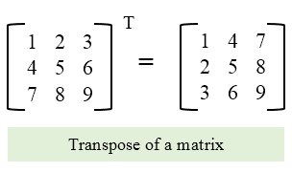
2D Array Example-3
Program to Find Transpose of a Matrix
for(row=0; row<MAX_ROWS; row++)
{
for(col=0; col<MAX_COLS; col++)
{
/* Store each row of matrix A to each column of matrix B */
B[col][row] = A[row][col];
}
}

