Slide 1
Error Handling
Low Level Programming
Exception Handling
errno/perror/strerror
User defined error
Md. Jakaria
Lecturer
Dept. of CSE, MIST

Slide 2
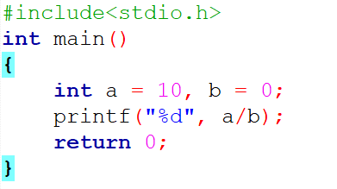
Divide by zero
What is the output of the following program?

Slide 3
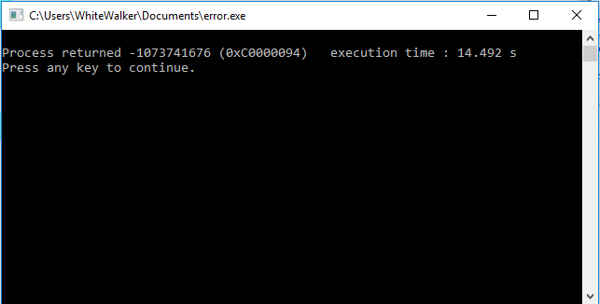
Divide by zero
What is the output of the following program?

Slide 4
Error or Exception
A programs that work when everything is expected is a good start.
When unexpected conditions encountered, it gets really challenging.
Two types of problem: Programmer mistakes and genuine problems.
Errors are dealt by finding and fixing them, by using some codes or numbers.

Slide 5
Error Handling
Error handling refers to the response and recovery procedures from error conditions present in a software application.
Anticipation
Detection
Resolution

Slide 6
C - Error Handling
C programming does not provide direct support for error handling
Then how?
C is a system programming language

Slide 7
C - Error Handling
A function returns -1 or NULL value in case of any error
Global variable errno is set with the error code
Methods and variables regarding error handling defined in error.h header file
The return value can be used to check error while programming.

Slide 8
What is errno?
Whenever a function call is made, a variable named errno is associated with it
errno is global variable
Used to identify which type of error was encountered while function execution
Each value errno can take, has some meaning

Slide 9
List of Error numbers
errno value | Error
1 | Operation not permitted
2 | No such file or directory
3 | No such process
4 | Interrupted system call
5 | I/O error
6 | No such device or address
7 | Argument list too long
8 | Exec format error
9 | Bad file number
10 | No child processes
11 | Try again
12 | Out of memory
13 | Permission denied

Slide 10
Error handling functions
C uses the following functions to represent error messages associated with errno
perror(): This function returns a string to pass to it along with the textual representation of current errno value.
strerror(): This function is defined in string.h library and this method return a pointer to the string representation of the present errno value.

Slide 11
Error handling Example-1
#include <stdio.h>
#include <errno.h>
#include <string.h>
int main ()
{
FILE *fp;
// If a file, which does not exists, is opened, we will get an error
fp = fopen("IWillReturnError.txt", "r");
printf("Value of errno: %d \n ", errno);
printf("The error message is : %s \n", strerror(errno));
perror("Message from perror");
return 0;
}

Slide 12
Program Exit Status
A common practice to exit with exit status.
EXIT_SUCCESS in case of program coming out after a successful operation
EXIT_FAILURE in case of an error condition.
exit() function is used to inform the calling function about the error.
EXIT_SUCCESS and EXIT_FAILURE macros are defined in stdlib.h header file.

Slide 13
Error handling Example-2
#include <stdio.h>
#include <stdlib.h>
void main() {
int ddend = 60, dsor = 0, q;
if( dsor == 0){
printf("Divide by zero error \n");
exit(EXIT_FAILURE );
}
q = ddend / dsor;
printf("Value of quotient = %d", q);
exit(EXIT_SUCCESS);
}

Slide 14
Further study on Error Handling:
https://www.studytonight.com/c/error-handling-in-c.php
https://www.tutorialspoint.com/cprogramming/c_error_handling.htm

