Slide 1
Functions
Lec Md. Jakaria
Dept. of CSE, MIST

Slide 2
Outline
Introduction
Program Modules in C
Math Library Functions
Functions
Function Definitions
Function Prototypes
Header Files
Calling Functions: Call by Value and Call by Reference
Storage Classes
Scope Rules
Recursion
Example Using Recursion: The Fibonacci Series
Recursion vs. Iteration

Slide 3
Introduction
Divide and conquer
Construct a program from smaller pieces or components
These smaller pieces are called modules
Each piece more manageable than the original program

Slide 4
Program Modules in C
Functions
Modules in C
Programs combine user-defined functions with library functions
C standard library has a wide variety of functions

Slide 5
Program Modules in C
Function calls
Invoking functions
Provide function name and arguments (data)
Function performs operations or manipulations
Function returns results
Function call analogy:
Boss asks worker to complete task
Worker gets information, does task, returns result
Information hiding: boss does not know details

Slide 6
Math Library Functions
Math library functions
perform common mathematical calculations
#include <math.h>
Format for calling functions
FunctionName( argument );
If multiple arguments, use comma-separated list
printf( "%.2f", sqrt( 900.0 ) );
Calls function sqrt, which returns the square root of its argument
All math functions return data type double
Arguments may be constants, variables, or expressions

Slide 7
Functions
Functions
Modularize a program
All variables declared inside functions are local variables
Known only in function defined
Parameters
Communicate information between functions
Local variables

Slide 8
Functions
Benefits of functions
Divide and conquer
Manageable program development
Software reusability
Use existing functions as building blocks for new programs
Abstraction - hide internal details (library functions)
Avoid code repetition

Slide 9
Function Definitions
Function definition format
return-value-type function-name( parameter-list ) { declarations and statements }
Function-name: any valid identifier
Return-value-type: data type of the result (default int)
void – indicates that the function returns nothing
Parameter-list: comma separated list, declares parameters
A type must be listed explicitly for each parameter unless, the parameter is of type int

Slide 10
Function Definitions
Function definition format (continued)
return-value-type function-name( parameter-list ) { declarations and statements }
Declarations and statements: function body (block)
Variables can be declared inside blocks (can be nested)
Functions can not be defined inside other functions
Returning control
If nothing returned
return;
or, until reaches right brace
If something returned
return expression;

Slide 11
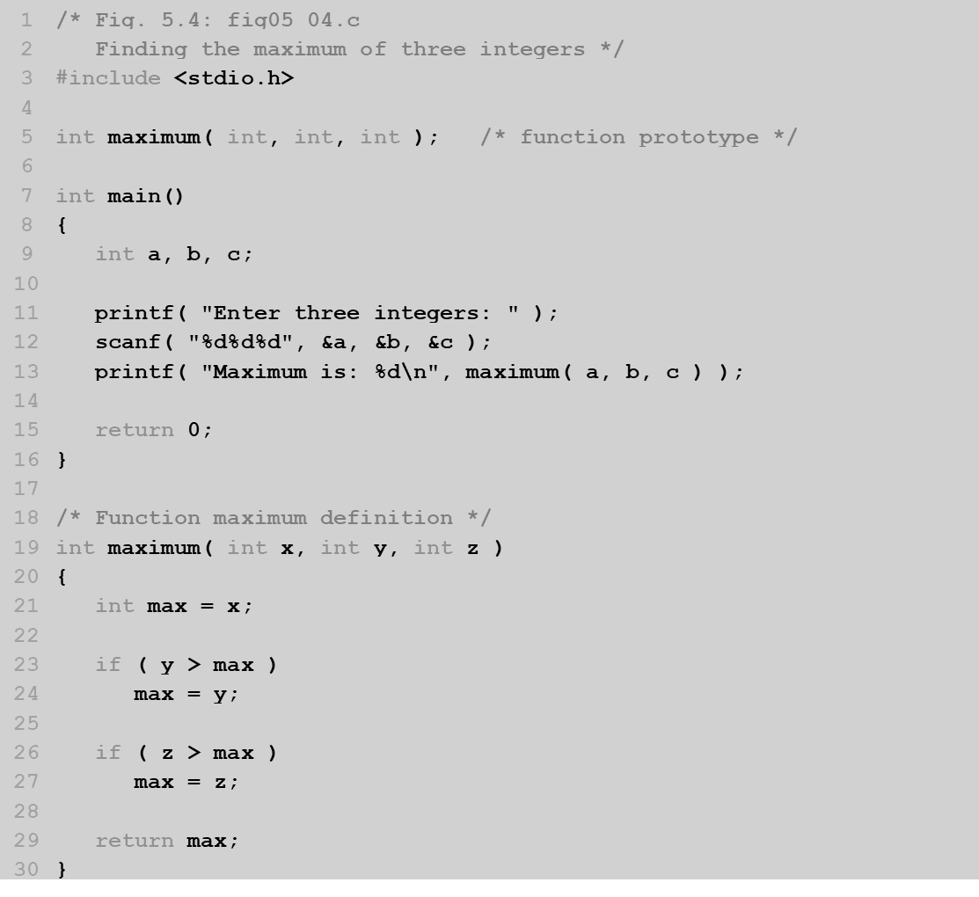
Function Definitions

Slide 12
Function Definitions

Slide 13
Function Definitions
Enter three integers: 22 85 17
Maximum is: 85

Slide 14
Function Prototypes
Function prototype
Function name
Parameters – what the function takes in
Return type – data type function returns (default int)
Used to validate functions
Prototype only needed if function definition comes after use in program
The function with the prototype
int maximum( int, int, int );
Takes in 3 ints
Returns an int

Slide 15
Header Files
Header files
Contain function prototypes for library functions
<stdlib.h> , <math.h> , etc
Load with #include <filename>
#include <math.h>
Custom header files
Create file with functions
Save as filename.h
Load in other files with #include "filename.h"
Reuse functions

Slide 16
Calling Functions: Call by Value and Call by Reference
Call by value
Copy of argument passed to function
Changes in function do not effect original
Use when function does not need to modify argument
Avoids accidental changes
Call by reference
Passes original argument
Changes in function effect original
Only used with trusted functions
For now, we focus on call by value

Slide 17
Storage Classes
Storage class specifiers
Storage duration – how long an object exists in memory
Scope – where object can be referenced in program
Linkage – specifies the files in which an identifier is known (more in Chapter 14)

Slide 18
Storage Classes
Automatic storage
Object created and destroyed within its block
auto: default for local variables
auto double x, y;
register: tries to put variable into high-speed registers
Can only be used for automatic variables
register int counter = 1;

Slide 19
Storage Classes
Static storage
Variables exist for entire program execution
Default value of zero
static: local variables defined in functions.
Keep value after function ends
Only known in their own function
extern: default for global variables and functions
Known in any function

Slide 20
Scope Rules
File scope
Identifier defined outside function, known in all functions
Used for global variables, function definitions, function prototypes
Function scope
Can only be referenced inside a function body
Used only for labels (start:, case: , etc.)

Slide 21
Scope Rules
Block scope
Identifier declared inside a block
Block scope begins at declaration, ends at right brace
Used for variables, function parameters (local variables of function)
Outer blocks "hidden" from inner blocks if there is a variable with the same name in the inner block
Function prototype scope
Used for identifiers in parameter list

Slide 22
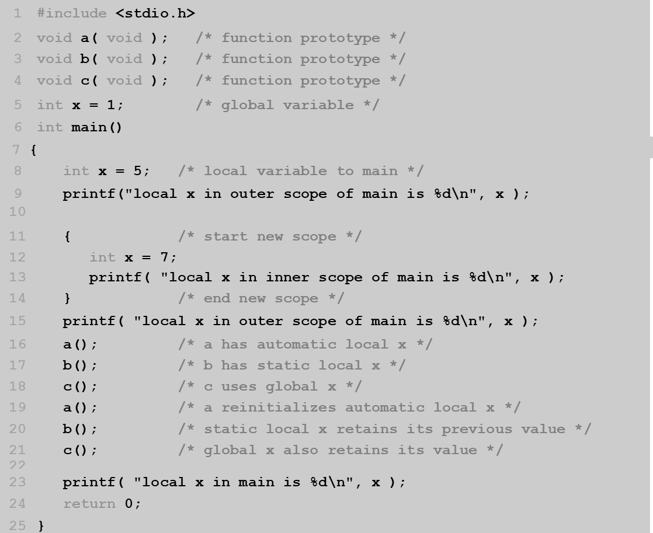

Slide 23
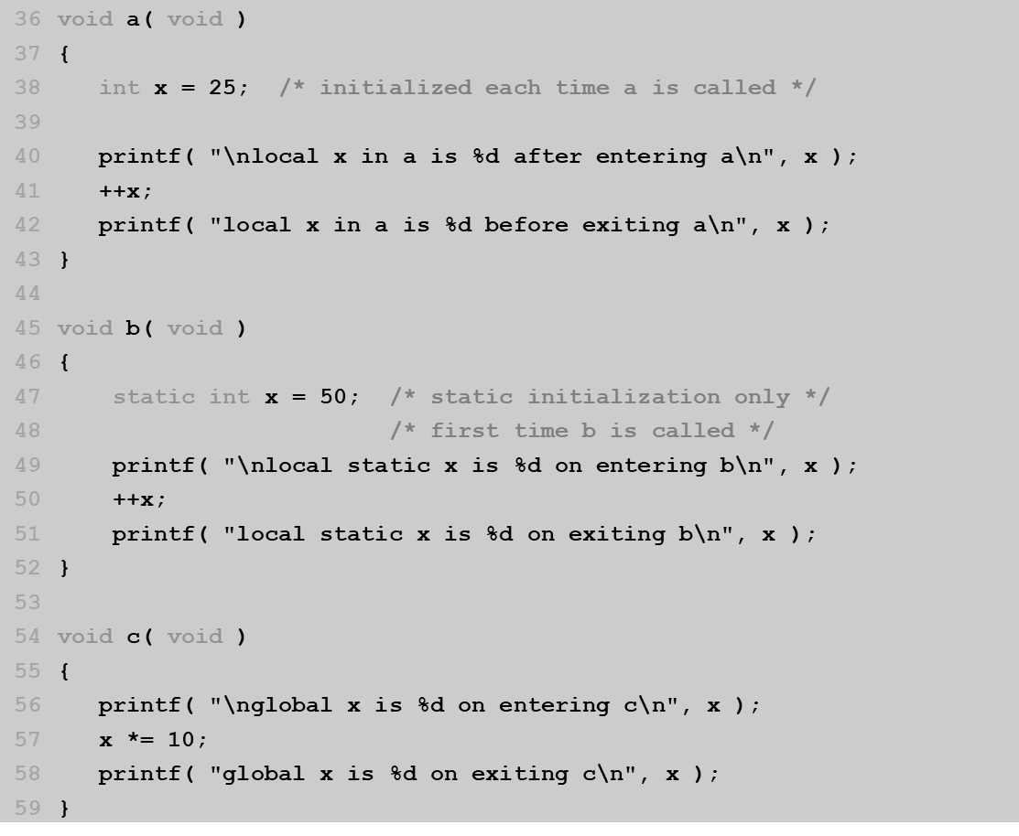

Slide 24
local x in outer scope of main is 5
local x in inner scope of main is 7
local x in outer scope of main is 5
local x in a is 25 after entering a
local x in a is 26 before exiting a
local static x is 50 on entering b
local static x is 51 on exiting b
global x is 1 on entering c
global x is 10 on exiting c
local x in a is 25 after entering a
local x in a is 26 before exiting a
local static x is 51 on entering b
local static x is 52 on exiting b
global x is 10 on entering c
global x is 100 on exiting c
local x in main is 5

Slide 25
Recursion
Recursive functions
Functions that call themselves
Can only solve a base case
Divide a problem up into
What it can do
What it cannot do
What it cannot do resembles original problem
The function launches a new copy of itself (recursion step) to solve what it cannot do
Eventually base case gets solved
Gets plugged in, works its way up and solves whole problem

Slide 26
Recursion
Example: factorials
5! = 5 * 4 * 3 * 2 * 1
Notice that
5! = 5 * 4!
4! = 4 * 3! ...
Can compute factorials recursively
Solve base case (1! = 0! = 1) then plug in
2! = 2 * 1! = 2 * 1 = 2;
3! = 3 * 2! = 3 * 2 = 6;

Slide 27
Example Using Recursion: The Fibonacci Series
Fibonacci series: 0, 1, 1, 2, 3, 5, 8...
Each number is the sum of the previous two
Can be solved recursively:
fib( n ) = fib( n - 1 ) + fib( n – 2 )
Code for the fibaonacci function
long fibonacci( long n )
{
if (n == 0 || n == 1) // base case
return n;
else
return fibonacci( n - 1) + fibonacci( n – 2 );
}

Slide 28
Example Using Recursion: The Fibonacci Series
Set of recursive calls to function fibonacci
f( 3 )
return
f( 2 )
+
f( 1 )
return
f( 1 )
+
f( 0 )
return 1
return 1
return 0

Slide 29
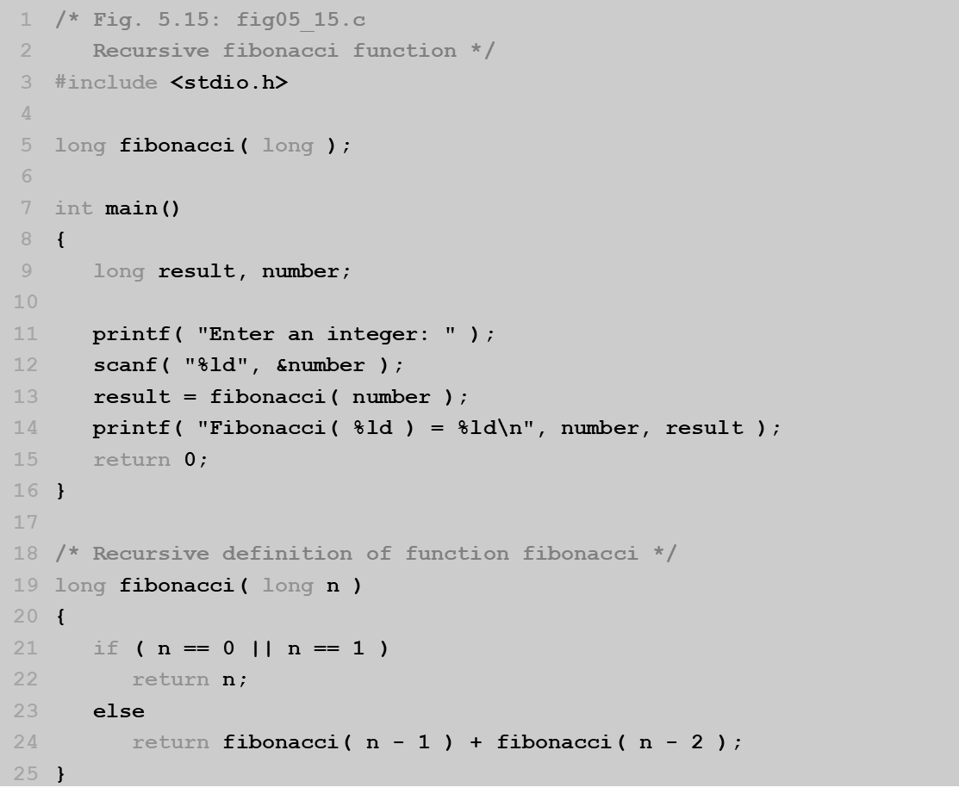

Slide 30
Enter an integer: 0
Fibonacci(0) = 0
Enter an integer: 1
Fibonacci(1) = 1

Slide 31
Recursion vs. Iteration
Repetition
Iteration: explicit loop
Recursion: repeated function calls
Termination
Iteration: loop condition fails
Recursion: base case recognized
Both can have infinite loops
Balance
Choice between performance (iteration) and good software engineering (recursion)

Slide 32
Thank You

