Slide 1
Pointer & Array
Md. Jakaria
Lecturer
Dept. of cse, mist

Slide 2
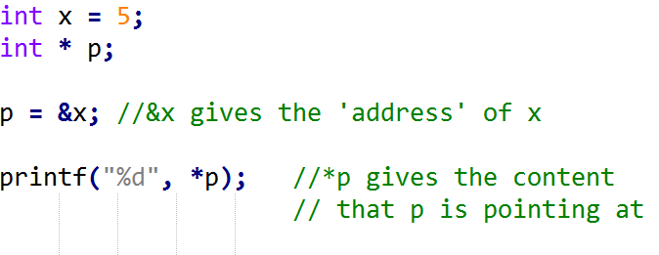
Pointer Recap
5
x
p
(Currently pointing to unknown address)

Slide 3
Pointer Recap
5
x
p
(Currently pointing to address of x)

Slide 4
Pointer Recap
5
x
p
(Currently pointing to address of x)

Slide 5
Pointer Recap
So, what is a pointer?
5
x
p
(Currently pointing to address of x)

Slide 6
Pointer Recap
So, what is a pointer?
A variable that ‘holds’ the address of another variable
5
x
p
(Currently pointing to address of x)

Slide 7
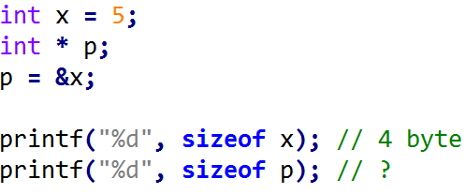
Pointer
What is the size of it?

Slide 8
Pointer
What is the size of it?

Slide 9
Pointer
What is the size of it?
What does it hold?

Slide 10
Pointer
Normally,
A 4 GB RAM = 4 x 2³⁰ Byte = 2³² Byte = 2³² Boxes

Slide 11
Pointer
Normally,
A 4 GB RAM = 4 x 2³⁰ Byte = 2³² Byte = 2³² Boxes
8 = 2³ Boxes can be named using 3 bits.

Slide 12
Pointer
Normally,
A 4 GB RAM = 4 x 2³⁰ Byte = 2³² Byte = 2³² Boxes
8 = 2³ Boxes can be named using 3 bits.
0
1
2
3
4
5
6
7

Slide 13
Pointer
Normally,
A 4 GB RAM = 4 x 2³⁰ Byte = 2³² Byte = 2³² Boxes
8 = 2³ Boxes can be named using 3 bits.
0
1
2
3
4
5
6
7
000 => 0
001 => 1
010 => 2
011 => 3
100 => 4
101 => 5
110 => 6
111 => 7

Slide 14
Pointer
Normally,
A 4 GB RAM = 4 x 2³⁰ Byte = 2³² Byte = 2³² Boxes
8 = 2³ Boxes can be named using 3 bits.
000
001
010
011
100
101
110
111

Slide 15
Pointer
Normally,
A 4 GB RAM = 4 x 2³⁰ Byte = 2³² Byte = 2³² Boxes
8 = 2³ Boxes can be named using 3 bits.
000
001
010
011
100
101
110
111
Therefore, 2³² Boxes can be addressed
using 32 bits

Slide 16
Pointer
Normally,
A 4 GB RAM = 4 x 2³⁰ Byte = 2³² Byte = 2³² Boxes
8 = 2³ Boxes can be named using 3 bits.
000
001
010
011
100
101
110
111
Therefore, 2³² Boxes can be addressed
using 32 bits = 4 Byte

Slide 17
Pointer
What is the size of it?
What does it hold?

Slide 18
Pointer
What is the size of it?
What does it hold?
Depending on the architecture of the system, the size can be 4 Byte or 8 Byte

Slide 19
Pointer to Array

Slide 20
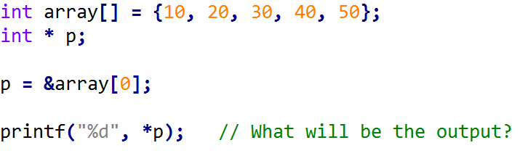
Pointer to Array
0 | 1 | 2 | 3 | 4
array
10 | 20 | 30 | 40 | 50
p

Slide 21
Pointer to Array
0 | 1 | 2 | 3 | 4
array
10 | 20 | 30 | 40 | 50
p

Slide 22
Pointer to Array
0 | 1 | 2 | 3 | 4
array
10 | 20 | 30 | 40 | 50
p

Slide 23
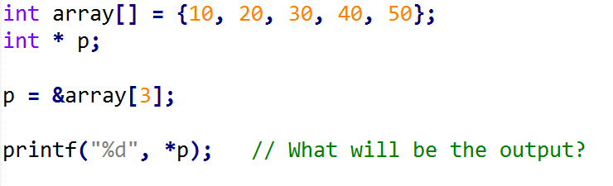
Pointer to Array

Slide 24
Pointer to Array
0 | 1 | 2 | 3 | 4
array
10 | 20 | 30 | 40 | 50
p

Slide 25
Pointer Arithmetic

Slide 26
Pointer Arithmetic

Slide 27
Pointer Arithmetic
0 | 1 | 2 | 3 | 4
array
10 | 20 | 30 | 40 | 50
p

Slide 28
Pointer Arithmetic
0 | 1 | 2 | 3 | 4
array
10 | 20 | 30 | 40 | 50
p

Slide 29
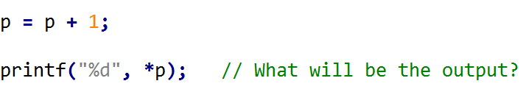
Pointer Arithmetic
0 | 1 | 2 | 3 | 4
array
10 | 20 | 30 | 40 | 50
p

Slide 30
Pointer Arithmetic
0 | 1 | 2 | 3 | 4
array
10 | 20 | 30 | 40 | 50
p

Slide 31
Pointer Arithmetic
0 | 1 | 2 | 3 | 4
array
10 | 20 | 30 | 40 | 50
p

Slide 32
Pointer Arithmetic
How to do this?
0 | 1 | 2 | 3 | 4
array
10 | 20 | 30 | 40 | 50
p

Slide 33
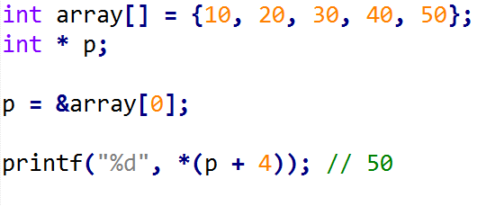
Pointer Arithmetic
Can we do this?
0 | 1 | 2 | 3 | 4
array
10 | 20 | 30 | 40 | 50
p

Slide 34
Pointer Arithmetic
We can use this shortcut
0 | 1 | 2 | 3 | 4
array
10 | 20 | 30 | 40 | 50
p

Slide 35
Pointer Arithmetic
Where p is pointing right now?
0 | 1 | 2 | 3 | 4
array
10 | 20 | 30 | 40 | 50
p

Slide 36
Pointer Arithmetic
Where p is pointing right now?
0 | 1 | 2 | 3 | 4
array
10 | 20 | 30 | 40 | 50
p

Slide 37
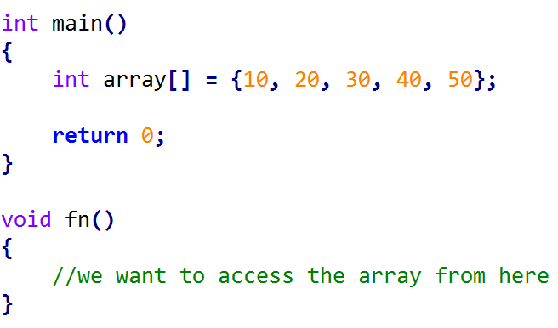
Array as function parameter

Slide 38
Array as function parameter

Slide 39

Array as function parameter

Slide 40
Array as function parameter
How do we pass the array in function?

Slide 41
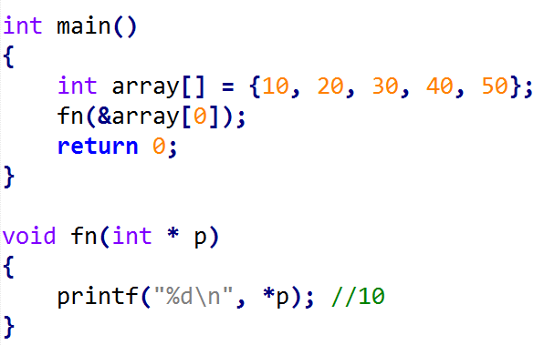
Array as function parameter

Slide 42
Array as function parameter
0 | 1 | 2 | 3 | 4
array
10 | 20 | 30 | 40 | 50

Slide 43
Array as function parameter
0 | 1 | 2 | 3 | 4
array
10 | 20 | 30 | 40 | 50

Slide 44
Array as function parameter
0 | 1 | 2 | 3 | 4
array
10 | 20 | 30 | 40 | 50

Slide 45
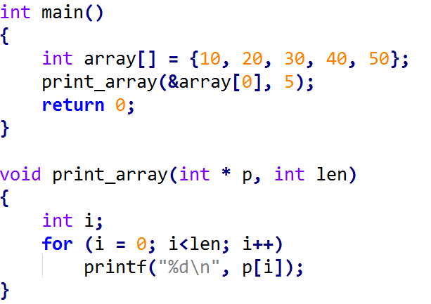
Array as function parameter
Print all the array elements
0 | 1 | 2 | 3 | 4

Slide 46
Array as function parameter
0 | 1 | 2 | 3 | 4

Slide 47
Array as function parameter
Modifying the content to 100
0 | 1 | 2 | 3 | 4
array
10 | 20 | 30 | 40 | 50

Slide 48
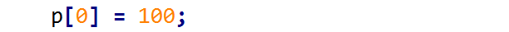
Array as function parameter
0 | 1 | 2 | 3 | 4
array
100 | 20 | 30 | 40 | 50

Slide 49
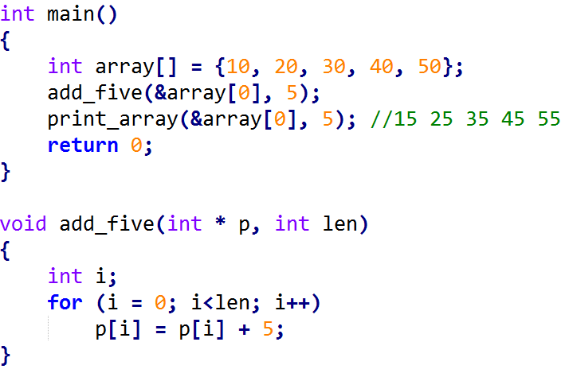
Array as function parameter
add five with each element.
add five with each element.
0 | 1 | 2 | 3 | 4

Slide 50
Array as function parameter
add five with each element.
add five with each element.
0 | 1 | 2 | 3 | 4

Slide 51
Array as function parameter
add five with each element.
0 | 1 | 2 | 3 | 4

Slide 52
Array as function parameter
add five with each element.
0 | 1 | 2 | 3 | 4

Slide 53


A Closer look at [ ] operator
is equivalent to

Slide 54
A Closer look at [ ] operator
is equivalent to

Slide 55
A Closer look at [ ] operator
is equivalent to

Slide 56
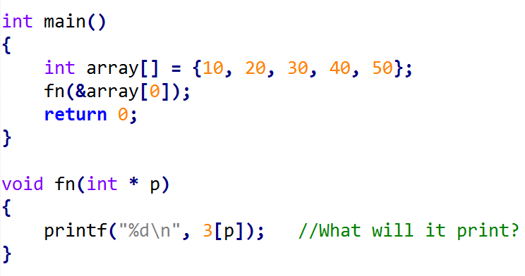
A Closer look at [ ] operator
is equivalent to

Slide 57
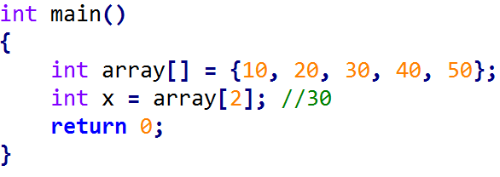
A Closer look at [ ] operator
is equivalent to

Slide 58
A Closer look at [ ] operator
is equivalent to
Can we write *(array+2) instead of array[2]?

Slide 59
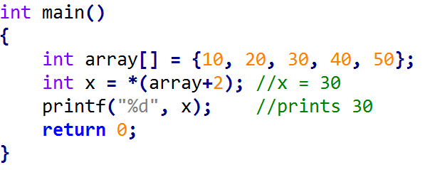
A Closer look at [ ] operator
is equivalent to

Slide 60
A Closer look at [ ] operator
is equivalent to
That means, the identifier array is sometimes treated as a pointer.

Slide 61
A Closer look at [ ] operator
is equivalent to
That means, the identifier array is sometimes treated as a pointer.
Exception: in sizeof, array is still an array

Slide 62
A Closer look at [ ] operator
is equivalent to
That means, the identifier array is sometimes treated as a pointer.
Exception: in sizeof, array is still an array

Slide 63
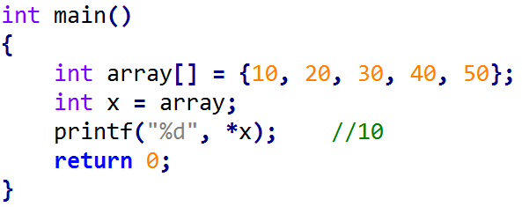
Another observation
So, assigning address to a pointer is now easier

Slide 64
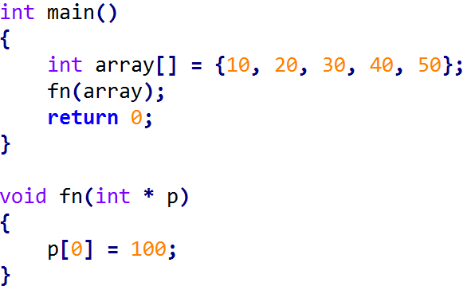
Another observation
So, assigning address to a pointer is now easier

