Slide 1
Bitwise Operations
Low Level Programming
Set/Reset/Toggle Bits
Extraction of Bits
Bit Fields in C
Md. Jakaria
Lecturer
Dept. of CSE, MIST

Slide 2
Attendance System
31 | 30 |  |  |  |  |  |  | 3 | 2 | 1 | 0
0 | 0 |  |  |  |  |  |  | 0 | 0 | 0 | 0
0 | 0 |  |  |  |  |  |  | 0 | 0 | 0 | 0
0 | 0 |  |  |  |  |  |  | 0 | 0 | 0 | 0
0 | 0 |  |  |  |  |  |  | 0 | 0 | 0 | 0
0 | 0 |  |  |  |  |  |  | 0 | 0 | 0 | 0
0 | 0 |  |  |  |  |  |  | 0 | 0 | 0 | 0
Roll 1
Roll 2
Roll 3
Roll 38
Roll 39
Roll 40

Slide 3
Attendance System
31 | 30 |  |  |  |  |  |  | 3 | 2 | 1 | 0
0 | 0 |  |  |  |  |  |  | 0 | 0 | 0 | 1
0 | 0 |  |  |  |  |  |  | 0 | 0 | 0 | 1
0 | 0 |  |  |  |  |  |  | 0 | 0 | 0 | 1
0 | 0 |  |  |  |  |  |  | 0 | 0 | 0 | 1
0 | 0 |  |  |  |  |  |  | 0 | 0 | 0 | 0
0 | 0 |  |  |  |  |  |  | 0 | 0 | 0 | 1
Roll 1
Roll 2
Roll 3
Roll 38
Roll 39
Roll 40

Slide 4
Attendance System
31 | 30 |  |  |  |  |  |  | 3 | 2 | 1 | 0
0 | 0 |  |  |  |  |  |  | 0 | 0 | 0 | 1
0 | 0 |  |  |  |  |  |  | 0 | 0 | 0 | 1
0 | 0 |  |  |  |  |  |  | 0 | 0 | 0 | 1
0 | 0 |  |  |  |  |  |  | 0 | 0 | 0 | 1
0 | 0 |  |  |  |  |  |  | 0 | 0 | 0 | 0
0 | 0 |  |  |  |  |  |  | 0 | 0 | 0 | 1
Roll 1
Roll 2
Roll 3
Roll 38
Roll 39
Roll 40

Slide 5
Attendance System
97% Memory unused
31 | 30 |  |  |  |  |  |  | 3 | 2 | 1 | 0
0 | 0 |  |  |  |  |  |  | 0 | 0 | 0 | 1
0 | 0 |  |  |  |  |  |  | 0 | 0 | 0 | 1
0 | 0 |  |  |  |  |  |  | 0 | 0 | 0 | 1
0 | 0 |  |  |  |  |  |  | 0 | 0 | 0 | 1
0 | 0 |  |  |  |  |  |  | 0 | 0 | 0 | 0
0 | 0 |  |  |  |  |  |  | 0 | 0 | 0 | 1
Roll 1
Roll 2
Roll 3
Roll 38
Roll 39
Roll 40

Slide 6
Values are stored as bits
int x = 5;
RAM
0 | .. | 0 | 0 | 1 | 0 | 1
32 bit

Slide 7
Our goal is to modify the bits
int x = 5;
RAM
0 | .. | 0 | 0 | 1 | 0 | 1
32 bit
RAM
0 | .. | 0 | 0 | 1 | 1 | 1
32 bit
//value of x is now 7

Slide 8
Bitwise operators (Binary operators)
AND(&):
A | B | A & B
0 | 0 | 0
0 | 1 | 0
1 | 0 | 0
1 | 1 | 1
1 if both are 1

Slide 9
Bitwise operators (Binary operators)
AND(&):
OR(|):
A | B | A & B
0 | 0 | 0
0 | 1 | 0
1 | 0 | 0
1 | 1 | 1
A | B | A | B
0 | 0 | 0
0 | 1 | 1
1 | 0 | 1
1 | 1 | 1
1 if both are 1
1 if any is 1

Slide 10
Bitwise operators (Binary operators)
AND(&):
OR(|):
XOR(^):
A | B | A & B
0 | 0 | 0
0 | 1 | 0
1 | 0 | 0
1 | 1 | 1
A | B | A | B
0 | 0 | 0
0 | 1 | 1
1 | 0 | 1
1 | 1 | 1
A | B | A ^ B
0 | 0 | 0
0 | 1 | 1
1 | 0 | 1
1 | 1 | 0
1 if both are 1
1 if any is 1
1 if both are different

Slide 11
Bitwise operators (Binary operators)
Left Shift Operator(<<):
int x = 5; // 0000 0101
x = x << 1; // 0000 1010
//Bits are shifted 1 bit to the left,
//Filled with zero
x = x << 2; // 0010 1000

Slide 12
Bitwise operators (Binary operators)
Right Shift Operator(>>):
int x = 5; // 0000 0101
x = x >> 1; // 0000 0010
//Bits are shifted 1 bit to the right,
//Filled with zero if unsigned or positive
//if negative, then depends on compiler
x = x >> 1; // 0000 00001

Slide 13
Bitwise operators (Unary Operator)
NOT(~):
A | ~A
0 | 1
1 | 0
Toggle the bit

Slide 14
Try out the operators
A = 5 = 0000 0101
B = 3 = 0000 0011
A & B = ?
A | B = ?
A ^ B = ?
~A = ?

Slide 15
Try out the operators
A = 5 = 0000 0101
B = 3 = 0000 0011
A & B = 0000 0001
A | B = ?
A ^ B = ?
~A = ?

Slide 16
Try out the operators
A = 5 = 0000 0101
B = 3 = 0000 0011
A & B = 0000 0001
A | B = 0000 0111
A ^ B = ?
~A = ?

Slide 17
Try out the operators
A = 5 = 0000 0101
B = 3 = 0000 0011
A & B = 0000 0001
A | B = 0000 0111
A ^ B = 0000 0110
~A = ?

Slide 18

Try out the operators
A = 5 = 0000 0101
B = 3 = 0000 0011
A & B = 0000 0001
A | B = 0000 0111
A ^ B = 0000 0110
~A = 1111 1010
~B = 1111 1100
Don’t confuse
bitwise operator & | ~
with
logical operator && || !

Slide 19
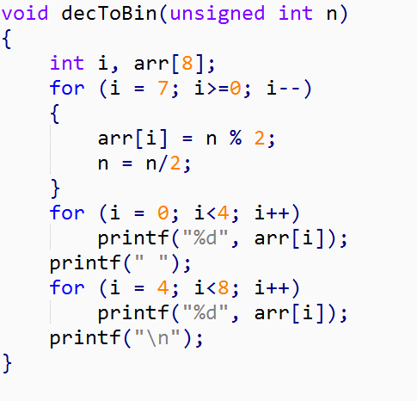
The decToBin() function

Slide 20
The modifier function – Set()
unsigned int set(unsigned int A, int pos)
//set the ‘pos’th bit of A to 1
unsigned int A = 5; //0000 0101
unsigned int res = set(A, 4);
//res = 0001 0101
What do we need to do?

Slide 21
The modifier function – Set()
unsigned int set(unsigned int A, int pos)
//set the ‘pos’th bit of A to 1
unsigned int A = 5; //0000 0101
unsigned int res = set(A, 4);
//res = 0001 0101
What do we need to do?
0000 0101
0001 0000 //How do we make it?
OR 0001 0101

Slide 22
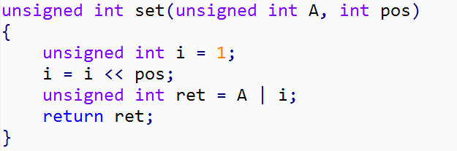
The modifier function – Set()

Slide 23
The modifier function – Reset()
unsigned int reset(unsigned int A, int pos)
//reset the ‘pos’th bit of A to 0
unsigned int A = 5; //0000 0101
unsigned int res = reset(A, 2);
//res = 0000 0001
What do we need to do?

Slide 24
The modifier function – Reset()
unsigned int reset(unsigned int A, int pos)
//reset the ‘pos’th bit of A to 0
unsigned int A = 5; //0000 0101
unsigned int res = reset(A, 2);
//res = 0000 0001
What do we need to do?
0000 0101
1111 1011 //How do we make it?
AND 0000 0001

Slide 25
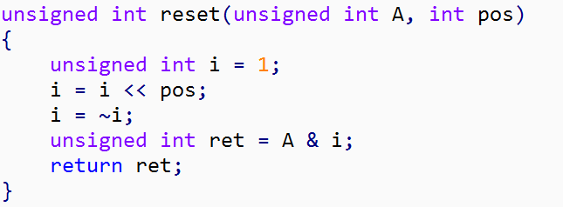
The modifier function – Reset()

Slide 26
The modifier function – Toggle()
unsigned int toggle(unsigned int A, int pos)
//toggle the ‘pos’th bit of A
//set if 0, reset if 1
unsigned int A = 5; //0000 0101
unsigned int res = toggle(A, 2);
//res = 0000 0001
unsigned int res = toggle(res, 2);
//res = 0000 0101
What do we need to do?

Slide 27
The modifier function – Toggle()
unsigned int toggle(unsigned int A, int pos)
//toggle the ‘pos’th bit of A
//set if 0, reset if 1
unsigned int A = 5; //0000 0101
unsigned int res = toggle(A, 2);
//res = 0000 0001
XOR(^):
A | B | A ^ B
0 | 0 | 0
0 | 1 | 1
1 | 0 | 1
1 | 1 | 0
XOR with 0 to keep unchanged

Slide 28
The modifier function – Toggle()
unsigned int toggle(unsigned int A, int pos)
//toggle the ‘pos’th bit of A
//set if 0, reset if 1
unsigned int A = 5; //0000 0101
unsigned int res = toggle(A, 2);
//res = 0000 0001
XOR(^):
A | B | A ^ B
0 | 0 | 0
0 | 1 | 1
1 | 0 | 1
1 | 1 | 0
XOR with 1 to toggle

Slide 29
The modifier function – Toggle()
unsigned int toggle(unsigned int A, int pos)
//toggle the ‘pos’th bit of A
//set if 0, reset if 1
unsigned int A = 5; //0000 0101
unsigned int res = toggle(A, 2);
//res = 0000 0001
XOR(^):
A | B | A ^ B
0 | 0 | 0
0 | 1 | 1
1 | 0 | 1
1 | 1 | 0
0000 0101
0000 0100
XOR 0000 0001

Slide 30
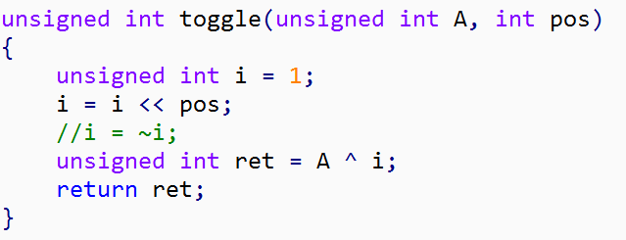
The modifier function – Toggle()

Slide 31
The modifier function – check()
int check(unsigned int A, int pos)
//1 if ‘pos’th bit of A is 1
//0 otherwise
unsigned int A = 5; //0000 0101
res = check(A, 2);
//res = 1
res = check(A, 1);
//res = 0
What do we need to do?

Slide 32
The modifier function – check()
int check(unsigned int A, int pos)
//1 if ‘pos’th bit of A is 1
//0 otherwise
unsigned int A = 5; //0000 0101
res = check(A, 2);
//res = 1
res = check(A, 1);
//res = 0
What do we need to do?
We’ll need AND operator

Slide 33
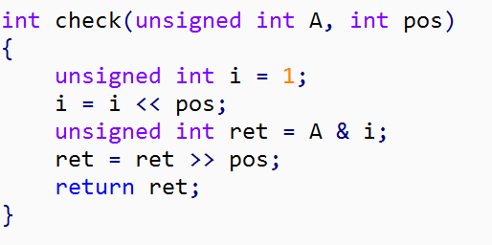
The modifier function – check()

Slide 34
Implement the following functions:
1) unsigned change(unsigned int A, int pos, int val)
//set ‘pos’th bit of A to val
//change(0000 0101, 4, 1) = 0001 0101
2) int sum(unsigned int A)
//return the sum of all 8 bits
3) int parity(unsigned int A)
//return 1 if even number of bits are set
//0 otherwise
//parity(0000 0101) = 1
//parity(0100 0101) = 0
4) unsigned extract(unsigned int A, int from, int to)
//extract bits from ‘from’ to ‘to’
//extract(00000101, 2, 4) = 001

Slide 35
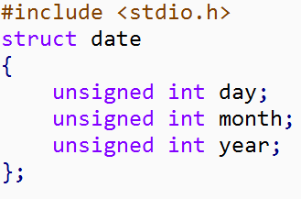
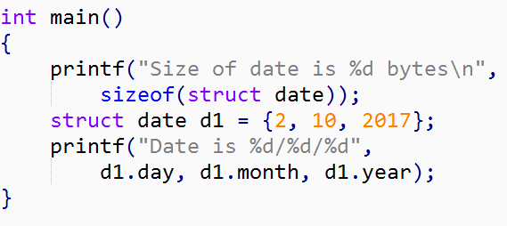
Bit-Fields in C
day <4Byte> | month <4Byte> | year <4Byte>

Slide 36
Notice that,
Value of day can be at most 31, which requires only 5 bits (2^5 = 32)
Value of month can be at most 12, which requires only 4 bits (2^4 = 16)

Slide 37
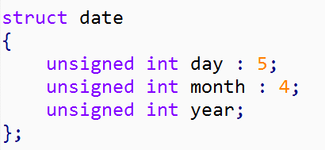
Bit-Fields in C
day(5b) | month(8b) | year(32b)

Slide 38
Bit-Fields in C
32 bit
32 bit
day(5b) | month(8b) | year(32b)

Slide 39
Can we,
Shrink the total size of struct date to 4 byte?
How about limiting the year up to 4095? How many bits will it require?

Slide 40
Further study on Bit-Fields:
http://www.geeksforgeeks.org/bit-fields-c/

