Slide 1
A Deeper Look at Structure How structures are structured
Md. Jakaria
Lecturer
Dept. of cse, mist

Slide 2
Difference between struct and array?

Slide 3
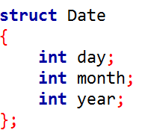
What is the sizeof a struct?

Slide 4
What is the sizeof a struct?
Date
day
month
year
4 bytes

Slide 5
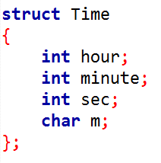
What is the sizeof this struct?

Slide 6
What is the sizeof this struct?
Time
hour
minute
sec
m | <unused>
4 bytes

Slide 7
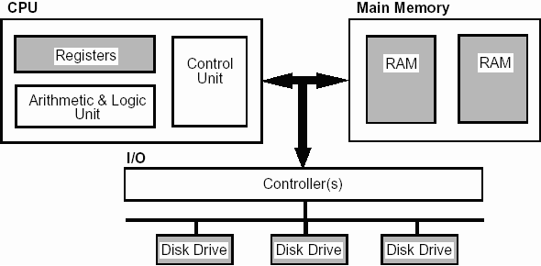
Memory Retrieval
https://www.doc.ic.ac.uk/~eedwards/compsys/memory/index.html
https://www.ibm.com/developerworks/library/pa-dalign/index.html

Slide 8


Memory Granularity
How much information will be read at a time?
How programmers see memory
How processors see memory
https://www.doc.ic.ac.uk/~eedwards/compsys/memory/index.html
https://www.ibm.com/developerworks/library/pa-dalign/index.html

Slide 9
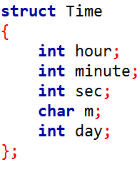
What is the sizeof this struct?

Slide 10
What is the sizeof this struct?
Time
hour
minute
sec
m | <unused>
day
3 byte padding
4 bytes

Slide 11
Memory Alignment rules for struct
Size of a struct will be divisible by the size of largest member
Starting address of each member will be divisible by it’s size
char and char[] are special, they can be placed anywhere
Padding is order-dependent
Time
hour
minute
sec
m | <unused>
day
4 bytes

Slide 12
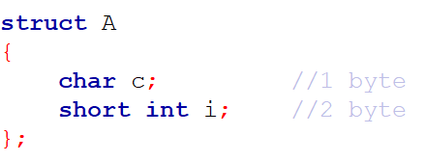
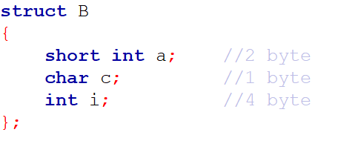
Task: Find out the size of the following structs

Slide 13
Technique to reduce wastage

Slide 14
Technique to reduce wastage
1. Tell the compiler not to pad
Time
hour
minute
sec
m | <unused>
day
Time
hour
minute
sec
m | day
4 bytes
4 bytes

Slide 15
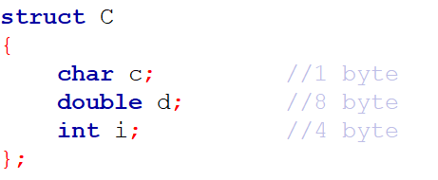
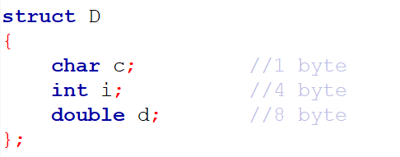
Technique to reduce wastage
2. Declare variables in ascending/descending order of size

Slide 16
Technique to reduce wastage
2. Declare variables in ascending/descending order of size
struct C
c
d
i
struct D
c |  | i
d

Slide 17
Technique to reduce wastage
3. Use bit fields
Each int (if unsigned) can hold = 2³² - 1 = 4,29,49,67,295
How many bits should a day require?

Slide 18
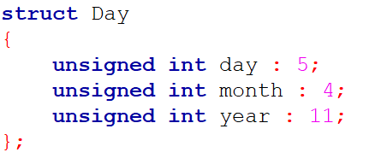
Technique to reduce wastage
3. Use bit fields

Slide 19
Technique to reduce wastage
3. Use bit fields
Number of bits day should occupy

Slide 20
Technique to reduce wastage
3. Use bit fields
What will be the highest value of year?
What will be the overall size of struct Day?

Slide 21
Restrictions of Bit Fields
We cannot have pointers to bit field members as they may not start at a byte boundary.
It is implementation defined to assign an out-of-range value to a bit field member.
Bit fields cannot be static in C.
Array of bit fields is not allowed.

