Slide 1
Understanding Digital Computer:
Programming languages
Lt Col Razzak
CSE Dept
MIST

Slide 2
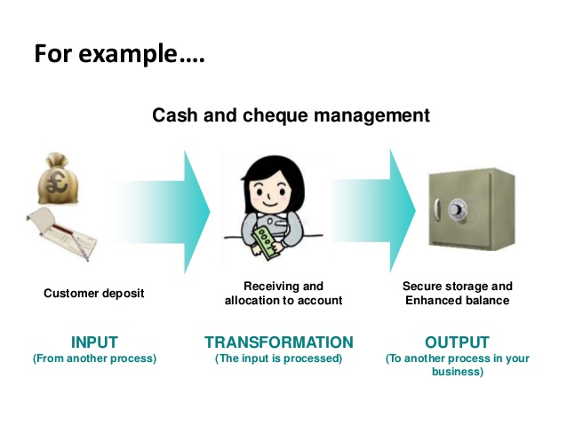
UNDERSTANDING DIGITAL COMPUTER

Slide 3
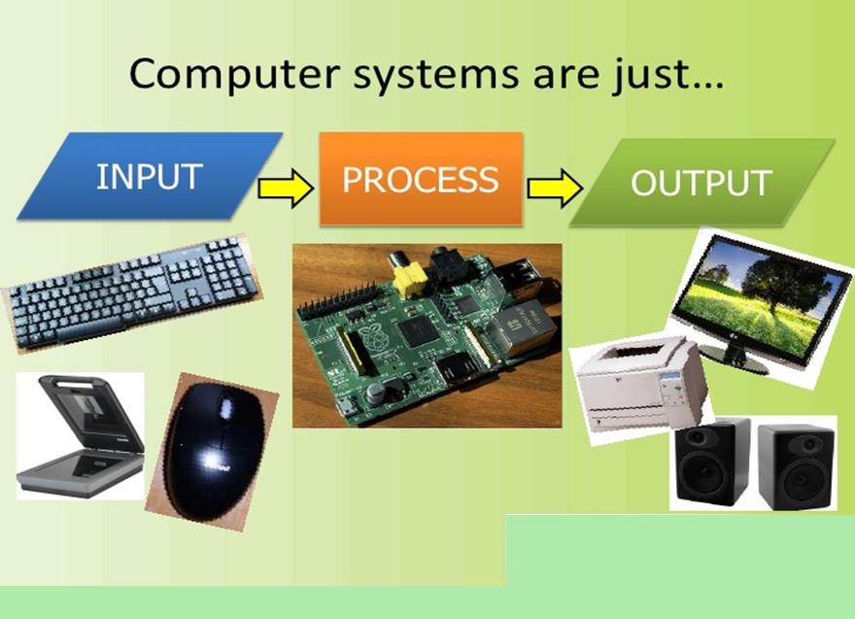
UNDERSTANDING DIGITAL COMPUTER

Slide 4
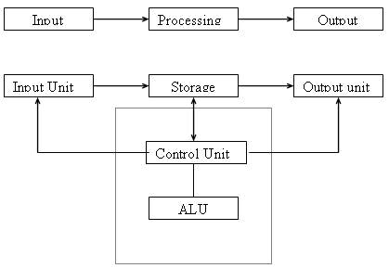
BLOCK DIAGRAM OF COMPUTER

Slide 5
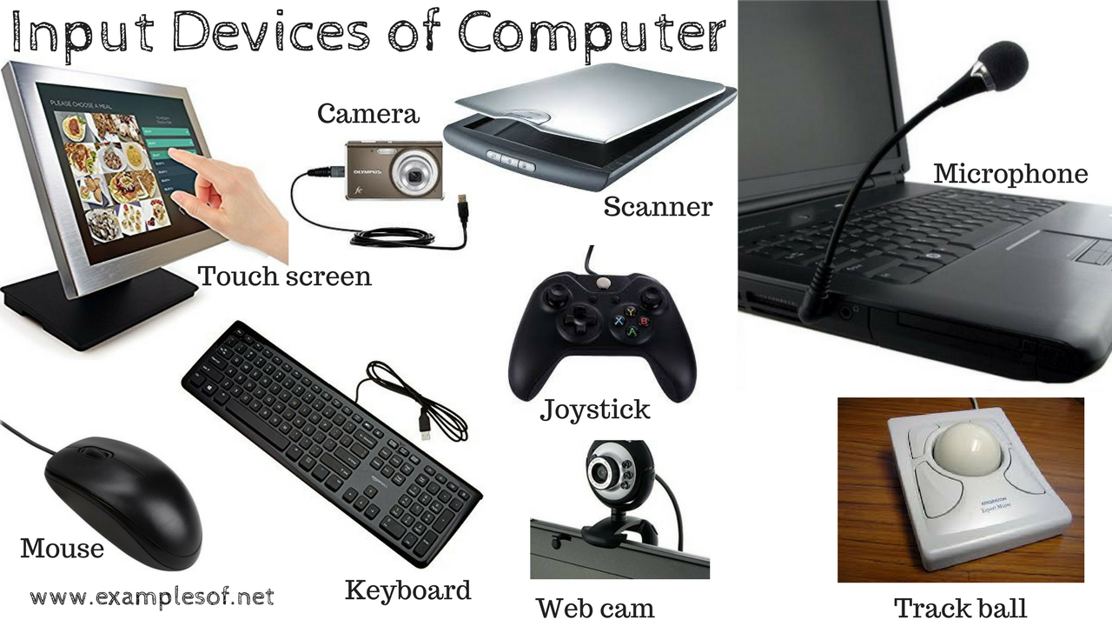
UNDERSTANDING DIGITAL COMPUTER
Input Unit:
Accept the data and instructions from the outside world
Convert it to a form that the computer can understand.
Supply the converted data to the computer system for further processing

Slide 6
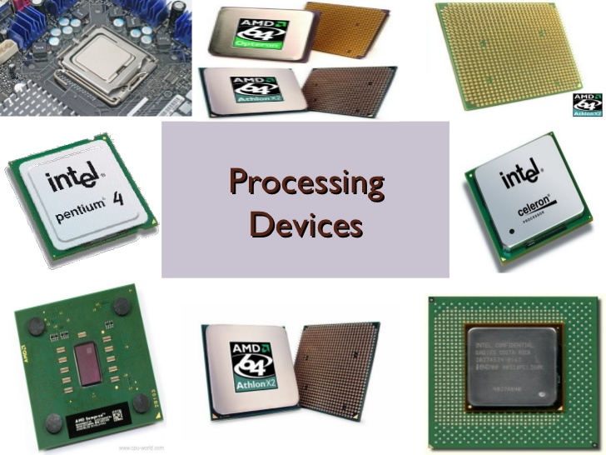
UNDERSTANDING DIGITAL COMPUTER
Processing Unit:
Control Unit - responsible for directing and coordinating most of the computer system activities. It tells other parts of the computer system what to do
Arithmetic logic Unit: ALU performs all the arithmetic and logical functions i.e. addition, subtraction, multiplication, division and certain comparisons. These comparisons include greater than, less than, equals to etc

Slide 7
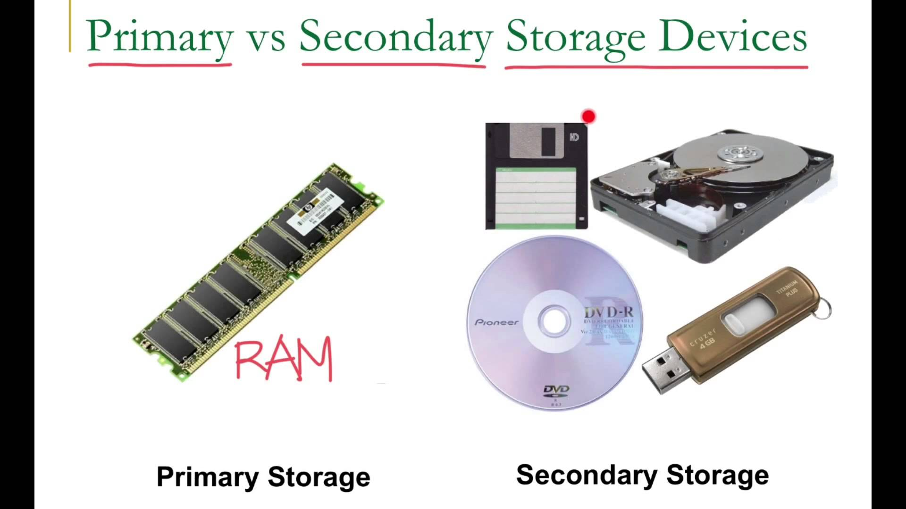
UNDERSTANDING DIGITAL COMPUTER
Storage Unit:
Holds data and instructions that are entered through the input unit
It preserves the intermediate and final results before these are sent to the output devices.
Primary Storage- Stores and provides very fast, hold the program being currently executed, temporary in nature RAM
Secondary Storage- used like an archive

Slide 8
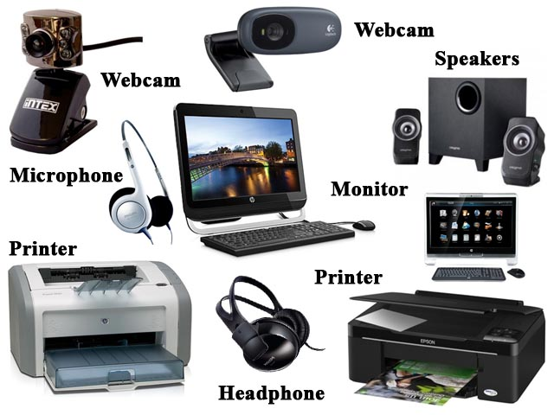
UNDERSTANDING DIGITAL COMPUTER
Output Unit:
provides the information and results of a computation to outside world

Slide 9
SIX BASIC COMPUTER OPERATIONS
1. A computer can receive (input) data
2. A computer can store data in memory
3. A computer can perform arithmetic and manipulate text strings
4. A computer can compare the contents of two memory locations and select one of two alternatives
5. A computer can repeat a group of operations
6. A computer can output information (processed data)

Slide 10
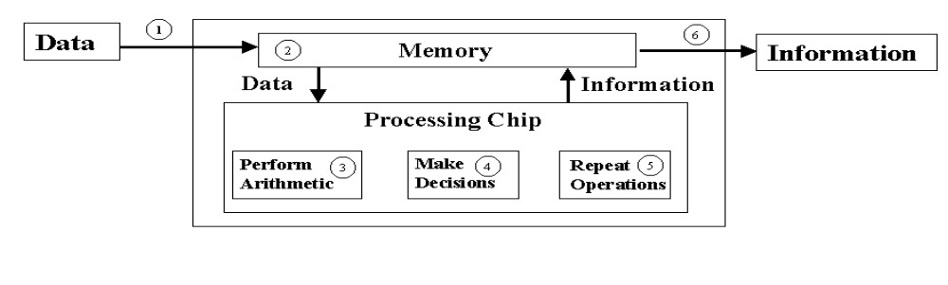
SIX BASIC COMPUTER OPERATIONS

Slide 11
WHAT IS PROGRAMMING?
Deciding if there is a task to be accomplished or problem to be solved using a computer, e.g., is there a need for a program?
Determining the nature of the task or problem, e.g., what must the program do?
Developing a plan that will accomplish the task or solve the problem, e.g., generating the step-by-step process that the program will follow (algorithm).
Converting the plan into a computer language program
Testing the program to ensure it accomplishes task or solves problem defined earlier.
Implementing the program to accomplish the task or solve the problem.

Slide 12
PROGRAMMING CONCEPTS
Issue of Problem Solving
  Developing a solution to a problem, not merely a programing
  Our tasks is to convert the natural language to the language machine understand efficiently
Considerations
  Solving a problem on a computer
  Computer has particular architecture

Slide 13
PROGRAMMING CONCEPTS
Technique of Problem Solving
  Convert a problem to a sequence of steps
  Steps require because of the architecture of the computer itself
  Algorithm design, program methodology, data structure

Slide 14
PROGRAMMING CONCEPTS
Technique of Problem Solving
  Start solving a problem by decomposition the problem
  Style of thinking. Solve the problem on your mind before solving on computer
Example: MAX of n integer

Slide 15
PROGRAMMING CONCEPTS
Technique of Problem Solving
Example: MAX of n integer
READ ( number)
MAX=number
Loop: i=2, n, 1
READ ( number)
If MAX<number
MAX=number
PRINT ( MAX)
End loop

Slide 16
PROGRAMMING CONCEPTS
Steps in Problem Solving
1. Initial Solution Generation
    Contains a set of actual programs
    Initial solution must be correct
    Issue of correctness is tested and validated

Slide 17
PROGRAMMING CONCEPTS
Steps in Problem Solving
2. Initial Solution Refinement
  Efficiency
    Time efficiency – we want a program to run as fast as possible.
    Space Efficiency - Will not have sufficient memory to solve the problem

Slide 18
PROGRAMMING CONCEPTS
Steps in Problem Solving
2. Initial Solution Refinement
  Efficiency
    Need some techniques to achieve efficiency
Algorithm Designing
Data structuring
Selection of exact sequence of steps
Organization of data
How will the data will be stored
How will the data will be organized ( array or list)

Slide 19
PROGRAMMING CONCEPTS
Steps in Problem Solving
  3. Final Solution
  Algorithm and data structuring will give the final solution
  Most efficient if algorithm design/flow chat is good
  Final solution to be converted to a program

Slide 20
PROGRAMMING CONCEPTS
Steps in Problem Solving
  3. Final Solution
  We need a Vehicle language
  Language should be as much close as algorithm and process you developed in initial solution
  Language that are structure than we are able to write easily
  High level language. These requires some features
  These features are related to data structure and algorithm

Slide 21
PROGRAMMING CONCEPTS
Steps in Problem Solving
  3. Final Solution
  Data structure
    Data type & operations
    Data procedure encapsulation- required for object oriented programing
    Dynamic data structure - dynamic allocation and reallocation- Pointer
  Algorithm Expression- exact sequence of steps
    Control construct- if else, do while etc
    Functions for decompositions, recursive functions

Slide 22
PROGRAM DEVELOPMENT STAGES
To develop a program using any programming language, we follow a sequence of steps. These steps are called phases in program development.

Slide 23
PROGRAM DEVELOPMENT STAGES
Define the problem
Outline the solution
Develop the outline into an algorithm
Test the algorithm for correctness
Code the algorithm into a programming language
Run the program on computer
Document and maintain the program

Slide 24
PROGRAM DEVELOPMENT STAGES
Problem Definition
define the problem statement
decide the boundaries of the problem
understand the problem statement, what is our requirement, what should be the output of the problem solution.
Input | Processing | Output
Num-1 | Read 3 numbers | Total
Num-2 | Add numbers together
Num-3 | Print Total number

Slide 25
PROGRAM DEVELOPMENT STAGES
Outline the solution
determine the requirements like variables, functions, etc. to solve the problem.
gather the required resources to solve the problem defined in the problem definition phase.

Slide 26
PROGRAM DEVELOPMENT STAGES
Algorithm Development
develop a step by step procedure to solve the problem using the specification given in the previous phase.
write the solution in step by step statements.
To improve clarity and understandability of the program flow charts are drawn using the algorithms

Slide 27
PROGRAM DEVELOPMENT STAGES
Test the algorithm for correctness
check whether the code written in previous step is solving the specified problem or not.
test the program whether it is solving the problem for various input data values or not.
also test that whether it is providing the desired output or not.
here is a possibility of occurrence of errors in programs. These errors must be removed to ensure proper working of programs. Hence error check is made. This process is known as “Debugging”

Slide 28
PROGRAM DEVELOPMENT STAGES
Code the algorithm into a programming language
use a programming language to write or implement actual programming instructions for the steps defined in the previous phase.
construct actual program. That means we write the program to solve the given problem using programming languages like C, C++, Java etc.,
The actual program is written in the required programming language with the help of information depicted in flow charts and algorithms

Slide 29
PROGRAM DEVELOPMENT STAGES
Run the program on computer
Run the program on a platform that can convert the program in to machine language
Compile
Correct syntax errors
Run program with test data
Correct logic errors

Slide 30
PROGRAM DEVELOPMENT STAGES
Document and maintain the program
the program is actively used by the users.
If the user encounters any problem or wants any enhancement, then we need to repeat all the phases from the starting, so that the encountered problem is solved or enhancement is added.

Slide 31
PROGRAM DEVELOPMENT STAGES
Document and maintain the program
On-going task
Comments within program – very important in Java
Structure charts
Solution Algorithm
Test data results
  Maintenance often done by other programmers. If program well designed, code will be easier to maintain

Slide 32
Consider a problem
Take three numbers into the program, add them together and output the result

Slide 33
Defining the problem
Determine INPUT
Determine OUTPUT
Determine processing
This can be done using an IPO chart (Input, Processing, Output):
INPUT
Number1
Number2
Number3
PROCESSING
Read 3 numbers
Add numbers together
Print total
OUTPUT
Total

Slide 34
Designing a solution algorithm
Draw a rough sketch of the steps required to solve the problem.
Add-Three-Numbers
Read Number1, Number2, Number3
Total = Number1 + Number2 + Number3
Print Total
END
The algorithm is suitably named.
The end of the algorithm is marked as END.
Statements between the start and end are indented.

Slide 35
Checking the algorithm
Choose 2 or 3 simple input test cases which are valid.
Establish what the expected results should be.
Make a table of the relevant variable names within the algorithm
Walk the first test case through the algorithm, keeping a record of the contents of each variable in the table as the data passes through the logic.
Repeat the walkthrough process, using the other test data cases.
Check the expected results against the actual results.

Slide 36
Code the algorithm into a programming language
Computer languages are the languages through which user can communicate with the computer by writing program instructions.

Slide 37
Types of Computer Languages
Procedural: Monolithic programs that run from start to finish with no intervention from user other than input
Basic, QBasic, QuickBasic
COBOL
FORTRAN
C
Object Oriented/Event Driven (OOED): Programs that use objects which respond to events; use small segments to code for each object
JAVA
Visual Basic
Visual C++

Slide 38
Types of Computer Languages
Procedural: Monolithic programs that run from start to finish with no intervention from user other than input
Basic, QBasic, QuickBasic
COBOL
FORTRAN
C
Object Oriented/Event Driven (OOED): Programs that use objects which respond to events; use small segments to code for each object
JAVA
Visual Basic
Visual C++

Slide 39
Levels of Computer Languages
Low Level: at the level of the computer, i.e., in binary (0-1) format. Computer can only execute a binary form of a program
Mid/Intermediate Level: close to the computer but uses English words or mnemonics, e.g., Assembler, that is converted directly into binary
High Level: at the level of the programmer using English words and clearly defined syntax; must be converted or translated into binary for computer to implement it
Need a software program to handle the conversion of high-level into binary

Slide 40
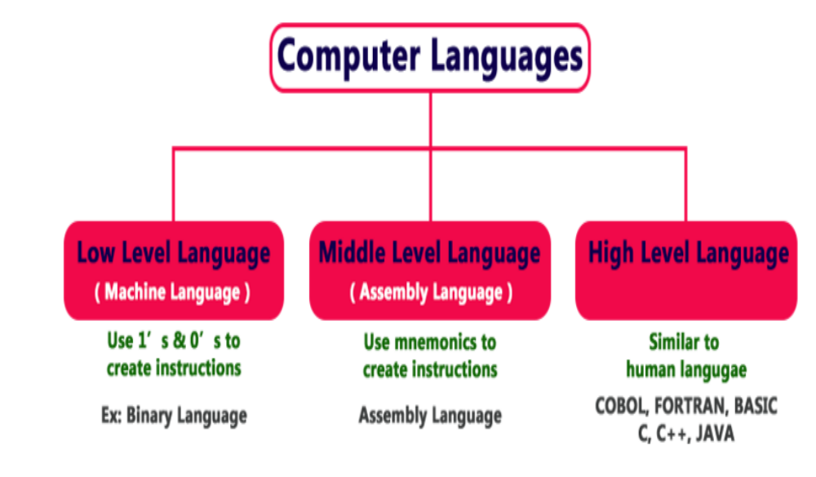

Slide 41
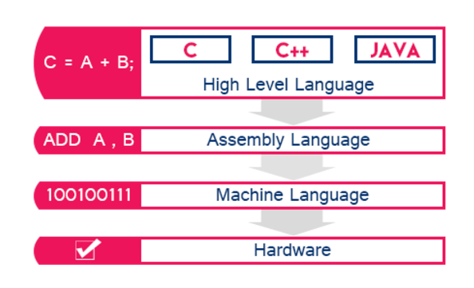

Slide 42
Translating from High-level Language to Binary
Interpreted: each statement translated as it is executed--slow but easy to use
Compiled: entire program is converted to binary--executes faster, but more difficult to use (.exe files are compiled programs)

Slide 43
Compiler
Source Program
(High Level Language)
Compiler or Translator
Executable Program
(Machine Language)
High Level Language | Compiler | Machine Language
#include<stdio.h> void main(void) { printf(“Hello World”); } |  | 10111011 10101011 11101110 11010110 11011101

Slide 44
Program Structure
Language | Example program
“C” | #include <stdio.h> void main() { printf("Hello World"); }
C++ | #include <iostream> int main() { cout << "Hello World"; return 0; }
Pascal | program helloworld (output); begin writeln('Hello World'); end.

Slide 45
Program Structure
Language | Example program
Oracle PL/SQL | CREATE OR REPLACE PROCEDURE helloworld AS BEGIN DBMS_OUTPUT.PUT_LINE('Hello World'); END;
Java | class helloworld { public static void main (String args []) { System.out.println ("Hello World"); } }
BASIC (Beginner's All-purpose Symbolic Instruction Code) | print "Hello World"

