Slide 1
Algorithms and Flow Charts
Lt Col Razzak
CSE Dept
MIST

Slide 2
What is an algorithm?
Algorithm is a finite sequence of steps that solves a specific problem.
Let's say that you have a friend arriving at the airport, and your friend needs to get from the airport to academic hostel in MIST.
The following algorithm that you might give your friend for getting to MIST hostel:

Slide 3
What is an algorithm?
The taxi algorithm:
  Go to the taxi stop.
  Get in a taxi.
  Give the driver the location address.
The bus algorithm:
  Outside baggage claim, take mirpur-12 bus.
  Get off at Mirpur-12 Bus stop.
  Take a Rickshaw and come to MIST hostel.

Slide 4
Algorithm Properties
Finiteness : An algorithm must terminate in a finite number of steps.
Definiteness : Each step of the algorithm must be precisely and unambiguously stated.
Effectiveness : Each step must be effective, in the sense that it should be easily convertible into program statement.
Generality : The algorithm must be complete in itself so that it can be used to solve all problems of a specific type for any input data.
Input / Output : Each algorithm must take zero, one or more inputs.

Slide 5
Computer Program Algorithm
There are two commonly used tools for the algorithm
  Pseudocodes – large problems
  Flowcharts – small problems

Slide 6
Pseudocode
  Pseudocode is an artificial and informal language that helps programmers develop algorithms.
Statements are written in simple English.
Each instruction is written on a separate line.
Keywords and indentation are used to signify particular control structures.
Each set of instructions is written from top to bottom with only 1 entry and 1 exit.

Slide 7
Pseudocode & Algorithm
Example 1:
Write an algorithm to determine a student’s final grade and indicate whether it is passing or failing. The final grade is calculated as the average of four marks.

Slide 8
Pseudocode & Algorithm
Pseudocode:
Input a set of 4 marks
Calculate their average by summing and dividing by 4
if average is below 60
Print “FAIL”
else
Print “PASS”

Slide 9
Pseudocode & Algorithm
Detailed Algorithm
Step 1: Input M1,M2,M3,M4
Step 2: GRADE ← (M1+M2+M3+M4)/4
Step 3: if (GRADE < 60) then
Print “FAIL”
else
Print “PASS”
endif

Slide 10
The Flowchart
A Flowchart is another algorithm but graphical.
  Flowcharts are schematic representations of processes
  Shows logic solution
  Emphasizes individual steps and their interconnections
  A flowchart must have a start and stop
  A steps in a flowchart must connect. Can’t leave a step “hanging” with no connection e.g. control flow from one action to the next
  Flow-charts can be created by hand or manually in most office software, but lately specialized diagram drawing software has emerged that can also be used for the purpose

Slide 11
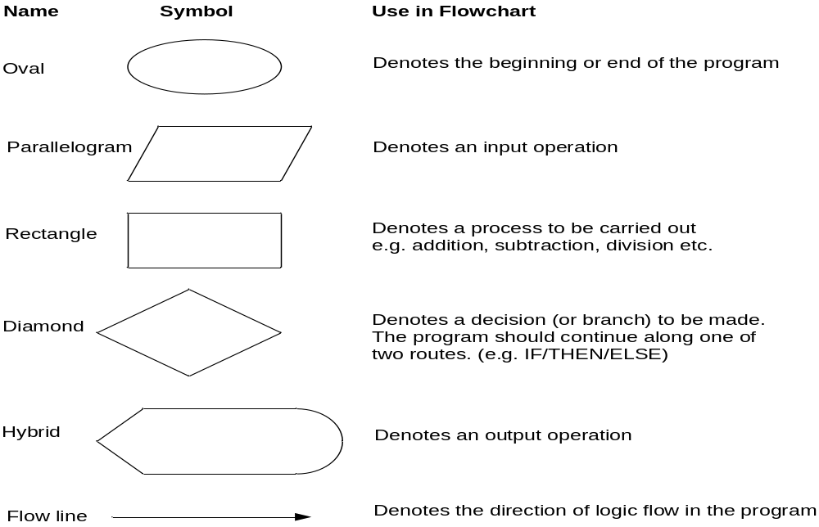
Flowchart Symbols
General Used Symbols

Slide 12
Example
START
Display message “How many hours did you work?”
Read Hours
Display message “How much do you get paid per hour?”
Read PayRate
Multiply Hours by PayRate. Store result in GrossPay.
Display GrossPay
END

Slide 13
Basic Flowchart Symbols
Rounded Rectangle
START
Display message “How many hours did you work?”
Notice there are three types of symbols in this flowchart:
  rounded rectangles
  parallelograms
  a rectangle
Each symbol represents a different type of operation.
Read Hours
Display message “How much do you get paid per hour?”
Parallelogram
Read PayRate
Multiply Hours by PayRate. Store result in GrossPay.
Rectangle
Display GrossPay
Rounded Rectangle
END

Slide 14
Basic Flowchart Symbols
START
Terminal
Display message “How many hours did you work?”
Terminals
  represented by rounded rectangles
  indicate a starting or ending point
Read Hours
Display message “How much do you get paid per hour?”
Read PayRate
Multiply Hours by PayRate. Store result in GrossPay.
START
Display GrossPay
END
Terminal
END

Slide 15
Basic Flowchart Symbols
START
Display message “How many hours did you work?”
Input/Output Operations
  represented by parallelograms
  indicate an input or output operation
Read Hours
Display message “How much do you get paid per hour?”
Input/Output Operation
Read PayRate
Multiply Hours by PayRate. Store result in GrossPay.
Display message “How many hours did you work?”
Read Hours
Display GrossPay
END

Slide 16
Basic Flowchart Symbols
START
Display message “How many hours did you work?”
Processes
  represented by rectangles
  indicates a process such as a mathematical computation or variable assignment
Read Hours
Display message “How much do you get paid per hour?”
Read PayRate
Multiply Hours by PayRate. Store result in GrossPay.
Multiply Hours by PayRate. Store result in GrossPay.
Process
Display GrossPay
END

Slide 17

Stepping Through the Flowchart
Stepping Through the Flowchart
START
Display message “How many hours did you work?”
Read Hours
Display message “How much do you get paid per hour?”
Read PayRate
Multiply Hours by PayRate. Store result in GrossPay.
Variable Contents:
Hours: ?
PayRate: ?
GrossPay: ?
Display GrossPay
END

Slide 18
Stepping Through the Flowchart
Stepping Through the Flowchart
START
Step 1: An Output Operation
Display message “How many hours did you work?”
How many hours did you work?
Screen Output
Read Hours
Display message “How much do you get paid per hour?”
Read PayRate
Multiply Hours by PayRate. Store result in GrossPay.
Variable Contents:
Hours: ?
PayRate: ?
GrossPay: ?
Display GrossPay
END

Slide 19
Stepping Through the Flowchart
Stepping Through the Flowchart
START
Display message “How many hours did you work?”
How many hours did you work?
40
Step 2: An Input Operation
(User types 40)
Read Hours
Display message “How much do you get paid per hour?”
Read PayRate
Multiply Hours by PayRate. Store result in GrossPay.
Variable Contents:
Hours: 40
PayRate: ?
GrossPay: ?
The value 40 is stored in Hours.
Display GrossPay
END

Slide 20
Stepping Through the Flowchart
Stepping Through the Flowchart
START
Display message “How many hours did you work?”
How much do you get paid per hour?
Screen Output
Read Hours
Display message “How much do you get paid per hour?”
Step 3: An Output Operation
Read PayRate
Multiply Hours by PayRate. Store result in GrossPay.
Variable Contents:
Hours: 40
PayRate: ?
GrossPay: ?
Display GrossPay
END

Slide 21
Stepping Through the Flowchart
Stepping Through the Flowchart
START
Display message “How many hours did you work?”
How much do you get paid per hour? 20
Read Hours
Display message “How much do you get paid per hour?”
Step 4: Input Operation
(User types 20)
Read PayRate
Multiply Hours by PayRate. Store result in GrossPay.
Variable Contents:
Hours: 40
PayRate: 20
GrossPay: ?
The value 20 is stored in PayRate.
Display GrossPay
END

Slide 22
Stepping Through the Flowchart
START
Display message “How many hours did you work?”
How much do you get paid per hour? 20
Read Hours
Display message “How much do you get paid per hour?”
Step 5: The product of Hours times PayRate is stored in GrossPay
Read PayRate
Multiply Hours by PayRate. Store result in GrossPay.
Variable Contents:
Hours: 40
PayRate: 20
GrossPay: 800
Display GrossPay
The value 800 is stored in GrossPay.
END

Slide 23
Stepping Through the Flowchart
START
Display message “How many hours did you work?”
Your gross pay is 800
Screen Output
Read Hours
Display message “How much do you get paid per hour?”
Read PayRate
Multiply Hours by PayRate. Store result in GrossPay.
Variable Contents:
Hours: 40
PayRate: 20
GrossPay: 800
Step 6: An Output Operation
Display GrossPay
END

Slide 24
Three Flowchart Structures
Sequence
Selection
Iteration

Slide 25
Sequence Structure
A series of actions are performed in sequence
The pay-calculating example was a sequence flowchart.

Slide 26
Selection Structure
One of two possible actions is taken, depending on a condition.

Slide 27
Selection Structure
A new symbol, the diamond, indicates a yes/no question. If the answer to the question is yes, the flow follows one path. If the answer is no, the flow follows another path
NO
YES

Slide 28
Selection Structure
In the flowchart segment below, the question “is x < y?” is asked. If the answer is no, then process A is performed. If the answer is yes, then process B is performed.
NO
YES
x < y?
Process A
Process B

Slide 29
Selection Structure
The flowchart segment below shows how a decision structure is expressed in C as an if/else statement.
Flowchart
C Code
NO
YES
if (x < y)
a = x * 2;
else
a = x + y;
x < y?
Calculate a as x plus y.
Calculate a as x times 2.

Slide 30
Selection Structure
The flowchart segment below shows a decision structure with only one action to perform. It is expressed as an if statement in C code.
Flowchart
C Code
NO
YES
if (x < y)
a = x * 2;
x < y?
Calculate a as x times 2.

Slide 31
Iteration Structure
An iteration structure represents part of the program that repeats. This type of structure is commonly known as a loop.

Slide 32
Iteration Structure
Notice the use of the diamond symbol. A loop tests a condition, and if the condition exists, it performs an action. Then it tests the condition again. If the condition still exists, the action is repeated. This continues until the condition no longer exists.

Slide 33
Iteration Structure
In the flowchart segment, the question “is x < y?” is asked. If the answer is yes, then Process A is performed. The question “is x < y?” is asked again. Process A is repeated as long as x is less than y. When x is no longer less than y, the iteration stops and the structure is exited.
YES
x < y?
Process A

Slide 34
Iteration Structure
The flowchart segment below shows an iteration structure expressed in C as a while loop.
Flowchart
while (x < y)
x++;
YES
x < y?
Add 1 to x

Slide 35
Connectors
Sometimes a flowchart will not fit on one page.
A connector (represented by a small circle) allows you to connect two flowchart segments.
A

Slide 36
Connectors
The “A” connector indicates that the second flowchart segment begins where the first segment ends.
START
A
END
A

Slide 37
Example 1
START
Step 1: Input M1,M2,M3,M4
Step 2: GRADE ← (M1+M2+M3+M4)/4
Step 3: if (GRADE < 60) then
Print “FAIL”
else
Print “PASS”
endif
Input
M1,M2,M3,M4
GRADE←(M1+M2+M3+M4)/4
IS
GRADE<60
N
Y
PRINT
“PASS”
PRINT
“FAIL”
STOP

Slide 38
Example 2
Write an algorithm and draw a flowchart to convert the length in feet to centimeter.
Pseudocode:
Input the length in feet (Lft)
Calculate the length in cm (Lcm) by multiplying LFT with 30
Print length in cm (LCM)

Slide 39
Example 2
Flowchart
Algorithm
Step 1: Input Lft
Step 2: Lcm ← Lft x 30
Step 3: Print Lcm
START
Input
Lft
Lcm ← Lft x 30
Print
Lcm
STOP

Slide 40
Example 3
Write an algorithm and draw a flowchart that will read the two sides of a rectangle and calculate its area.
Pseudocode
Input the width (W) and Length (L) of a rectangle
Calculate the area (A) by multiplying L with W
Print A

Slide 41
Example 3
Algorithm
Step 1: Input W,L
Step 2: A ← L x W
Step 3: Print A
START
Input
W, L
A ← L x W
Print
A
STOP

Slide 42
Write an algorithm that reads two values, determines the largest value and prints the largest value with an identifying message
Example 4
.
ALGORITHM
Step 1: Input VALUE1, VALUE2
Step 2: if (VALUE1 > VALUE2) then
MAX ← VALUE1
else
MAX ← VALUE2
endif
Step 3: Print “The largest value is”, MAX

Slide 43
Example 4
START
Input
VALUE1,VALUE2
Y
is
VALUE1>VALUE2
N
MAX ← VALUE1
MAX ← VALUE2
Print
“The largest value is”, MAX
STOP

Slide 44
CLASS PRACTICE
Example 1 Write an algorithm in pseudo code that finds the average of two numbers
AverageOfTwo
Input: Two numbers
    Add the two numbers
    Divide the result by 2
    Return the result by step 2
End

Slide 45
Example 2 Write an algorithm to change a numeric grade to a pass/no pass grade.
Pass/NoPassGrade
Input: One number
    if (the number is greater than or equal to 70)
    then
      1.1 Set the grade to “pass”
      else
      1.2 Set the grade to “nopass”
      End if
    Return the grade
End

Slide 46
Example 3 Write an algorithm to change a numeric grade to a letter grade.
LetterGrade
Input: One number
    1. if (the number is between 90 and 100, inclusive)
    then
      1.1 Set the grade to “A”
      End if
    2. if (the number is between 80 and 89, inclusive)
    then
      2.1 Set the grade to “B”
  End if

Slide 47
    3. if (the number is between 70 and 79, inclusive)
    then
      3.1 Set the grade to “C”
      End if
    4. if (the number is between 60 and 69, inclusive)
    then
      4.1 Set the grade to “D”
      End if
    5. If (the number is less than 60)
    then
      5.1 Set the grade to “F”
      End if
    6. Return the grade
  End

Slide 48
Example 4 Write an algorithm to find the largest of a set of numbers. You do not know the number of numbers.
FindLargest
Input: A list of positive integers
Set Largest to 0
while (more integers)
2.1 if (the integer is greater than Largest)
then
2.1.1 Set largest to the value of the integer
End if
End while
Return Largest
End

Slide 49
Example 5 Write an algorithm to find the largest of 1000 numbers
FindLargest
Input: 1000 positive integers
Set Largest to 0
Set Counter to 0
while (Counter less than 1000)
3.1 if (the integer is greater than Largest)
then
3.1.1 Set Largest to the value of the integer
End if
3.2 Increment Counter
End while
Return Largest
End

