Slide 1
Structured Programming Using C: Variable & Constants, Operators and Expressions
Lt Col Razzak
CSE Dept
MIST

Slide 2
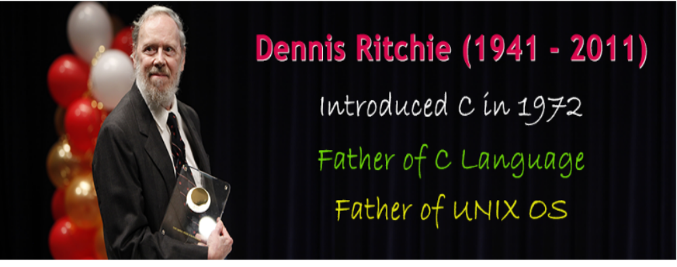
C Language

Slide 3
language before ‘c’
CPL (Common Programming Language)
  The CPL was invented by Martin Richards at the University of Cambridge in the early of 1960's.
2. BCPL (Basic Combined Programming Language)-
  The BCPL was invented by Martin Richards at the University of Cambridge in the year of 1966.
  It was a popular programming language at that time.
  BCPL allows the user, direct access to the computer memory.
  BCPL is the extension of CPL.
3. B Language-
  B language is derived from BCPL.
  It was introduced in the year of 1969 by Ken Thompson and Dennis Ritchie at Bell Laboratory, USA.
  The B language is similar to the BCPL.

Slide 4
language before ‘c’
4. C Language-
C language is derived from B language.
It was introduced in the year of 1972 by Dennis Ritchie at Bell Laboratory, USA.
The C language was mainly developed to create a operating system called UNIX. The first outcome of the c language was UNIX operating system.
The name C is given based on the previous language B and BCPL.
Ninety percent of the UNIX operating system code is written in C language.

Slide 5
various versions of ‘c’
5. ANSI C (C89)-
  In the year of 1983, the ANSI (American National Standards Institute) formed a committee to frame standard specifications for the C language.
  In the year of 1989, this committee introduced a standard version of C with the name "ANSI C" with standard library files.
6. C90-
  In the year of 1990, the ANSI C included of few new features like new library files, new processor commands. And it was also added with keywords const, volatile and signed etc...
7. C99-
  In the year of 1995, many new features were added to the C90 to create a new version of it.
  C99 became the official standard version of C.

Slide 6
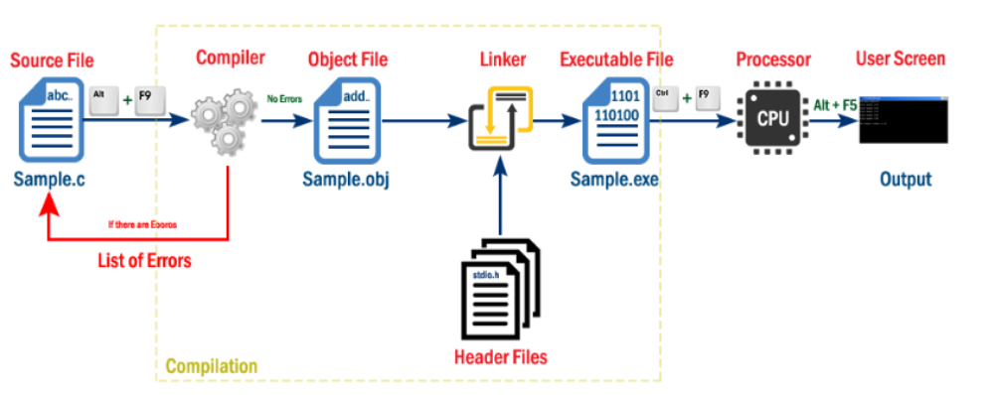
Execution Process of a C Program
C program file (Source file) must save with .c extension.
Compiler converts complete program at a time from high level language to low level language.
Input to the compiler is .c file and output from the compiler is .exe file, but it also generates .obj file in this process.
Compiler converts the file only if there are no errors in the source code.
CPU places the result in User Screen window.

Slide 7
Features of C Language
It is structured language
Functions are building blocks- compartmentalization-do no affects others. Uses block of codes
Uses compiler ( entire program converted to an object code) not interpreter( execute line by line-JAVA, BASIC)
All instructions perform specific tasks
Supports loop constructs – do, while, goto etc
Not cumbersome nature like assembly language
It combines best elements of both high and low level language
Allows manipulation of bits, bytes, address, pointers
Codes are portable
Has built in data type- integer, character and floating points
Almost no run time error checking-checking array boundary
Only 32 keywords- BASIC has over 100

Slide 8
C Program Basics
Comments-
  ignored by the compiler, not executed
  used to provide small description of the program.
  two types of comments.
  Single Line Comments: Single line comment begins with // symbol.
  Multiple Lines Comments: Multiple lines comment begins with /* symbol and ends with */.
Preprocessing Commands-
  Preprocessing commands are used to include header files and to define constants.
  use #include statement to include header file into our program.
  use #define statement to define a constant.

Slide 9
C Program Basics
Global Declaration
  to define the global variables, which are common for all the functions after its declaration.
  used also to declare functions.
int main()
  Every C program must write this statement.
  This statement (main) specifies the starting point of the C program execution.
  Here, int is a datatype of a value that is going to return to the Operating System after completing the main method execution.
  If we don't want to return any value, we can use it as void.
Open Brase ( { )
  The open brase indicates the begining of the block which belongs to the main method.
  In C program, every block begins with '{' symbol.

Slide 10
C Program Basics
Local Declaration
  variables and functions that are local to the function or block in which they are declared.
  The variables which are declared in this section are valid only within the function or block in which they are declared.
Executable statements
  statements which perform tasks like reading data, displaying result, calculations etc.,
  All the statements in this section are written according to the requirement.
Closing Brase ( } )
  The close brase indicates the end of the block which belongs to the main method.
  In C program every block ends with '}' symbol.

Slide 11
C Program Basics
General rules for any C program
  Every executable statement must end with semicolon symbol (;).
  Every C program must contain exactly one main method (Starting point of the program execution).
  All the system defined words (keywords) must be used in lowercase letters.
  Keywords can not be used as user defined names(identifiers).
  For every open brase ({), there must be respective closing brase (}).
  Every variable must be declared before it is used.

Slide 12
C Character Set
Every C program contains statements.
These statements are constructed using words and these words are constructed using characters from C character set.
C language character set contains the following set of characters...
  Alphabets
  Digits
  Special Symbols
Every character in C language has its equivalent ASCII (American Standard Code for Information Interchange) value

Slide 13
C Character Set
Alphabets
  C language supports all the alphabets from English language. Lower and upper case letters together supports 52 alphabets.
    lower case letters - a to z
    UPPER CASE letters - A to Z
Digits
  C language supports 10 digits which are used to construct numerical values in C language.
  Digits - 0, 1, 2, 3, 4, 5, 6, 7, 8, 9
Special Symbols
  C language supports rich set of special symbols
  Special Symbols - ~ @ # $ % ^ & * ( ) _ - + = { } [ ] ; : ' " / ? . > , < \ | tab newline space NULL bell backspace vertical tab etc.

Slide 14
C Character Set
#include<stdio.h>
#include<conio.h>
int main()
{ int i;
printf("ASCII ==> Character\n");
for(i = -128; i <= 127; i++)
printf("%d ==> %c\n", i, i);
return 0;
}

Slide 15
C Escape Sequences / Backslash Characters
Although it consists of two characters, it represents single character.
Each escape sequence has unique ASCII value.
Each and Every combination starts with back slash ( \ )
It can also be expressed in terms of octal digits or hexadecimal sequence.
Escape Sequences are preprocessed by Preprocessor.

Slide 16
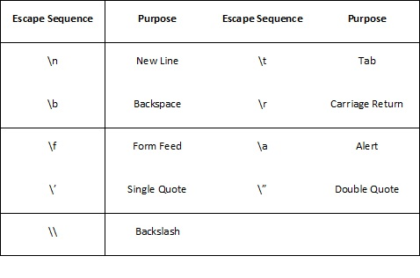
C Escape Sequences / Backslash Characters

Slide 17
C Escape Sequences / Backslash Characters
Tab : ‘\t’ Character -
It is Horizontal Tab
#include<stdio.h>
int main()
{
printf("Hello\t World ");
return 0;
}

Slide 18
C Escape Sequences / Backslash Characters
Tab : ‘\v’ Character -
It is Vertical Tab
#include <stdio.h>
int main(void)
{
printf("Hello Students");
printf("\v Welcome to C Programming");
return 0;
}

Slide 19
C Escape Sequences / Backslash Characters
New Line Character : ‘\n’ - It is New Line Character. Takes Control to new Line
#include<stdio.h>
int main()
{
printf("Hello\n World ");
return 0;
}

Slide 20
C Escape Sequences / Backslash Characters
Backslash : ‘\b’ Character- It is Backslash Character. Takes Control one position back
#include<stdio.h>
int main()
{
printf("He\bllo World");
return 0;
}

Slide 21
C Escape Sequences / Backslash Characters
Carriage Return : ‘\r’ Character- It is Carriage Return Character. Takes Control to First Position in the Line
#include <stdio.h>
int main(void)
{
printf("Hollo My Dear Stu\rdents");
return 0;
}

Slide 22
C Escape Sequences / Backslash Characters
Carriage Return : ‘ and “ Character
#include <stdio.h>
int main(void)
{
printf("His height is 5 feet 10 inch\n");
printf("His height is 5\' 10\"");
return 0;
}

Slide 23
C Escape Sequences / Backslash Characters
Audible Return : ‘\a’ Character- It is audible Return Character Beeps Sound
#include<stdio.h>
int main()
{
printf("Hello\a");
return(0);
}

Slide 24
C Tokens
Every C program is a collection of instructions and every instruction is a collection of some individual units.
Every smallest individual unit of a c program is called token.
Every instruction in a c program is a collection of tokens.
Tokens are used to construct c programs
They are said to the basic building blocks of a c program.

Slide 25
C Tokens
In a c program tokens may contain the following...
  Keywords
  Identifiers
  Data values
  Constants
  Operators
  Special Symbols
  Strings

Slide 26
Keywords
Keywords are the reserved words with predefined meaning which already known to the compiler
In C programming language, there are 32 keywords
Properties of Keywords
  All the keywords in C programming language are defined as lowercase letters
  Every keyword has a specific meaning, users can not change that meaning.
  Keywords can not be used as user defined names like variable, functions, arrays, pointers etc...
  Every keyword in C programming language, represents something or specifies some kind of action to be performed by the compiler.

Slide 27
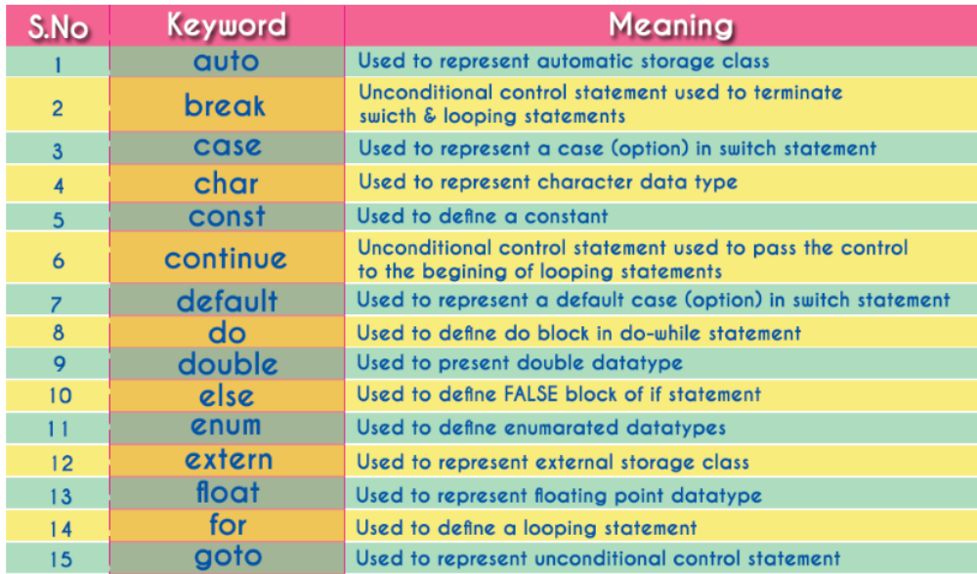
Keywords

Slide 28
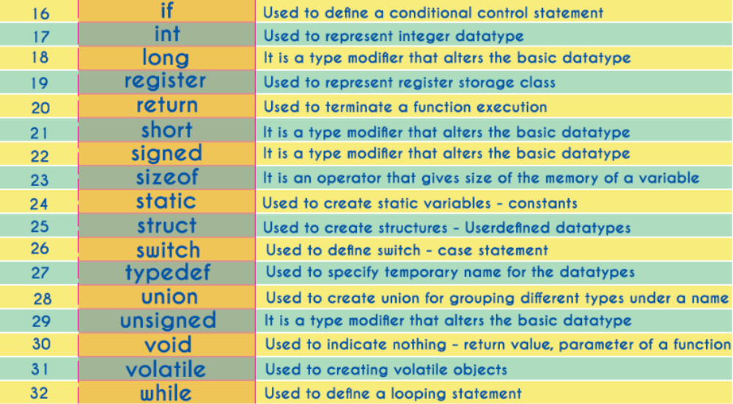
Keywords

Slide 29
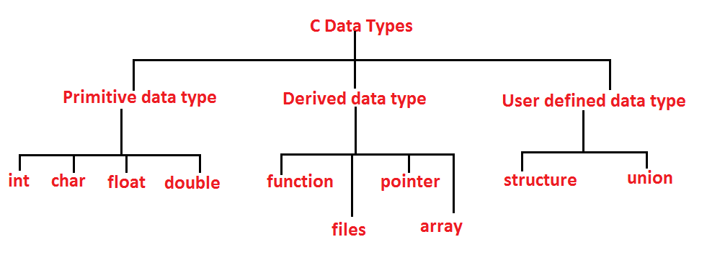
C Data Types

Slide 30
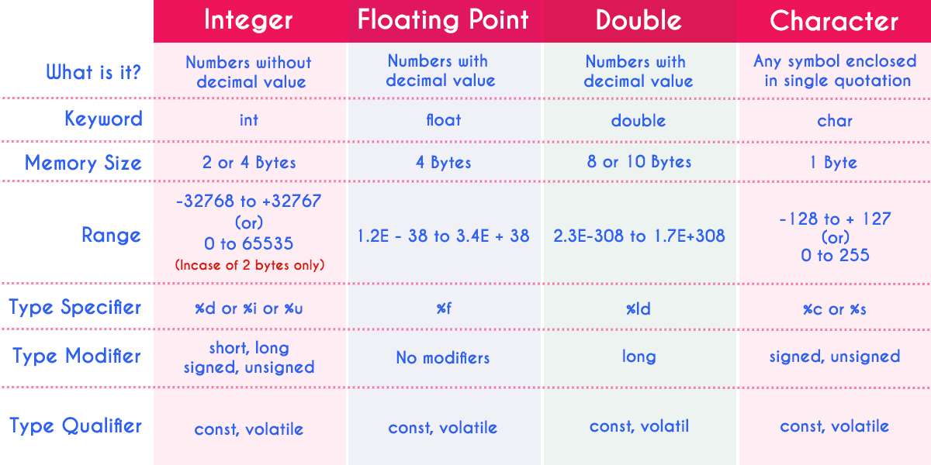
C Data Types
For 16 bit processor (CPU) , 2 byte (16 bit) of memory -32,768 to +32,767
For 32 bit processor (CPU), 4 byte (32 bit) of memory
For 64 bit processor (CPU), 8 byte (64 bit) of memory will be allocated

Slide 31
C Data Types
#include <stdio.h>
int main()
{
int a;
float b;
double c;
char d;
printf("Size of int=%d bytes\n",sizeof(a));
printf("Size of float=%d bytes\n",sizeof(b));
printf("Size of double=%d bytes\n",sizeof(c));
printf("Size of char=%d byte\n",sizeof(d));
return 0;
}

Slide 32
C Identifiers - Variables
Identifier refers to name given to entities such as variables, functions, structures etc.
Rules for Creating Identifiers
  Can contain letters (UPPERCASE and lowercase), numeric & underscore symbol only.
  Should not start with numerical value. It can start with a letter or an underscore.
  Should not use any special symbols in between the identifier even whitespace. However, the only underscore symbol is allowed.
  Keywords should not be used as identifiers.
  There is no limit for length of an identifier. However, compiler consider first 31 characters only.
  An identifier must be unique in its scope.

Slide 33
C Constants
A constant is similar to the variable but constant holds only one value during the program execution
constant can be of any datatype like integer, floating point, character, string and double etc.,
In c programming language, constants can be created using two concepts...
  Using 'const' keyword
  Using '#define' preprocessor

Slide 34
C Constants
Constants
Using 'const' keyword
Using '#define' preprocessor
#include <stdio.h>
void main()
{
int i = 9 ;
const int x = 10 ;
i = 15 ;
x = 100 ; // creates an error
printf("i = %d\nx = %d", i, x ) ;
}
#include <stdio.h>
#define PI 3.14
void main(){
int r, area ;
printf("Please enter the radius of circle : ") ;
scanf("%d", &r) ;
area = PI * (r * r) ;
printf("Area of the circle = %d", area) ;
}

Slide 35
C Operators and Expression
An operator is a symbol used to perform mathematical and logical operations in a program
set of operators are classified as follows...
  Arithmetic Operators-
  Relational Operators
  Logical Operators
  Increment & Decrement Operators
  Assignment Operators
  Bitwise Operators
  Conditional Operator
  Special Operators
(+, -, *, /, %)
(<, >, <=, >=, ==, !=)
(&&, ||, !)
(++ , --)
(=, +=, -=, *=, /=, %=)
(&, |, ^, ~, >>, <<)
( ? :)
(sizeof, pointer, comma, dot etc.)

Slide 36
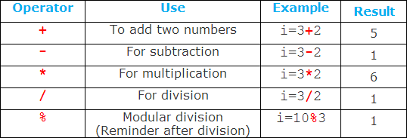
C Operators and Expression
C Arithmetic Operators
An arithmetic operator performs mathematical operations such as addition, subtraction and multiplication on numerical values (constants and variables

Slide 37
C Operators and Expression
C Arithmetic Operators
#include <stdio.h>
int main()
{
int a = 9, b = 4, c;
c = a+b;
printf("Result a+b = %d \n",c);
c = a-b;
printf("Result a-b = %d \n",c);
c = a*b;
printf("Result a*b = %d \n",c);
c=a/b;
printf("Result a/b = %d \n",c);
c=a%b;
printf("Result a mod b =%d \n",c);
return 0;
}

Slide 38
C Operators and Expression
C Increment and decrement operators
C programming has two operators increment ++ and decrement --
Increment ++ increases the value by 1 whereas decrement -- decreases the value by 1.

Slide 39
C Operators and Expression
C Increment and decrement operators
#include <stdio.h>
int main()
{
int a = 10, b = 100;
float c = 10.5, d = 100.5;
printf("++a = %d \n", ++a);
printf("--b = %d \n", --b);
printf("++c = %f \n", ++c);
printf("--d = %f \n", --d);
return 0;
}

Slide 40
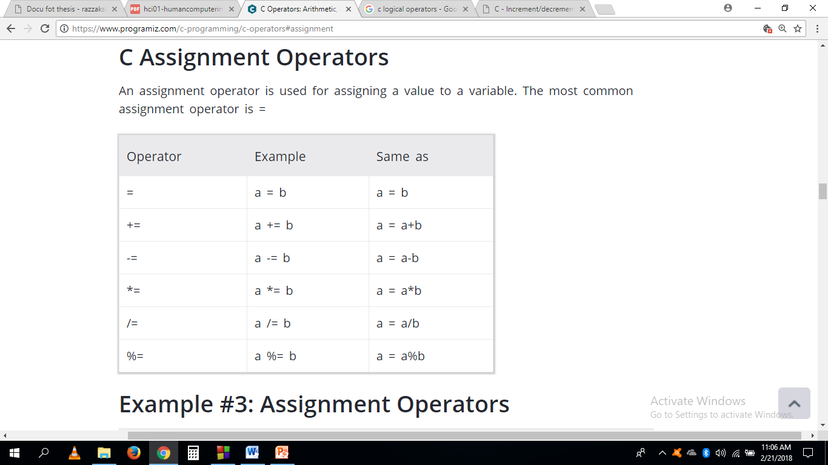
C Operators and Expression
C Assignment Operators
An assignment operator is used for assigning a value to a variable. The most common assignment operator is =

Slide 41
C Operators and Expression
C Assignment Operators
#include <stdio.h>
int main()
{
int a = 5, c;
c = a;
printf("c = %d \n", c);
c += a; // c = c+a
printf("c = %d \n", c);
c -= a; // c = c-a
printf("c = %d \n", c);
c *= a; // c = c*a
printf("c = %d \n", c);
c /= a; // c = c/a
printf("c = %d \n", c);
c %= a; // c = c%a
printf("c = %d \n", c);
return 0;
}

Slide 42
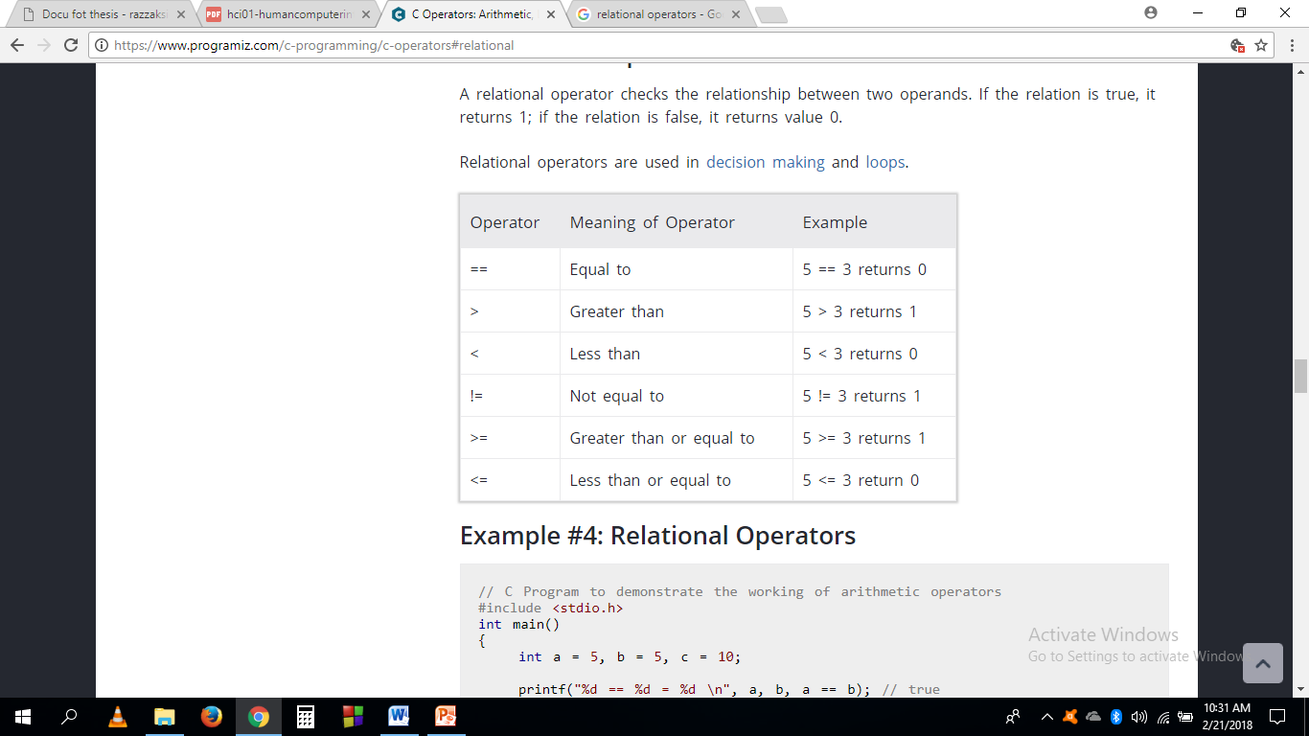
C Operators and Expression
C Relational Operators
A relational operator checks the relationship between two operands. If the relation is true, it returns 1; if the relation is false, it returns value 0.

Slide 43
C Operators and Expression
C Relational Operators
#include <stdio.h>
int main()
{
int number;
printf("Enter an integer: ");
scanf("%d", &number);
if(number % 2 == 0)
printf("%d is even.", number);
else
printf("%d is odd.", number);
return 0;
}

Slide 44
C Operators and Expression
C Relational Operators
#include<stdio.h>
int main()
{
int a, b;
a=5, b=5;
if (a>=b)
printf("The result is true");
else
printf("The result is False");
return 0;
}

Slide 45
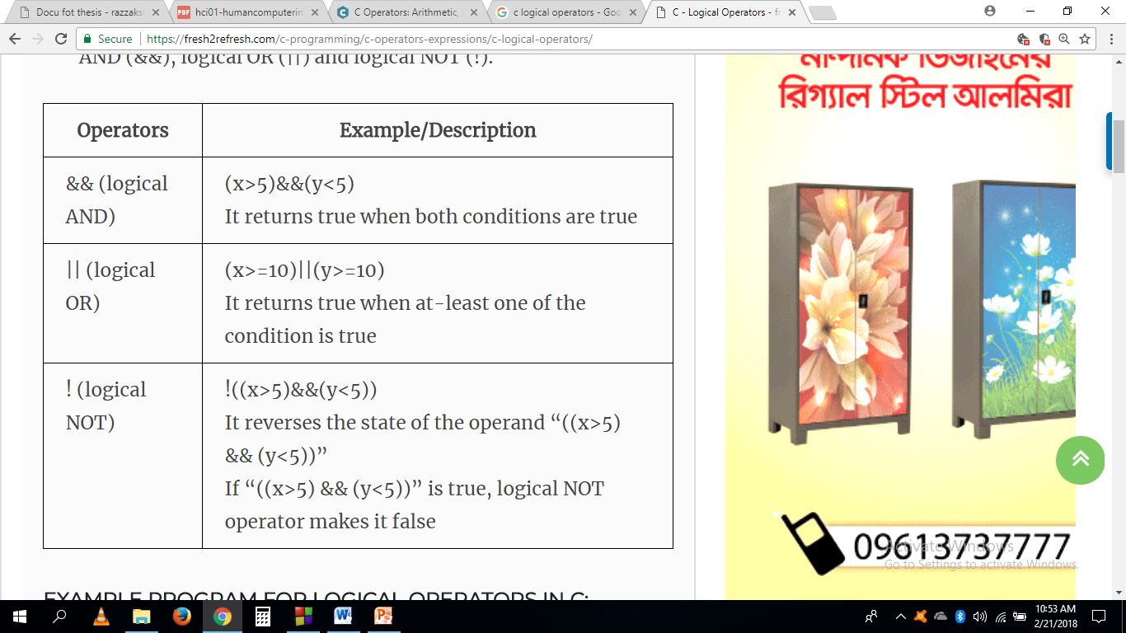
C Operators and Expression
C Logical Operators
An expression containing logical operator returns either 0 or 1 depending upon whether expression results true or false. Logical operators are commonly used in decision making in C programming.

Slide 46
C Operators and Expression
C Relational Operators-Write a C Program to Check Whether a Character is an Alphabet or not
#include <stdio.h>
int main()
{ char c;
printf("Enter a character: ");
scanf("%c",&c);
if( (c>='a' && c<='z') || (c>='A' && c<='Z'))
printf("%c is an alphabet.",c);
else printf("%c is not an alphabet.",c);
return 0;
}

Slide 47
C Operators and Expression
C Logical Operators
#include <stdio.h>
int main()
{
int a = 5, b = 5, c = 10, result;
result = (a == b) && (c > b);
printf("(a == b) && (c > b) equals to %d \n", result);
result = (a == b) && (c < b);
printf("(a == b) && (c < b) equals to %d \n", result);
result = (a == b) || (c < b);
printf("(a == b) || (c < b) equals to %d \n", result);
result = (a != b) || (c < b);
printf("(a != b) || (c < b) equals to %d \n", result);
result = !(a != b);
printf("!(a == b) equals to %d \n", result);
result = !(a == b);
printf("!(a == b) equals to %d \n", result);
return 0;
}

