Slide 1
Control Statement:
If … Else, Switch
Lt Col Razzak
CSE Dept
MIST

Slide 2
Control Statement
Statement
A statement is a part of program that can be executed.
It instructs the computer to take a specific action, such as display to the screen, or collect input.
Category of Statements
Selection/Conditional - If and switch
Iteration/loop - while, for, do-while
Jump - break, continue, goto, return
Label - case, default
Expression - statements composed of valid expression
Block/compound - blocks of code

Slide 3
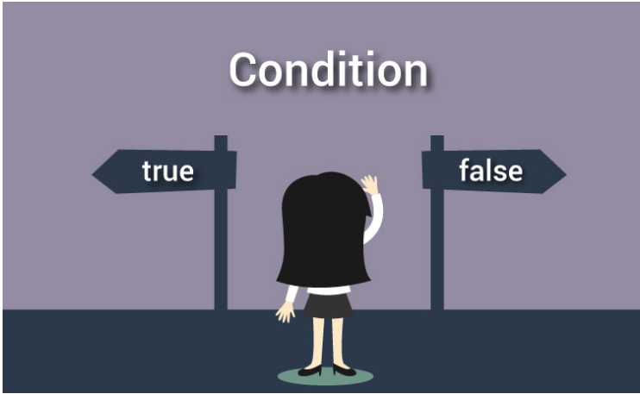
Selection/Conditional
If
Switch
If else statements in C language
Simple if condition
if else condition
ladder (multiple) if condition
nested (if within if) condition

Slide 4
Selection/Conditional if

Slide 5
Selection/Conditional if
-Practical example:
if it is not raining, we will go to school.
-Format:
if(expression / test-condition)
statement/ body;
In this type of if-statement, the sub-statement will only be executed if the expression is non-zero/true.
If the test expression is evaluated to false (0), statements inside the body of if is skipped from execution.
No Semicolon

Slide 6
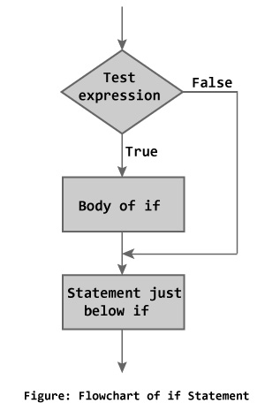
Selection/Conditional if

Slide 7
Control Statement (cont.) if
-Format:
if(expression /test-condition)
{
statement1;
statement2;
………………..;
statement n;
}
The if statement evaluates the test expression inside the parenthesis

Slide 8
Sample Program if
#include<stdio.h>
void main()
{
int var;
scanf(“ %d”, &var);
if(var > 0)
printf(“%d is a Positive Number”, var);
}

Slide 9
Sample Program (cont.) if
#include<stdio.h>
void main()
{
int var;
scanf(“ %d”, &var);
if(var > 0)
{
printf(“%d is a Positive Number”, var);
}
}

Slide 10
Sample Program (cont.) if
#include<stdio.h>
void main()
{
int var;
scanf(“ %d”, &var);
if(var > 0)
printf(“%d is a Positive Number”, var);
if(var < 0)
printf(“%d is a Negative Number”, var);
}

Slide 11
Sample Program (cont.) if
#include<stdio.h>
void main()
{
int var;
scanf(“ %d”, &var);
if(var %2 == 0)
printf(“%d is an Even Number”, var);
if(var %2 != 0)
printf(“%d is an Odd Number”, var);
}

Slide 12
Control Statement if else
This type of if condition is used, when you have one condition and two body of code (two set of statements) to execute based on a single condition.
if( test-condition)
{
True-block;
}
else
{
False-block;
}
If test-condition is true (non zero value), True-block will execute and if test-condition is false, False-block will execute

Slide 13
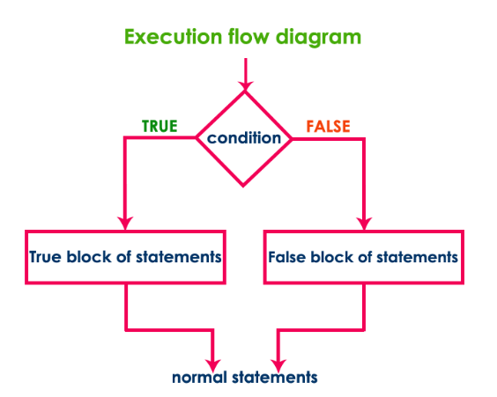
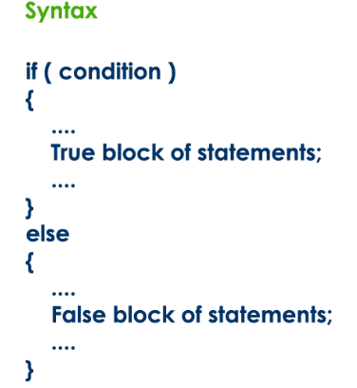
Control Statement if else

Slide 14
Control Statement if else
-Practical example:
if x is divisible by 2, then x is an even number.
otherwise x an odd number
-Format:
if(expression) statement1;
else statement2;
-Format:
if(expression)
statement1;
else
statement2;
No Semicolon
No Semicolon

Slide 15
Sample Program if else
#include<stdio.h>
void main()
{
int var;
scanf(“ %d”, &var);
if(var > -1)
printf(“%d is a Positive Number”, var);
else
printf(“%d is a Negative Number”, var);
}

Slide 16
Control Statement (Cont.) if else
Format:
if(expression)
{
statement1;
statement2;
…………………
}
else
statement 3;

Slide 17
Control Statement (Cont.) if else
Format:
if(expression)
statement1;
else
{
statement2;
…………………
statement n;
}

Slide 18
Control Statement (Cont.) if else
Format:
if(expression)
{ statement1;
statement2;
…………………
}
else
{
statement4;
………………….
statement n;
}

Slide 19
Control Statement (Cont.) if else
Format:
if(expression)
{
statement 1;
}
statement m; //Wrong
else //mismatched if else
{
statement4;
………………….
statement n;
}

Slide 20
Sample Program if else
#include<stdio.h>
void main()
{ int var, mid;
scanf(“ %d”, &var);
if(var %2 == 0)
{
mid = var / 2;
printf(“Mid = %d”, mid);
}
else
{ mid = (var + 1) / 2;
printf(“Mid = %d”, mid);
}
}
Input1
Output1
4
2
Input2
Output2
5
3

Slide 21
Nested if else
This type of if is used, when you want to check another condition within if condition’s block, suppose there are two conditions, condition1 and condition2 and you want to execute condition2 if condition1 is true

Slide 22
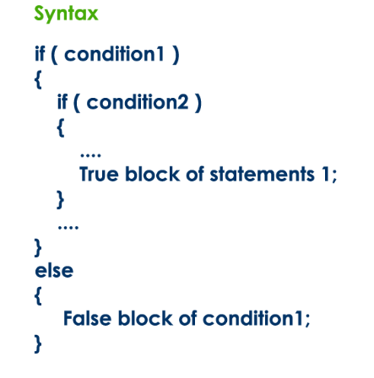
Nested if else

Slide 23
Nested if else
Format:
if (expression1)
{
if(expression2)
statement1;
else
statement2;
}

Slide 24
Nested if else (cont.)
if (expression1)
{
if(expression2)
statement1;
else
statement2;
}
else
{
if(expression3)
statement3;
}

Slide 25
Sample Program
#include<stdio.h>
void main()
{ int x;
scanf(“ %d”, &x)
if(x > 5)
{
if(x < 10)
printf(“%d is within 5 and 10”, x);
}
}

Slide 26
Sample Program(cont.)
#include<stdio.h>
void main()
{ int x;
scanf(“ %d”, &x)
if(x > 5)
{ if(x < 10)
printf(“%d is within 5 and 10”, x);
}
else
printf(“%d is not within 5 and 10”, x);
}

Slide 27
Sample Program(cont.)
#include<stdio.h>
void main()
{ int x;
scanf(“ %d”, &x)
if(x > 5)
if(x < 10)
printf(“%d is within 5 and 10”, x);
else
printf(“%d is not within 5 and 10”, x);
}

Slide 28
Sample Program(cont.)
#include<stdio.h>
void main()
{ int x;
scanf(“ %d”, &x)
if(x > 5 && x < 10)
{
printf(“%d is within 5 and 10”, x);
}
else
printf(“%d is not within 5 and 10”, x);
}

Slide 29
Sample Program(cont.)
Test whether given number is even or odd if it is below 100.
#include <stdio.h>
#include<conio.h>
void main(){
int n ;
printf("Enter any integer number: ") ;
scanf("%d", &n) ;
if ( n < 100 )
{
printf("Given number is below 100\n") ;
if( n%2 == 0)
printf("And it is EVEN") ;
else
printf("And it is ODD") ;
}
else
printf("Given number is not below 100") ;
}

Slide 30
Sample Program(cont.)
/* Program to check to entered character if vowel or consonant.*/
#include <stdio.h>
int main()
{
char ch;
printf("Enter a character: ");
scanf("%c",&ch);
if( (ch>='A' && ch<='Z') || (ch>='a' && ch<='z'))
{
if( ch=='A'||ch=='E'||ch=='I'||ch=='O'||ch=='U'||ch=='a'||ch=='e'||ch=='i'||ch=='o'||ch=='u')
{ printf("%c is a VOWEL",ch); }
else { printf("%c is a CONSONANT",ch); }
}
else
{
printf("%c is not a valid character",ch);
}
return 0;
}

Slide 31
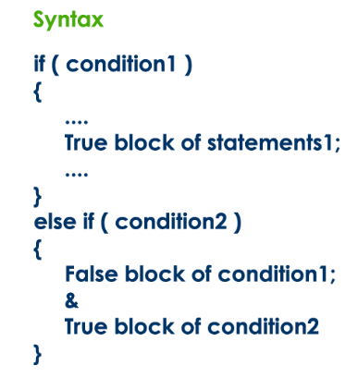
else if ladder
This type of if statement is used when you have more than one test conditions and blocks to execute.

Slide 32
else if ladder
Format:
if(expression)
statement1;
else if(expression)
statement2;
..........................
………………………..
else if(expression)
statement_n;
else
statement _x;
X =1
X =2
else
X =3
X =4

Slide 33
Sample
#include<stdio.h>
void main()
{ int a;
scanf(“ %d”, &a);
if(a >= 80)
printf(“A+”);
else if(a >= 75 && a<80)
printf(“A”);
else if(a >= 70 && a<75)
printf(“A-”);
else if(a >= 65 && a<70)
printf(“B+”);
else if(a >= 60 && a<65)
printf(“B”);
else if(a >= 55 && a<60)
printf(“B-”);
………………………………
………………………………
else if(a >= 40 && a<45)
printf(“D”);
else
printf(“F”);
}

Slide 34
Sample
#include<stdio.h>
void main()
{ int a;
scanf(“ %d”, &a);
if(a >= 80)
printf(“A+”);
else if(a >= 75)
printf(“A”);
else if(a >= 70)
printf(“A-”);
else if(a >= 65)
printf(“B+”);
else if(a >= 60)
printf(“B”);
else if(a >= 55)
printf(“B-”);
………………………………
………………………………
else if(a >= 40)
printf(“D”);
else
printf(“F”);
}

Slide 35
Sample
Find the largest of three numbers.
#include <stdio.h>
void main()
{
int a, b, c ;
printf("Enter any three integer numbers: ") ;
scanf("%d%d%d", &a, &b, &c) ;
if( a>=b && a>=c)
printf("%d is the largest number", a) ;
else if (b>=a && b>=c)
printf("%d is the largest number", b) ;
else
printf("%d is the largest number", c) ;
}

Slide 36
Sample
/*program to check entered number if ZERO, POSITIVE or NEGATIVE.*/
#include <stdio.h>
int main()
{
int num;
printf("Enter an integer number:");
scanf("%d",&num);
if(num==0){
printf("Number is ZERO");
}
else if(num>1)
{
printf("Nunber is POSITIVE");
}
else
{
printf("Number is NEGATIVE");
}
return 0;
}

Slide 37
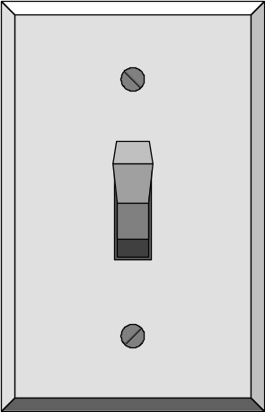
Programming
Switch Statement

Slide 38
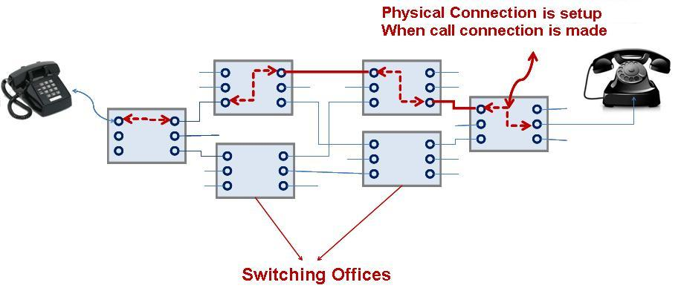
Switch Statement

Slide 39
Switch Statement
case 1
Action 1
case 2
Action 2
case 3
Action 3
default
Action 4

Slide 40
Switch Statement
Start
value1
action 1
value2
action 2
value3
action 3
value4
action 4
End

Slide 41
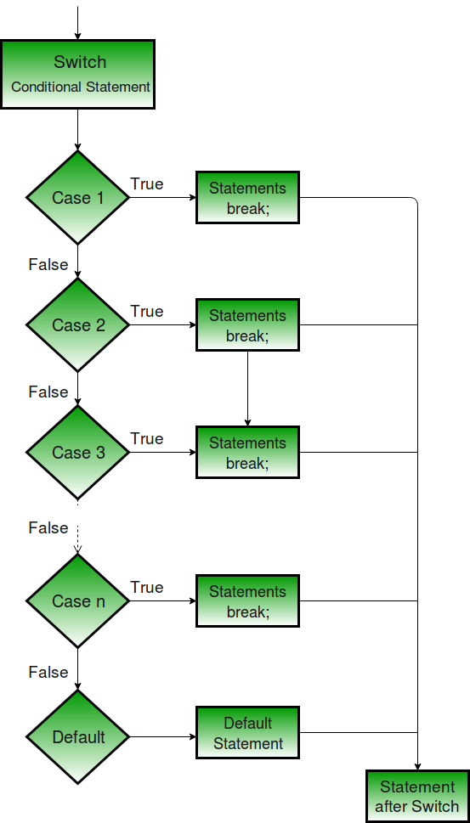
Switch - Flow Chart

Slide 42
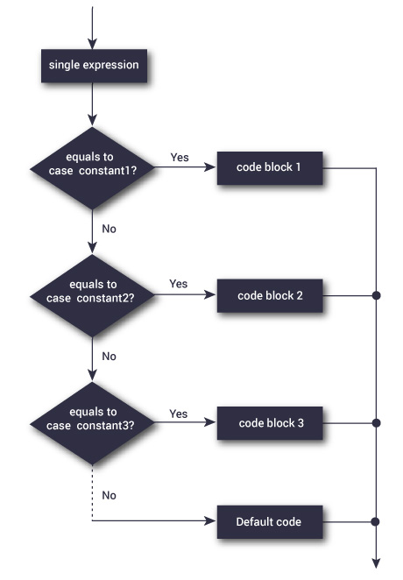
Switch - Flow Chart

Slide 43
Switch Statement- Syntax
switch (selector expression)
{
case 1: sequence of statement;
break;
case 2: sequence of statements;
break;
case 3: sequence of statements;
break;
default : sequence of statements;
}

Slide 44
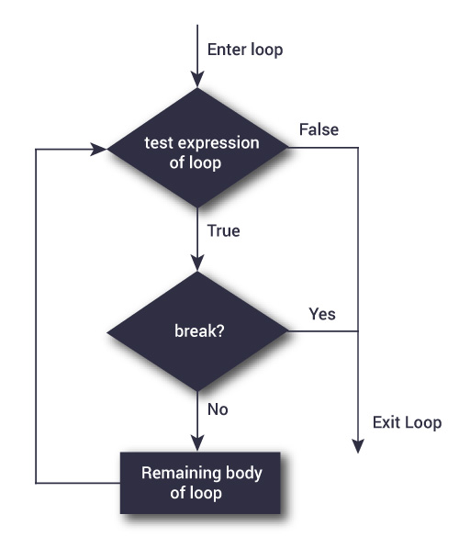
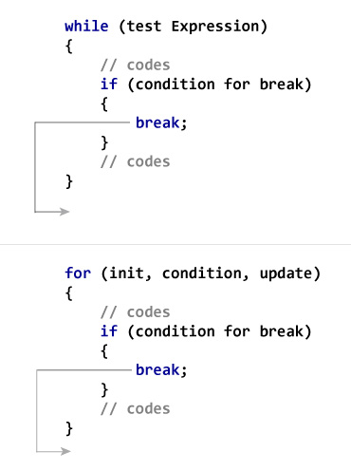
BREAK STATEMENT
# include <stdio.h>
int main()
{
int i; double number, sum = 0.0;
for(i=1; i <= 10; ++i)
{
  printf("Enter a n%d: ",i); scanf("%lf",&number);
// If user enters negative number, loop is terminated
  if(number < 0.0)
  { break;
  }
  sum += number; // sum = sum + number;
}
printf("Sum = %.2lf",sum);
return 0;
}

Slide 45
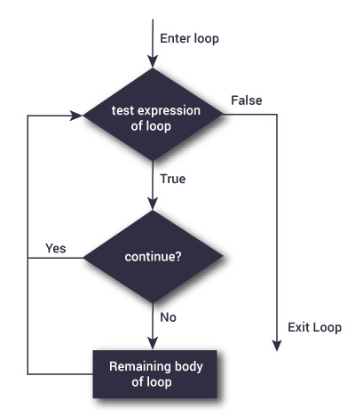
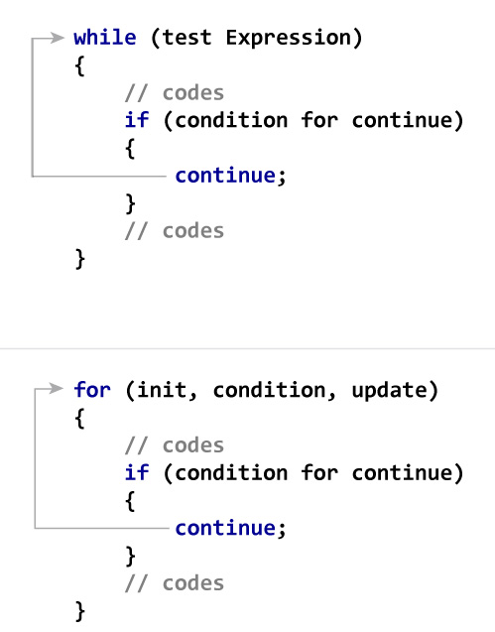
CONTINUE STATEMENT
# include <stdio.h>
int main()
{
int i; double number, sum = 0.0;
for(i=1; i <= 10; ++i)
{
  printf("Enter a n%d: ",i); scanf("%lf",&number);
  // Negative numbers are skipped from calculation
  if(number < 0.0)
  { continue;
  }
  sum += number; // sum = sum + number;
}
printf("Sum = %.2lf",sum);
return 0;
}

Slide 46
Switch Statement
The switch statement provides another way to decide which statement to execute next
The switch statement evaluates an expression, then attempts to match the result to one of several possible cases
The match must be an exact match.
switch ( expression ){
case value1 :
statement-list1
case value2 :
statement-list2
case value3 :
statement-list3
case ...
}

Slide 47
Switch Statement
switch ( expression )
{
case value1 :
statement-list1
case value2 :
statement-list2
case value3 :
statement-list3
case ...
}
Each case contains a value and a list of statements
The flow of control transfers to statement associated with the first case value that matches

Slide 48
Switch Statement
The break statement can be used as the last statement in each case's statement list
A break statement causes control to transfer to the end of the switch statement
If a break statement is not used, the flow of control will continue into the next case
switch ( expression ){
case value1 :
statement-list1
break;
case value2 :
statement-list2
break;
case value3 :
statement-list3
break;
case ...
}

Slide 49
Switch Statement
Examples of the switch statement:
switch (option){
case 'A':
aCount++;
break;
case 'B':
bCount++;
break;
case 'C':
cCount++;
break;
}
When a break statement is reached, the switch terminates, and the flow of control jumps to the next line following the switch statement

Slide 50
Switch Statement-No Break
Another Example:
switch (option){
case 'A':
aCount++;
break;
case 'B':
bCount++;
break;
case 'C':
cCount++;
break;
}
switch (option){
case 'A':
aCount++;
case 'B':
bCount++;
case 'C':
cCount++;
}

Slide 51
Switch Statement-Features
When a case constant is found that matches the switch expression, control of the program passes to the block of code associated with that case
Duplicate case values are not allowed.
The default statement is optional. Even if the switch case statement do not have a default statement, it would run without any problem.
The break statement is used inside the switch to terminate a statement sequence. When a break statement is reached, the switch terminates, and the flow of control jumps to the next line following the switch statement.
The break statement is optional. If omitted, execution will continue on into the next case. The flow of control will fall through to subsequent cases until a break is reached.
Nesting of switch statements are allowed, which means you can have switch statements inside another switch. However nested switch statements should be avoided as it makes program more complex and less readable

Slide 52
Switch Statement
All the statements following a matching case execute until a break statement is reached. If break statement is not used, all cases after the correct case is executed.
// There is no break in all cases
#include <stdio.h>
int main()
{
int x = 2;
switch (x)
{
case 1: printf("Choice is 1\n");
case 2: printf("Choice is 2\n");
case 3: printf("Choice is 3\n");
default: printf("Choice other than 1, 2 and 3\n");
}
return 0;
}

Slide 53
Switch Statement
All the statements following a matching case execute until a break statement is reached
/ There is no break in some cases
#include <stdio.h>
int main()
{
int x = 2;
switch (x)
{
case 1: printf("Choice is 1\n");
case 2: printf("Choice is 2\n");
case 3: printf("Choice is 3\n");
case 4: printf("Choice is 4\n");
break;
default: printf("Choice other than 1, 2, 3 and 4\n");
break;
}
printf("After Switch");
return 0;
}

Slide 54
Switch Statement
The default block can be placed anywhere. The position of default doesn’t matter, it is still executed if no match found
// The default block is placed above other cases.
#include <stdio.h>
int main()
{
int x = 4;
switch (x)
{
default: printf("Choice other than 1 and 2");
break;
case 1: printf("Choice is 1");
break;
case 2: printf("Choice is 2");
break;
}
return 0;
}

Slide 55
Switch Statement
The statements written above cases are never executed After the switch statement, the control transfers to the matching case, the statements executed before case are not executed
#include <stdio.h>
int main()
{
int x = 1;
switch (x)
{
x = x + 1; // This statement is not executed
printf(“The extra statement");
case 1: printf("Choice is 1");
break;
case 2: printf("Choice is 2");
break;
default: printf("Choice other than 1 and 2");
break;
}
return 0;
}

Slide 56
Switch Statement
Two case labels cannot have same value
// Program where two case labels have same value
#include <stdio.h>
int main()
{
int x = 1;
switch (x)
{
case 2: printf("Choice is 1");
break;
case 1+1: printf("Choice is 2");
break;
}
return 0;
}

Slide 57
Switch Statement
The expression used in switch must be integral type ( int, char and enum). Any other type of expression is not allowed.
// float is not allowed in switch
#include <stdio.h>
int main()
{
float x = 1.1;
switch (x)
{
case 1.1: printf("Choice is 1");
break;
default: printf("Choice other than 1, 2 and 3");
break;
}
return 0;
}

Slide 58
Switch Statement
we can use a range of values with switch case statement. Use range like min_value, three dots (...) and max_value
#include <stdio.h>
int main()
{
int number;
//read number
printf("Enter any number (1-100): ");
scanf("%d",&number);
switch(number)
{
//case values within a range
case 1 ... 50: printf("Number is in between 1 to 50\n"); break;
case 51 ... 100: printf("Number is in between 51 to 100\n"); break; default: printf("Number is out of range!!!\n"); break;
}
return 0;
}

Slide 59
Practice- Prepare a menu for edit, delete and quit using switch statement
int choice;
printf( “my menu\n\n” );
printf( “1 – edit\n” );
printf( “2 – delete\n” );
printf( “3 – quit\n” );
printf( “enter your choice: “ );
scanf( “%d”, &choice );
switch( choice )
{
case 1: printf( “Do edit\n” ); break;
case 2: printf( “Do delete\n” ); break;
case 3: printf( “Done\n” ); break;
default: printf( “Invalid choice!\n” ); break;
}

Slide 60
Switch Statement -Example
#include <stdio.h>
int main () {
char grade = 'B';
switch(grade) {
case 'A' : printf("Excellent!\n" );
break;
case 'B' :
case 'C' : printf("Well done\n" );
break;
case 'D' : printf("You passed\n" );
break;
case 'F' : printf("Better try again\n" );
break;
default : printf("Invalid grade\n" );
}
printf("Your grade is %c\n", grade );
return 0;
}

Slide 61
Binary Selection
if ( age >= 18 )
{
printf(“Vote!\n”) ;
}
else
{
printf(“May be next time!\n”) ;
}
if ( age >= 18 )
{
printf(“Vote!\n”) ;
}

Slide 62
Multiple Selection with If
if (day == 0 ) {
printf (“Sunday”) ;
}
if (day == 1 ) {
printf (“Monday”) ;
}
if (day == 2) {
printf (“Tuesday”) ;
}
if (day == 3) {
printf (“Wednesday”) ;
}
(continued)
if (day == 4) {
printf (“Thursday”) ;
}
if (day == 5) {
printf (“Friday”) ;
}
if (day == 6) {
printf (“Saturday”) ;
}
if ((day < 0) || (day > 6)) {
printf(“Error - invalid day.\n”) ;
}

Slide 63
Multiple Selection with else If
if (day == 0 ) { printf (“Sunday”) ;}
else if (day == 1 ) {
printf (“Monday”) ;}
else if (day == 2) {
printf (“Tuesday”) ;}
else if (day == 3) {
printf (“Wednesday”) ;}
else if (day == 4) {
printf (“Thursday”) ; }
else if (day == 5) {
printf (“Friday”) ; }
else if (day = 6) {
printf (“Saturday”) ; }
else {
printf (“Error - invalid day.\n”) ;
}
This if-else structure is more efficient than the corresponding if structure.

Slide 64
Else If
Switch Statement
if (day == 0 ) {
printf (“Sunday”) ;
} else if (day == 1 ) {
printf (“Monday”) ;
} else if (day == 2) {
printf (“Tuesday”) ;
} else if (day == 3) {
printf (“Wednesday”) ;
} else if (day == 4) {
printf (“Thursday”) ;
} else if (day == 5) {
printf (“Friday”) ;
} else if (day = 6) {
printf (“Saturday”) ;
} else {
printf (“Error - invalid day.\n”) ;
}
switch ( day )
{
case 0: printf (“Sunday\n”) ;
break ;
case 1: printf (“Monday\n”) ;
break ;
case 2: printf (“Tuesday\n”) ;
break ;
case 3: printf (“Wednesday\n”) ;
break ;
case 4: printf (“Thursday\n”) ;
break ;
case 5: printf (“Friday\n”) ;
break ;
case 6: printf (“Saturday\n”) ;
break ;
default: printf (“Error -- invalid day.\n”) ;
break ;
}

Slide 65
Difference between switch and if
if statements can evaluate float conditions. switch statements cannot evaluate float conditions.
if statement can evaluate relational operators. switch statement cannot evaluate relational operators i.e they are not allowed in switch statement.
Cases have to equal an exact value such as 1,2,3, and so on, cases can't have conditions. This is where conditional statements offer a lot more flexibility in program.
if (x <= 10);
/*This is saying to execute the statement for all values less than or equal to x.*/
case: (x <= 10) /*DOES NOT WORK*/

Slide 66
Practice – Create a calculator for addition and subtraction
#include<stdio.h>
void main( )
{
int a, b, c, choice;
printf("\n 1. Press 1 for addition");
printf("\n 2. Press 2 for subtraction");
printf("\n Enter your choice");
/* Taking users input */
scanf("%d", &choice);
switch(choice)
{
case 1:
printf("Enter 2 numbers");
scanf("%d%d", &a, &b);
c = a + b;
printf("%d", c);
break;
case 2:
printf("Enter 2 numbers");
scanf("%d%d", &a, &b);
c = a - b;
printf("%d", c);
break;
default:
printf("you have passed a wrong key");
printf("\n press any key to continue");
}
}
}

