Slide 1
Control Statement: Loop
(While, For, Do While)
Lt Col Razzak
CSE Dept
MIST

Slide 2
Loop
#include<stdio.h>
void main()
{
printf(“Hello World\n”);
printf(“Hello World\n”); printf(“Hello World\n”); printf(“Hello World\n”); printf(“Hello World\n”); printf(“Hello World\n”); printf(“Hello World\n”); printf(“Hello World\n”); printf(“Hello World\n”); printf(“Hello World\n”);
}
.
#include<stdio.h>
void main()
{
int i = 0;
while(i < 10)
{
printf(“Hello World\n”);
i++;
}
}
.

Slide 3
Loop
Loop - Repeated Statement Execution
Loops are used in programming to repeat a specific block until some end condition is met.
Three types of loop statements:
while
for
do while
Nested Loop

Slide 4
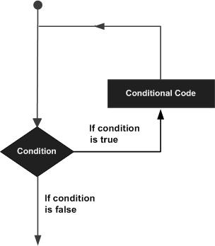
Loop
A loop statement allows us to execute a statement or group of statements multiple times.

Slide 5

How loop works?
Example:
for(initialization statement ; condition statement ; iteration statement)
{
statement1;
statement2;
…………………..
}
The initialization statement is executed only once.
Then, the condition is evaluated. If the test condition is false (0), for loop is terminated.
But if the test condition is true (nonzero), codes inside the body of for loop is executed and the update expression is updated.
This process repeats until the test condition is false.
The for loop is commonly used when the number of iterations is known
While loop is explicitly used when iterations is not known
Do while is used when at least one iterations is required

Slide 6
Loop Control Statements
Loop control statements change execution from its normal sequence.
break statement
Terminates the loop or switch statement and transfers execution to the statement immediately following the loop or switch.
continue statement
Causes the loop to skip the remainder of its body and immediately retest its condition prior to reiterating.
goto statement
Transfers control to the labeled statement.

Slide 7
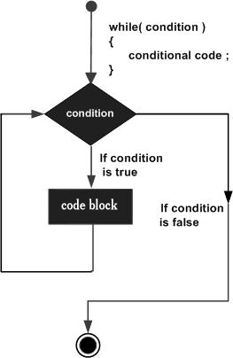
while loop
While loop is explicitly used when iterations is not known
while(condition)
{
statement1;
statement2;
…………………..
}

Slide 8
while loop (cont.)
Format:
while(condition/expression)
statement;
Format:
while(condition/expression)
{
statement1;
statement2;
…………………..
}
How while loop works?
While loop consists of a condition/expression.
If the condition/expression is evaluated to true, statements inside the while loop are executed.
After execution, the condition/expression is evaluated again.
If the condition/expression is evaluated to false, the while loop terminates.
A while loop might not execute at all. When the condition is tested and the result is false, the loop body will be skipped and the first statement after the while loop will be executed

Slide 9
Sample Program while loop
#include<stdio.h>
void main()
{
int i;
i = 0;
while(i < 10)
{
printf(“%d\n”, i);
i++;
}
}
i
Output
0
0
1
1
2
2
3
3
4
4
5
5
6
6
7
7
8
8
9
9
10
10

Slide 10
Sample Program while loop
C program to print all even numbers between 1 to n.
#include<stdio.h>
void main()
{
int i;
i = 0;
while(i < 10)
{
if(i %2 == 0)
printf(“%d\n\n”, i);
i++;
}
}
i
Output
0
0
1
2
2
3
4
4
5
6
6
7
8
8
9
10

Slide 11
Sample Program while loop
C program to print all odd numbers between 1 to n.
#include<stdio.h>
void main()
{
int i;
i = 0;
while(i < 10)
{
if(i %2==1)
printf(“%d\n\n”, i);
i++;
}
}
i
Output
0
1
1
2
3
3
4
5
5
6
7
7
8
9
9
10

Slide 12
Sample Program while loop
C program to print all even numbers between 1 to n.
#include<stdio.h>
void main()
{
int i = 0, n;
scanf(“ %d”, &n);
while(i < n)
{
if(i %2 == 0)
printf(“%d\n”, i);
i++;
}
}
Input
12
Output
0
2
4
6
8
10

Slide 13
Sample Program while loop
#include<stdio.h>
void main()
{
int i=0, k=0;
while(i < 5)
{
k = k + 2;
i++;
}
printf(“%d”, k);
}
i
k
0
2
1
4
2
6
3
8
4
10
5
10

Slide 14
Sample Program while loop
#include<stdio.h>
void main()
{
int i=0, sum=0;
while(i < 5)
{
sum = sum + i;
i++;
}
printf(“%d”, sum);
}
i
sum
0
0
1
1
2
3
3
6
4
10
5
10

Slide 15
Sample Program while loop
Exercise:
Find out the sum of the following series up to n
  1 + 2 + 3 + ………….+ n
#include<stdio.h>
void main()
{
int i=0, sum=0, n;
scanf(“ %d”, &n);
while(i <= n)
{
sum = sum + i;
i++;
}
printf(“%d”, sum);
}

Slide 16
Sample Program while loop
#include<stdio.h>
void main()
{
int i=0, sum=0, n;
scanf(“ %d”, &n);
while(i <= n)
{
sum = sum + i;
i++;
}
printf(“%d”, sum);
}
Input
21
Output
231

Slide 17
Sample Program while loop
Exercise:
Find out the sum of the following series up to n
  0 + 2 + 4 + ………….+ n
#include<stdio.h>
void main()
{
int i=0, sum=0, n;
scanf(“ %d”, &n);
while(i <= n)
{
sum = sum + i;
i+=2;
}
printf(“%d”, sum);
}
Input
10
Output
30

Slide 18
Sample Program
Exercise:
  1 – 2 + 3 – 4 + ……. n
  1² + 2² + 3² + ….. + n²
void main()
{
int i=0, sum=0, n;
scanf("%d", &n);
while(i <= n)
{
if (i%2==0)
sum = sum - i;
else
sum = sum + i;
i++;
}
printf("%d", sum);
}
#include<stdio.h>
void main()
{
int i=0, sum=0, n;
scanf("%d", &n);
while(i <= n)
{
sum = sum + i*i;
i++;
}
printf("%d", sum);

Slide 19
Sample Program
Exercise:
Print the following series up to n
  3 6 9 ……… n
  5 10 15 …….. n
  1 + 3 + 5 + …….+ n

Slide 20
Sample Program while loop
Exercise:
Take input of n and Print the following multiplication table output
  Sample Input: 5
  Sample output
  1 x 5 = 5
  2 x 5 = 10
  3 x 5 = 15
  ………......
  9 x 5 = 45
  10 x 5 = 50
#include <stdio.h>
int main()
{
int i, num;
printf("Enter number to print table: ");
scanf("%d", &num);
i=1;
while (i<=10)
{
printf("%d x %d = %d\n", num, i, (num*i));
i++;
}
return 0;
}

Slide 21
Sample Program while loop
Exercise:
Program to print alphabets from a-z
#include <stdio.h>
int main()
{
char ch;
ch='a';
printf("Alphabets from a - z are: \n");
while(ch<='z')
{
printf("%c\n", ch);
ch++;
}
return 0;
}
#include <stdio.h>
int main()
{
int i=97;
printf("Alphabets from a - z are: \n");
while (i<=122)
{
printf("%c\n", i);
i++;
}
return 0;
}

Slide 22
Sample Program while loop
Exercise: Program to find reverse of any number
#include <stdio.h>
int main()
{
int num, rem,reverse = 0;
printf("Enter any number to find reverse: ");
scanf("%d", &num);
while(num != 0) /* Repeat the till 'num' becomes 0 */
{
rem=num % 10;
reverse = (reverse * 10) + rem;
num = num/10;
}
printf("Reverse = %d", reverse);
return 0;
}

Slide 23
Sample Program while loop
Exercise: Program to check palindrome number
include <stdio.h>
int main()
{
int n, num, rem,rev = 0;
printf("Enter any number to check palindrome: ");
scanf("%d", &n);
num = n;
while(n != 0)
{
rem=n % 10;
rev = (rev * 10) + rem;
n = n/10;
}
if(rev == num) /* Check if reverse is equal to 'num' or not */
printf("%d is palindrome.", num);
else
printf("%d is not palindrome.", num);
return 0;
}

Slide 24
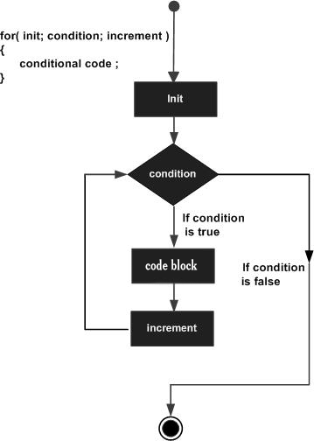
Sample Program
For loop

Slide 25
How for loop Works
for(expression1/initialization ; expression2/condition ; expression3)
{
statement1;
statement2;
statement3;
…………………..
}
1
2
5
3
If true
4

Slide 26
Components of for loop
Format:
for(initialization statement ; condition statement ; iteration statement)
{
statement1;
statement2;
…………………..
}
The initialization statement step is executed first, and only once.
The condition is evaluated. If it is true, the body of the loop is executed. If it is false, the body of the loop does not execute and the flow of control jumps to the next statement just after the 'for' loop.
After the body of the 'for' loop executes, the flow of control jumps back up to the iteration statement (Increment/Decrement)
The condition is now evaluated again. If it is true, the loop executes and the process repeats itself (body of loop, then increment step, and then again condition). After the condition becomes false, the 'for' loop terminates

Slide 27
for loop
#include <stdio.h>
int main () {
int a;
/* for loop execution */
for( a = 10; a < 20; a ++ )
{
printf("value of a: %d\n", a);
}
return 0;
}

Slide 28
for loop
Format:
for(initialization statement ; condition statement ; iteration statement)
The initialization, condition and the iterator statement are optional in a for loop. It means we can run a for loop without these statements as well.
for ( ; <=5; )
{
…..
i++;
}
In such cases, for loop acts as a while loop
If condition is blank, for loop won't test any condition and will run forever

Slide 29
Infinite for loop
If the condition in a for loop is always true, for loop will run forever. This is called infinite for loop.
When the condition part is left blank, the C compiler will treat it as true and the loop will run infinite times
Condition is i>0, Never false
Infinite loop with no conditions
for (int i=1 ; i>0; i++)
{
printf(“%d”, i);
}
for ( ; ; )
{
// body of for loop
}
for (initialization ; ; iterator)
{
// body of for loop
}

Slide 30
Infinite for loop
We can use break statement to exit from an infinite loop
for ( ; ; )
{
// body of for loop
break;
}
for (initialization ; ; iterator)
{
// body of for loop
break;
}

Slide 31
Sample Program
For loop
While loop
For loop
i
Output
#include<stdio.h>
void main()
{
int i;
i = 0;
while(i < 10)
{
printf(“%d\n”, i);
i++;
}
}
#include<stdio.h>
void main()
{
int i;
for (i = 0; i < 10; i++)
{
printf(“%d\n”, i);
}
}
0
0
1
1
2
2
3
3
4
4
5
5
6
6
7
7
8
8
9
9
10
10

Slide 32
Sample Program
For loop
C program to print all even numbers between 1 to n.
While loop
For loop
i
Output
#include<stdio.h>
void main()
{
int i;
i = 0;
while(i < 10)
{
if(i %2 == 0)
printf(“%d\n\n”, i);
i++;
}
}
#include<stdio.h>
void main()
{
int i;
for(i = 0; i < 10; i++)
{
if(i %2 == 0)
printf(“%d\n\n”, i);
}
}
0
0
1
2
2
3
4
4
5
6
6
7
8
8
9
10

Slide 33
Sample Program
For loop
C program to print all odd numbers between 1 to n.
While loop
For loop
i
Output
0
#include<stdio.h>
void main()
{
int i;
i = 0;
while(i < 10)
{
if(i %2==1)
printf(“%d\n\n”, i);
i++;
}
}
#include<stdio.h>
void main()
{
int i;
for (i = 0; i < 10; i++)
{
if(i %2==1)
printf(“%d\n\n”, i);
}
}
1
1
2
3
3
4
5
5
6
7
7
8
9
9
10

Slide 34
Sample Program
For loop
C program to print all even numbers between 1 to n.
While loop
For loop
#include<stdio.h>
void main()
{
int i = 0, n;
scanf(“ %d”, &n);
while(i < n)
{
if(i %2 == 0)
printf(“%d\n”, i);
i++;
}
}
#include<stdio.h>
void main()
{
int i, n;
scanf(“ %d”, &n);
for(i = 0; i < n, i++)
{
if(i %2 == 0)
printf(“%d\n”, i);
}
}
Input
12
Output
0
2
4
6
8
10

Slide 35
Sample Program
For loop
While loop
For loop
#include<stdio.h>
void main()
{
int i=0, k=0;
while(i < 5)
{
k = k + 2;
i++;
}
printf(“%d”, k);
}
#include<stdio.h>
void main()
{
int i, k=0;
for(i=0; i < 5; i++)
{
k = k + 2;
}
printf(“%d”, k);
}
i
k
0
2
1
4
2
6
3
8
4
10
5
10

Slide 36
Sample Program
For loop
While loop
For loop
#include<stdio.h>
void main()
{
int i=0, sum=0;
while(i < 5)
{
sum = sum + i;
i++;
}
printf(“%d”, sum);
}
#include<stdio.h>
void main()
{
int i, sum=0;
for(i=0;i < 5;i++)
{
sum = sum + i;
}
printf(“%d”, sum);
}
i
sum
0
0
1
1
2
3
3
6
4
10
5
10

Slide 37
Sample Program
For loop
Exercise:
Find out the sum of the following series up to n
  1 + 2 + 3 + ………….+ n
#include<stdio.h>
void main()
{
int i=0, sum=0, n;
scanf(“ %d”, &n);
for (;i <= n;)
{
sum = sum + i;
i++;
}
printf(“%d”, sum);
}

Slide 38
Sample Program
For loop
#include<stdio.h>
void main()
{
int i=0, sum=0, n;
scanf(“ %d”, &n);
for(;i <= n;)
{
sum = sum + i;
i++;
}
printf(“%d”, sum);
}
Input
21
Output
231

Slide 39
Sample Program
For loop
Exercise:
Find out the sum of the following series up to n
  0 + 2 + 4 + ………….+ n
#include<stdio.h>
void main()
{
int i=0, sum=0, n;
scanf(“ %d”, &n);
for(;i <= n;)
{
sum = sum + i;
i+=2;
}
printf(“%d”, sum);
}
Input
10
Output
30

Slide 40
Multiple initialization inside for Loop in C
#include<stdio.h>
int main()
{
int i,j;
for (i=1,j=1 ; i<3 || j<5; i++,j++)
{
printf("%d, %d\n",i ,j);
}
return 0;
}

Slide 41
Example: Program to Check Prime Number
Definition of Prime Number
A number which does have any other divisors except 1 and itself.
dividend
1
5
5
quotient
divisor
5
0
Reminder

Slide 42
Example: Program to Check Prime Number
dividend
divisor
2
5
2
quotient
4
1
Reminder

Slide 43
Example: Program to Check Prime Number
dividend
3
5
1
quotient
divisor
3
2
Reminder

Slide 44
Example: Program to Check Prime Number
dividend
4
5
1
quotient
divisor
4
1
Reminder

Slide 45
Example: Program to Check Prime Number
We will take a loop and divide number from 2 to number/2. If the number is not divisible by any of the numbers then we will print it as prime number
dividend
5
5
1
quotient
divisor
5
0
Reminder

Slide 46
Example: Program to Check Prime Number
dividend
5
5
1
quotient
divisor
5
0
Reminder
for (I =2; i<=num/2; i++)
{
if (num % I == 0)
printf(“This num is a prime number”);
}

Slide 47
Sample Program
Exercise: Determine whether a number is prime or not.
#include <stdio.h>
int main()
{
int i, num, isPrime;
isPrime = 1;
printf("Enter any number to check prime: ");
scanf("%d", &num);
for(i=2; i<=num/2; i++)
{
if(num%i==0)
{
isPrime = 0;
break;
}
}
if(isPrime == 1) { printf("%d is prime number", num); }
else { printf("%d is composite number", num); }
return 0;
}

Slide 48
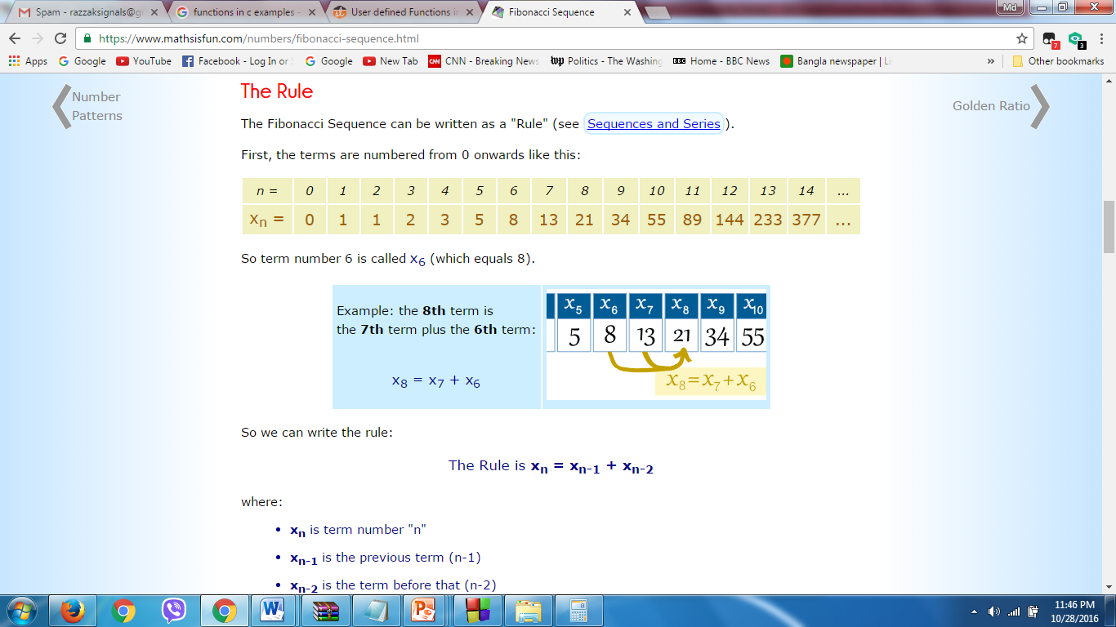
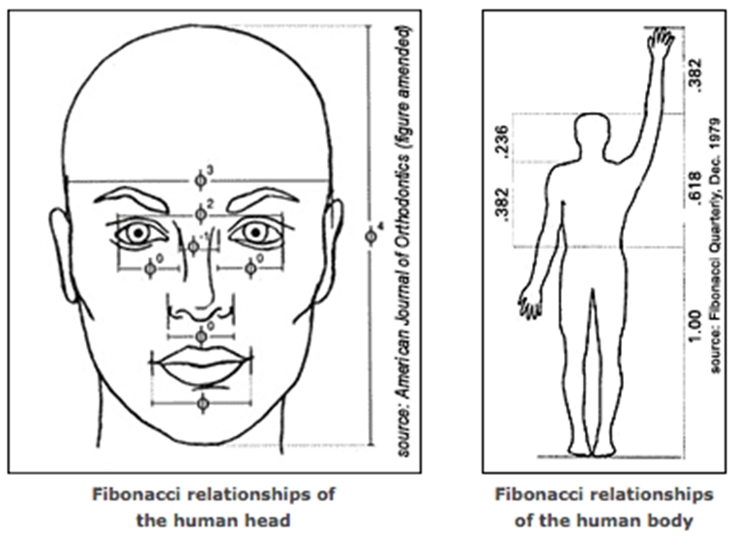
Fibonacci series: 0, 1, 1, 2, 3, 5, 8, 13, 21, 34, 55, 89, ...
for (i = 1; i <= n; ++i)
{
nextTerm = t1 + t2;
t1 = t2;
t2 = nextTerm;
}

Slide 49
Sample Program
Exercise: Take a number n as input and print Fibonacci series up to n terms.
1 1 2 3 5 8 13 21
#include <stdio.h>
int main()
{
int a, b, c, i, terms;
printf("Enter number of terms: ");
scanf("%d", &terms);
a = 0; b = 1; c = 0;
printf("Fibonacci terms: \n");
for(i=1; i<=terms; i++)
{
printf("%d, ", c);
c = a + b; // New term
a = b; // Copy n-1 to n-2
b = c; // Copy current to n-1
}
return 0;
}

Slide 50
do while loop
Format:
do
{
statement;
statement1;
statement2;
…………………..
}
While(condition);

Slide 51
do while loop
Unlike for and while loops, which test the loop condition at the top of the loop, the do...while loop in C programming checks its condition at the bottom of the loop
It is similar to a while loop, however there is a major difference between them.
In while loop, the condition is checked before the body is executed. It is the exact opposite in do...while loop, i.e. condition is checked after the body is executed.
This is why, the body of do...while loop will execute at least once irrespective to the test-expression.
For many applications it is more natural to test for continuation of a loop at the beginning rather than at the end of the loop. For this reason, the do - while statement is used less frequently than the while statement

Slide 52
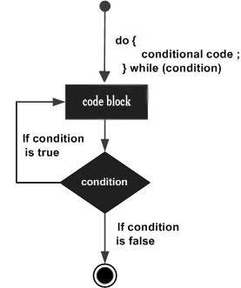
do while loop- Flow Chart
Conditional expression appears at the end of the loop, so the statement(s) in the loop executes once before the condition is tested
A do...while loop is similar to a while loop, except the fact that it is guaranteed to execute at least one time

Slide 53
Sample Program do while
C program to print natural numbers using do while loop
#include <stdio.h>
int main()
int n=1;
do
{
printf("%d ", n);
n++;
} while(n <= 10); /* Loop condition */
return 0:
}

Slide 54
Sample Program
Exercise:
Find out the sum of the following series up to n
  1 + 3 + 5 + ………….+ n
  2 + 4 + 6 + …………..+ n

Slide 55
Infinite while and do...while loop
If the test expression in the while and do...while loop never evaluates to false, the body of loop will run forever. Such loops are called infinite loop.
Infinite while loop
Infinite do...while loop
while (true)
{
// body of while loop
}
do
{
// body of while loop
} while (true);
The infinite loop is useful when we need a loop to run as long as our program runs.
For example, if your program is an animation, you will need to constantly run it until it is stopped. In such cases, an infinite loop is necessary to keep running the animation repeatedly.

Slide 56
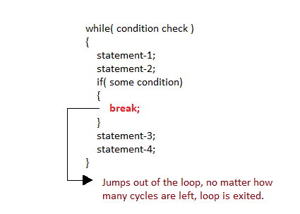
break statement
It is used to come out of the loop instantly
When a break statement is encountered inside a loop, the control directly comes out of loop and the loop gets terminated. This provides a convenient way to terminate the loop if an error or other irregular condition is detected
It is used with if statement, whenever used inside loop.
#include<stdio.h>
void main()
{
int i, n;
scanf(“ %d”, &n);
while(1)
{
printf(“%d”, i);
i++; break;
}
}

Slide 57
break statement(cont)
#include<stdio.h>
void main()
{
int i=0, n;
scanf(“ %d”, &n);
while(1)
{
if(i > n)
break;
printf(“%d”, i);
i++;
}
}

Slide 58
break statement(cont)
#include<stdio.h>
void main()
{
int i=0, n;
scanf(“ %d”, &n);
for( ; ; )
{
if(i > n)
break;
printf(“%d”, i);
i++;
}
}

Slide 59
break statement(cont)
#include<stdio.h>
#include<math.h>
void main()
{
float i, n, res;
for( ; ; )
{
scanf("%f", &n);
if(n <= 0)
break;
res = sqrt(n);
printf("%f", res);}
}

Slide 60
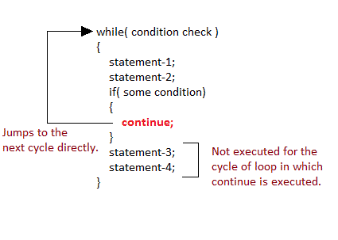
continue statement
It causes the control to go directly to the test-condition and then continue the loop process. On encountering continue, cursor leave the current cycle of loop, and starts with the next cycle.

Slide 61
continue statement
For example, consider the situation of sending some message or documents to 100 employees. In the process of sending email for each employee, you will perform two operation. First, get email address of employee. Afterwards attempt to send email at his address. Suppose an employee does not have email. In such case, instead of terminating entire email process it is better to skip sending mail to that employee and continue to next employee. For such situations in programming we use continue keyword.

Slide 62
continue statement
#include<stdio.h>
void main()
{
int i, n;
scanf("%d", &n);
for(i=0 ; i < n ; i++)
{
if(i == 5)
{
continue;
}
printf("%d", i);
}
}

Slide 63
continue statement
#include<stdio.h>
#include<conio.h>
void main(){
int i, n=20;
for(i=1;i<=n;++i)
{
if(i % 5 == 0)
{
printf("pass\n");
continue; /*this continue the execution of loop if i % 5 == 0 */
}
printf("%d\n",i);
}
}

Slide 64
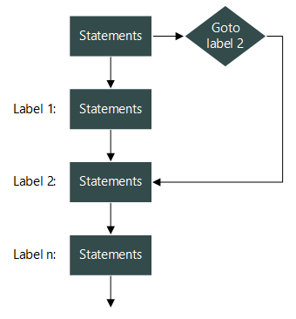
Goto and labels – Flow Chart

Slide 65
Goto and labels
There are a few situation when instead of terminating from loop you need to skip some part of the loop and continue to next iteration. There goto may be used.
The most common is to abandon processing in some deeply nested structure, such as breaking out of two or more loops at once.
The break statement cannot be used directly since it only exits from the innermost loop
A label has the same form as a variable name, and is followed by a colon. It can be attached to any statement in the same function as the goto.
for ( ... )
{
for ( ... )
{
...
if (disaster)
{
goto error;
}
}
}
...
error: error handling code

Slide 66
Goto and labels
#include <stdio.h>
int main()
{
int i, j, k;
for(i=1; i<=3; i++)
{
printf("\nValue of i =%d ", i);
for(j=1; j<=4; j++)
{
if(j==3 )
{
// break;//
goto out_of_loop; /* Move the program control outside the loop */
}
printf("Value of j= %d ", j);
}
}
out_of_loop: printf("\nout of loop");
return 0;
}

Slide 67
Reasons to avoid goto statement
Though, using goto statement give power to jump to any part of program, using goto statement makes the logic of the program complex and tangled.
In modern programming, goto statement is considered a harmful construct and a bad programming practice.
The goto statement can be replaced in most of C program with the use of break and continue statements.
In fact, any program in C programming can be perfectly written without the use of goto statement.

