Slide 1
Nested Loop
Nested loop in C
Lt Col Razzak
CSE Dept
MIST

Slide 2
Nested Loop
Nested loop in C
A loop inside another loop is called a nested loop.
The depth of nested loop depends on the complexity of a problem.
We can have any number of nested loops as required.
In the event of several nested while, do - while, for or switch statements, a break statement will cause a transfer of control out of the immediate enclosing statement, but not out of the outer surrounding statements
Consider a nested loop where
  the outer loop runs n times and inner loop runs m times. Then, the total number of times the inner loop runs during the program execution is n*m.

Slide 3
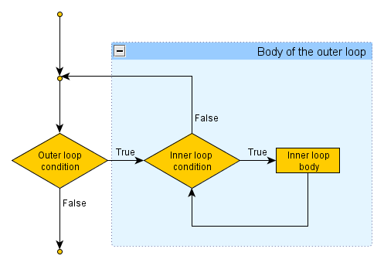
Nested Loop
nested loops

Slide 4
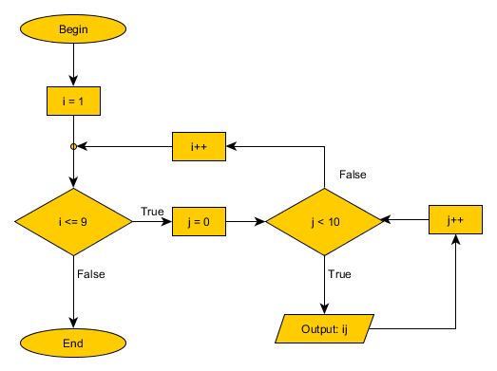
Nested Loop
nested loops
Let's create a program, which outputs the numbers from 10 to 99, using two number variables.

Slide 5
Nested Loop
Types of nested loops
Nested while loop
Nested do-while loop
Nested for loop
There can be mixed type of nested loop i.e. a for loop inside a while loop, or a while loop inside a do-while loop.

Slide 6
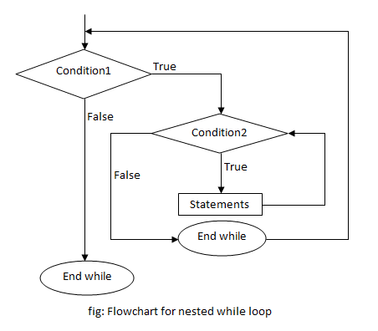
Nested Loop
Nested while loop
A while loop inside another while loop is called nested while loop.
while (condition1)
{
statement(s);
while (condition2)
{
statement(s);
... ... ...
}
... ... ...
}

Slide 7
Nested Loop
Nested while loop
#include <stdio.h>
int main()
{
int i=1,j;
while (i <= 5)
{
j=1;
while (j <= i )
{
printf("%d ",j);
j++;
}
printf("\n");
i++;
}
return 0;
}
1
1 2
1 2 3
1 2 3 4
1 2 3 4 5

Slide 8
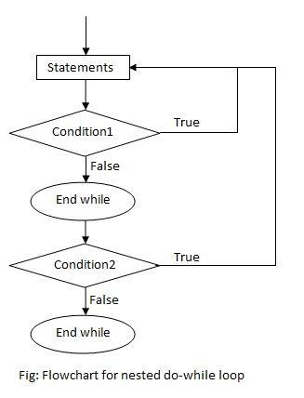
Nested do-while loop
A do-while loop inside another do-while loop is called nested do-while loop.
do
{
statement(s);
do
{
statement(s);
... ... ...
}while (condition2);
... ... ...
}while (condition1);

Slide 9
Nested do-while loop
#include <stdio.h>
int main()
{
int i=1,j;
do
{
j=1;
do
{
printf("*");
j++;
}while(j <= i);
i++;
printf("\n");
}while(i <= 5);
return 0;
}
*
**
***
****
*****

Slide 10
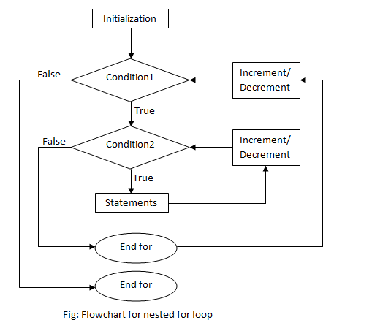
Nested for loop
A for loop inside another for loop is called nested for loop.
for (initialization; condition; increment/decrement)
{
statement(s);
for (initialization; condition; increment/decrement)
{
statement(s);
... ... ...
}
... ... ...
}

Slide 11
Nested for loop
#include<conio.h>
int main()
{
int i,j;
for(i=1;i<=3;i++)
{
printf("i=%d ", i);
for(j=1;j<=3;j++)
printf("j=%d ", j);
printf("\n");
}
return 0;
}
Output :
i=1 j=1 j=2 j=3
i=2 j=1 j=2 j=3
i=3 j=1 j=2 j=3

Slide 12
Example 1: Program to print half pyramid using *
#include <stdio.h>
int main()
{
int i, j, rows;
printf("Enter the number of rows: ");
scanf("%d",&rows);
for(i=1; i<=rows; ++i)
{
for(j=1; j<=i; ++j)
{
printf("* ");
}
printf("\n");
}
return 0;
}
No of *
*
**
***
****
*****
1
2
3
4
5
No of line=5

Slide 13
Example 2: Program to print half pyramid using Number
#include <stdio.h>
int main()
{
int i, j, rows;
printf("Enter the number of rows: ");
scanf("%d",&rows);
for(i=1; i<=rows; i++)
{
for(j=1; j<=i; j++)
{
printf("%d ", j);
}
printf("\n");
}
return 0;
}
1
1 2
1 2 3
1 2 3 4
1 2 3 4 5

Slide 14
Example 3: Program to print half pyramid using Number
#include <stdio.h>
int main()
{
int i, j, rows, K=1;
printf("Enter the number of rows: ");
scanf("%d",&rows);
for(i=1; i<=rows; ++i)
{
for(j=1; j<=i; ++j)
{
printf("%d ", K++);
}
printf("\n");
}
return 0;
}
1
2 3
4 5 6
7 8 9 10
11 12 13 14 15

Slide 15
Example 4: Program to print half pyramid using Character
#include <stdio.h>
int main()
{
int i, j, rows;
char ch='A';
printf("Enter the number of rows: ");
scanf("%d",&rows);
for(i=1; i<=rows; ++i)
{
for(j=1; j<=i; ++j)
{
printf("%c ", ch++);
}
printf("\n");
}
return 0;
}
A
B C
D E F
G H I J
K L M N O

Slide 16
Example 4: Program to print half pyramid using Character
#include <stdio.h>
int main()
{
int i, j;
char input, alphabet = 'A';
printf("Enter the uppercase character you want to print in last row: ");
scanf("%c",&input);
for(i=1; i <= (input-'A'+1); ++i)
{
for(j=1;j<=i;++j)
{
printf("%c", alphabet);
}
alphabet++;
printf("\n");
}
return 0;
}
A
B B
C C C
D D D D
E E E E E

Slide 17
Example 5: Program to print half reverse pyramid using *
#include <stdio.h>
int main()
{
int i, j, rows;
printf("Enter the number of rows: ");
scanf("%d",&rows);
for(i=rows; i>=1; i--)
{
for(j=1; j<=i; ++j)
{
printf("* ");
}
printf("\n");
}
return 0;
}
No of *
*****
****
***
**
*
5
4
3
2
1
No of line=5

Slide 18
Example 7: Program to print pyramid using *
#include<stdio.h>
int main()
{
int i,j;
int space=4, rows=5;
/*run loop (parent loop) till number of rows*/
for(i=0;i< rows;i++)
{ //for initially space before printing
for(j=0;j< space; j++)
{
printf(" ");
}
for(j=0;j<=i;j++)
{
printf("* ");
}
printf("\n");
space--; // decrement one space after one row
}
return 0;
}
No of *
*
* *
* * *
* * * *
* * * * *
1
2
3
4
5
No of line=5

Slide 19
Example 8: Program to print reverse pyramid using *
#include<stdio.h>
int main()
{
int i,j;
int space=0, rows=5;
/*run loop (parent loop) till number of rows*/
for(i=rows;i>0;i--)
{
/*loop for initially space, before star printing*/
for(j=0;j< space;j++)
{
printf(" ");
}
for(j=0;j< i;j++)
{
printf("* ");
}
printf("\n");
space++;
}
return 0;}
No of *
* * * * *
* * * *
* * *
* *
*
5
4
3
2
1
No of line=5

Slide 20
Example 9: Program to print mirror pyramid using *
#include<stdio.h>
int main()
{
int i,j;
int space=4, rows=5;
/*run loop (parent loop) till number of rows*/
for(i=0;i< rows;i++)
{ //for initially space before printing
for(j=0;j< space; j++)
{
printf(" ");
}
for(j=0;j<=i;j++)
{
printf("* ");
}
printf("\n");
space--; // decrement one space after one row
}
*
* *
* * *
* * * *
* * * * *
* * * * *
* * * *
* * *
* *
*

Slide 21
space=0;
/*run loop (parent loop) till number of rows*/
for(i=rows;i>0;i--)
{
/*loop for initially space, before star printing*/
for(j=0;j< space;j++)
{
printf(" ");
}
for(j=0;j< i;j++)
{
printf("* ");
}
printf("\n");
space++;
}
return 0;}
*
* *
* * *
* * * *
* * * * *
* * * * *
* * * *
* * *
* *
*

Slide 22
Example 10: Program to print double reverse pyramid using *
#include<stdio.h>
int main()
{
int i,j, rows=5, space=0;
for(i=rows;i>0;i--) /*run loop (parent loop) till number of rows*/
{
for(j=0;j< i;j++) /*print first set of stars*/
{
printf("*");
}
for(j=0;j< space;j++)
{
printf(" ");
}
for(j=0;j< i;j++) /*print second set of stars*/
{
printf("*");
}
printf("\n");
space+=2;
}
return 0;
}
No of space
**********
**** ****
*** ***
** **
* *
0
2
4
6
8

Slide 23
Example 11: Program to print double reverse pyramid using *
include<stdio.h>
int main()
{
int i,j, rows=5, space=0;
for(i=rows;i>0;i--) /*run loop (parent loop) till number of rows*/
{
for(j=0;j< i;j++) /*print first set of stars*/
{
printf("*");
}
for(j=0;j< space;j++)
{
printf(" ");
}
for(j=0;j< i;j++) /*print second set of stars*/
{
printf("*");
}
printf("\n");
space+=2;
}
* * * * * * * * * *
* * * * * * * *
* * * * * *
* * * *
* *
* *
* * * *
* * * * * *
* * * * * * * *
* * * * * * * * * *

Slide 24
//reverse
space=8;
for(i=1; i<=rows; ++i)/*run loop (parent loop) till number of rows*/
{
for(j=1; j<=i; ++j)/*print first set of stars*/
{
printf("*");
}
for(j=0;j< space;j++)
{
printf(" ");
}
for(j=1; j<=i; ++j)/*print second set of stars*/
{
printf("*");
}
printf("\n");
space-=2;
}
return 0;
}

Slide 25
Pattern Exercise
*****
* *
* *
* *
*****
*****
*****
*****
*****
*****
*
**
***
****
*****
****
***
**
*
1 2 3 4 5
1 2 3 4
1 2 3
1 2
1
13579
3579
579
79
9
A
B B
C C C
D D D D
E E E E E

Slide 26
Example 12: C program to Calculate (1*1) + (2*2) + (3*3) + (4*4) + (5*5) + ... + (n*n) series
#include<stdio.h>
void main()
{
int i,n,sum=0;
n=10;
for(i=1;i<=n;i++)
{
sum+=i*i;
}
printf("Sum: %d",sum);
}

Slide 27
Example 13: 1+3+5+7+... using C program using while
Using While Loop
#include<stdio.h>
void main()
{
int n,i=1,sum=0;
clrscr();
printf("enter the value for n:");
scanf("%d",&n);
while(i<=n)
{
sum=sum+i;
i=i+2;
}
printf("the series is =%d");
}
Using For Loop
#include<stdio.h>
void main()
{
int i,n,sum=0;
printf("N=");
scanf("%d",&n);
for(i=1;i<=n;i=i+2)
sum=sum+i;
printf("\n1+3+5+7+....+%d=%d",n,sum);
}

Slide 28
Series Exercise
Exercise 1 : C program to Calculate (1¹) + (2²) + (3³) + (4⁴) + (5⁵) + ... + (n^{n}) series using pow function
Exercise 2 : C program to Calculate (1) + (1+2) + (1+2+3) + (1+2+3+4) + ... + (1+2+3+4+...+n) series
Exercise 3 : C program to find sum of following series:1+ 1/2 + 1/3 + 1/4 + 1/5 + .. 1/N

