Slide 1
Nested Loop
Arrays in C
Lt Col Razzak
CSE Dept
MIST

Slide 2

ARRAYS
An array is a collection of elements of the same type that are referenced by a common name. An individual variable in the array is called an array element.
All the elements of an array occupy a set of contiguous memory locations.
Arrays allow programmers to group related items of the same data type in one variable.
However, when referring to an array, one has to specify not only the array or variable name but also the index number of interest.
Example:
int var[10];
float venus[20];
double earth[5];
char pluto[7];
Books

Slide 3
ARRAYS
Array is a collection - Array is a container that can hold a collection of data.
Array is finite - The collection of data in array is always finite, which is determined prior to its use.
Array is sequential - Array stores collection of data sequentially in memory.
Array contains homogeneous data - The collection of data in array must share a same data type.
We can divide arrays in two categories.
One-dimensional array (Or single-dimensional array)
Multi-dimensional array

Slide 4
Why Need To Use Array Type?
Consider the following issue:
"We have a list of 1000 students' marks of an integer type. If using the basic data type (int), we will declare something like the following…"
int studMark0, studMark1, studMark2, ..., studMark999;
Can you imagine how long we have to write the declaration part by using normal variable declaration?
  int main(void)
  {
    int studMark1, studMark2, studMark3, studMark4, …, …, studMark998, stuMark999, studMark1000;
    …
    …
    return 0;
  }

Slide 5
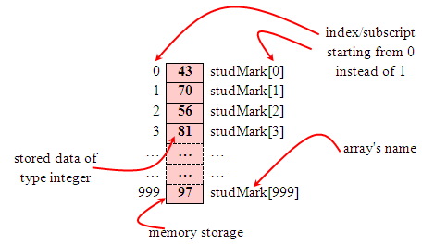
Why Need To Use Array Type?
By using an array, we just declare like this,
    int studMark[1000];
This will reserve 1000 contiguous memory locations for storing the students’ marks.
Graphically, this can be depicted as in the following figure.

Slide 6
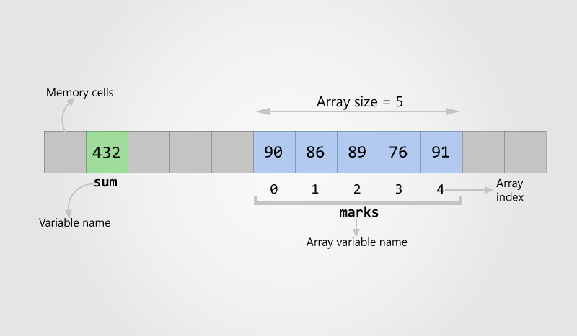
Why Need To Use Array Type?

Slide 7
Array Applications
Given a list of test scores, determine the maximum and minimum scores.
Read in a list of student names and rearrange them in alphabetical order (sorting).
Given the height measurements of students in a class, output the names of those students who are taller than average.

Slide 8
Array Declaration
Syntax:
data_type arrayName [array_size]
  int studMark [1000];
<type> define the base type of the array, which is the type of each element in the array I,e common to all array elements
<array_size> The size of the array is indicated by the number of elements in the array. How big the array is.

Slide 9
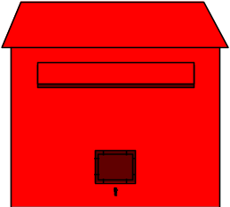
Array Declaration
  array of 10 uninitialized ints
  int Ar[10];
0
1
2
3
4
5
6
7
8
9
Ar
--
--
--
--
--
--
--
--
--
--
0
1
2
3
4
5

Slide 10
Array Declaration
Declare an array of 10 integers array named Ar:
  int Ar[10]; // array of 10 ints
The expression in the brackets is known as the index/Subscript.
  First element of array has index 0.
    Ar[0]
  Second element of array has index 1, and so on.
    Ar[1], Ar[2], Ar[3],…
  Last element has an index one less than the size of the array. Ar[9]
0
1
2
3
4
5
6
7
8
9
Ar
--
--
--
--
--
--
--
--
--
--
Array indexes always start at zero in C

Slide 11
Subscripting
  // array of 10 uninitialized ints
  int Ar[10];
  Ar[3] = 1;
0
1
2
3
4
5
6
7
8
9
Ar
--
--
--
--
--
--
--
--
--
--
Ar[0]
Ar[1]
Ar[2]
Ar[3]
Ar[4]
Ar[5]
Ar[6]
Ar[7]
Ar[8]
Ar[9]
0
1
2
3
4
5
6
7
8
9
Ar
--
--
--
1
--
--
--
--
--
--
Ar[0]
Ar[1]
Ar[2]
Ar[3]
Ar[4]
Ar[5]
Ar[6]
Ar[7]
Ar[8]
Ar[9]

Slide 12
Array Initialization
Static array initialization - Initializes all elements of array during its declaration.
Dynamic array initialization - The declared array is initialized some time later during execution of program
Static array initialization
  int Ar[10] = {9, 8, 7, 6, 5, 4, 3, 2, 1, 0};
0
1
2
3
4
5
6
7
8
9
Ar
9
8
7
6
5
4
3
2
1
0
Ar[3] = -1;
0
1
2
3
4
5
6
7
8
9
Ar
9
8
7
-1
6
5
4
3
2
1
0

Slide 13
Array Initialization
int A[5] = {2, 4, 8, 16, 32};
    Static or automatic
int B[20] = {2, 4, 8, 16, 32};
    Unspecified elements are guaranteed to be zero
int C[4] = {2, 4, 8, 16, 32};
    Error — compiler detects too many initial values, extra values are discarded

Slide 14
Array Initialization
Dynamic array initialization
#include<stdio.h>
int main()
{
int ar[10];
int i;
for (i=0; i<10; i++) // for Initializing Array
{
ar[i]=i;
}
  for (i=0; i<10; i++) // for displaying Array
  {
  printf("%d ", ar[i]);
}
}

Slide 15
Array(Cont.)
Array Initialization
int var[7];
var[0] - 1st element, index 0
var[1] - 2nd element, index 1
var[2] - 3rd element, index 2
var[3] - 4th element, index 3
var[4] - 5th element, index 4
var[5] - 6th element, index 5
var[6] - 7th element, index 6
0
1
2
3
4
5
6

Slide 16
Array(Cont.)
Array Initialization
int var[7];
var[0] = 14;
var[6] = 23;
var[5] = 7;
var[3] = 18;
var[4] = 19;
var[1] = 22;
var[2] = 31;
0
1
2
3
4
5
6
14
22
31
18
19
7
23

Slide 17
Array initialize
Array Initialization
int var[7] = {14, 22, 31, 18, 19, 7, 23};
int var[ ] = {14, 22, 31, 18, 19, 7, 23};
int var[7] = {14, 22, 31};
0
1
2
3
4
5
6
14
22
31
18
19
7
23
0
1
2
3
4
5
6
14
22
31
0
0
0
0
Size of array is optional when declaring and initializing array at once. The C compiler automatically determines array size using number of array elements

Slide 18
Array initialize(Cont.)
Array Initialization
int var[7] = {9, 14, 0};
int var[7] = {9};
int var[7] = {0};
0
1
2
3
4
5
6
9
14
0
0
0
0
0
0
1
2
3
4
5
6
9
0
0
0
0
0
0
0
1
2
3
4
5
6
0
0
0
0
0
0
0

Slide 19
Array-Bounds Checking
C, unlike many languages, does NOT check array bounds subscripts during:
  Compilation (some C compilers will check literals)
  Runtime (bounds are never checked)
If you access off the ends of any array, it will calculate the address it expects the data to be at, and then attempts to use it anyways
  may get “something…”
  may get a memory exception (segmentation fault, bus error, core dump error)
It is the programmer’s responsibility to ensure that their programs are correctly written and debugged!
  This does have some advantages but it does give you all the rope you need to hang yourself!

Slide 20
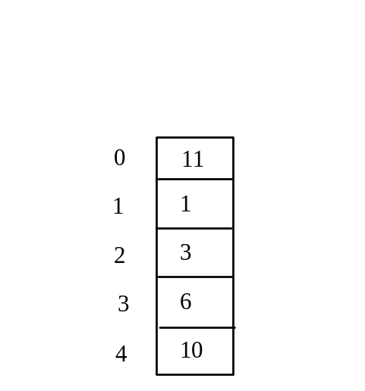
Program with Arrays
int main()
{
int values[5]= {11,1,3,6,10};
int i;
for ( i = 1; i < 5; i++)
{
printf(“%d”, values[i])
}

Slide 21
Program with Arrays
finding sum of array's element 6,4,2,3,5,10,12
#include <stdio.h>
int main(void)
{
int num [10] = {6,4,2,3,5,10,12};
int index, sum = 0;
for (index=0; index<10; index++)
{
printf("%d ", num[index]); // display the array contents
sum = sum + num[index]; // do the summing up
}
// display the sum
printf("\nSum of %d numbers is = %d\n", index, sum);
return 0;
}

Slide 22
ARRAYS
Program example 2: Searching the smallest value.
Finding the smallest element in the array named num.
num[]={12.0,41.5,-31.2,-45.0,33.0,-21.2,-24.1,0.7,3.2,0.5};
12.0 | 41.5 | -31.2 | -45.0 | 33.0 | -21.2 | -24.1 | 0.7 | 3.2 | 0.5
0 | 1 | 2 | 3 | 4 | 5 | 6 | 7 | 8 | 9
First, it assumes that the smallest value is in num [0] and assigns it to the variable Small.
Then it compares Small with the rest of the values in numy, one at a time.
When an element is smaller than the current value contained in Small, it is assigned to Small. The process finally places the smallest array element in Small.

Slide 23
Program-2: finding the smallest number
#include <stdio.h>
int main(void)
{
int index;
float Small, num[]={12.0,41.5,-31.2,-45.0,33.0,-21.2,-24.1,0.7,3.2,0.5};
Small = num[0];
for(index=0; index<10; index++) // loop for displaying array content
printf("%.2f ",num[index]);
// another loop do the array element comparing
for(index=1; index<10; index++) // until condition Counter = Array Size
{
if(Small > num[index])
Small = num[index];
}
// display the result
printf("\nThe smallest value in the given array is %.2f\n", Small);
return 0;
}

Slide 24
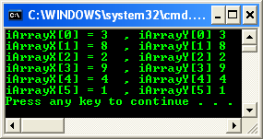
ARRAYS
Program example 3: reading array content and to another array
iArrayX[6], iArrayY[6] = {3, 8, 2, 9, 4, 1};
Value | 3 | 8 | 2 | 9 | 4 | 1
Index | 0 | 1 | 2 | 3 | 4 | 5
iArrayY[6]

Slide 25
ARRAYS
Program example 3: reading array content and to another array
#include <stdio.h>
void main(void)
{
int Index, ArrayX[6], ArrayY[6] = {3, 8, 2, 9, 4, 1};
// Copying the value of ArrayY to ArrayX
for(Index = 0; Index <= 5; index++)
ArrayX[Index] = ArrayY[Index];
//printing
for(Index = 0; Index <= 5; Index++)
printf("ArrayX[%d] = %d\t, ArrayY[%d] %d\n",
Index, ArrayX[Index], Index, ArrayY[Index]);
}

Slide 26
ARRAYS
Program example 4: Searching the location for the given value in an array
int Score[6]= {3, 8, 2, 9, 4, 12};
Value | 3 | 8 | 2 | 9 | 4 | 12
Index | 0 | 1 | 2 | 3 | 4 | 5
Score[6]

Slide 27
ARRAYS
Program example 4: Searching the location for the given value in an array
void main(void)
{
int Score[6]= {3, 8, 2, 9, 4, 12};
int Lookup; // value to look for Index
// read a score to be searched in the array
printf("What score do you want to look up? ");
scanf("%d", &Lookup);
// search the array for this score
for(Index = 0; Index <=5; Index = Index + 1)
if(Score[Index] == Lookup) // abandon the loop
break;
if(Index <= 5)
printf("The score of %.d was number %d in the list.\n", Lookup, Index+1 );
else
printf("The score of %d was not found in the list.\n", Lookup);
}

Slide 28
Practice Problem of Array
Program to print negative elements in array
for(i=0; i<N; i++)
{
if(arr[i] < 0) /* If current array element is negative */
{
printf("%d\t", arr[i]);
}
}

Slide 29
Practice Problem of Array
C program to count even and odd elements in an array
int even = 0;
int odd = 0;
for(i=0; i<size; i++)
{
if(arr[i]%2 == 0)
{
even++;
}
else
{
odd++;
}
}

Slide 30
Two Dimensional Array in C
Matrix

Slide 31
One Dimension Array
Int mark[6] = {1,3,5,7,5,6};
Int mark[6] = {2,4,6,8,7,6};
Int mark[6] = {1,2,3,4, 5,6};
0 | 1 | 2 | 3 | 4 | 5
coloum
0
1 | 3 | 5 | 7 | 5 | 6
row
1
2 | 4 | 6 | 8 | 7 | 6
2
1 | 2 | 3 | 4 | 5 | 6

Slide 32
Two Dimensional Array
A two dimensional array has two subscripts/indexes.
The first subscript refers to the row, and the second, to the column.
Its declaration has the following form,
  data_type array_name[1st dimension size][2nd dimension size];
For examples,
  int mark[3][6];
It declares mark as an integer array with 3 rows and 6 columns.

Slide 33
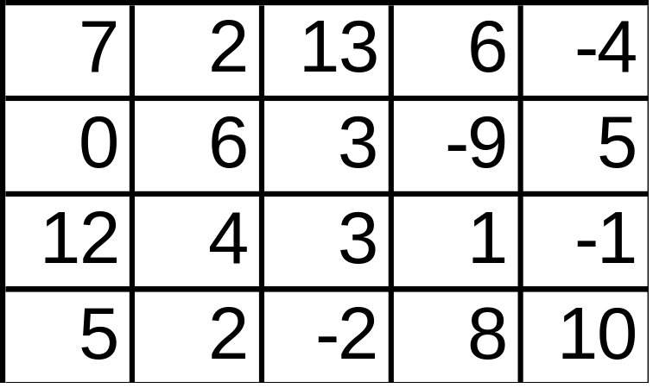
Two Dimensional Array
Syntax:
data_type array_name [row_dim][col_dim];
Example:
First element is
int_table[0][0]
Last element is
int_table[4][3]
int int_table [5][4];
0 1 2 3 4
0
1
2
3

Slide 34
Example: Two Dimensional Array to store and display values
#include <stdio.h>
void main(void)
{
int row, coloum, array[4][3] = {{1,2,3},{4,5,6},{7,8,9},{10,11,12}};
// for every row
for(row = 0; row <4; row++)
{
// for every column
for(coloum = 0; coloum < 3; coloum++)
printf("array[%d][%d] = %d ", row, coloum, array[row][coloum]);
printf("\n");
}
}

Slide 35
Example: C program to add/sub/multiplication two matrices
#include <stdio.h>
#define SIZE 3 // Size of the matrix
int main()
{
int A[3][4]; // Matrix 1
int B[3][4]; // Matrix 2
int C[3][4]; // Resultant matrix
//Take input
// Calculate
for(row=0; row<3; row++)
{
for(col=0; col<4; col++)
{
C[r][c] = A[r][c] + B[r][c];
}
}

Slide 36
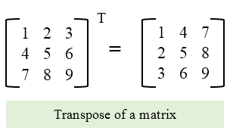
Practice Problem of Array
Program to Find Transpose of a Matrix
for(row=0; row<MAX_ROWS; row++)
{
for(col=0; col<MAX_COLS; col++)
{
/* Store each row of matrix A to each column of matrix B */
B[col][row] = A[row][col];
}
}

