Slide 1
Pointer
MD. JAKARIA
LECTURER
DEPT. OF CSE, MIST

Slide 2
Pointers
A pointer is a variable that holds the memory address of another object.
If p contains the address of variable q, then p is said to point q
Syntax
type *var_name;
Example
int *p;

Slide 3
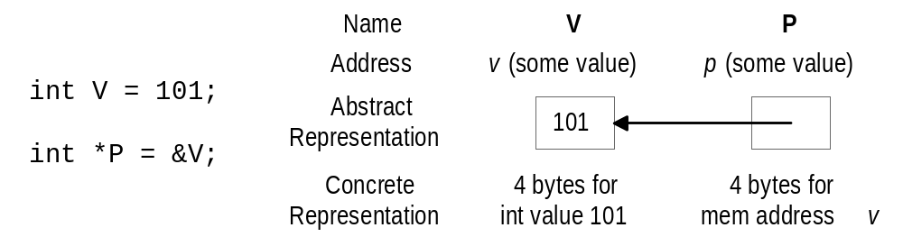
Pointer Basics
Variables are allocated at addresses in computer memory
A pointer variable contains a representation of an address of another variable.

Slide 4
Pointer Variable Definition
Basic syntax: Type *Name
Examples:
  int *p; /* p is var that can point to an int var */
  float *q; /* q is a float pointer */
  char *r; /* r is a char pointer */
Complex example:
  int *a[5]; /* a is an array of 5 pointers to ints */
  more on how to read complex declarations later

Slide 5
Address (&) Operator
The address (&) operator can be used in front of any variable object in C -- the result of the operation is the location in memory of the variable
Syntax: &VariableReference
Examples:
  int q;
  int *P;
  int a[5];
  &q memory location of integer variable q
  &(a[2]) memory location of array element 2 in array q
  &p memory location of pointer variable p

Slide 6
Pointer Variable Initialization/Assignment
NULL - pointer lit constant to non-existent address
  used to indicate pointer points to nothing
Can initialize/assign pointer vars to NULL or use the address (&) op to get address of a variable
  variable in the address operator must be of the right type for the pointer (an integer pointer points only at integer variables)
Examples:
  int q;
  int *p = &q;
  int a[5];
  p = &(a[2]);

Slide 7
Indirection (*) Operator
A pointer variable contains a memory address
To refer to the contents of the variable that the pointer points to, we use indirection operator
Syntax: *PointerVariable
Example:
  int q = 101;
  int *p = &q;
  /* Then *p would refer to the contents of the variable q (in this case, the integer 101) */
  printf(“%d”,*p); /* Prints 101 */

Slide 8
Arithmetic Operations
Four arithmetic operators: + ++ - --
Example:
int *p,q;
p = &q;
p++;
p--;
p = p + 10;
p = p - 10;
p = p * 2; // Not okay

Slide 9
Arithmetic Operations
Four arithmetic operators: + ++ - --
Example:
int *p,q=10;
q = &q;
p++;
*p++;
(*p)++;

