Slide 1
AgentData Pay
Agentic Economy · Arc Testnet
Autonomous data, paid for by an agent.
Notes:
Open with the core claim: this agent does not only recommend data—it buys the smallest useful dataset autonomously.
[Sources]
- https://agentdata-pay.vercel.app/
- https://github.com/jakariamirza/agentdata-pay
- Project production verification and repository, accessed 2026-07-27.

Slide 2
Data access should be as autonomous as the agent
CHOOSE The agent maps a market question to the smallest useful paid dataset.
PAY HTTP 402 triggers a $0.001 test-USDC authorization on Arc Testnet.
UNLOCK Verified payment releases protected JSON for immediate analysis.
02
Notes:
Frame the problem as an agent-economy gap: most agents can reason, but still depend on a human to purchase protected information.
[Sources]
- https://agentdata-pay.vercel.app/
- https://github.com/jakariamirza/agentdata-pay
- Project production verification and repository, accessed 2026-07-27.

Slide 3
One question triggers a complete x402 payment loop
01 SELECT
02 SETTLE
03 ANALYSE
Agent chooses
The query is routed to market summary, new listings, reductions or opportunities.
Gateway verifies
The API returns HTTP 402; the buyer signs and Circle Gateway settles test USDC.
Insight returns
Protected JSON is unlocked, ranked and explained in the same request.
03
Notes:
Walk left to right. Emphasize that resource selection, payment negotiation, authorization and analysis happen without wallet pop-ups.
[Sources]
- https://agentdata-pay.vercel.app/
- https://github.com/jakariamirza/agentdata-pay
- Project production verification and repository, accessed 2026-07-27.

Slide 4
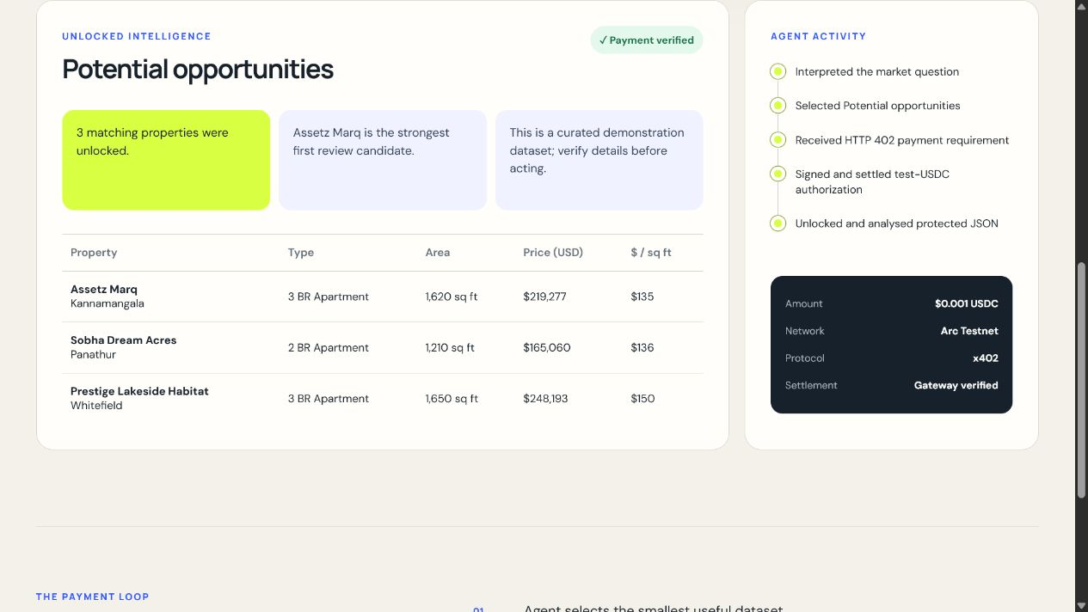
Live payment, verified
LIVE ON ARC TESTNET
A real query received HTTP 402, signed a test-USDC authorization and unlocked three protected property signals. Payment: $0.001 USDC Protocol: x402 Settlement: Gateway verified
04
Notes:
Point to the evidence in the screenshot: payment verified, Arc Testnet, x402, Gateway verified and the unlocked data table.
[Sources]
- https://agentdata-pay.vercel.app/
- https://github.com/jakariamirza/agentdata-pay
- Project production verification and repository, accessed 2026-07-27.

Slide 5
The MVP is live, paid and judge-ready
WORKING EVIDENCE
The public application runs the full autonomous purchase loop. The repository includes deterministic demo mode plus live Arc Testnet settlement.
$0.001
HTTP 402
4 / 4
test-USDC per paid request
payment requirement handled automatically
end-to-end tests passing
05
Notes:
Use these three proof points as the technical summary. The fee is deliberately tiny to demonstrate nanopayments rather than traditional checkout.
[Sources]
- https://agentdata-pay.vercel.app/
- https://github.com/jakariamirza/agentdata-pay
- Project production verification and repository, accessed 2026-07-27.

Slide 6
A small stack delivers the complete agent economy loop
BUILT FOR ARC
Each component has one job: decide, request, pay, verify or analyse.
The result is a compact MVP that is easy for judges to run and inspect.
Network
Arc Testnet
Money
test USDC + Circle Gateway
Protocol
x402 protected API
Application
TypeScript · Express · Vercel
06
Notes:
Keep this technical slide brief. The differentiator is the integration of Arc, USDC, Circle Gateway and x402 into one autonomous request.
[Sources]
- https://agentdata-pay.vercel.app/
- https://github.com/jakariamirza/agentdata-pay
- Project production verification and repository, accessed 2026-07-27.

Slide 7
FINAL LINKS
Try the live agent
agentdata-pay.vercel.app
github.com/jakariamirza/ agentdata-pay
Agentic Economy · Arc Testnet
Notes:
Close on the live links and invite the judges to run an underpriced-property query to trigger another verified nanopayment.
[Sources]
- https://agentdata-pay.vercel.app/
- https://github.com/jakariamirza/agentdata-pay
- Project production verification and repository, accessed 2026-07-27.

