Slide 1
Analytics at Scale on HDInsight
Feature engineering with Pig / Hive / Microsoft R Server
Azure Blob storage accessed via HDFS
Modeling and deployment on Azure ML
Process orchestration with Azure Data Factory
Visualization with Power BI
Simulated patient data (so we can share it)
Notes:
These slides were from a presentation to the Bay Area R User’s Group, June 21, 2016.
Creating a large-scale semi-synthetic healthcare dataset for education and demos
Realizing that our healthcare customers were getting tired of seeing technical demonstrations about mortgages, taxi rides and airline flight delays, we have used simulations to construct a large set of data for a health care analytics use case. Starting with published anonymized data about hospital readmission rates for diabetic patients we reverse-engineered admission histories, generated fictitious personal details (names, birthdates, zipcodes, weights), and simulated a variety of additional data sources from which we can engineer analytical features. These include grocery purchases (used to estimate percentage of calories from carbohydrates in the diet), continuous blood glucose monitoring measurements (used to calculate standard deviation), and wearable vital sign sensor data (to quantify activity). We used Hive, Pig, and Microsoft R Server on an HDInsight cluster to extract the features from these large datasets.
Since there are no privacy concerns with this simulated data, it should be useful for a variety of training exercises and demonstrations that bring together demographic information, wearable sensor data, and electronic medical records to predict a medical outcome.
Simulating data for analysis is a sort of "red team/blue team" exercise, where the simulation team embeds signals in the data and the analysis team tries to find them. I will describe the approaches used to generate the simulated data such that the engineered features are predictive of the outcome.

Slide 2
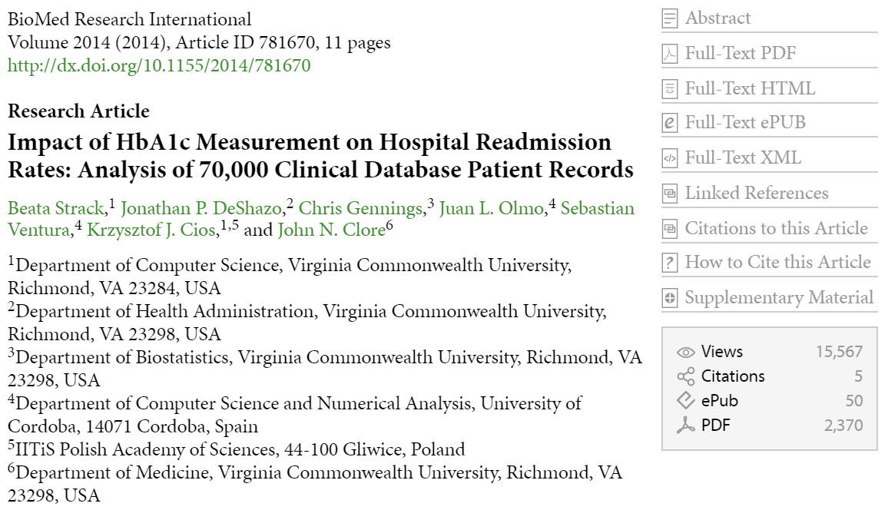
Now with SIMULATED
BONUS FEATURES!
Notes:
https://www.hindawi.com/journals/bmri/2014/781670/

Slide 3
EMR
purchasing
history
wearable
sensors
weight
Simulated
Data
grocery
list
glucose
levels
activity &
vital signs
Hx
zipcode
feature
engineering
text mining web service
demographic
attributes
nutrient accounting
summary
statistics
compile counts
Features
convenience/
grocery store
ratio
minutes
walking
per day
% calories
from carbs
BMI
stdev
models
predictive
modeling
after discharge
Notes:
We added five additional simulated features to the dataset:
Weight (and height), to determine BMI. These are placed into a free-form text field where they must be extracted using a regular expression.
Zipcode: neighborhoods with high rations of convenience stores to grocery stores will have higher readmission rates. Zipcode is also a very high cardinality variable, which requires large numbers of observations to model directly.
Grocery list: Samples of food purchases were generated for each patient, from which we calculate the percentage of calories from carbohydrates.
Glucose levels: Wearable continuous glucose monitors record blood glucose levels every 3 minutes over 4 days. From this we calualate the standard deviation of glucose concentration.
Activity readings: A wearable activity sensor (similar to the VitalConnect HealthPatch (http://www.vitalconnect.com/) records posture, heart rate, respiration rate, skin temperature, etc. for 4 days after discharge.

Slide 4
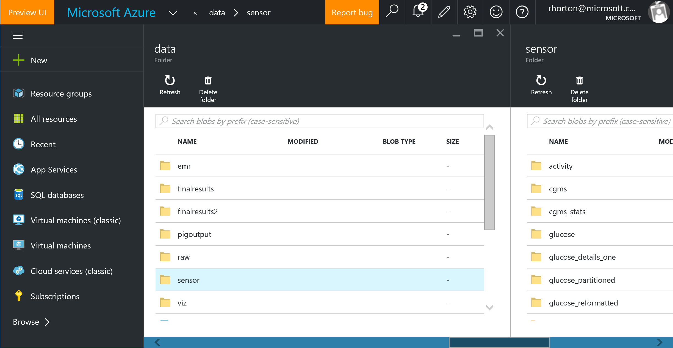
Notes:
Simulated data is placed on Azure Blob storage, and can be analyzed directly on HDInsight using HDFS.

Slide 5
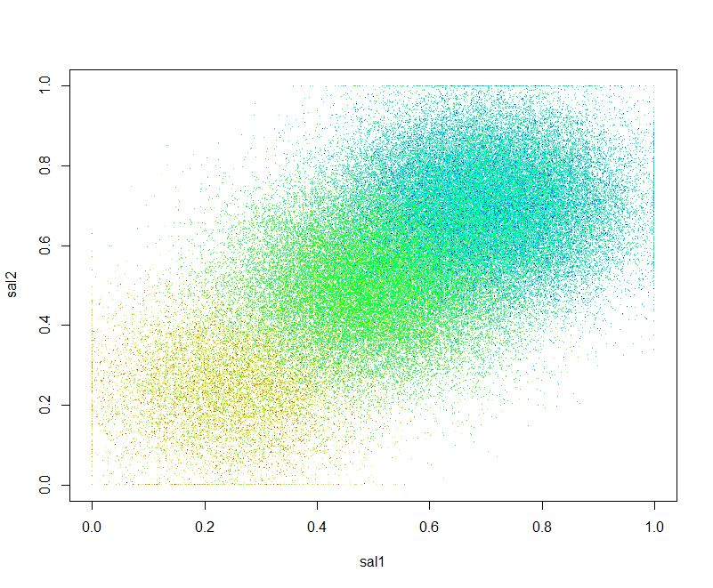
Engineering Simulated Features Relating new features to hidden latent factors
Notes:
Each simulated feature was correlated with an independent latent risk vector. This way, knowing more features gives a better prediction of risk.

Slide 6
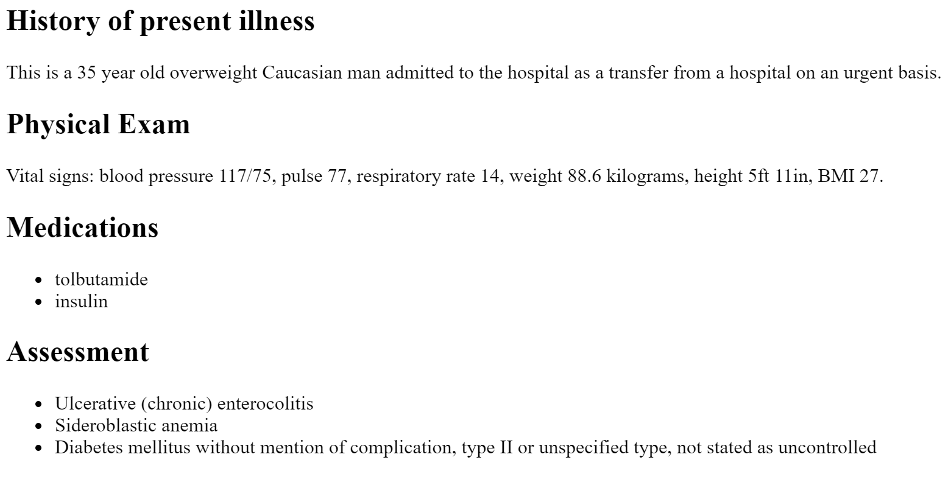
Weight Embedded in “Admission History” text field
Notes:
Toy admission histories were reverse-engineered from the available data. In our demo, we just use a regular expression to extract the weight from the text.

Slide 7
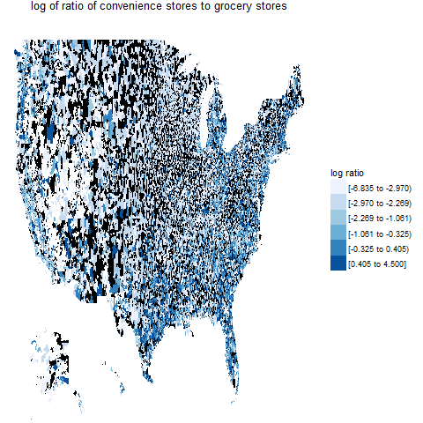
Engineering Zipcodes Relating to demographic parameters
Notes:
This shows the ration of convenience stores to grocery stores in each zip code.

Slide 8
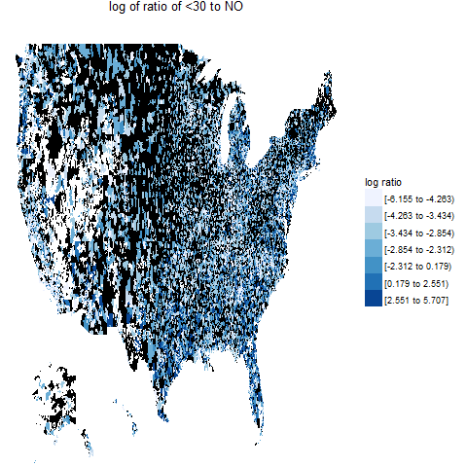
Engineering Zipcodes Relating to demographic parameters
Notes:
This is the risk of readmission within 30 days. Zipcodes were assigned to patients so that this correlates well with the ration of convenience stores to grocery stores in each zip code. These maps don’t show that correlation very well because the low-population areas are distracting.

Slide 9
Grocery List Feature Engineering Calculating percent calories from carbohydrates
Grocery Table
Food-Nutrients Table
diet_id | item | quantity | units
diet00001 | Wine table white | 100 | g
diet00002 | Avocado | 100 | g
diet00002 | Banana | 200 | g
diet00002 | Beer | 100 | g
diet00002 | Beets | 100 | g
diet00002 | Berries | 200 | g
diet00002 | Bologna | 100 | g
diet00002 | Broccoflower | 100 | g
diet00002 | Butter | 100 | g
diet00002 | Chard | 100 | g
diet00002 | Corn flakes | 200 | g
item | nutrient | quantity
Avocado | carbs | 8.53
Avocado | protein | 2
Avocado | fat | 14.66
Avocado | alcohol | 0
Avocado | fiber | 6.7
Avocado | water | 73.23
Avocado | energy | 160
Banana | carbs | 22.84
Banana | protein | 1.09
Banana | fat | 0.33
Banana | alcohol | 0
Notes:
Converting a list of foods into a list of nutrients involves looking up the nutrients in a table, multiplying by quantities, and adding all the nutrients of all the foods. This can also be thought of as a dot product, or a matrix multiplication problem. Since SQL handles this type of accounting nicely, we used Hive.

Slide 10
Grocery List Feature Engineering Calculating percent calories from carbs
with nut as (
select diet_id, nutrient, sum(fn.quantity * g.quantity/100) as quantity
from grocery g join food_nutrients fn
on g.item = fn.item
group by diet_id, nutrient
),
diet_nutrients as (
select diet_id,
sum(case when nutrient = 'carbs' then 4.1 * quantity end) carb_calories,
sum(case when nutrient = 'energy' then quantity end) calories
from nut group by diet_id
)
INSERT INTO TABLE diet_pct_calories_carb
select diet_id, (100*carb_calories/calories) as pct_calories_carbs from diet_nutrients;
Notes:
This is the Hive query we used to convert foods to nutrients, and take the ratio of carbohydrate calories to total calories. The same query also works in SQLite without modification.

Slide 11
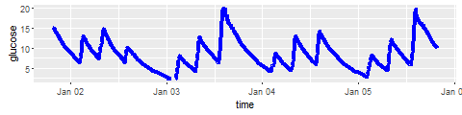
Glucose Levels variance relates to outcome
Notes:
These glucose peaks are knd of funny looking (they should be more rounded), but at least they match with the activity reported by the activity sensor.

Slide 12
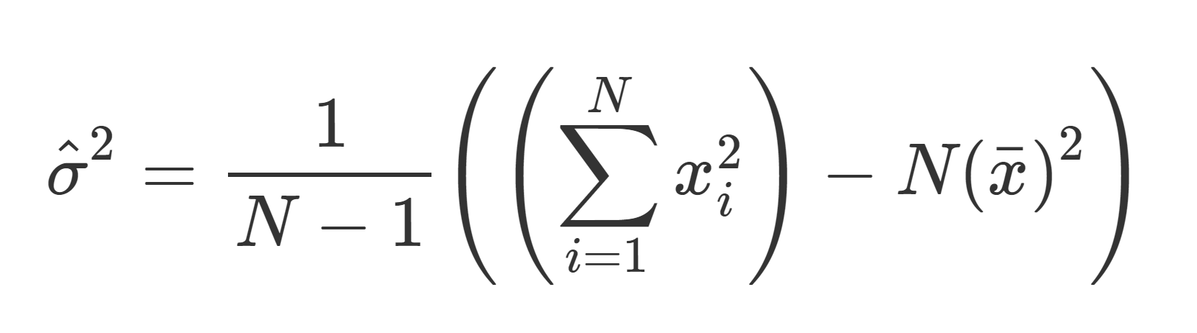
Standard Deviation Do it yourself!
subset = GROUP measurement BY set;
homespun_stats = FOREACH subset {
sum = SUM(measurement.value);
value_sq = FOREACH measurement generate value * value;
sumsq = SUM(value_sq);
n = COUNT(measurement.value);
avg = AVG(measurement.value);
var = (n*sumsq - sum*sum)/(n*(n - 1));
GENERATE group, sumsq AS sumsq, sum AS sum, n AS n, sum/n AS mean, avg AS avg, var AS var, SQRT(var) AS stdev;
};
“… use of these formulas can be unwise in practice …”
Notes:
The feature we need to engineer from the glucose readings is the variability, as reflected in the standard deviation. In theory this is an easy thing to calculate, and we show one way to do it using Pig. But it is easy to run into numerical stability problems, and we recommend that most users should employ off-the-shelf routines for these kinds of statistics.
Normally you might think of high average glucose levels as being “bad”, but we chose to make the variability be bad instead. Average glucose levels is reflected in the good old-fashioned HbA1c level, and you don’t really need a continuous monitor to measure it. But CBGM lets you see the variability, so that’s the exciting new thing.

Slide 13
Standard Deviation Don’t do it yourself!
id n mean sd pig_sd my_sd rx_sd
A 100000 9.999776 0.10035232 0.10035237 0.10035232 0.10035232
B 100000 100.000103 0.10012107 0.10012142 0.10012107 0.10012107
C 100000 999.999995 0.09974035 0.09928033 0.09974035 0.09974035
D 100000 9999.999878 0.09991125 0.13177929 0.09991124 0.09991125
E 100000 100000.000007 0.09988266 NaN 0.09988152 0.09988266
F 100000 999999.999920 0.10003151 NaN 0.10033160 0.10003151
G 100000 10000000.000002 0.09981527 613.86950571 0.16384082 0.09981527
H 100000 99999999.999802 0.10011237 16509.60172727 0.00000000 0.10011237
I 100000 1000000000.000202 0.09996886 NaN 0.00000000 0.09996885
J 100000 10000000000.000362 0.10025095 1415665.13461386 118.63342520 0.10025090
Notes:
This shows numerical instability problems calculating standard deviation on simulated data using the approach from the previous slide (“pig_sd”). The same algorithm works better in R (“my_sd”), presumably because of increased numerical precision, but it is still not as stable as either the base R implementation (“sd”), or the standard deviation computed by rxSummary (“rx_sd”).

Slide 14
Summary Statistics with MRS
# data is in HDFS
path_to_xdf_dir <- readRDS("path_to_xdf_dir.Rds")
glucose_xdf <- RxXdfData(path_to_xdf_dir, fileSystem=RxHdfsFileSystem())
# run computations on local node
rxSetComputeContext(RxLocalParallel())
glucose_summary_local <- rxSummary(glucose ~ sensorid, data = glucose_xdf)
# run the same thing on Hadoop
rxSetComputeContext(RxHadoopMR(consoleOutput=TRUE))
glucose_summary_hadoop <- rxSummary(glucose ~ sensorid, data = glucose_xdf)
Notes:
rxSummary computes standard deviation (and other summary statistics) from a simple function call. We use this to show the difference between the local compute context (which runs on a single computer) and the Hadoop compute context (which launched a Hadoop Map Reduce job). Note that the code to call the function is the same in both cases; only the compute context has been changed.

Slide 15
Glucose Levels Calculating Summary Statistics at Scale with MRS
rxSetComputeContext(RxHadoopMR(consoleOutput=TRUE))
rxHadoopMakeDir(glucose_xdf_dir)
glucose_colInfo <- list( list(index=1, newName="sensorid", type="factor"),
list(index=2, newName="timestamp", type="character"),
list(index=3, newName="glucose", type="numeric"))
glucose_indata <- RxTextData(glucose_indata_dir, colInfo=glucose_colInfo,
fileSystem=RxHdfsFileSystem())
glucose_xdf <- RxXdfData(glucose_xdf_dir, fileSystem=RxHdfsFileSystem())
rxImport(glucose_indata, glucose_xdf)
glucose_summary <- rxSummary(glucose ~ sensorid, data = glucose_xdf)
Notes:
To work with CSV files, you have to supply metadata, such as column names and types. Here we import the CSV data to XDF, then we can run rxSummary.

Slide 16
Selected scaleR Functions
rxAuc | Receiver Operating Characteristic (ROC) computations and plot
rxBTrees | Parallel External Memory Algorithm for Stochastic Gradient Boosted Decision Trees
rxCovCor | Covariance/Correlation Matrix
rxCube | Cross Tabulation
rxDataStep | Data Step for .xdf Files, Data Frames, and Teradata
rxDForest | Parallel External Memory Algorithm for Classification and Regression Decision Forests
rxExec | Run A Function on Multiple Nodes or Cores
rxGetInfo | Get .xdf File or Data Frame Information
rxHadoopCommand | Execute Hadoop Commands
rxQuantile | Approximate Quantiles for .xdf Files and Data Frames
rxLinMod | Linear Models
rxLogit | Logistic Regression
Notes:
The RevoScaleR package contains the major functions from Revolution R Enterprise, now Microsoft R Server. These functions are designed to work efficiently on data that can be too large to fit into memory, and they can be transparently distributed on platforms such as Spark or Hadoop just by setting the “compute context”.

Slide 17
Activity & Vital Signs Quantifying overall activity level
{"sensor_id":"VSS02C-1050","bt":1451660400,"e":[
{"t":0,"n":"ts","v":3366},
{"t":0,"n":"re","v":1596},
{"t":0,"n":"po","v":1},
{"t":0,"n":"hr","v":6631},
{"t":15,"n":"po","v":1},
{"t":15,"n":"hr","v":5421},
{"t":30,"n":"re","v":1144},
{"t":30,"n":"po","v":1},
{"t":30,"n":"hr","v":5191},
{"t":45,"n":"po","v":1}
]}
Notes:
Our simulate wearable activity sensors record a variety of measurements in JSON format. Each record includes the sensor_id (assigned to a particular patient) and the timestamp at which measurements were begun (“bt”).
Measurements are recorded in array “e”, where “t” is the time of the event (relative to “bt”), “n” is the name of the event, and “v” is the value. Events include “ts” (temperature of the skin in degrees Celsius times 100), “re” (respirations per minute times 100), “hr” (heart rate), and “po” (a posture code for lying down, sitting, standing, walking, etc.).

Slide 18
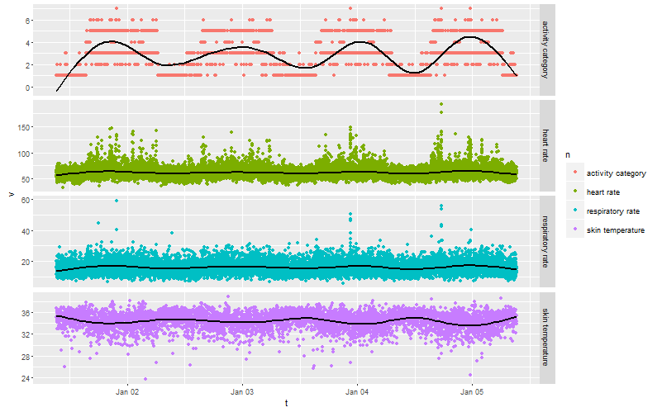
Activity & Vital Signs Quantifying overall activity level
Notes:
Activity data is gathered from each patient for 4 days after discharge from the hospital. All activity measurements are driven by a 24 hour circadian pattern, which determines which of three Markov state transition matrices to use (night time, day time, and meal time matrices). Each patient was assigned an activity level between 0 and 1 which controls how the “sedentary” and “active” matrices are mixed to produce a set of state transition matrices for that patient.
Since all the measurements are driven by the same process, there are a variety of different features that could be derived to reflect the underlying activity level. But it turns out that “minutes per day spent walking” works well, and is easy to calculate.

Slide 19
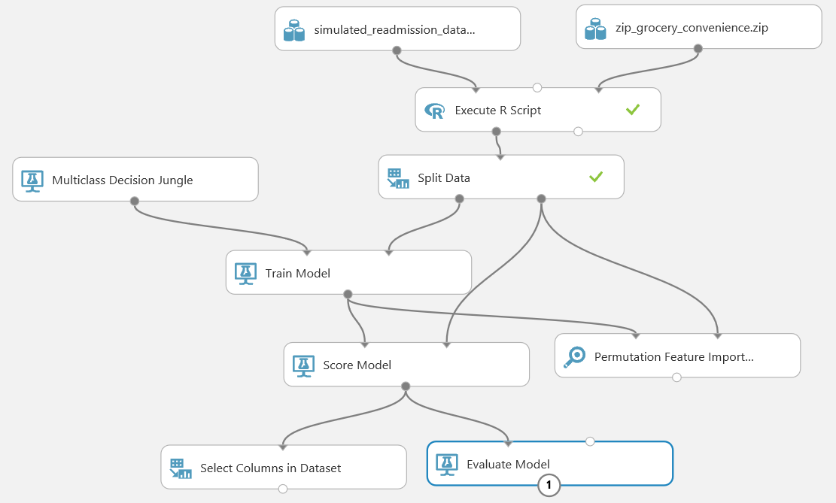
Notes:
The feature engineering is done on big data using an HDInsight cluster, but the resulting dataset is small enough to model in ML Studio. Here we use a simple custom R script to look up demographic information by zipcode, but all other modules are “off the shelf”. The data is split into training and test sets. A multiclass decision jungle model is trained on the training set, then its performance is evaluated on the test set. We use the Permutation Feature Importance module to evaluate how much each feature contributes to the prediction.

Slide 20
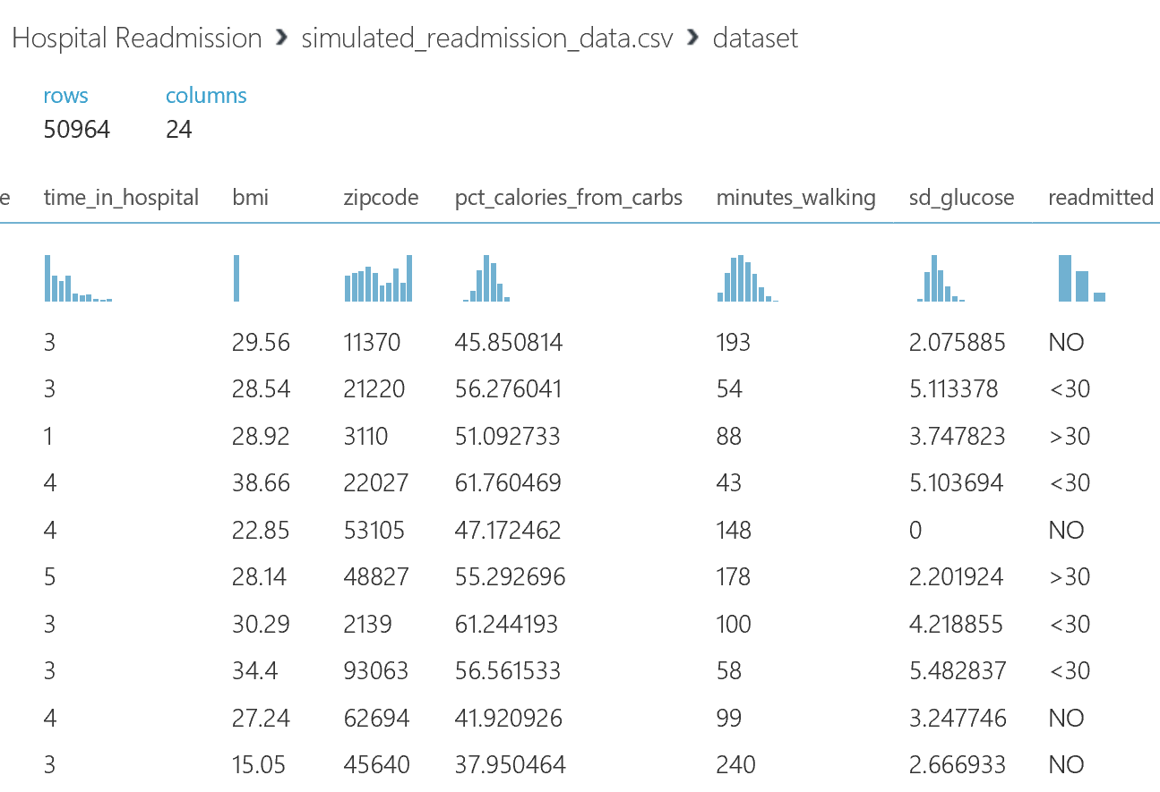
Dataset
Notes:
This shows a few of the 24 columns in the final dataset, including the 5 new simulated features we have generated through our feature engineering process.

Slide 21
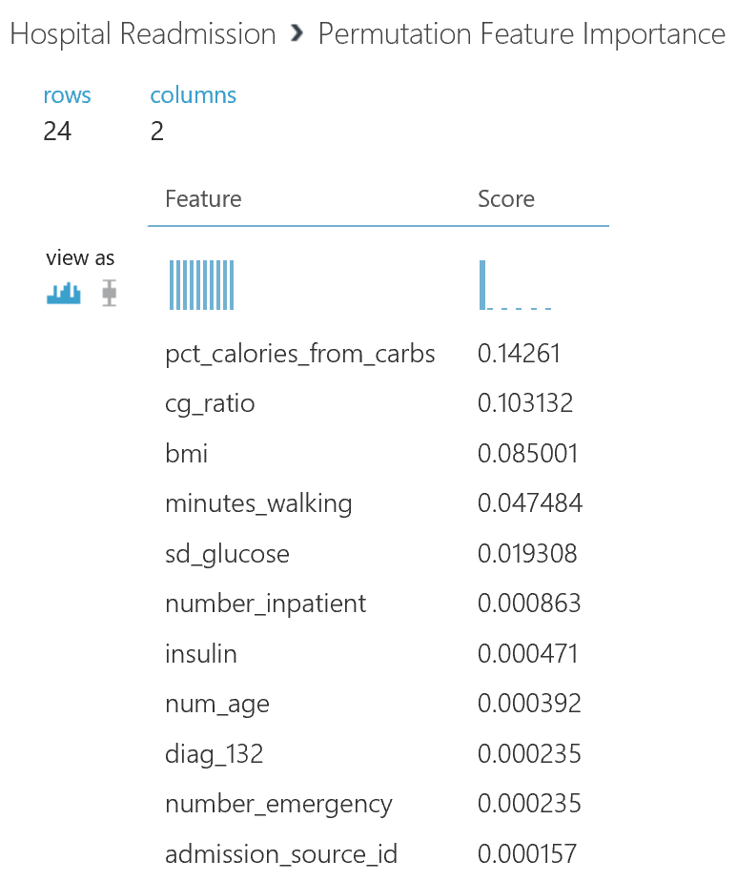
Feature Importance
Notes:
Results from the Permutation Feature Importance module. Not surprisingly, the simulated features are highly predictive of the outcome (in fact, they are probably too good – far better than any real features in the actual dataset).

Slide 22
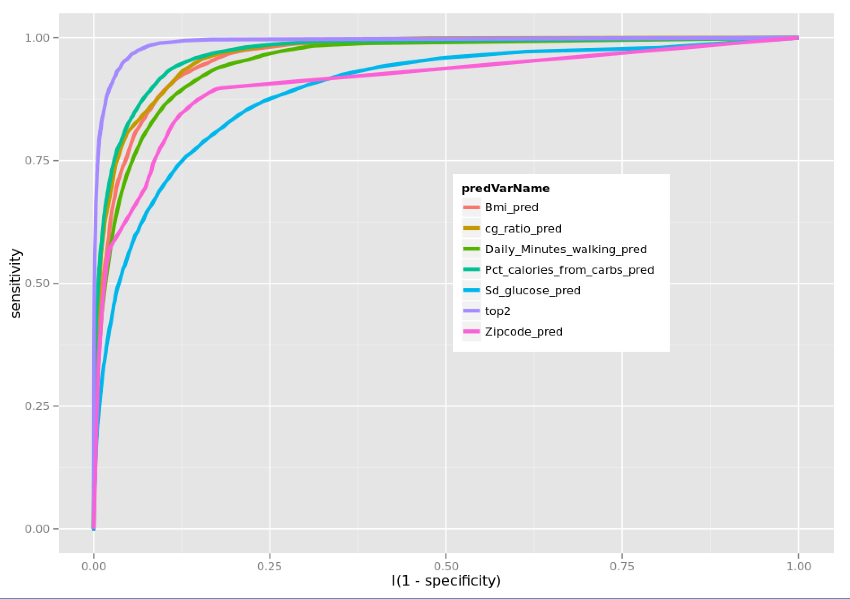
Notes:
ROC curves for models built with different features. The first 5 lines in the legend are for the individual simulated features, and the sixth one (the lavender line, “top2”) is for a model with the top 2 predictors. Note that the model with two predictors is better than any of the individual predictors alone; this is expected because the correlations with the outcome are independent.
The bright pink line shows a model built with zipcode as predictor. This is not as informative as if we had looked up the driving demographic (in this case, the ratio of convenience stores to grocery stores in that zipcode). Nevertheless, it is fairly informative, even if we are not able to determine a related demographic value. Zipcodes are a classic high-cardinality feature that require fairly large training set sizes to be useful.

