Slide 1
Google Analytics report
BAIS:3300 – Digital Product Management
Sprint 3

Slide 2
Summary
I had 156 new users come to my site between April 4 – May 4, 2023
37 of these visitors came back at least one more time.
Nearly all users visited by domain name (businessanalytics.me), not a specific page (like from a link).
Most visitors came from Iowa City and West Branch which makes sense in my context. I’ve lived in West Branch and Iowa City for the past 15 years and my campaigns were targeted to family and friends.
I created two campaigns, one for Facebook posts and one for Twitter posts.
The Facebook campaign was most successful at driving traffic to my site.
Users who came from my website link on GitHub were on my site longer.

Slide 3
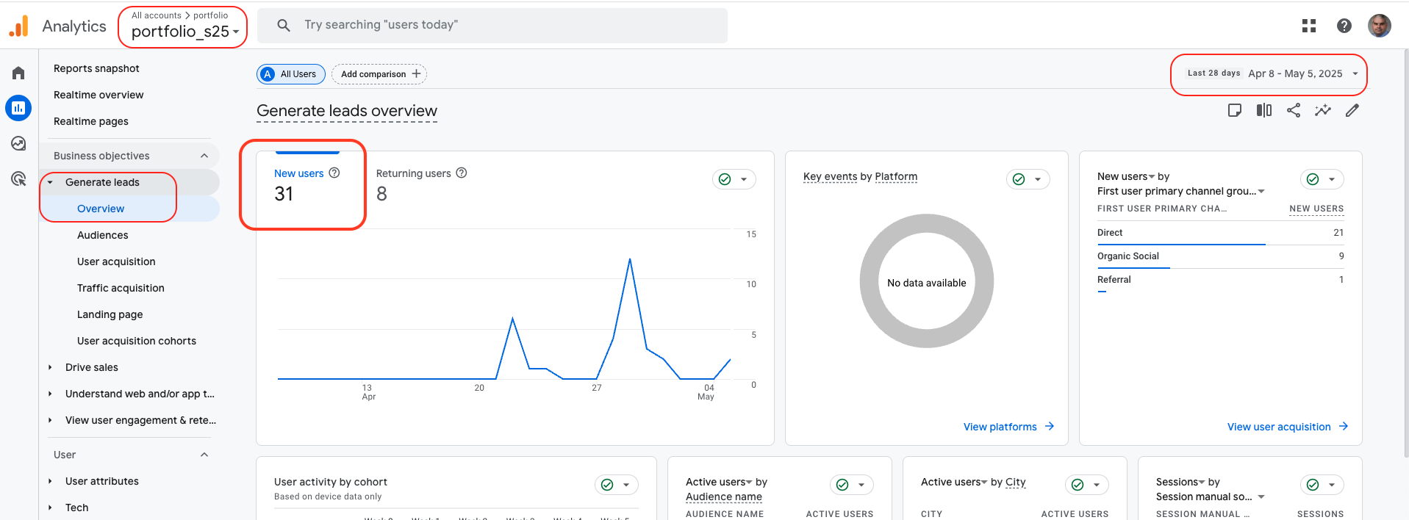
How many new visitors came to my site?
They have never been to my site before.

Slide 4
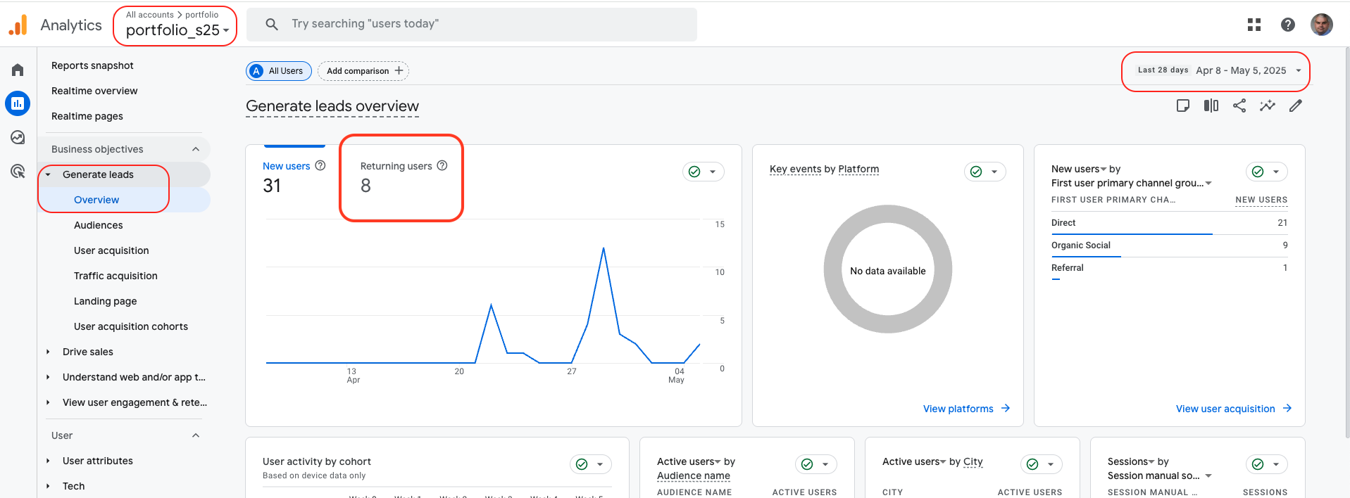
How many of my visitors returned to my site?
They have visited my site before.

Slide 5
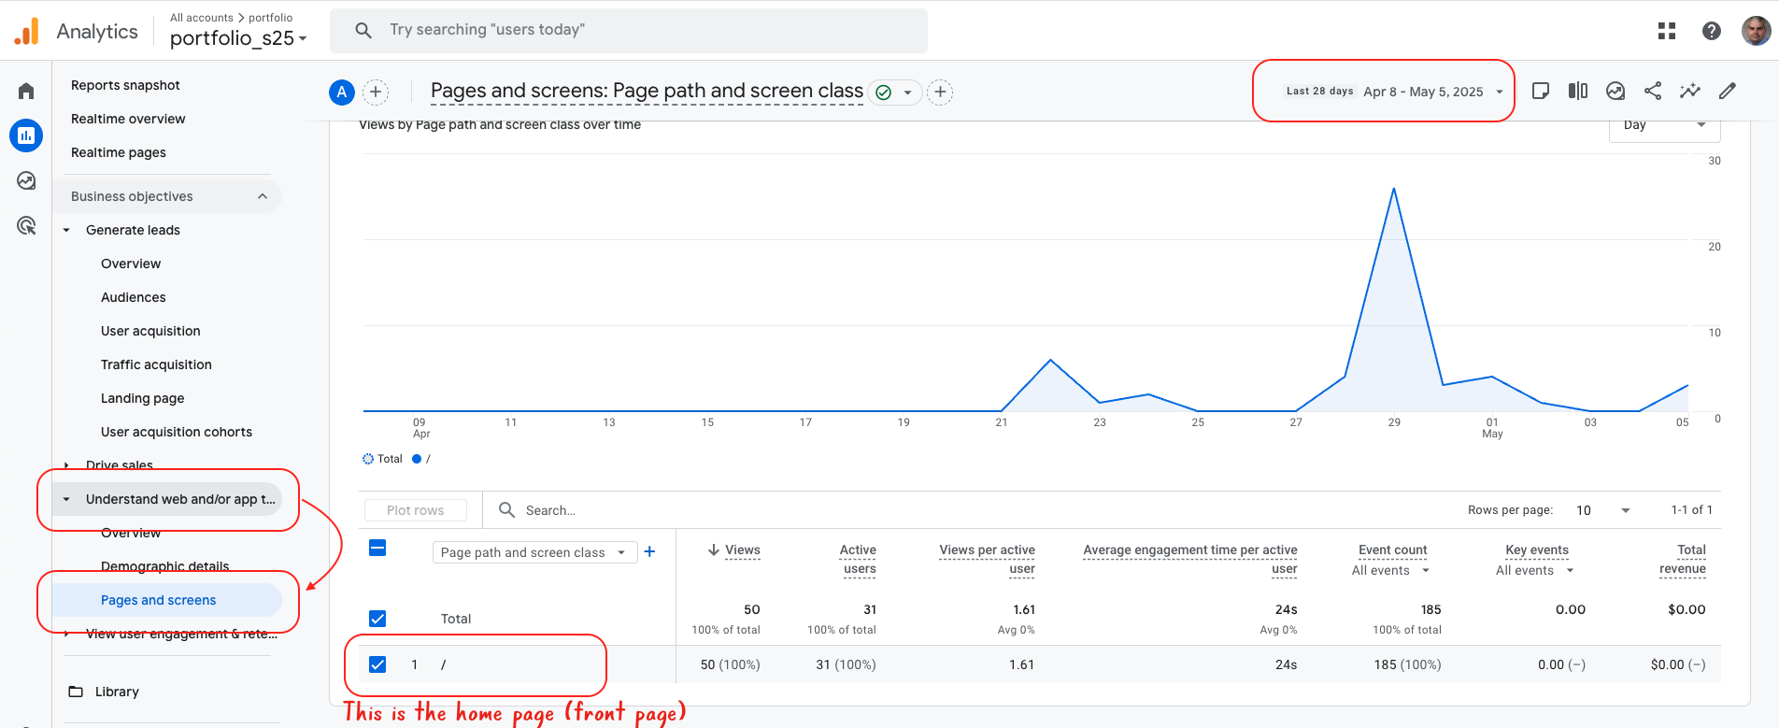
What are my most popular pages?

Slide 6
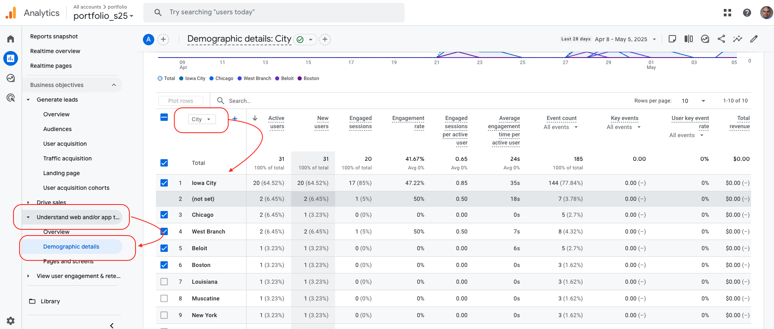
Where are my visitors coming from?

Slide 7
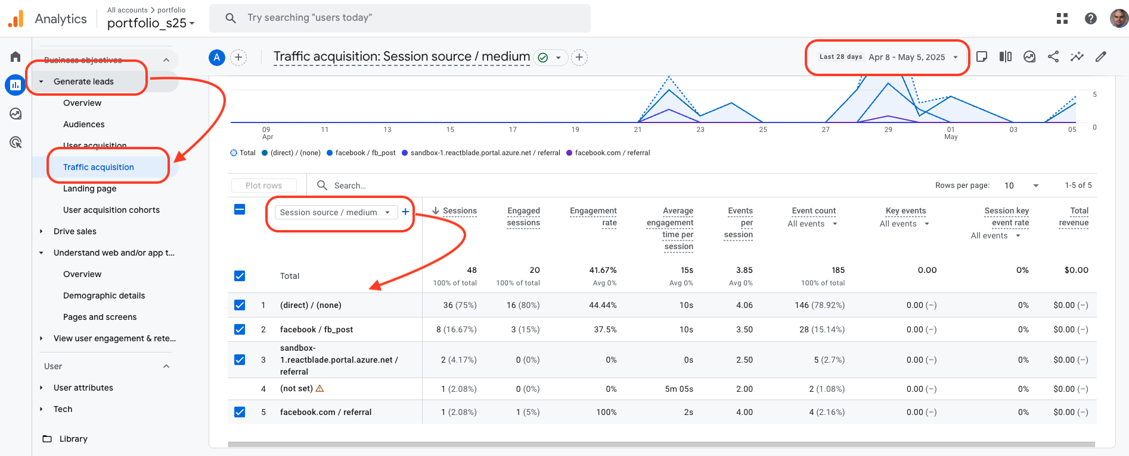
Did my Google Analytics campaign generate traffic?
Notes:
From the reports menu → Lifecycle → Acquisition → Traffic acquisition → set to Session source / medium
Make sure I can see your domain name.

Slide 8
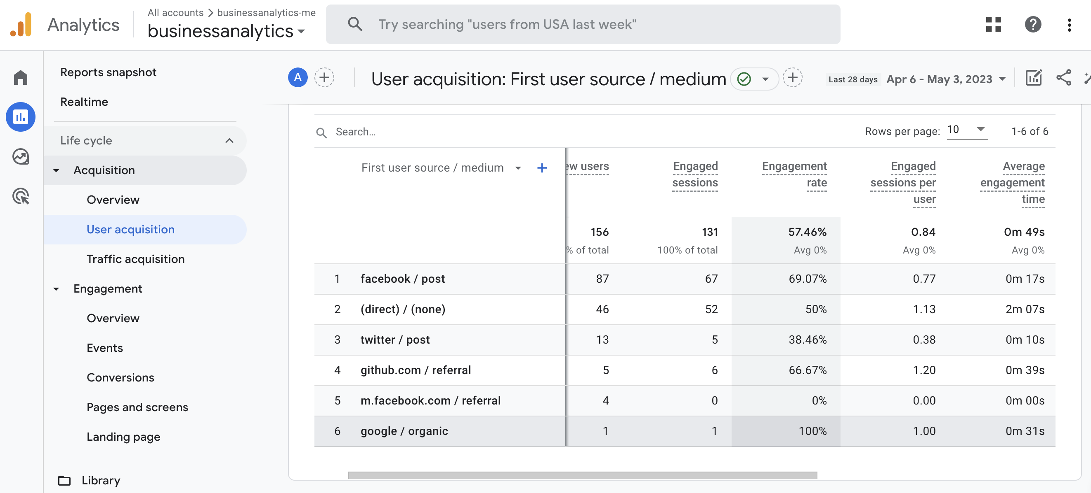
How much time are users spending on my pages?

