Slide 1
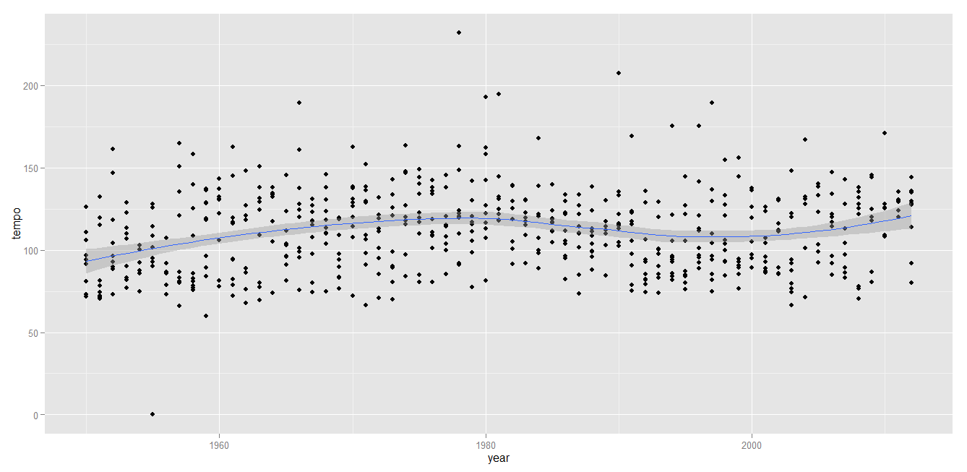
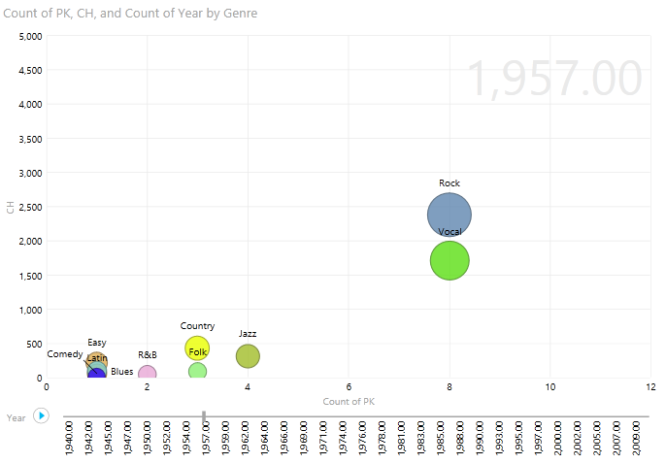
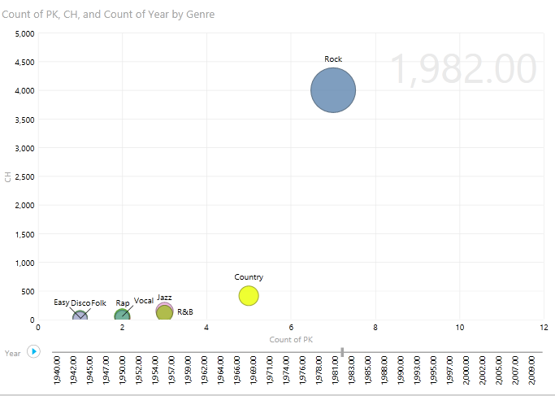
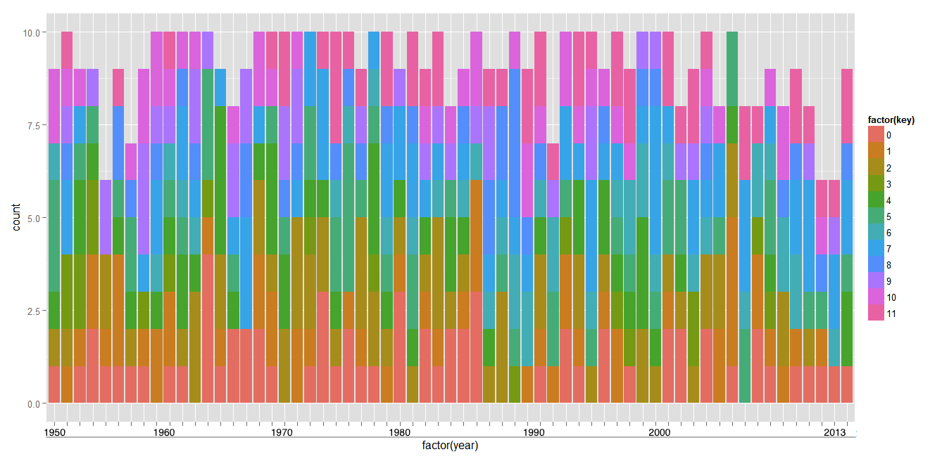
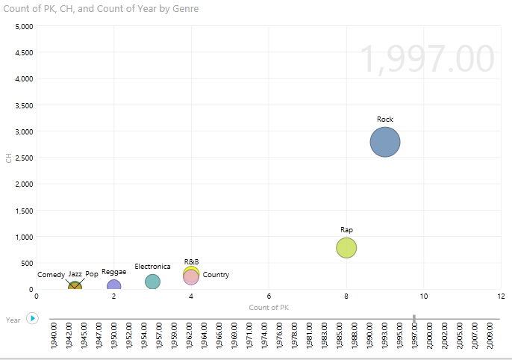
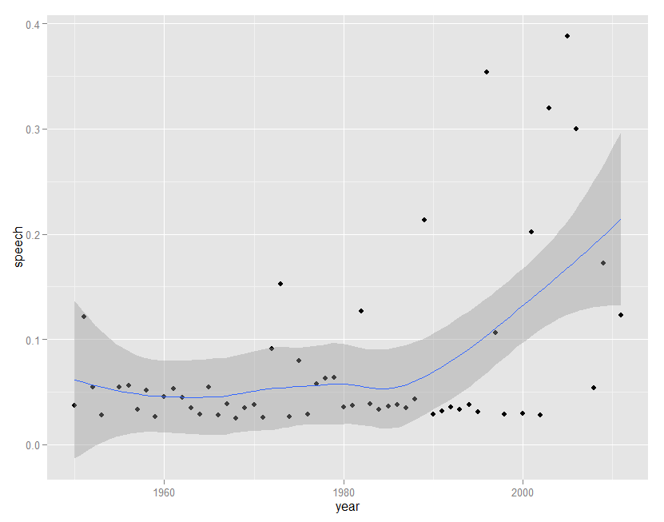
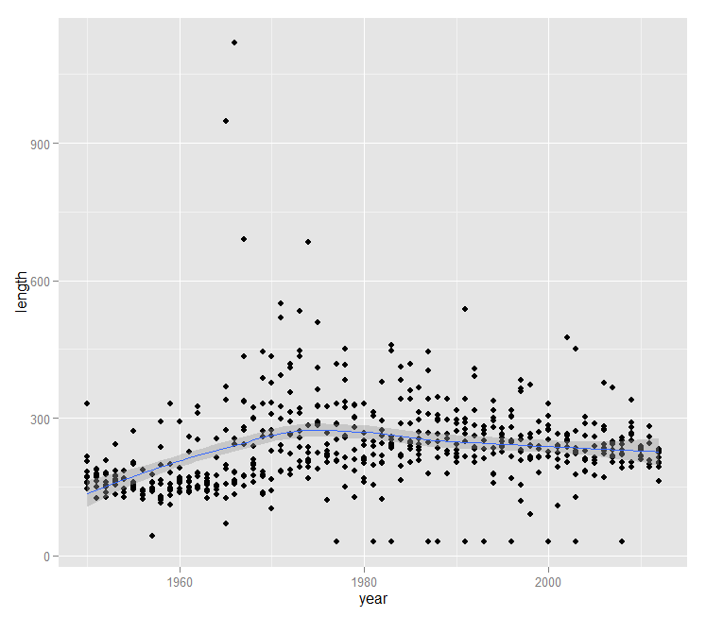
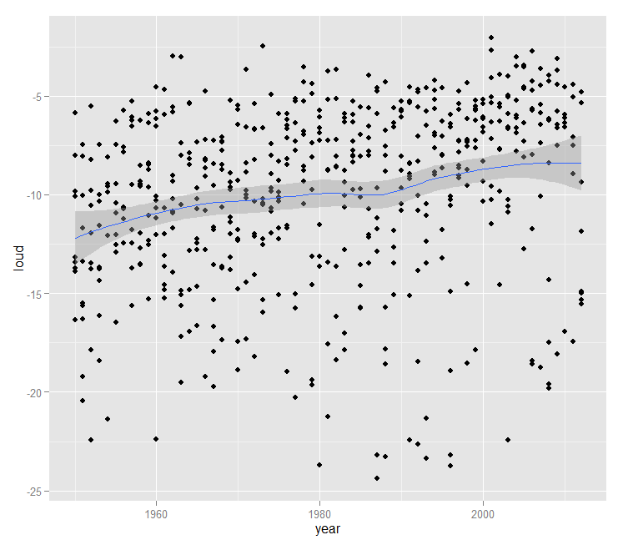
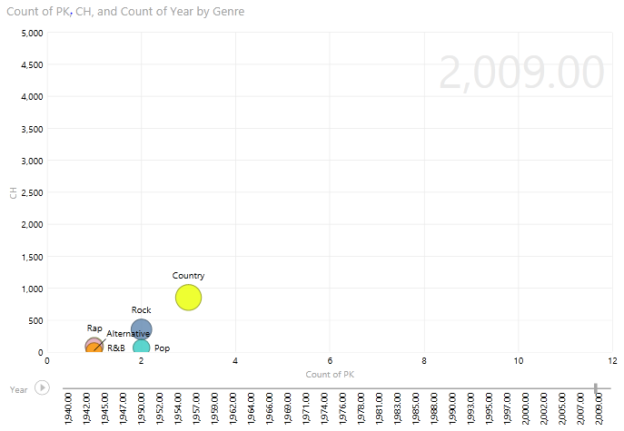
A Survey of Musical Features and Trends
Through History
Jak Akdemir, Alp Tilev
jakdemir@gmail.com, atilev@gmail.com
Introduction
The general perception around popular music is that through time changes drastically. However, as
genre’s change with we would like to find out tempo’s, note’s, lengths and other such features
change as well.
To investigate this problem, we use Echonest api and statistical languages like
R to analyze correlations between time and musical features.
Methods
Gathering historical, top 10 music chart data through scraping websites. (http://www.digitaldreamdoor.com/pages/best_songs2010-2019-top-ten.html)
Parsing and preparing the data with python to get ready for multi variant parsing.
Gathering musical data features through Echonest API
Sampling and graphing with R.
Further analysis with Microsoft Excel PowerPivot
Results
Genre Dominance and popularity volatility 1957-2009
Size: Songs in top100 in Genre
X: Avg: Number of weeks single was in top 100
Y: Avg: weeks song stayed in peak position
Movement of circles is through time
Popularity
Volatility of chart position
Tempo of Top 10 songs in each year between 1950 - 2013
Expected Results
Dominant musical genre’s change drastically over time. We expected that musical feature’s change proportionally as well. By analysing temporal features like vocal use, loudness we see that these features are changing as new musical genre’s emerge. On the other hand, we see some other consistent features like tempo. Further work can be done to go beyond the top ten songs and apply this as a regional survey going back to disperse geographies and folk songs.
Purpose
This poster session points for audience a complete workflow in all steps from finding musical
data source to visualizing these results while showing the correlation between musical features
and time with emphasis of top ten charts since 50’s.
Only the yearly top ten chart songs were analyzed to give a clue into the popularity of songs that have a stronger influence on society as a whole
The emergence and dominance of genre’s can be seen through time. It’s possible to see the emergence of Rock and Roll and Other Genre’s.
One can also see that as time progresses that the average amount of time spent in top 100 list gets lower signaling to the prevalence of one hit legends.
Song Keys signature vs Year
1960 to 2012 (extrapolated)
Notes:0 = C through 11 = B
Top 10 hit songs unique key distribution
Key distribution is pretty uniform, No magic key
Key Variation is in decline
Literature Cited
Thierry Bertin-Mahieux, Daniel P.W. Ellis, Brian Whitman, and Paul Lamere. The Million Song Dataset. In Proceedings of the 12th International Society for Music Information Retrieval Conference (ISMIR 2011), 2011.
Baio, Andy. “The Whitburn Project: 120 Years of Music Chart History.” waxy.org, May 15, 2008 http://waxy.org/2008/05/the_whitburn_project/
Paul Lamere (2013, February 15) musicmachinery.com
Visualization of speech in songs in the number one song of each year since 1950.
It’s possible to see the speech index of songs in the number one position increasing after 1990 as a result of Rap and R&B becoming emerging genre’s.
Duration of top songs per year
Average dB of top songs per year
NTCIR SUNY Albany, NY 2013

